Slide 1
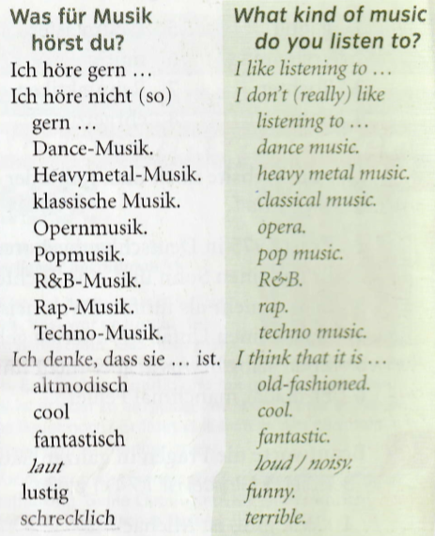
Year 9 German term 5 week 2
Spend some time learning the vocab for this week.

Slide 2
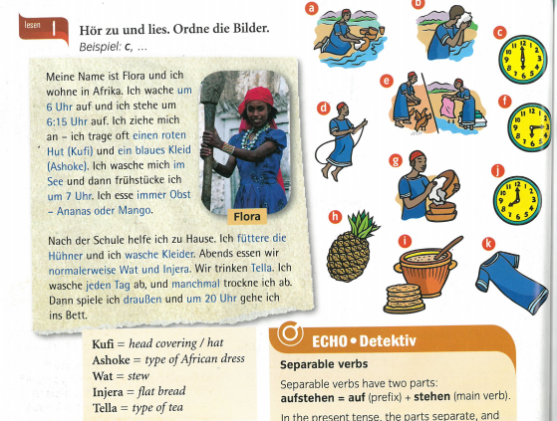
Read about Flora. Put the pictures a-k in order they happen.

Slide 3
Write out your daily routine in German and include times. For example…
Ich wache um Sieben Uhr auf – I wake up at 7 o’clock

Slide 4
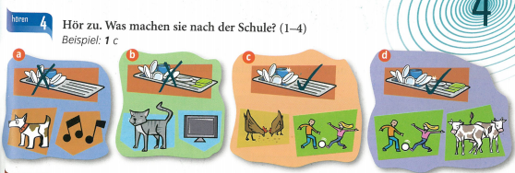
Listen to what they do after school. For each of the 4 people match up a-d

Slide 5
Copy out the text and fill in the gaps with words from the blue cloud shape.

