Slide 1
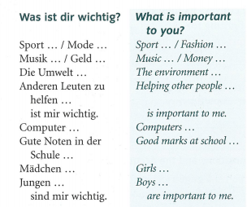
Year 9 German term 6 week 1
Spend some time learning the vocab for this week. There is more on the next slide.

Slide 2
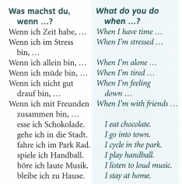

Slide 3
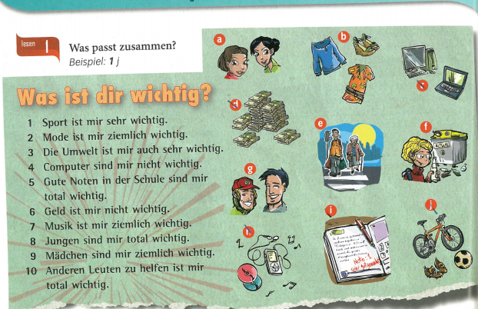
Read the sentences and match them to the pictures. Example 1j

Slide 4
Copy out the table and listen to the track. Fill in what is important, very important and not important to each of the 6 people. You need to look back at the previous slide for the choices.

Slide 5
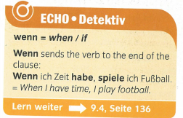
Copy out the grammar

Slide 6
Read the statements and match up 1-6 with a-f. Write out the sentences in German and translate them in to English.

