Slide 1
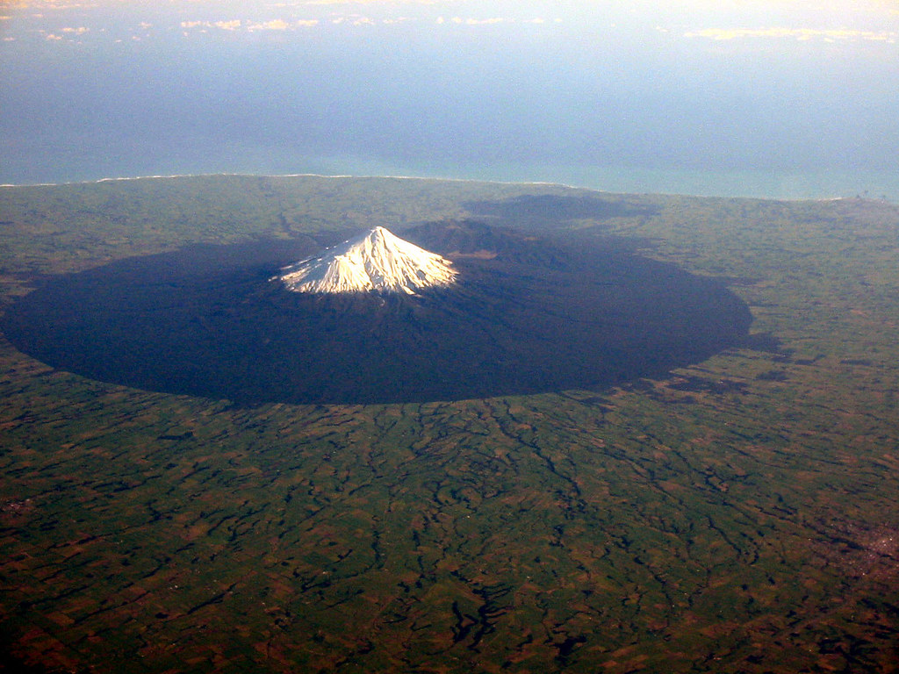
The challenge of natural hazards
Natural hazards
Tectonic hazards
Weather hazards
Climate change
33 marks
One 9 (3 spag) mark question. Likely to be on effects or responses to tectonic or weather hazards.

Slide 2
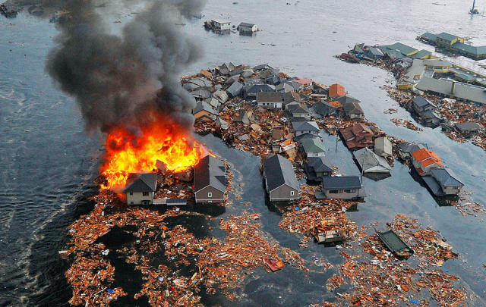
Natural hazards
Natural hazards pose major risks to people and property.
Social impact.
Atmospheric hazards, geological hazards, flooding.
Hazard risk – poverty, urbanisation, farming, climate change.

Slide 3
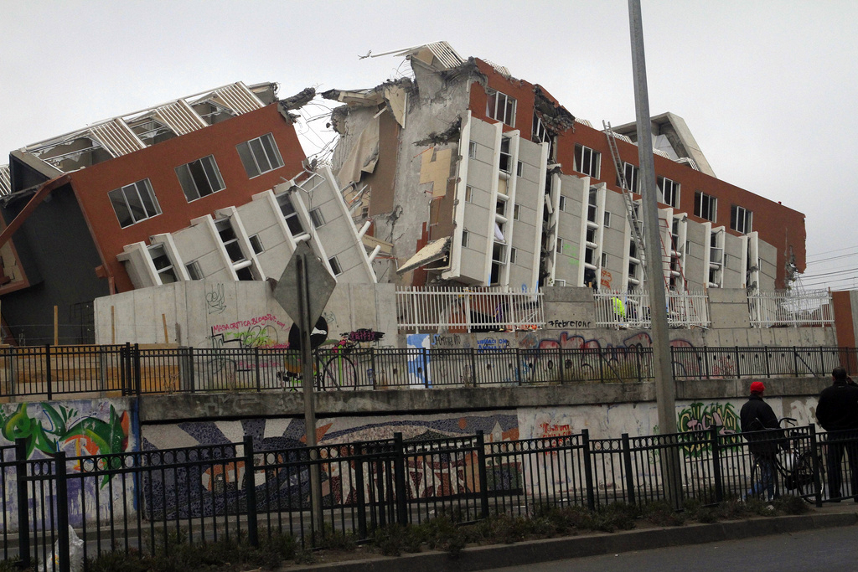
Tectonic hazards
Earthquakes and volcanic eruptions are the result of physical processes.
The effects and responses to tectonic hazards vary between areas of contrasting levels of wealth.
Management can reduce the effects of tectonic hazards.

Slide 4
Earthquakes and volcanic eruptions are the result of physical processes.
Why is there a pattern of earthquakes and volcanoes – narrow, bands.
Mid-Atlantic Ridge, Pacific Ring of Fire, San Andreas Fault.
Hot spots like Hawaii.
Tectonic plates – South American, Nazca.
Core, crust, mantle.
What happens at a constructive, destructive (collision) and conservative margins?
Shield vs composite volcanoes.

Slide 5
The effects and responses to tectonic hazards vary between areas of contrasting levels of wealth.
Primary and secondary effects.
Immediate and long term responses
Chile – HIC – 2010 – 8.8 magnitude just off coast of central Chile
Nepal – LIC – 2015 – 7.9 magnitude 80km north-west of Kathmandu
Learn specific names and figures.
Avalanche at Everest Base Camp - 24 deaths, no one summited Everest in 2015 for the first time in 41 years. Avalanche
In Chile power and water was restored to 90% of homes in 10 days.

Slide 6
Management can reduce the effects of tectonic hazards.
Why do people live in tectonically hazardous areas?
Tourism, soil, power, resources, awareness, rarity, coastal, poverty, protection and monitoring.
Monitoring, Prediction, Protection and Planning.
First two are more for volcanoes, last two for earthquakes.
How can volcanoes be monitored?
How can buildings be made safe in earthquake zones?

Slide 7
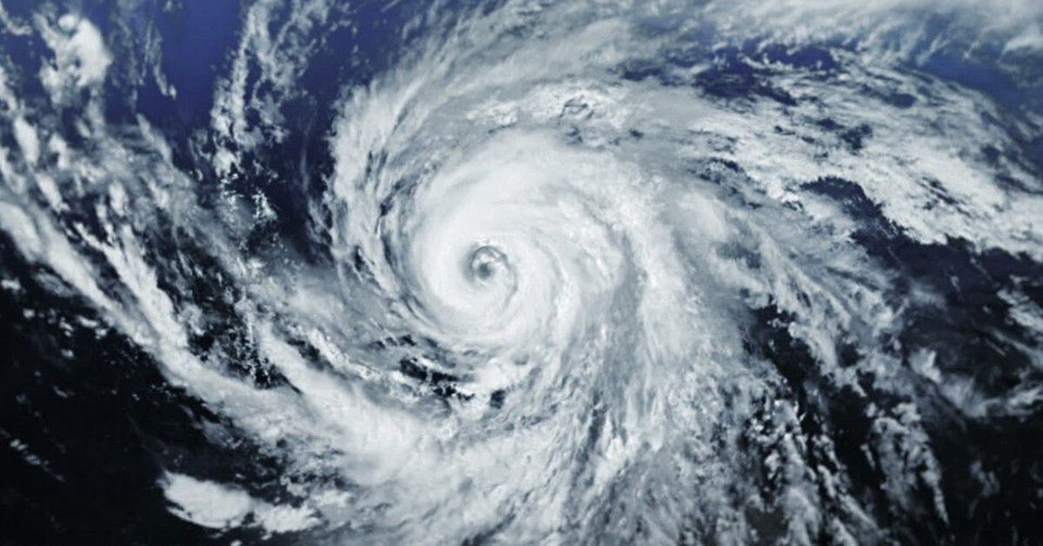
Weather hazards
Global atmospheric circulation helps determine patterns of weather and climate.
Tropical storms develop as a result of particular physical conditions.
Tropical storms have significant effects on people and environments.
The UK is affected by a number of weather hazards.
Extreme weather events in the UK have impacts on human activity.

Slide 8
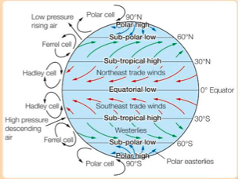
Global atmospheric circulation helps determine patterns of weather and climate.
What is global atmospheric circulation and how does it work?
Cells.
Low and high pressure.
Surface winds – especially trades
Seasonal changes.
Rainforest, desert and UK weather.

Slide 9
Tropical storms develop as a result of particular physical conditions.
What is a hurricane, cyclone or typhoon?
Where do tropical storms form?
How do tropical storms form?
Ingredients – water temperature, water depth, thunderstorms.
Life cycle – wind, rain eye, spin, move, die.
Structure of tropical storms – size, eyewall, eye, rotation, strength.
Impact of climate change on
Distribution.
Frequency.
Intensity.

Slide 10
Tropical storms have significant effects on people and environments.
Typhoon Haiyan.
Primary and secondary effects.
Immediate and long-term responses.
Ferry and air services disrupted impacting aid effort.
USS George Washington – rations, water, tents, body bags.
Reducing the effects of storms – MP3.
Forecasting, storm shelters, hurricane preparedness week in May.

Slide 11
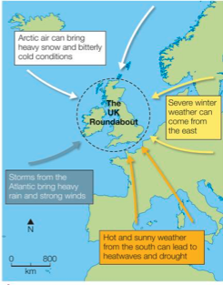
The UK is affected by a number of weather hazards.
UK on boundary of Ferrell and Polar Cells.
UK between ocean and continental land mass.
Beast from the East, March 2018 -15C, 60cm snow.
2018 summer heatwave – hottest ever English summer.
Rain in winter 2013/4 – wettest January.
Climate change may lead to more extreme events.
Energy in atmosphere.
Changes to global atmospheric circulation.
Jet stream and sticking weather patterns.

Slide 12
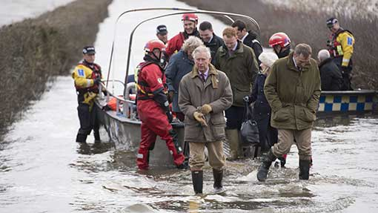
Extreme weather events in the UK have impacts on human activity.
Somerset Floods 2014.
Causes – wet weather in autumn and January, high tides, dredging.
Impacts – social, economic, environmental.
Village of Moorland was cut off.
14,000 ha of agricultural land under water.
Floodwater polluted with sewage had to be cleaned before pumped back into rivers.
Immediate and long-term responses.
Using boats to go to school.
River Parrett was dredged to increase capacity.

Slide 13
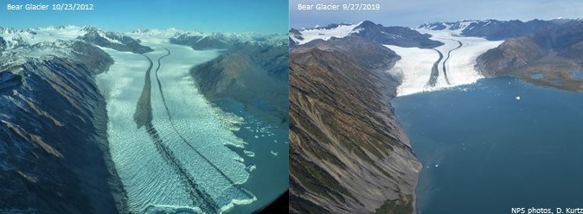
Climate change
Climate change is the result of natural and human factors, it has a range of effects.
Managing climate change involves both mitigation and adaptation.

Slide 14
Climate change is the result of natural and human factors, it has a range of effects.
We are in the Quaternary Period – a cold time in Earth’s history.
We are in the Holocene Epoch – an interglacial in the Quaternary.
Evidence – ice cores, rising sea levels and shrinking ice sheets, dendrochronology, sedimentology, seasonal changes.
Effects – shrinking ice sheets, sea level rise (Maldives), changing rainfall patterns, more extreme weather, pests and diseases.
Natural causes – orbital changes, solar activity, volcanoes.
Man-made causes – greenhouse effect, CO2, methane, nitrous oxides.

Slide 15
Managing climate change involves both mitigation and adaptation.
Mitigation – reducing the amount of greenhouse gases produced.
Renewable fuels, nuclear power.
Carbon capture and storage.
Planting trees (afforestation).
International agreements (Paris Agreement 2015) – aim for 2C increase max.
Adaptation – dealing with the impacts of climate change.
Agricultural adaptations – shade trees, drought resistant crops, irrigation.
Managing water supply – artificial glaciers.
Rising sea levels – plant mangroves, raise buildings, sea walls, evacuation.

