Slide 1
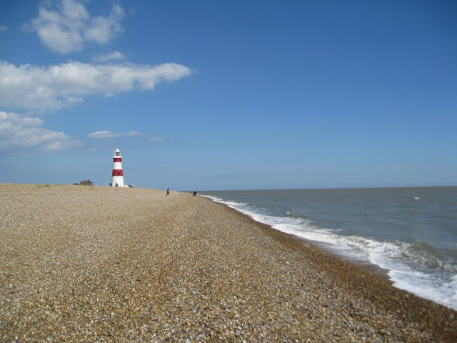
Physical landscapes in the Uk
UK landscapes
Coastal landscapes

Slide 2
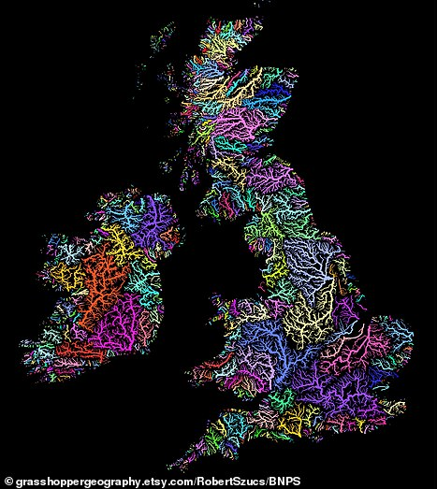
UK landscapes
The UK has a range of diverse landscapes
The Tees-Exe line – distribution of relief in the UK
How relief is linked to geology
River systems in the UK

Slide 3
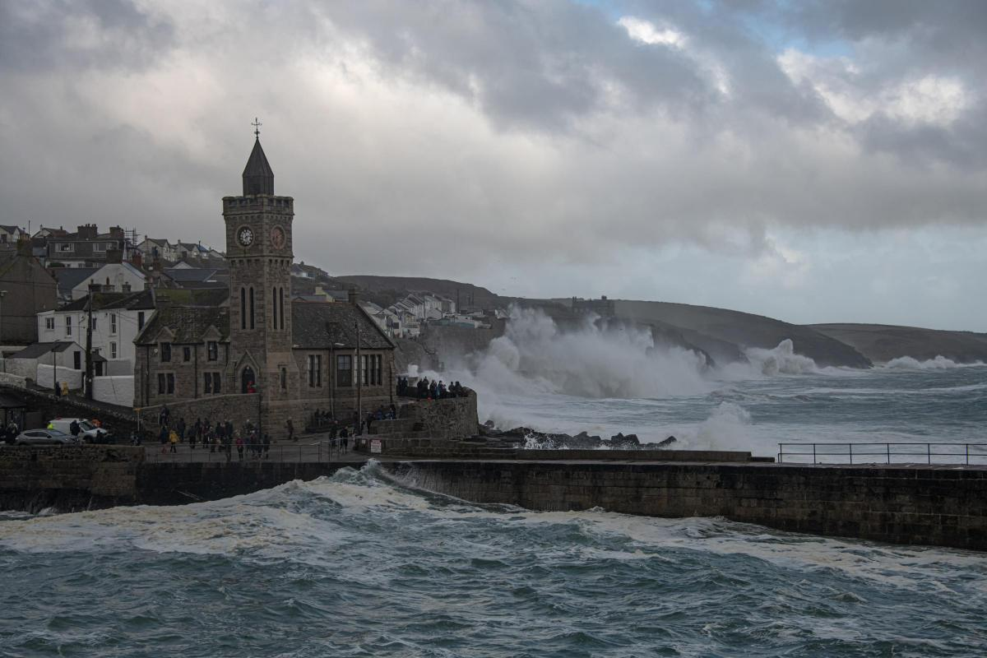
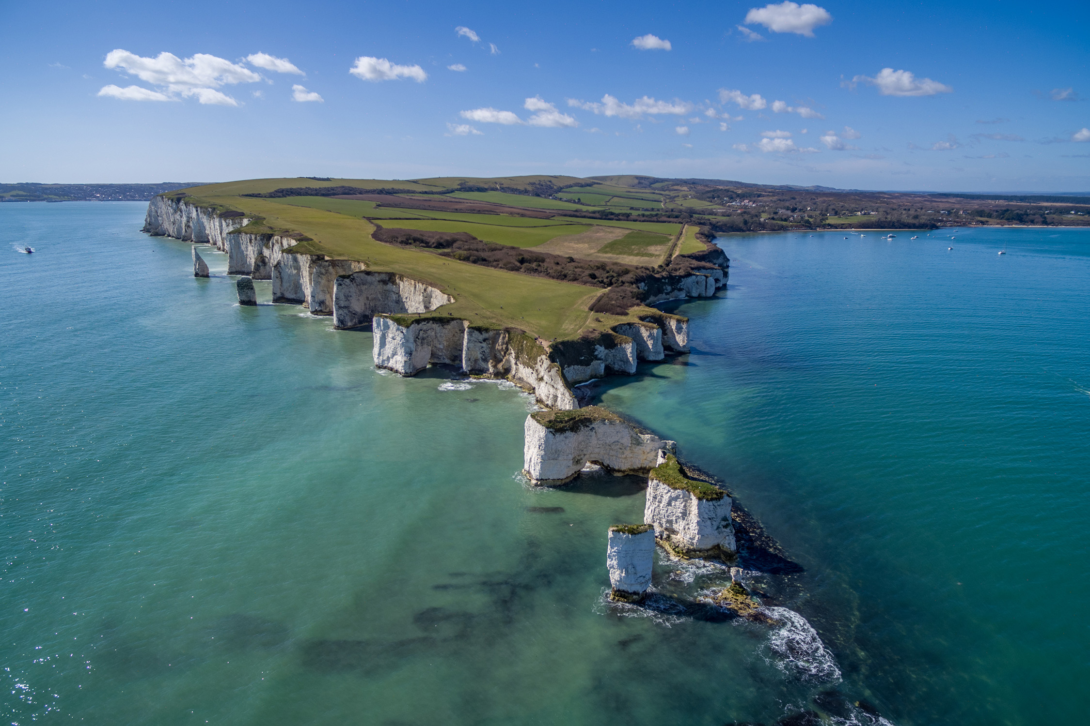
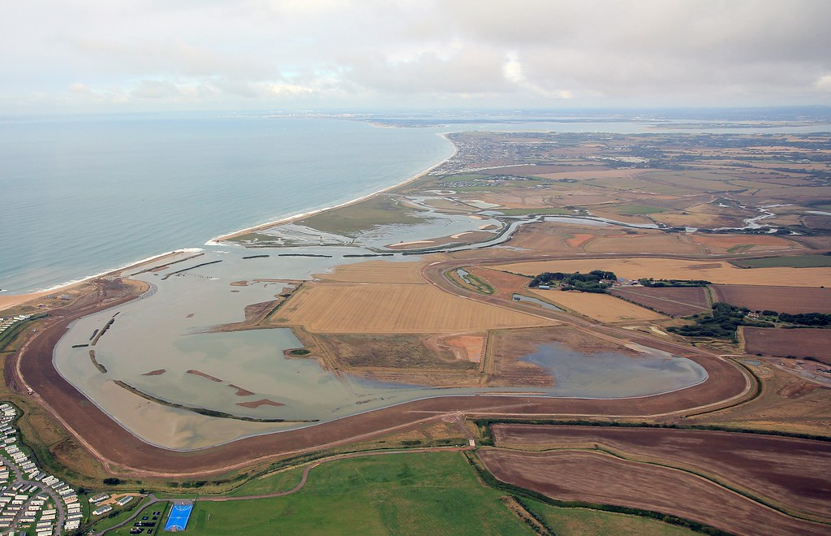
Coastal landscapes
The coast is shaped by a number of physical processes.
Distinctive coastal landforms are the result of rock type, structure and physical processes.
Different management strategies can be used to protect coastlines from the effects of physical processes.

Slide 4
The coast is shaped by a number of physical processes.
Where waves come from and the fetch.
What happens when waves reach the coast.
Wave types – constructive and destructive.
Weathering – physical, chemical, biological.
Mass movement – rockfall, landslide, mudflow, rotational slip.
Erosion – solution, hydraulic power, attrition, abrasion, corrasion
Transportation – solution, suspension, saltation, traction, long shore drift
Deposition – wave refraction, sheltered estuaries (behind spits)

Slide 5
Distinctive coastal landforms are the result of rock type, structure and physical processes.
Factors influencing coastal landforms – resistance, structure (faults), prevailing winds.
Headlands and bays.
Cliffs and wave-cut platforms.
Caves, arches and stacks (and stumps).
Beaches.
Sand dunes.
Spits and bars.
Off-shore bars and barrier beaches.
Examples around Swanage.

Slide 6
Different management strategies can be used to protect coastlines from the effects of physical processes.
Why do we manage coasts?
Climate change.
Options. Cost vs value (economic, social and environmental).
Hard engineering – sea wall, rock armour, gabions, groyne.
Soft engineering – beach nourishment (reprofiling), dune regeneration, dune fencing.
Managed retreat, coastal monitoring and adaptation, do nothing.
Lyme Regis – phase 2 and phase 4, sea wall, beach nourishment, groynes, rock armour, the Cobb, different view points.

