Slide 1
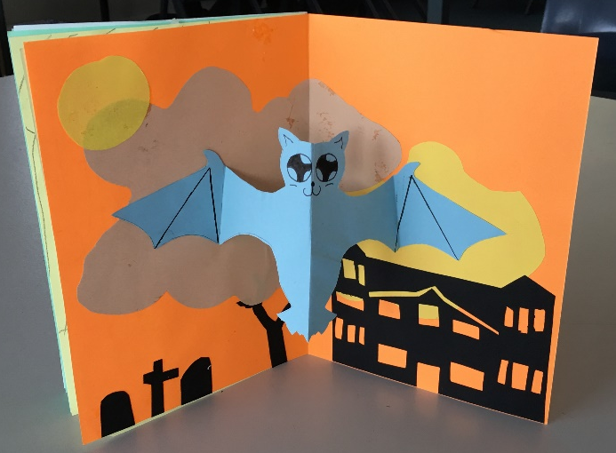
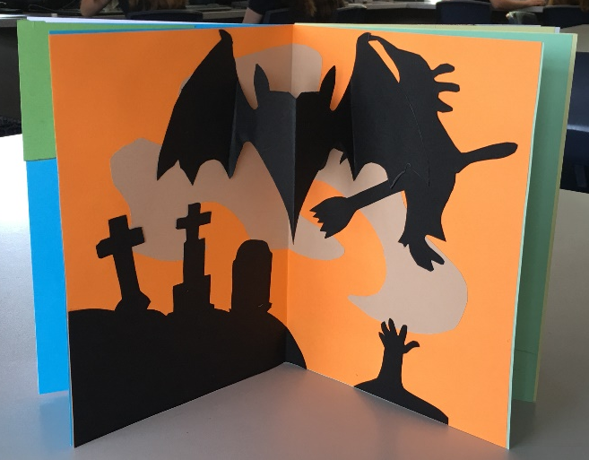
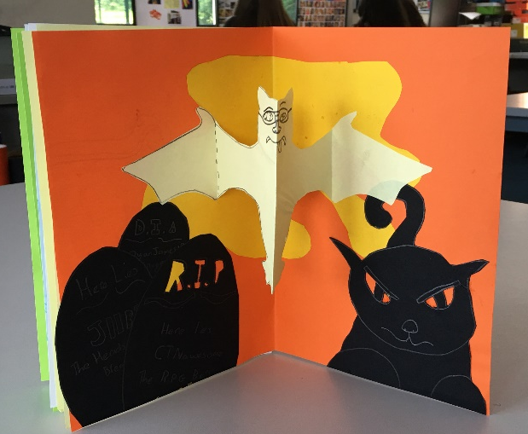
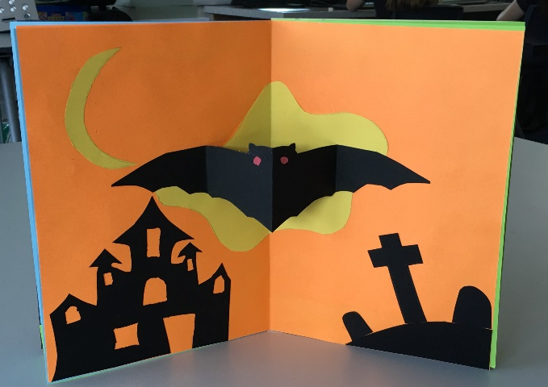
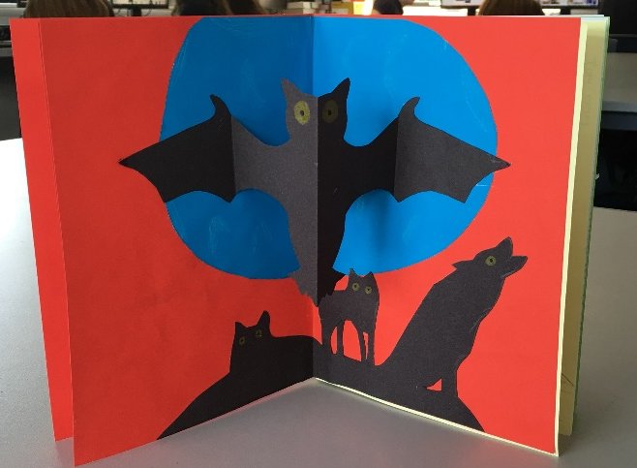
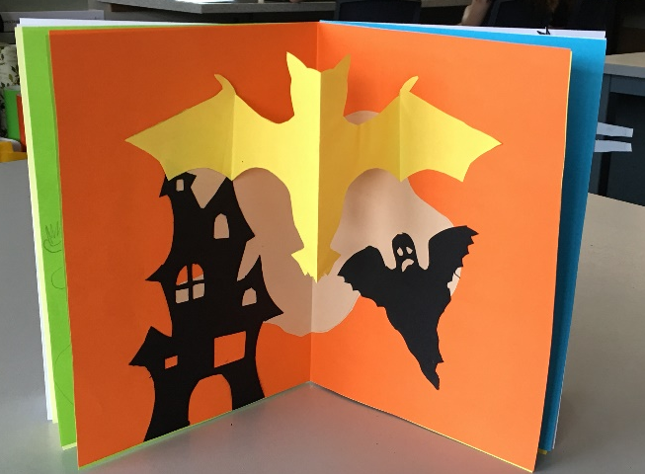
Valley & Mountain Mechanism

Slide 2
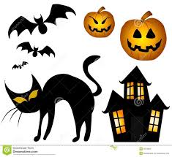
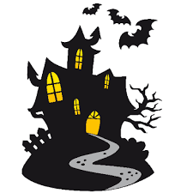
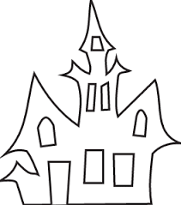
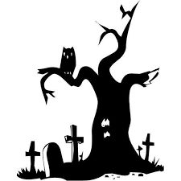
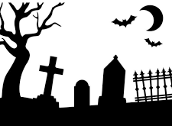
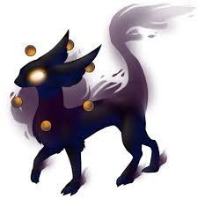

Slide 3
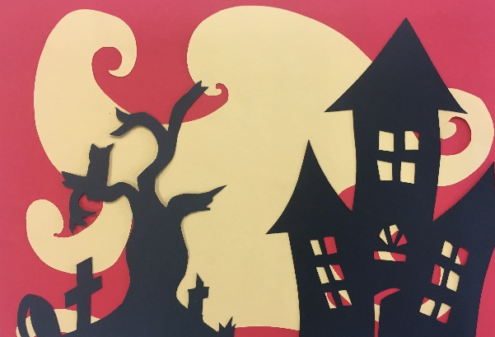
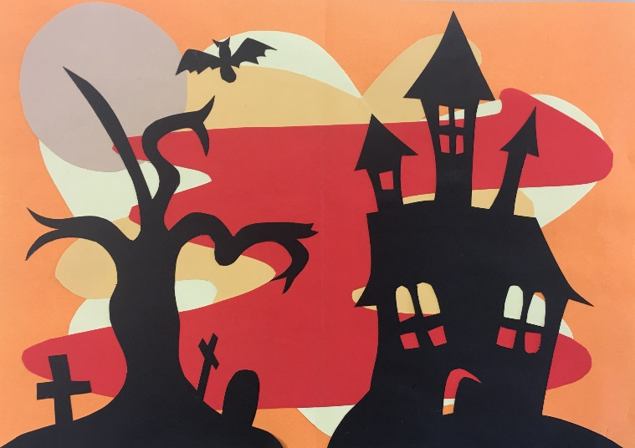
Lesson Task 1 Background
Sketch out 2-3 designs from the resource sheets onto the black A4 paper.
Cut out using scissors and a craft knife – NB Health & Safety!
Using the sheets of coloured paper in your pack create a background for your black silhouettes. One sheet needs to remain A4 and folded in half. The other colours can be used to create organic shapes, which are then layered on top of the A4 sheet.
Now add your silhouettes (black cut outs) by gluing in place.
Make sure your name is on the back.

Slide 4
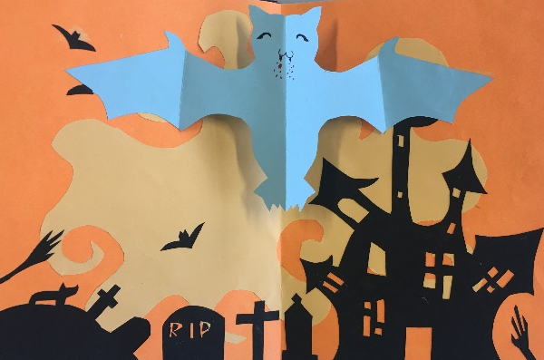
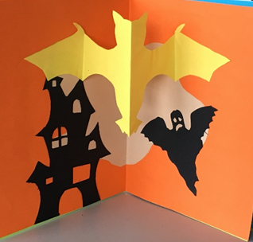
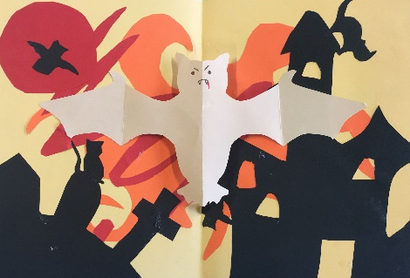
Lesson Task 2 Valley & Mountain (Bat)
Using the template for a bat create a Valley & Mountain mechanism.
Fold a piece of coloured paper in half.
Place the template in line with the centre fold.
Draw round the template. (Note the dashed fold line)
Cut out the shape whilst keeping your paper folded.
Fold the wings as identified by the dashed line.
Your bat should look like two valleys created by the wings and mountain in the middle which forms the body.
Add glue to the outer part of the wings.
Position the centre fold of the bat in line with the centre fold of your background, glue down the wings.
You should now have a working valley and mountain mechanism.

