Slide 1
Yr. 9 Graphics
Eco Festival

Slide 2
What are the 6 R’s?
Research the definitions of the 6 R’s and find visual examples to support the definitions
REDUCE
REUSE
RECYCLE
REFUSE
REPAIR
RETHINK

Slide 3
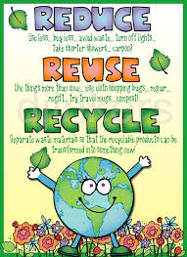
Design a poster to help you remember the 6 R’s
You can present it as either hand drawn or computer generated. It must identify all of the 6R’s and what they mean.

Slide 4
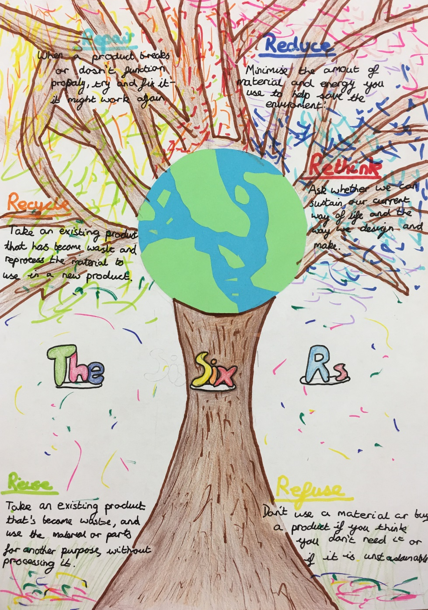
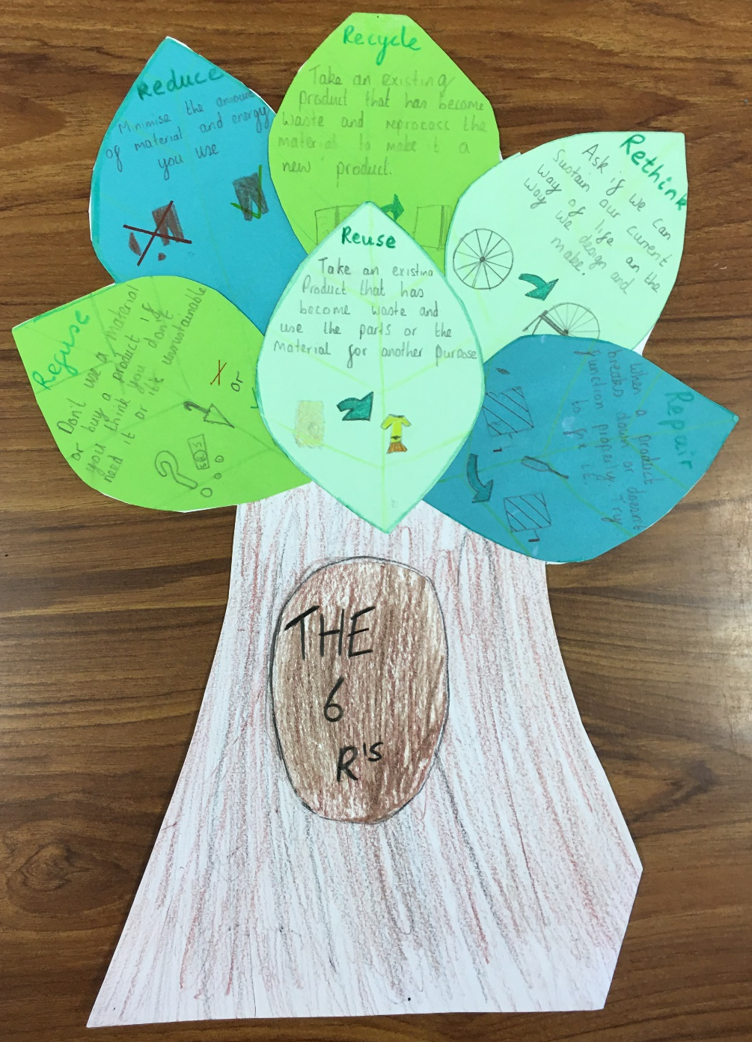

Slide 5
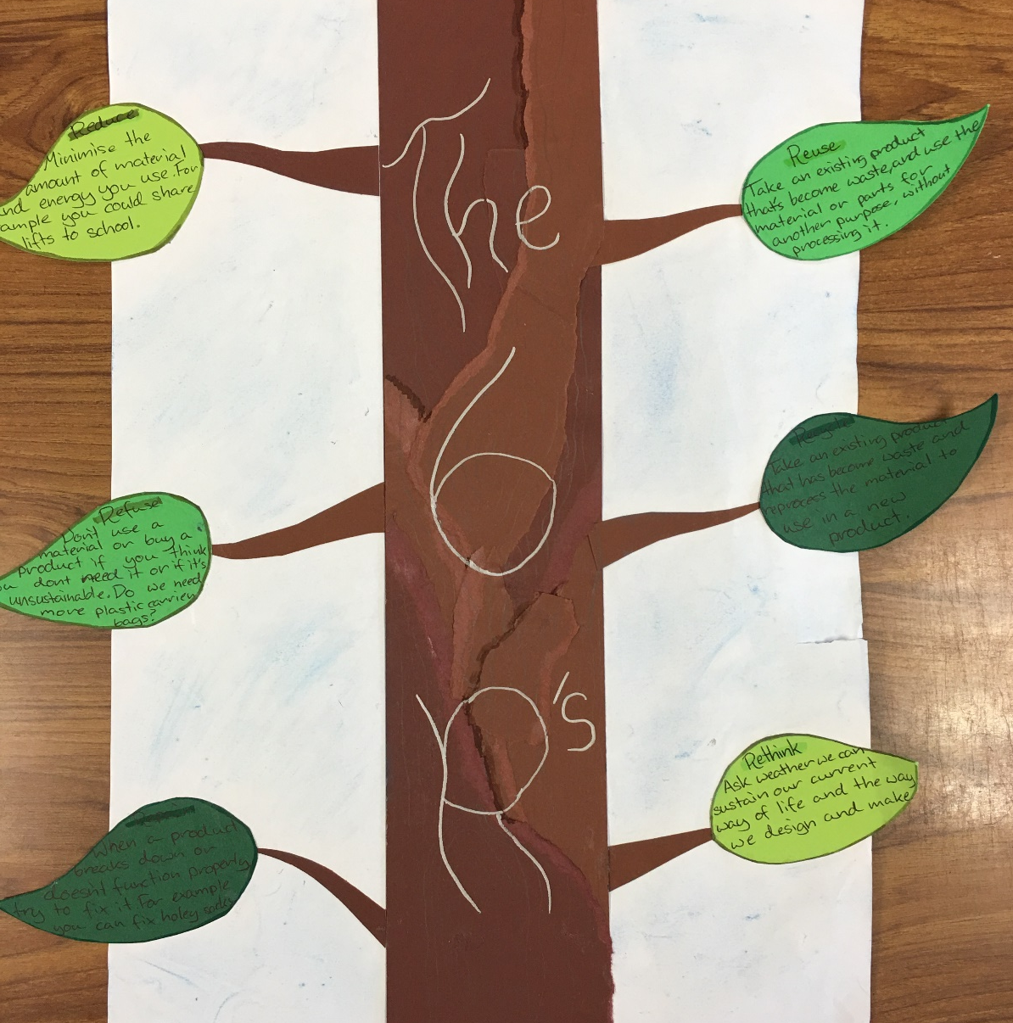
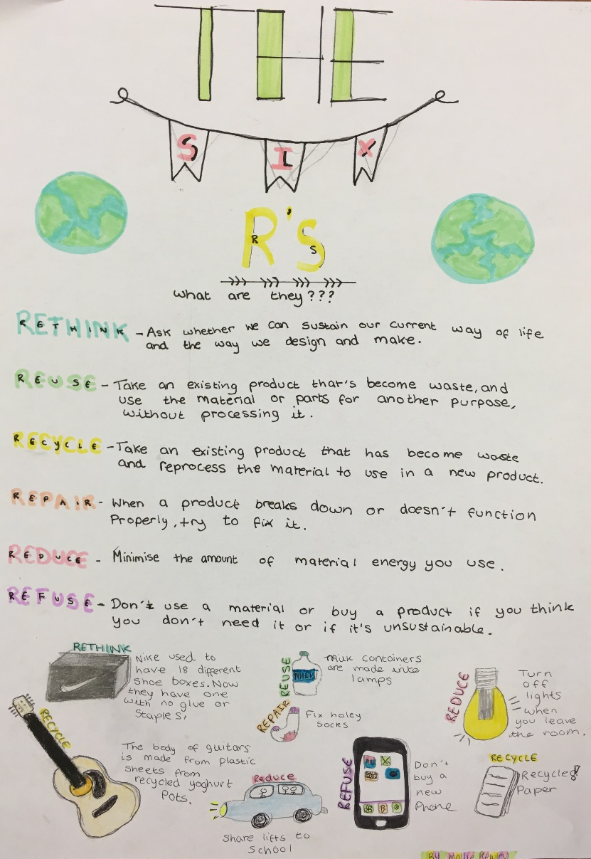

Slide 6
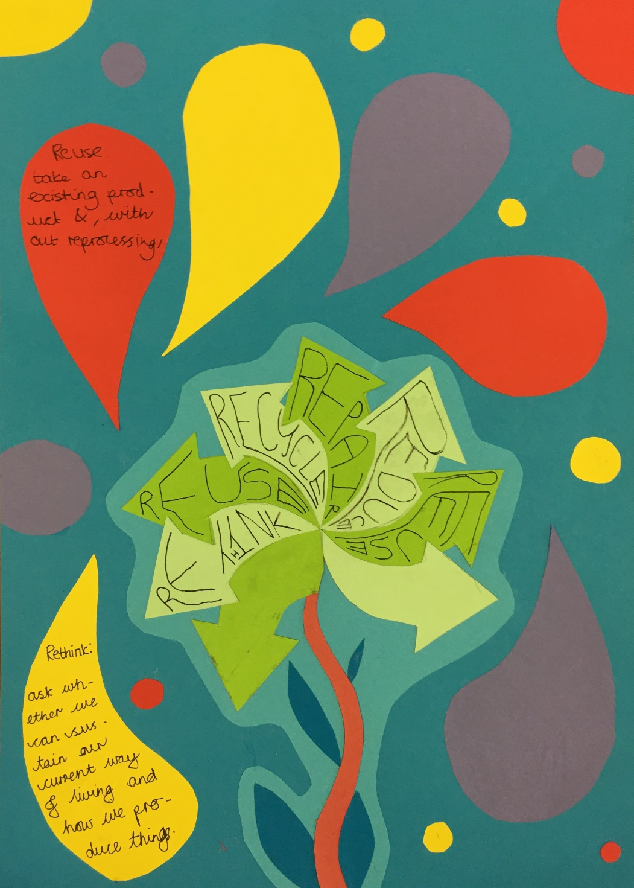
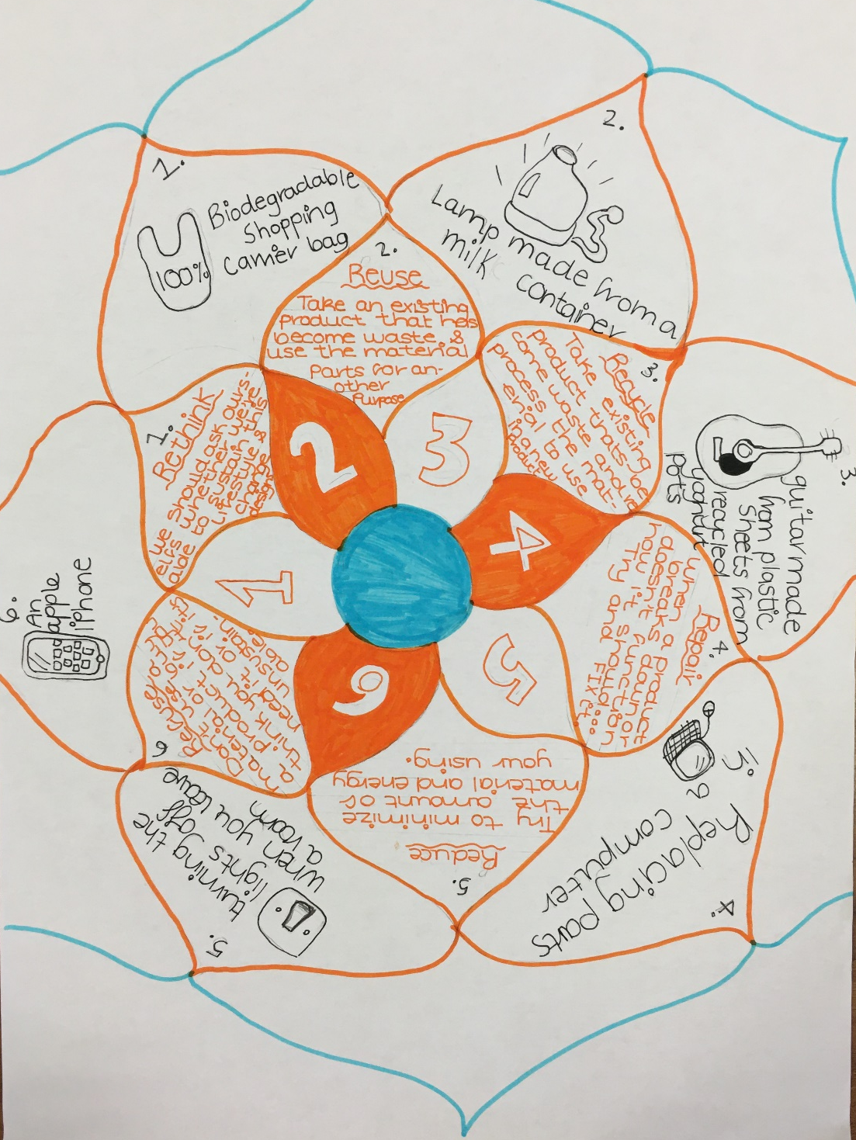

Slide 7
What is a Festival? The meaning of “festival” in the English Dictionary
a special day or period, usually in memory of a religious event, with its own social activities, food, or ceremonies
a Jewish/Christian/Hindu festival

Slide 8
Meaning of “festival” in the English Dictionary
an organized set of special events, such as musical performances: a folk/pop/rock festival
The New Orleans Jazz Festival is held every year in the spring.
The Cannes Film Festival

Slide 9
Boardmasters, Fistral Beach & Watergate Bay, Newquay: 10-14 Aug 2016
Headliners: Chase & Status, deadmau5, Catfish and the Bottlemen
Hidden amongst the swell and sunshine of the south-west coast of England, Boardmasters mixes the best boarders in the world - whether they’re surfers or skaters - with BMX kings, and soundtracks the action with dance dons, folk stars, and pop favourites. With cliff-top sessions and surf shack shows, it's only a cocktail short of the best weekend of the year. Ready to make your Instagram followers jealous?

Slide 10
Glastonbury Festival, Pilton, Somerset: 22-26 Jun 2016
Headliners: Muse, Adele, Coldplay
It may be one of the UK’s oldest festivals, but Glastonbury Festival still kicks stronger than even the youngest of pretenders. In a world of its own, those who enter can expect massive artists, but it's not unusual for some to go the whole week without passing by the infamous Pyramid Stage, and that's because of the immense amount of circus and theatre shows, 24-hour shenanigans, the best food stalls, secret acts and contagious hippydom you'll never shed. It really is one of a kind.

Slide 11
Latitude Festival, Henham Park, Southwold: 14-17 Jul 2016
Headliners:
The Maccabees, The National, New Order
.
Taking over the idyllic English countryside, Latitude is, as its tagline proclaims, much more than just a music festival. With DJs hidden in the woods, colourful sheep roaming the tufty fields, opera on the lake, film debuts in its onsite cinema, clowns under canvas, actors treading the boards, local ales, dance troupes and a huge children’s area, there's something to keep whatever age entertained. Oh, and there’s a full programme of music too.

Slide 12
HW
Research Glastonbury festival and find out the answers to the following questions.
Present your findings in the form of a poster (landscape or portrait)
How many tons of waste are left at the festival each year?
How much electricity is used over one weekend?
What year did the festival start?
Has the festival raised money for charity, if so how much?
Find out three more interesting facts about the festival.

Slide 13
Design Brief
You have been asked to design an environmentally friendly festival package that incorporates the 6 R’s.
The festival name is your choice and it can be held anywhere in the country, although it is reasonably small and can hold a maximum of 20,000 weekend guests.
You will need to design and produce a variety of items which will be presented as a presentation pack.
You must include
A logo
A festival Map
An entry ticket
A VIP Pass
You could include
A wrist band
A poster / flyer
A stall design

Slide 14
What is a festival? Before you start designing you will need to answer the following questions.
WHO
WHAT
WHY
WHEN
WHERE
Who will be at the festival ?
What type of festival will it be?
Why is the festival being held?
When is the festival going to be held?
Where will the festival take place?
(Look back at slides 6,7 &8 to help with this task)

Slide 15
What is a festival? Under each heading make a list of all the possible answers
Page 2
WHO
WHAT
WHY
WHEN
WHERE
Name…………………………….

Slide 16
Summary
Looking at the lists you have made you now need to sum up what your festival will be all about. For example:
My festival will be aimed at young people between the ages of 6 to 15 year olds. The theme of the festival will be on food. The aim of the festival is to introduce young children to different types of food from around the world whilst helping to raise money for starving children. It will take place on the last weekend in August and will be held in Cardiff Castle grounds.

Slide 17
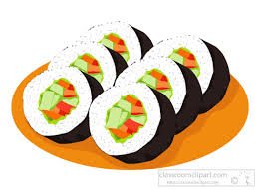
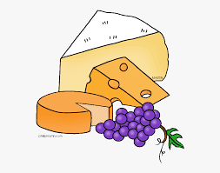
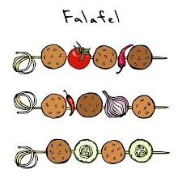
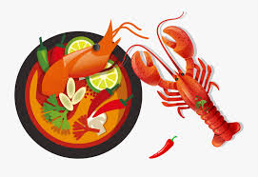
Food Fest
Food Fest

Slide 18
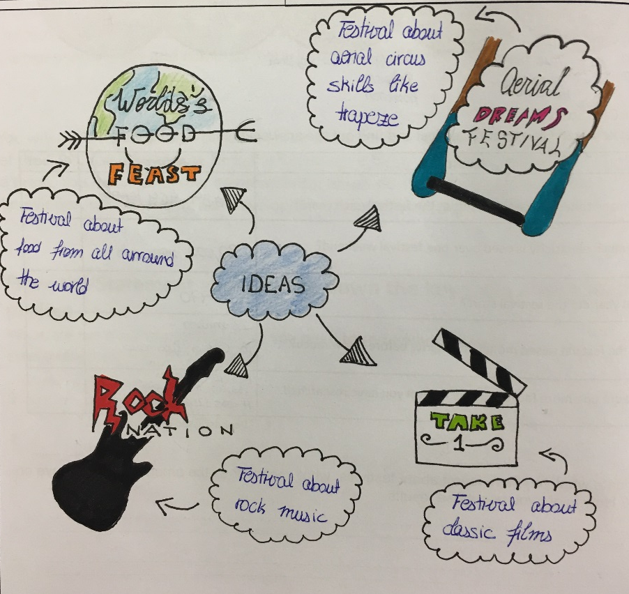
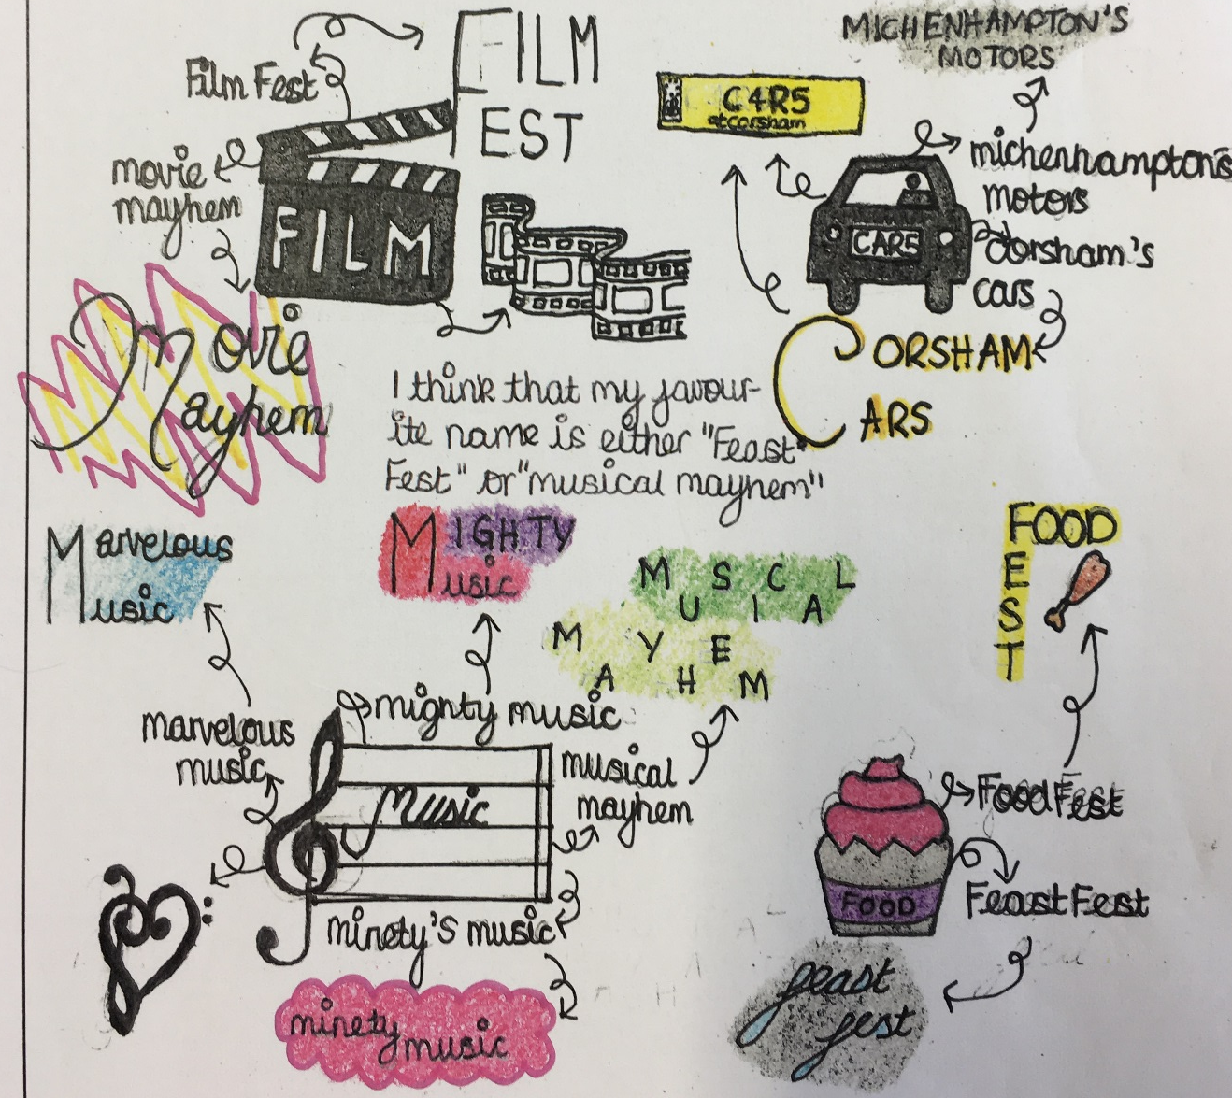
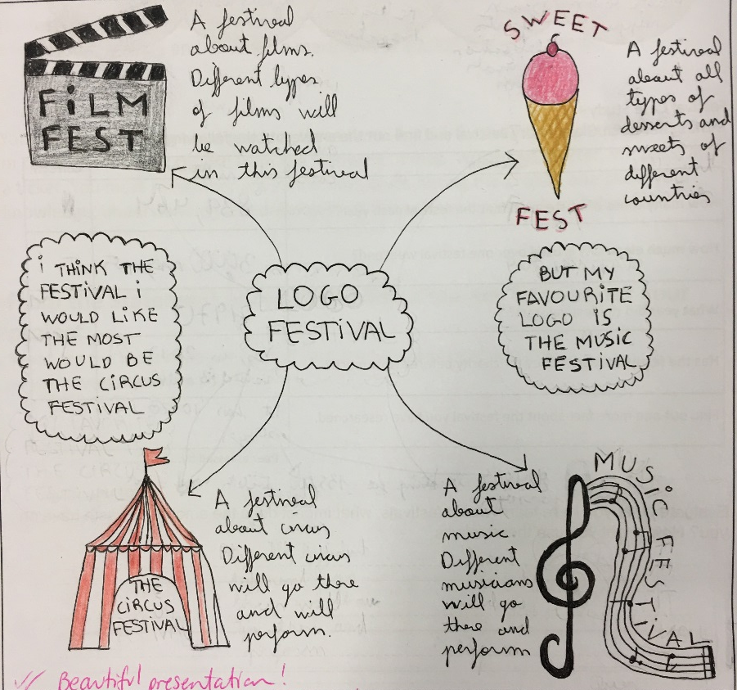
Create a mind map of ideas for your festival name and theme

Slide 19
4 X 4 development of idea exercise
1
2
Size / scale
Combine
Add
Replace
Eliminate
Duplicate
Initial Idea
4
3

Slide 20
Map Key
Make a list of all the possible services which will be available to visitors and staff at your festival.
Next to the list sketch out ideas for icons to represent the different services. These will then be used for the key on your map.
For example any of these icons would be suitable to identify the toilets…..

Slide 21
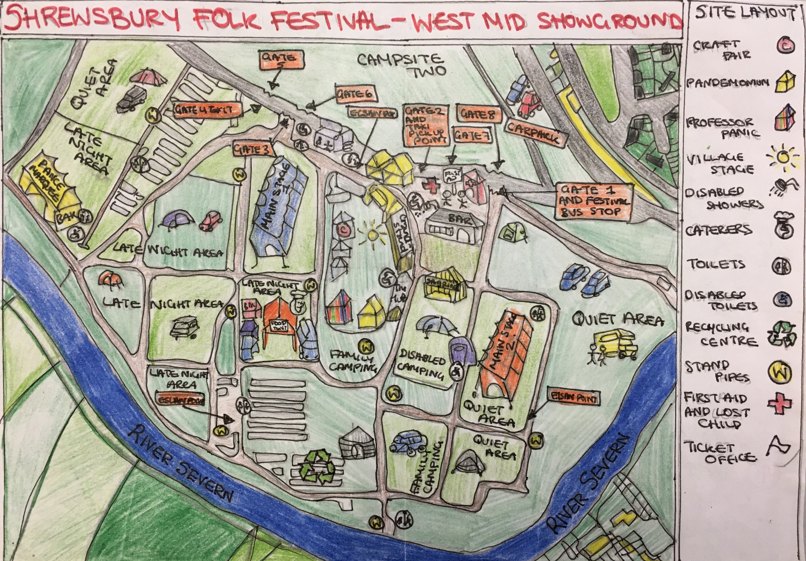
KEY

Slide 22
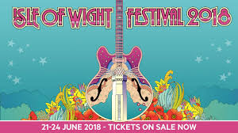
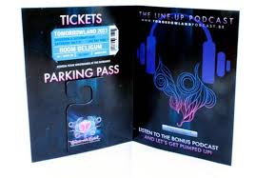
Ticket designs

Slide 23
Ticket Design
What your ticket communicates is just as important as how it looks! Ensure your ticket conveys the right message by using the following tips:
Make the most important information the most visible. In most cases, this will be the event name or main purpose of the ticket. This information should be placed in a larger font and be easy to find on the ticket.
Use a font color and style that will create contrast between the text and the background of the ticket. The text will just clutter the ticket design if it is lost in the background or difficult to read.
Be sure to leave some empty space on your ticket. Space without text will add balance to the ticket and make it more attractive.

Slide 24
Task - research & design festival ticket.
Spend no longer than 15min on the computer researching examples of interesting ticket designs. It would be wise to concentrate on examples that are of the same theme as your own festival.
On an A4 piece of paper come up with 4 creative different design ideas for a ticket for your festival. Be creative in the shape of the ticket. Remember to make use of annotation to get your idea across. Don’t forget to include relevant information for a festival ticket;
Name of the festival
Date
Location
Additional info such as headline bands etc…
Make sure you give your work a title, ‘Ticket Design Ideas’ and that you write your name in the bottom right hand corner.

Slide 25
Ticket Design
Once you have 4 design ideas you will need to select one as your final. Annotate to identify which one and why you have chosen as your final design.
You now need complete a presentation style drawing of the front and back of your final design ticket.

Slide 26
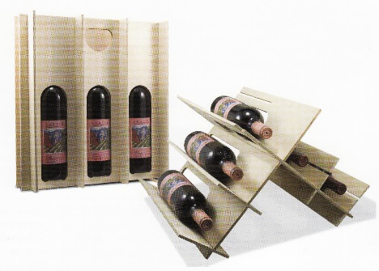
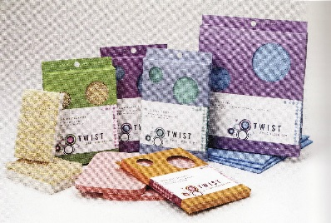
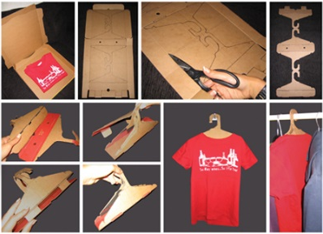
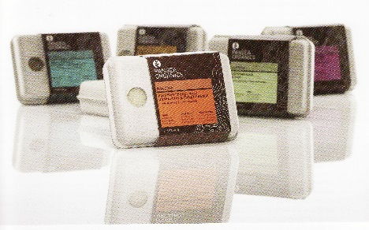
ECO Challenge Can you come up with a way of making your ticket have a secondary function? In other words could it be used for something else after the festival? Examples of Packaging with a secondary function

Slide 27
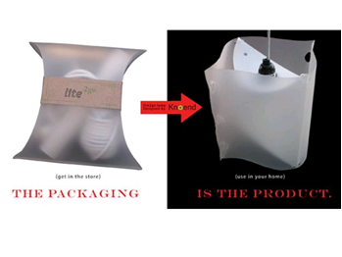
Packaging for this light becomes the shade part of the product

Slide 28
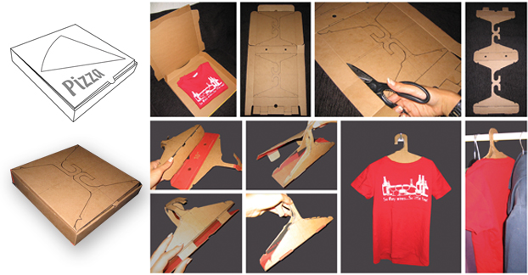
T-shirt box packaging becomes the hanger

Slide 29
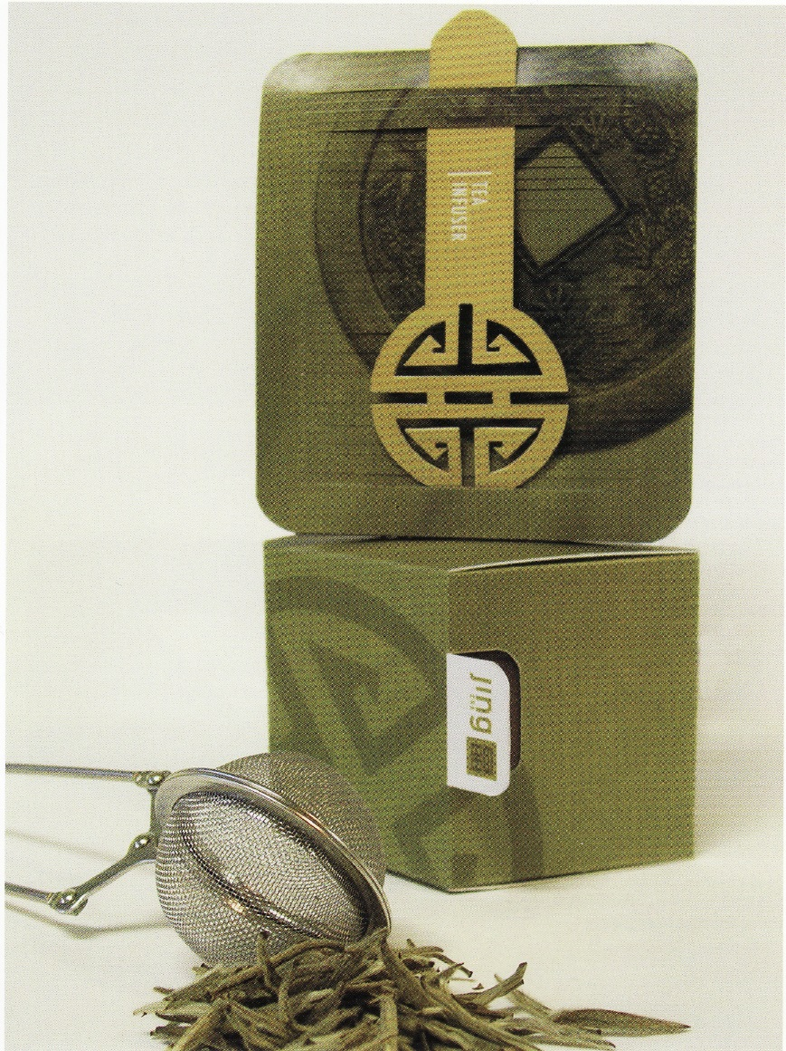
Packaging for a Tea Infuser – the secondary use in this case is a wind-chime.

Slide 30
Sustainable Product / Sustainable Packaging / Reusable Packaging
The sponge company Twist make products derived from fully sustainable resources, and complete the cycle by wrapping their products in equally sustainable packaging.
The entire line of products is packaged in post-consumer waste paper with soy-based inks.
Reusability of package.
The packaging can be turned into a bird feeder by following the instructions and Net printed on the reverse side.

Slide 31
Packaging for soap
Packaging made from 100% post-consumer newsprint. No glue required due to clamshell design of box.
Just unpack the soap, and plant the package. A fully biodegradable, moulded pulp box contains seeds of various herbs so that it can be planted in the backyard.

Slide 32
The Tresdon packaging incorporates 3 of the 6 R’s with its wine system – it reduces the material required to package and ship the wine bottles, it gives the consumer an option to keep the packaging and reuse it in multiple ways and the packaging can easily be made from any pressed, recycled material.

Slide 33
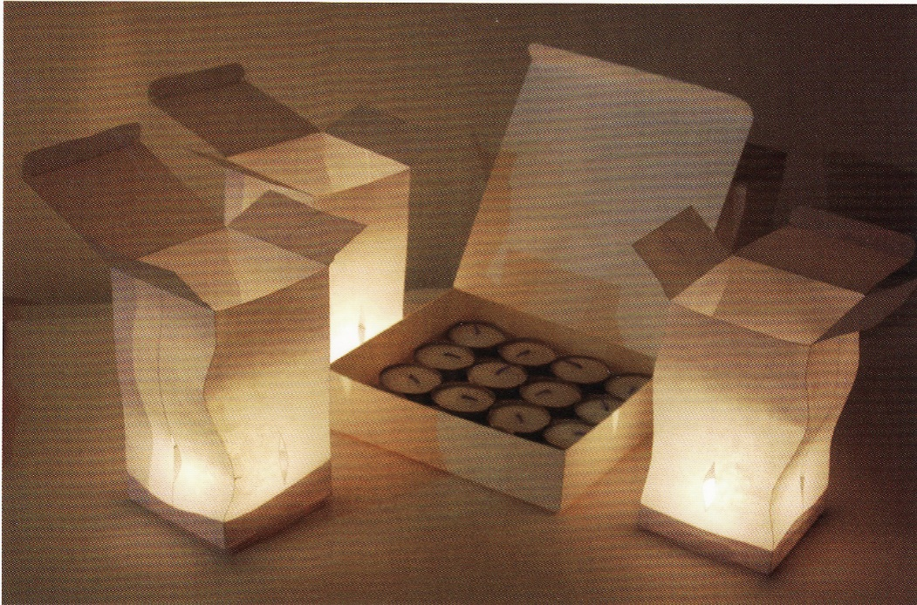
The package of four paper lanterns is supported by a base that also acts as a refillable storage container for the votives.
The design brief for this product was to create a set of votive candle holders that also function as their own packaging, the challenge was to make them small enough and aesthetically pleasing while at the same time ensuring that they did not become a fire hazard.

Slide 34
The secondary use for this torch is as a stand alone ‘candle’. The idea for the packaging arose from the desire to further the simple ingenuity of the secondary use by diffusing the light into a softer and more evenly dispersed glow.
Package design features a triangular form for minimal shipping volume and maximum reusability as a lampshade.
Packages are printed with muted colours on the interior, and the bottoms are detachable so that the carton can open into a lampshade. Die cut holes on the gussets allow light to beam outwards.

Slide 35
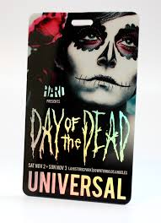
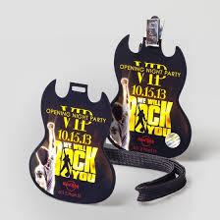
VIP pass designs

Slide 36
What is a VIP Pass?
Use the internet to research different festivals.
Find out what their VIP pass gives the consumer that is in addition to a normal ticket.
Make a list in the table below of ‘special extras’ that someone would get as a result of buying a VIP pass.

Slide 37
This is an example of what a VIP Pass for the Wireless Festival will get you
PACKAGE INCLUDES:
DESIGNATED VIP ENTRY LANE
General admission ticket with VIP entry lane to festival
VIP VILLAGE
Access to Wireless VIP Village & DJs
Chill out area
10 Complimentary drinks tokens per person (valid for wine, beer, selected spirits or soft drinks excludes champagne & cocktails)
One complimentary meal (£15 value and valid at VIP Food Trucks)
Complimentary cloakroom facilities
Luxury restrooms
Commemorative VIP wristband & laminate + lanyard

Slide 38
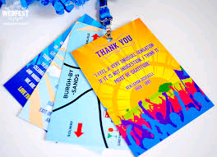
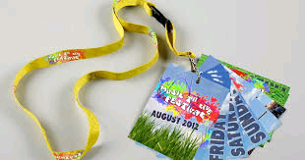
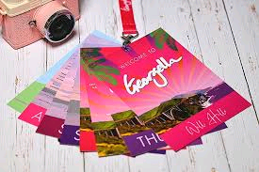
VIP Pass Design
VIP passes usually come as a lanyard and are made up of several leaves. Produce a rough design for each separate leaf of the lanyard. For example – one leaf could be for free drinks. Another could be access to luxury camping. Easy access parking… these leaves will then all come together to make up the lanyard VIP pass.

Slide 39
ECO Challenge
Research 5 different festival products, then for each one find as many different examples of reuse of that product.

Slide 40
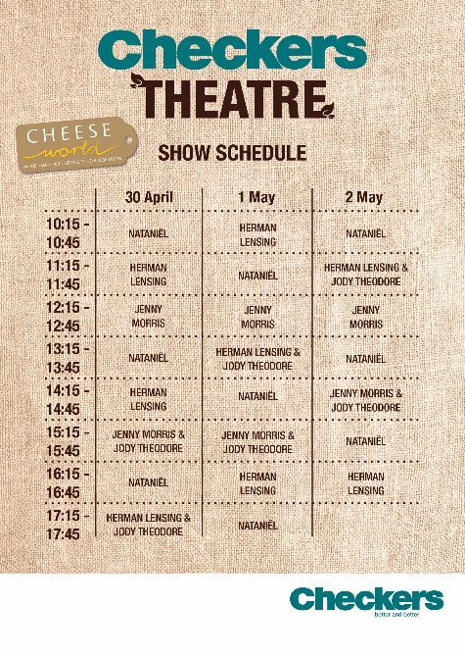
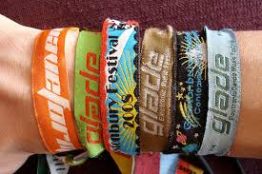
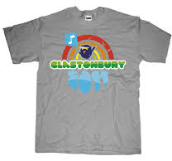
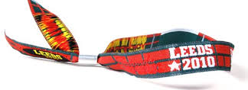
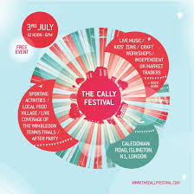
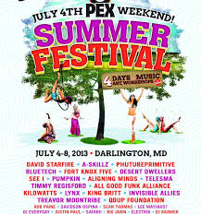
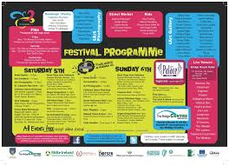
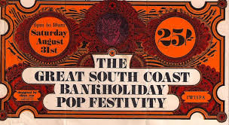
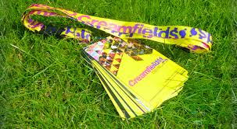
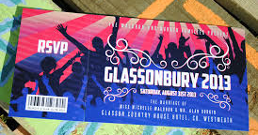
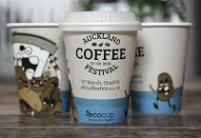
Festival Products

Slide 41
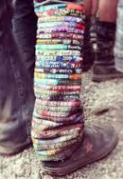
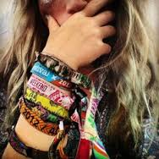
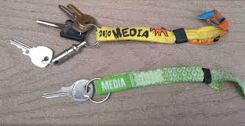
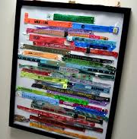
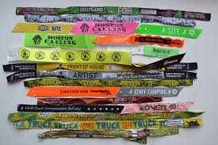
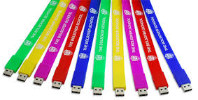
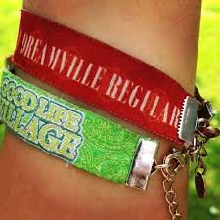
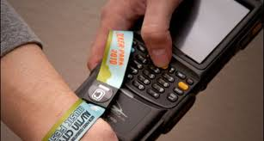
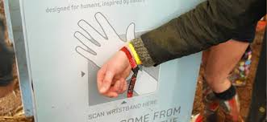
Reuse of Product – Wrist band
Lamp Shade
Fashion Accessory
Key Ring
Art Work / Collection
Entrance Ticket
Memory stick
Jewellery

