Slide 1


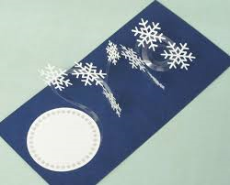

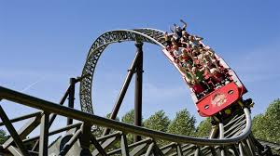



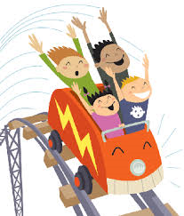
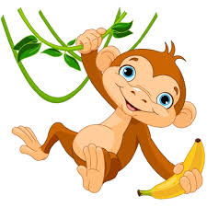



Spiral mechanism – Turn your spiral mechanism into a picture. Consider what the actual spiral could be – the track of a roller coaster?
Decorate the spiral with additional pictures that you draw and cut out and then stick on to the spiral.
Produce an A4 page of research ideas which will enable you to complete your own spiral mechanism design.

Slide 2

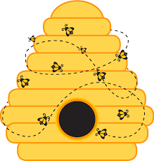

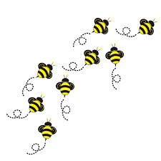



Internet research for spiral mechanism

Slide 3
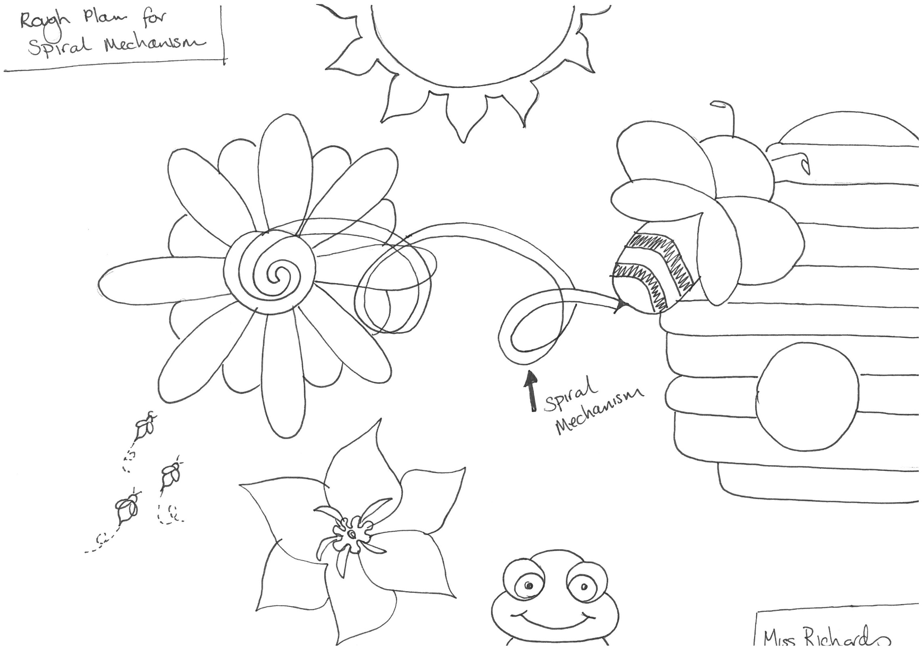

Slide 4
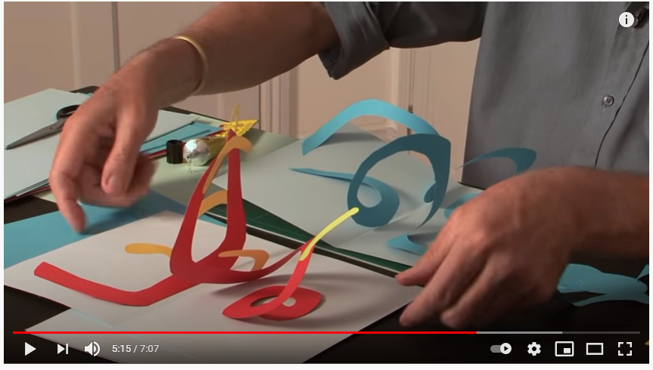
How to make a spiral pop-up
https://www.youtube.com/watch?v=q5YzFR82bV0&safe=true

Slide 5
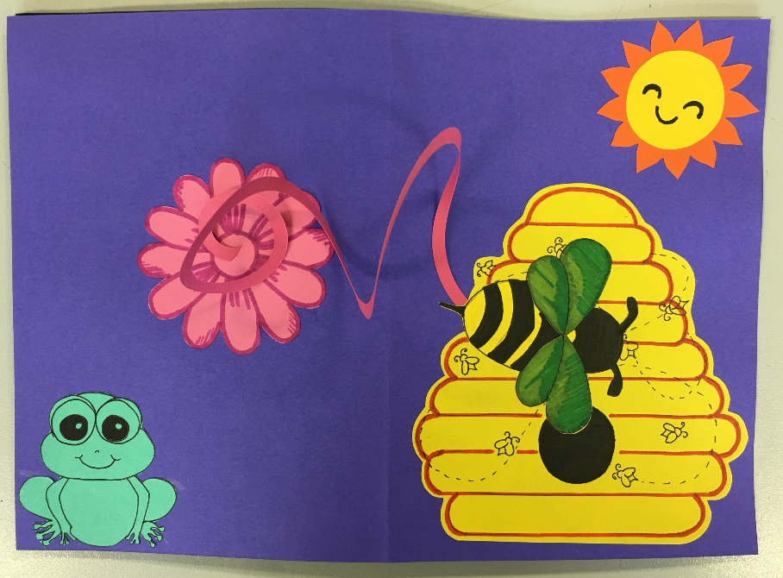
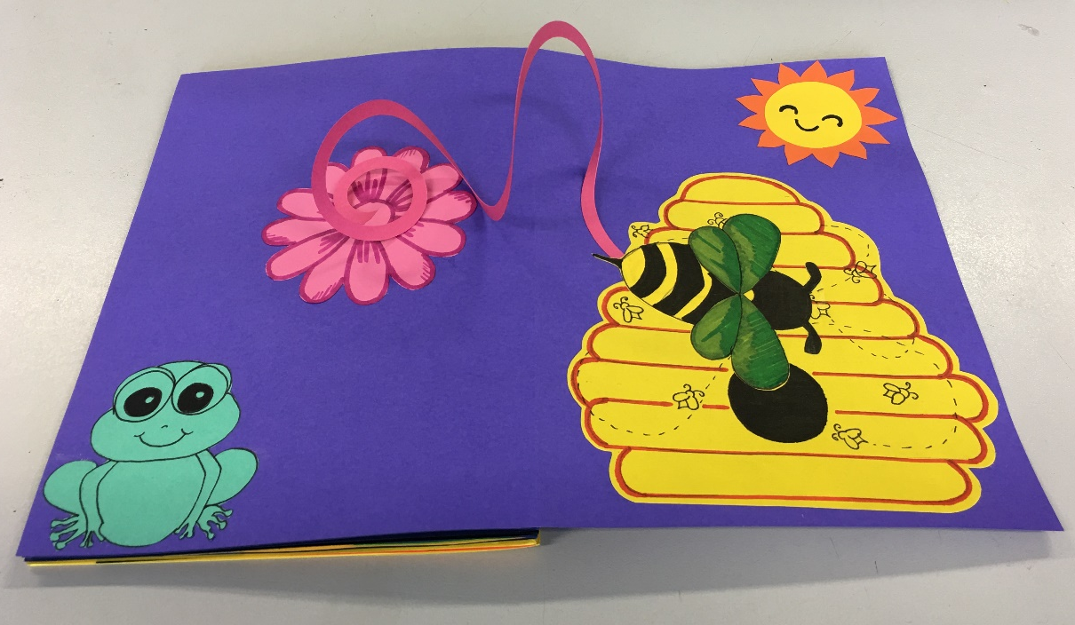
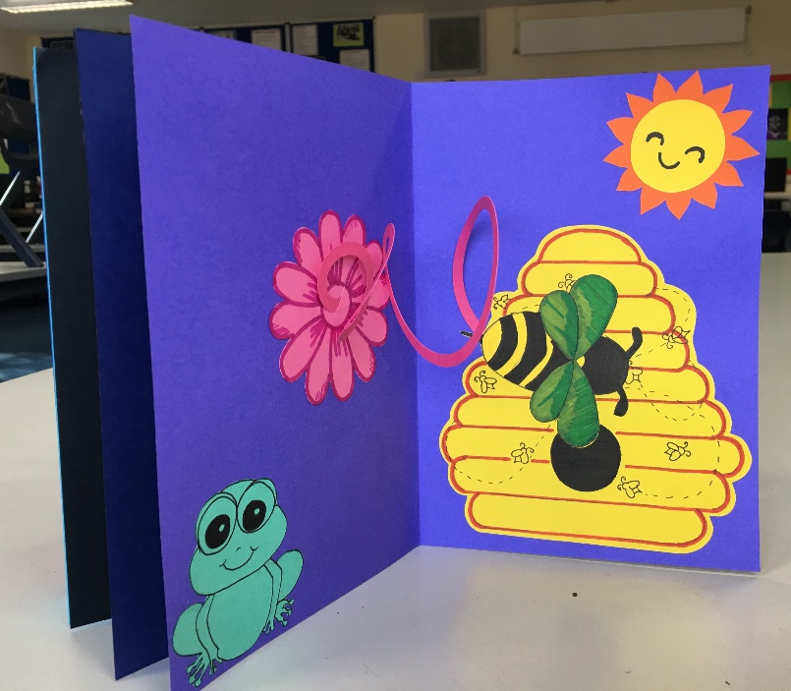
FINAL OUTCOME

