Slide 1
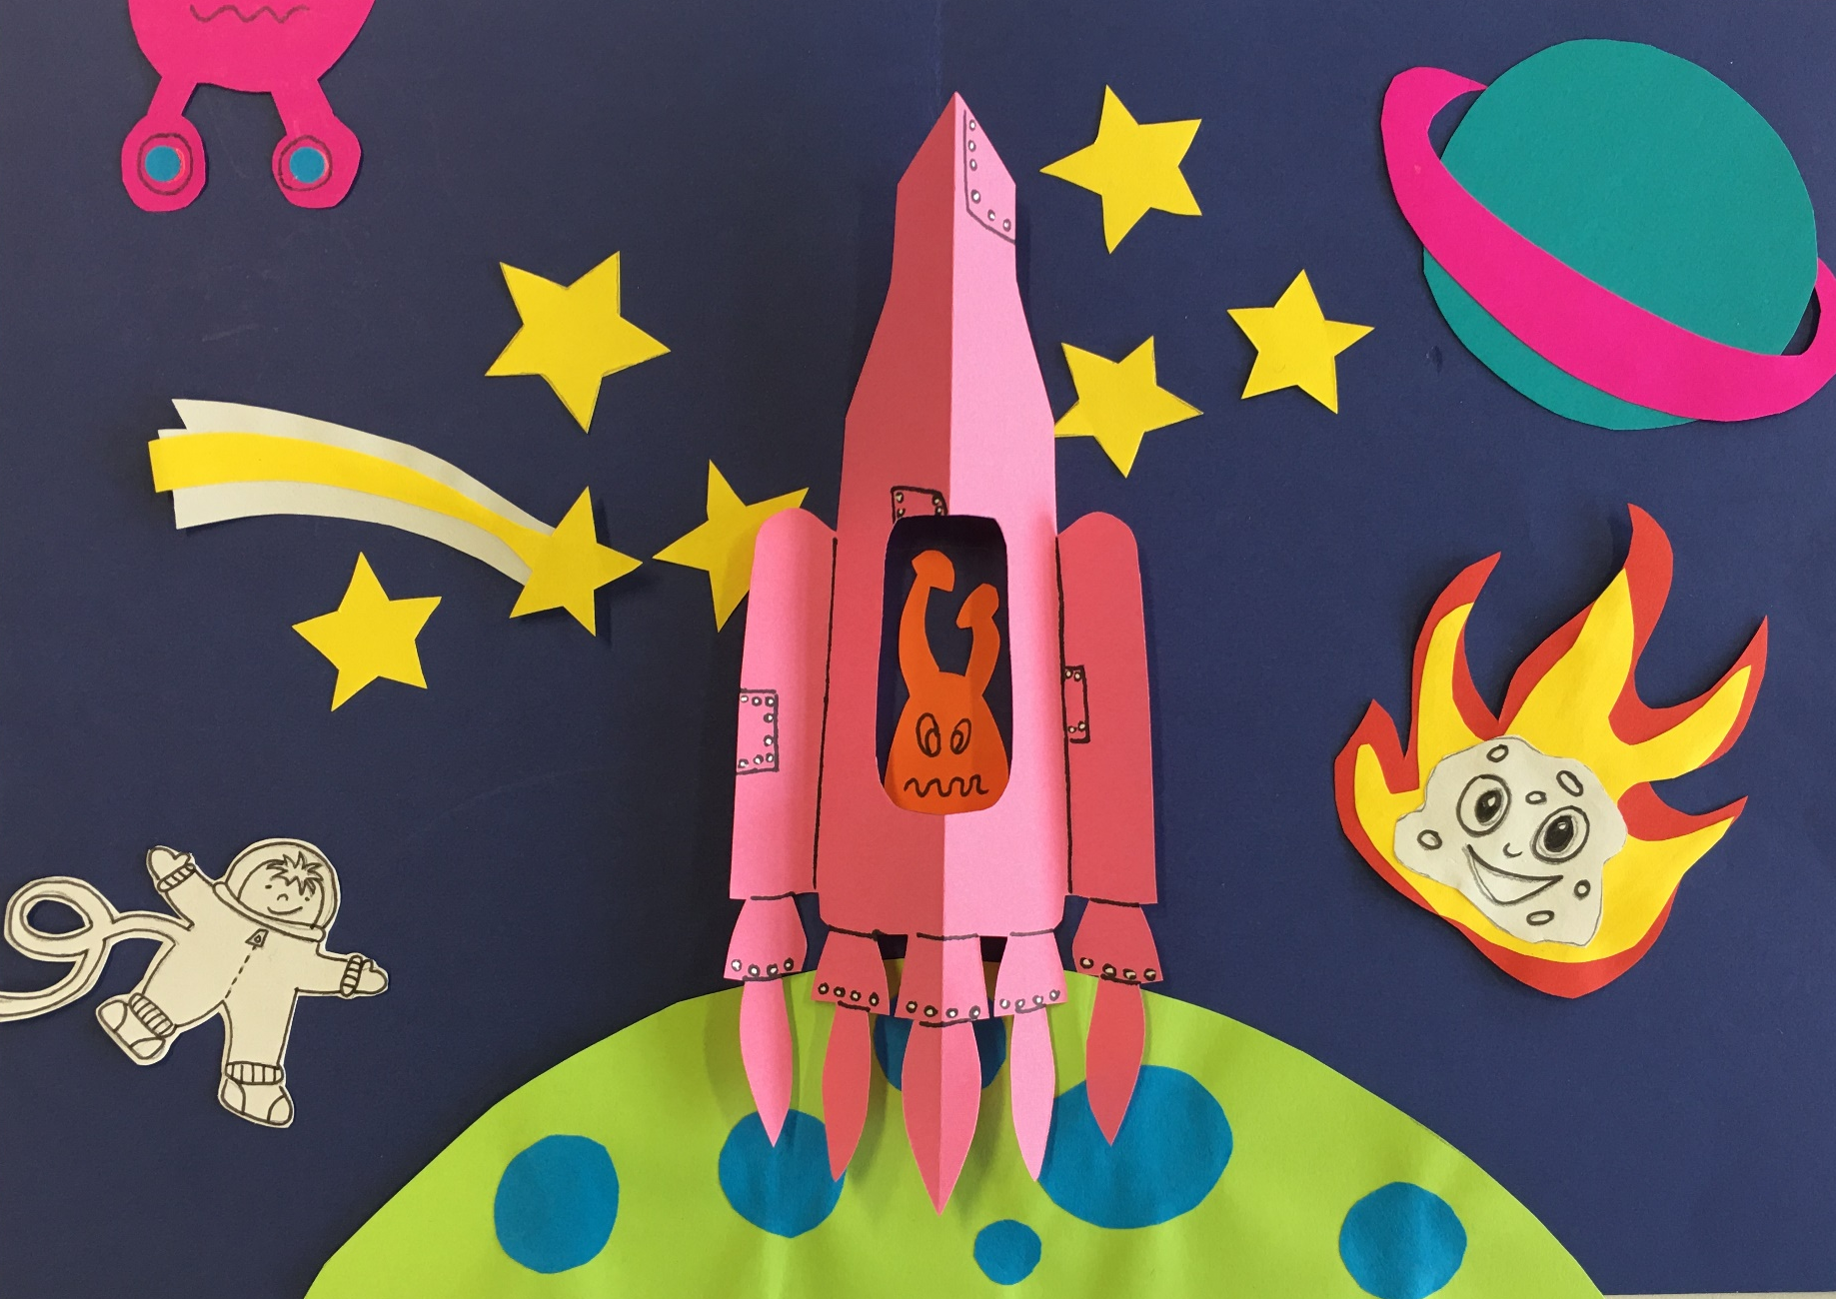
Rocket – Valley & Mountain Mechanism

Slide 2
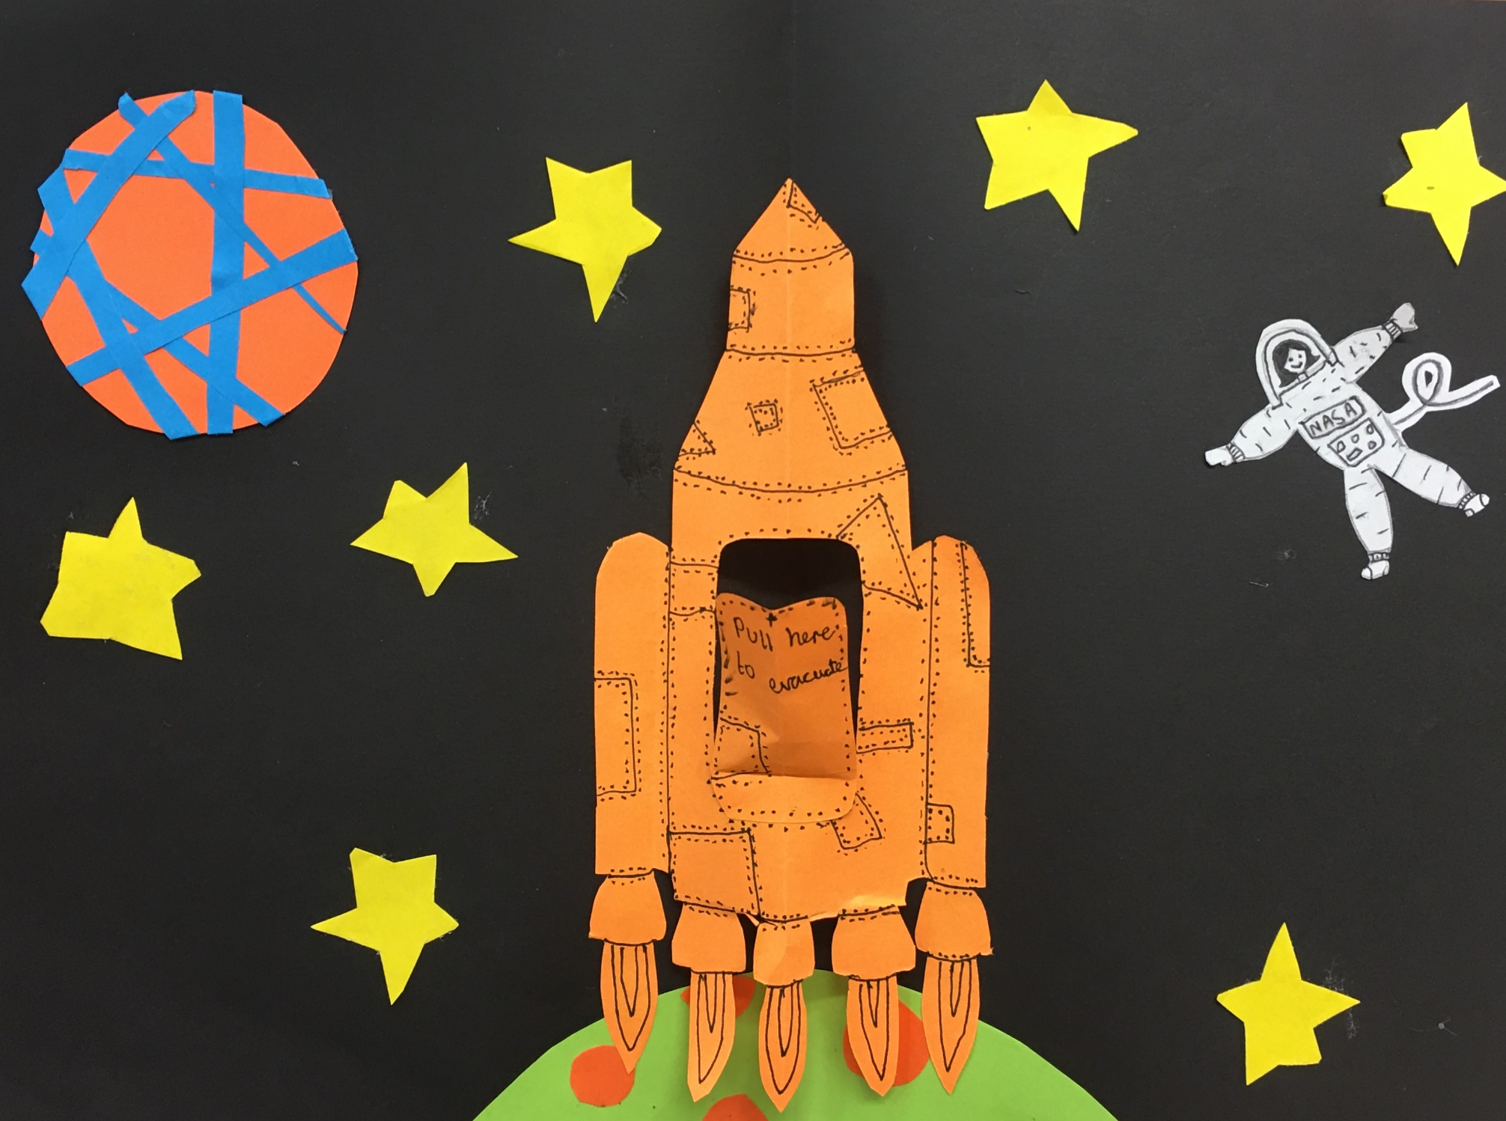

Slide 3
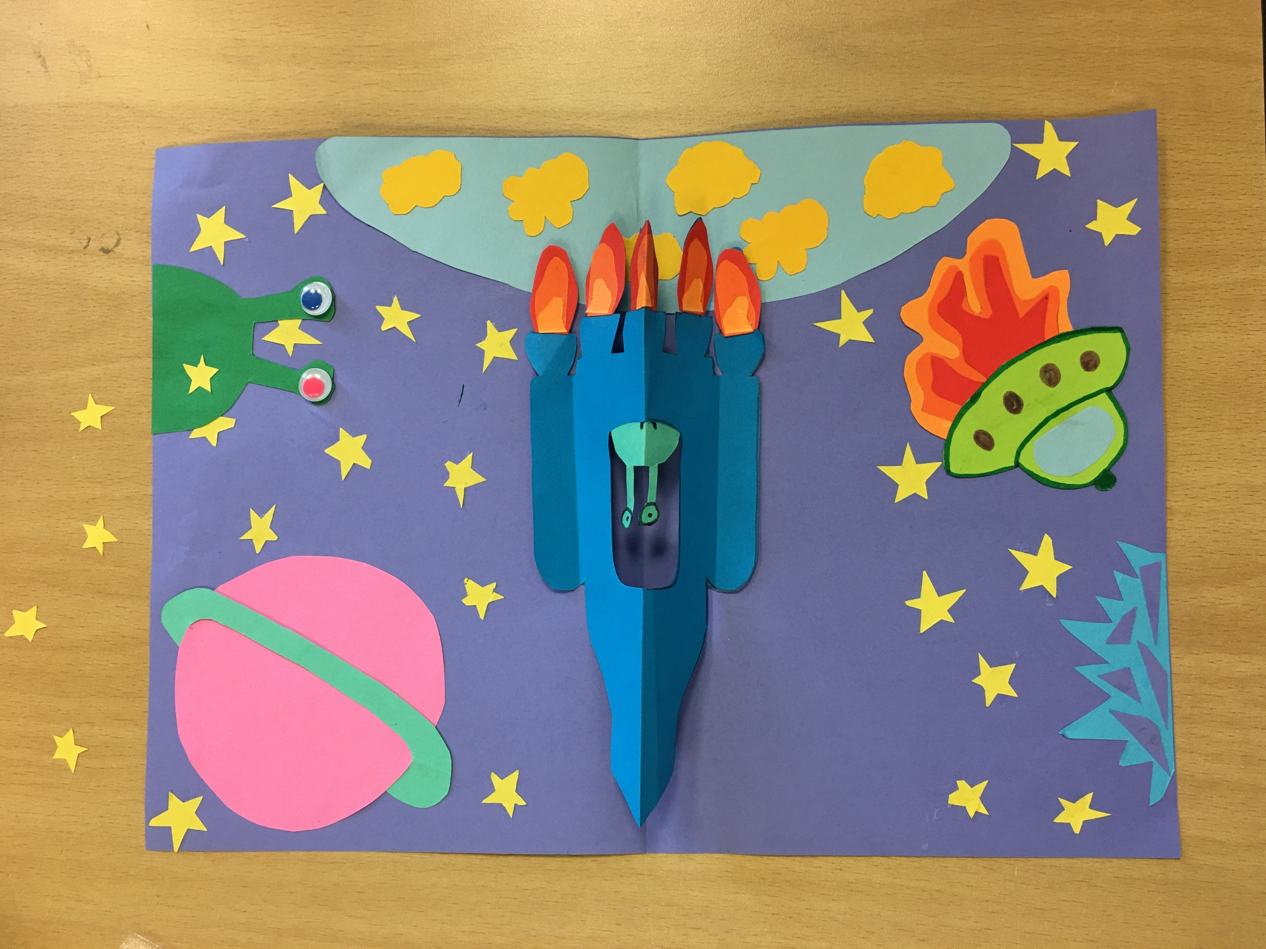

Slide 4



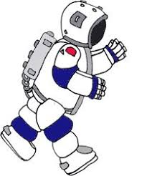
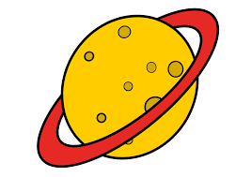
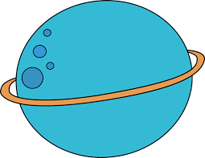



Research Clip Art style images
(Remember this makes it easier for you to reproduce out of colour paper).

Slide 5




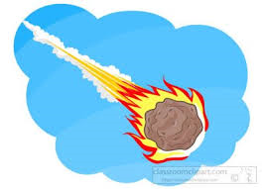
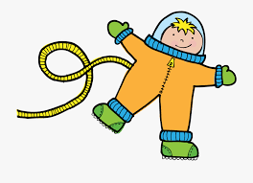






Slide 6
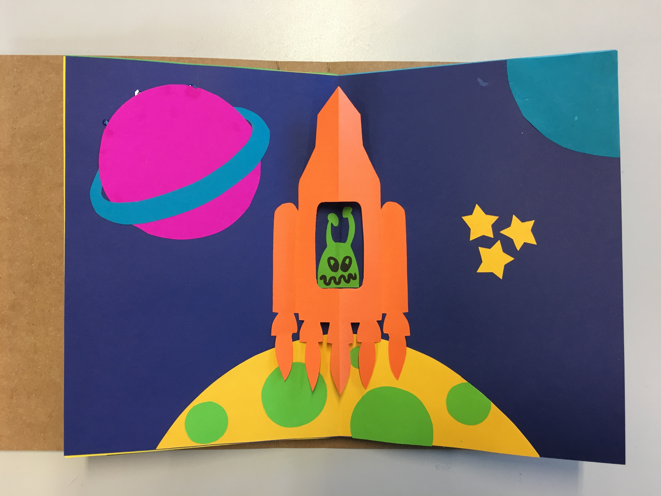
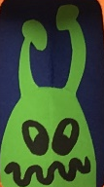
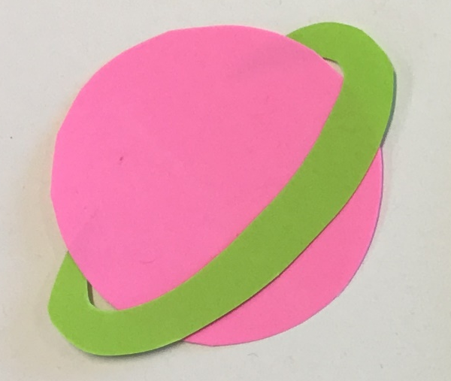
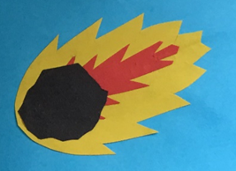
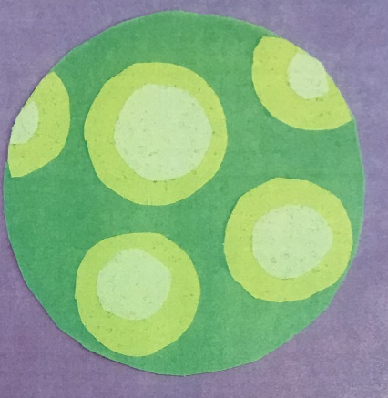

Use clipart style images to inspire and help you to create background characters.

Slide 7
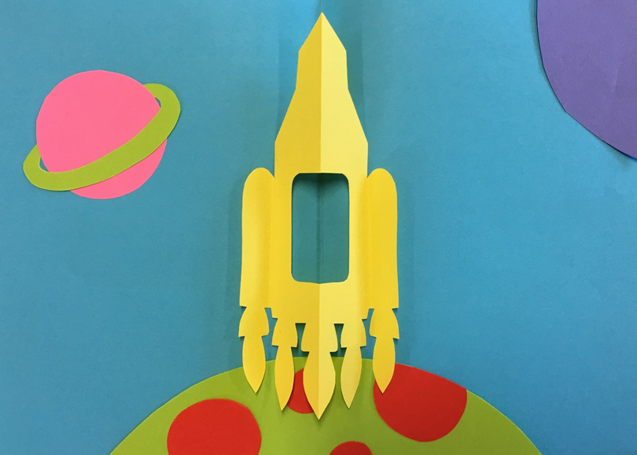
Final assembly of rocket mechanism
Select an appropriate colour background and fold in half.
Position your background characters. Remember your Rocket must go in the middle of the page.
Glue down the characters in place.
Create your valley and mountain rocket out of coloured paper. Cut, fold and glue in position.

Slide 8
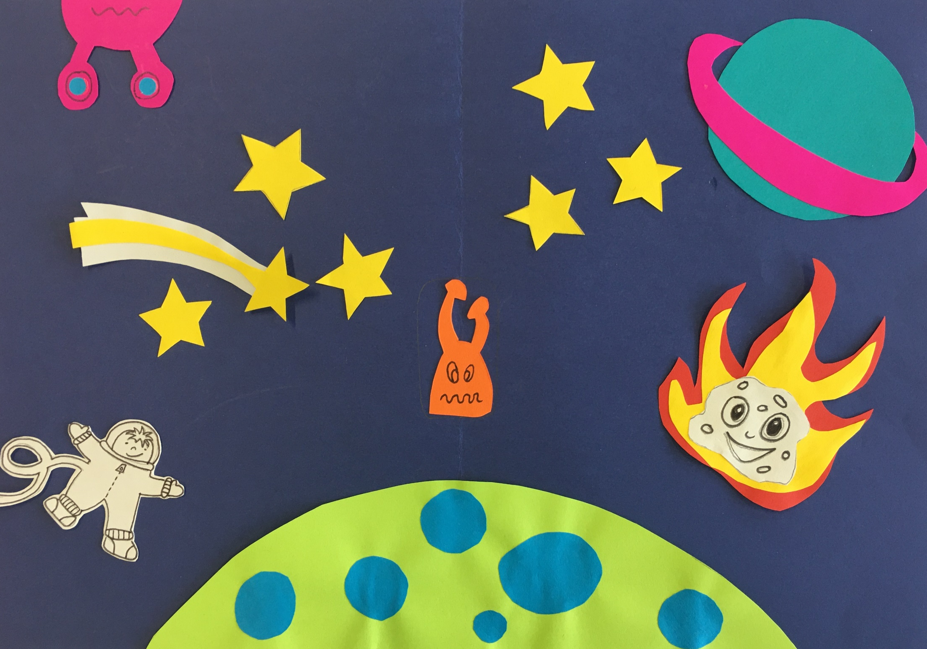

Slide 9
