Slide 1
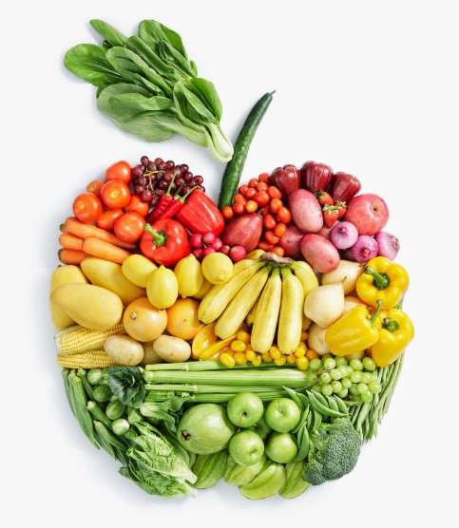
Food Technology
Year 8
Name:
Pathway:
Class:
Focus on Practical Skills and Healthy Eating

Slide 2
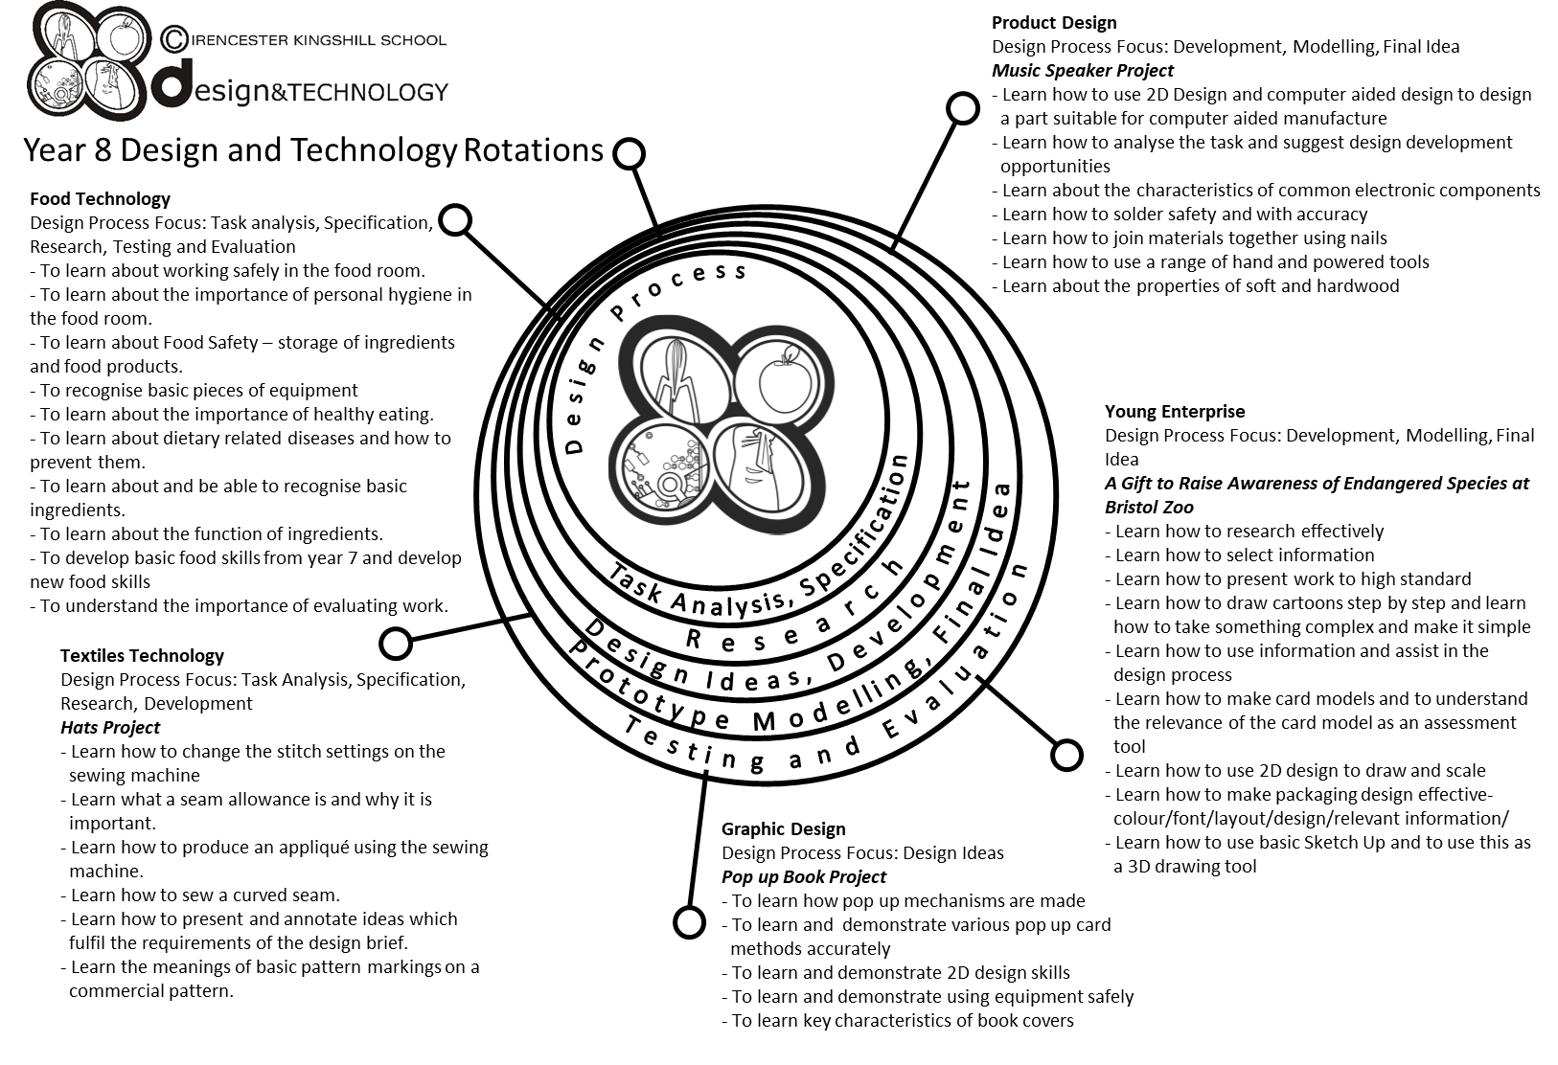

Slide 3
Year 8 pathways criteria
Year 8 Foundation | Year 8 Secure | Year 8 Confident | Year 8 Excellent
Four initial design ideas, completed and rendered. | Four initial design ideas, completed and rendered with accuracy. | All criteria from previous pathway has been completed to a high standard. | All criteria from previous pathway has been achieved to an exceptional standard.
At least two annotations made on each design. | Four annotations made on each design. | Six annotations made on each design. | Eight plus annotations made on each design.
One view of design ideas. | You have drawn some of your design ideas in 3D. | You have drawn all of your design ideas in 3D. | You have drawn all of your design ideas in 3D, showing some designs with different views e.g. cross-section.
You have named your chosen target market. | You have identified why your design is suitable for your chosen target market. | All criteria from previous pathway has been achieved with reference made to the design specification. | All criteria from previous pathway has been achieved with reference made to the design specification and a detailed design proposal has been completed.
You have a written plan of making. | You have written your plan of making showing a start and finish time. | You have written your plan of making with some timings. | You have written a detailed plan of making with timings and some control points.
Some ingredients and equipment handled with reasonable control. | Most ingredients and equipment handled with co-ordination. | Most ingredients and equipment handled with excellent competence and co-ordination. | All ingredients and equipment handled with excellent competence and co-ordination.
Practical sessions - needed a little assistance. | Practical session - mostly independent – a little assistance. | Practical sessions - completely independent. Demonstrating good organisation. | Practical sessions - Completely independent. Demonstrating a high level of organisation.
Mostly worked in a hygienic and safe manner. | Worked in a hygienic and safe manner. | Consistently worked in a hygienic and safe manner. | Consistently worked in a hygienic and safe manner.
Finished practical dish. | Finished on time. Sink and equipment cleaned and finished product packed away. | Finished well within the time limit. All equipment cleaned and finished product packed away, and extension work completed. | Finished well within the time limit. All equipment cleaned and finished product packed away, and extension work completed to a high standard.
Acceptable finish on end product. | Good finish to end product. | High quality product with excellent finish. | High quality product with excellent finish. Demonstrating good garnishing/decorating skills to finished product.

Slide 4
Food Technology – essential information
What to bring to school:
For each Food Technology lesson, you will need:
Your pencil case
Your planner
Your work booklet
When you have your practical lessons, you must also bring:
Your ingredients – weighed and measured
A lidded container to take your food home in, clearly marked with your name
For some practical lessons you may also need a dish/tin to cook the food in.
If you do not bring in ingredients – you will NOT cook
When you get to school
On the days that you have practical lessons, you must take your ingredients to the food room BEFORE registration.
Place your high-risk ingredients (meat, dairy, fish) in the fridge and your dry ingredients in the Cool Room.
After your practical lesson you must leave your food in the cool room and collect after afternoon registration.
Think about the environment. Try not to use too many plastic bags for your ingredients Try to reuse
plastic pots and bags. Use old margarine tubs/sweet tins instead.
It is essential that you leave your unit drawers and cupboards CLEAN and TIDY, ready for the next class.
Please sign to show that you have read and understood the essential information set out below.
Name………………………………………………… Signature………………………………………….. Date…………………………….

Slide 5
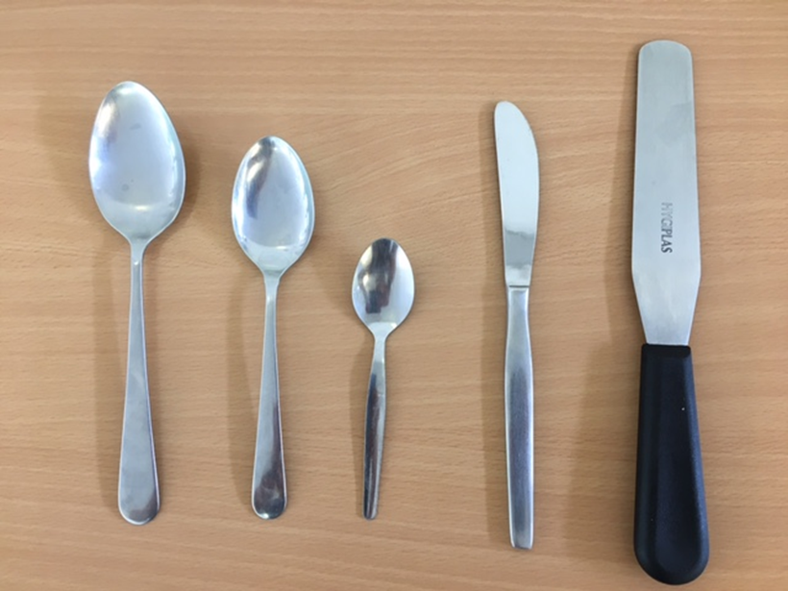
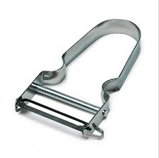
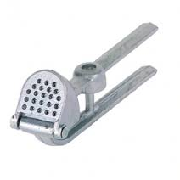
Recognising Equipment
Key words | Teaspoon | Palette knife | Dessert spoon | Kitchen Knife | Tablespoon
Can you name the equipment? Use the box above to help you.
A | B | C | D | E
In recipes what do the following abbreviations stand for?
tsp | dsp | tbsp.
A
B
C
D
E
Name the following pieces of equipment and their uses:
Name: P | Name: G | Name: Z
Use: | Use: | Use:

Slide 6
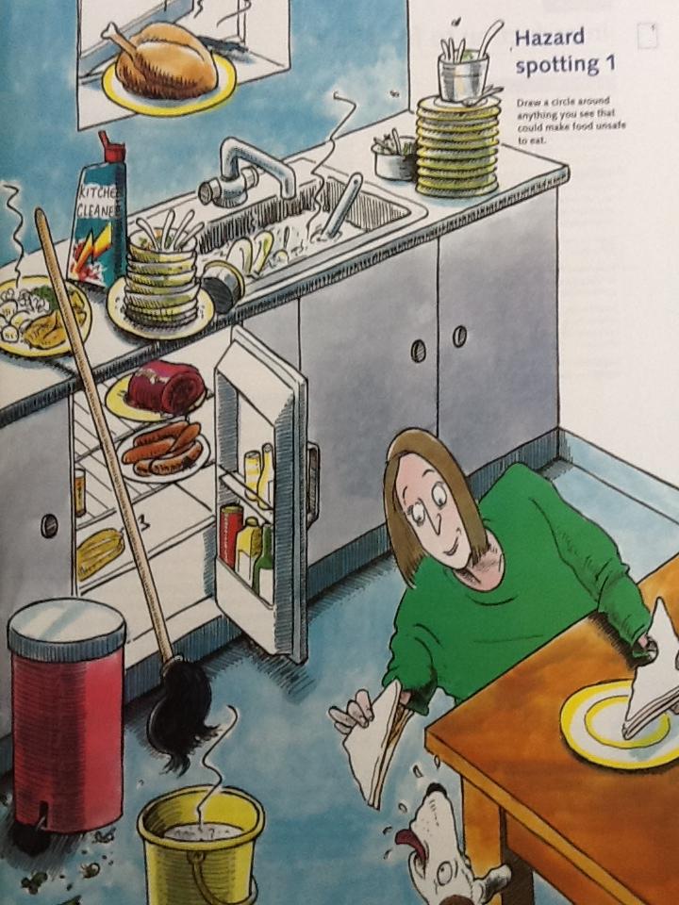
Kitchen and Personal Hygiene
Look at the kitchen below and identify 10 hazards. Number each hazard and give a brief explanation.
1
2
3
4
5
6
7
8
9
10

Slide 8
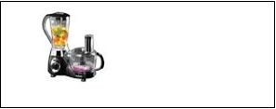
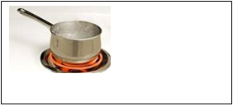
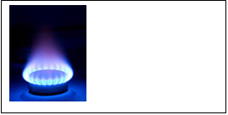
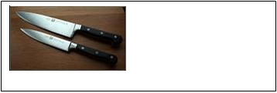
Safety in Food Technology
Each year many thousands of people are injured through accidents in the home. You can help to prevent accidents by thinking carefully about how you and your team work safely in the Food Room.
Read through the following rules. Why are they important when working in the food room?
Identify the main possible danger areas in the Food Room:
Electrical equipment
Hot pans/hob
Risk:
Risk:
1 | Make sure all bags and stools are out of the way.
2 | Walk; don’t run in the food room.
3 | Beware of any spilt food.
4 | Don’t leave pan handles sticking out over edge of a cooker or work surface.
5 | Always use dry oven gloves.
6 | Take care when using and washing sharp knives.
Naked gas flame
Electricity/trailing wires
Risk:
Risk:
Hot oven
Sharp knives
Risk:
Risk:

Slide 9
Design an informative safety poster for the Food Room.

Slide 10
Nutrient | Function | Where it’s found
Carbohydrates
Proteins
Fats
Vitamins and minerals
Fibre

Slide 11
Implementing Dietary Goals
For a healthy life we need to eat well. We know that the food we eat over a period of time rather than on any one particular day will affect our future health. As a nation we suffer from many diseases that are dietary related
Implementing these DIETARY GOALS: We can easily make the following changes to our diet to help implement these goals.
Gum Disease
Obesity
Strokes
Cancer of the Colon
High Blood Pressure
Tooth Decay
Constipation
Diabetes
Heart Disease
Diverticular Disease
REDUCE FAT | REDUCE SUGAR
REDUCE SALT | INCREASE DIETARY FIBRE
Too much FAT
Too much SUGAR
Too much SALT
Too little DIETARY FIBRE ( NSP)
Dietary Goals:
In order to avoid illness and to try to improve our state of health the government have set us targets in the form of dietary goals. These are:-
To reduce F _ _
To reduce S _ _ _ _
To reduce S _ _ _
To increase D _ _ _ _ _ _ F _ _ _ _ (NSP)

Slide 12
The function of ingredients – why do we use some ingredients and not others? What do the ingredients ‘do’ in the recipe?
Ingredient | Function
Flour
Butter/Margarine
Sugar
Eggs
Milk
Flavourings/seasonings

Slide 13
Homework Task – Research 3 different types of Bread. You must include an image of the bread –country of origin – description of the bread. Complete the following table.
 | 1 | 2 | 3
NAME OF BREAD
IMAGE OF BREAD
COUNTRY OF ORIGIN
DESCRIPTION

Slide 14
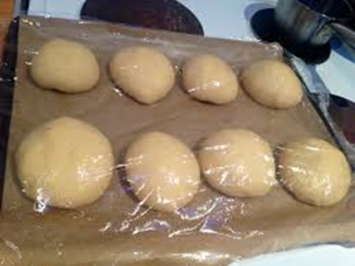
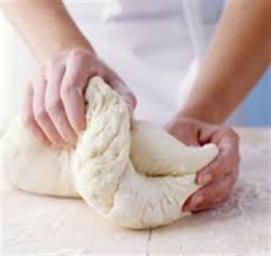
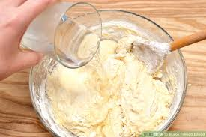
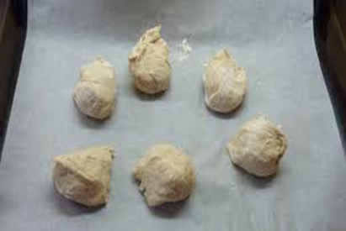
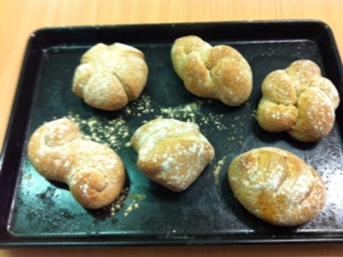
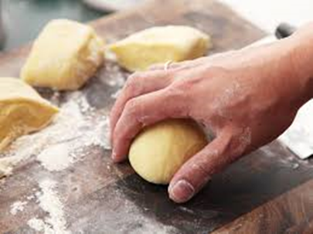
Making Bread Rolls
Knead for 10 minutes
Glaze and add any finishes.
Divide into 6 even
sized pieces
Put all the ingredients into bowl. Add enough warm water to make a dough.
Cover with cling film and leave to prove in top oven for 10 minutes until double in size.
Knead each roll until smooth and then shape. Place on baking sheet.
Bake for 10-12 minutes until golden brown

Slide 15
Bread Making Checklist
 | Question | Answer
1 | Name the type of flour we need to use in Bread making?
2 | What is the substance found in the flour that makes the dough stretchy?
3 | Wheat is high in Gluten. If someone cannot eat gluten it means they have what condition?
4 | What is the raising agent used in Bread making?
5 | What conditions does Yeast need to be active?
6 | What gas is produced by yeast when the above conditions are present?
7 | What is the scientific abbreviation for this gas?
8 | What is the chemical reaction called when yeast produces carbon dioxide?
9 | Put the following bread making processes in the correct order. Proving – kneading – glazing mixing – shaping -baking
10 | How could we add more Fibre to our bread mixture?
11 | Suggest 3 finishes that we could put on top of our rolls
KEY WORDS | Strong Plain Bread Flour | Warmth | Coeliac
CO₂ | Moisture | Gluten | Carbon Dioxide

Slide 16
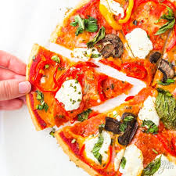
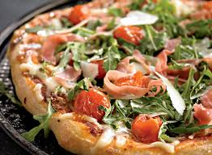
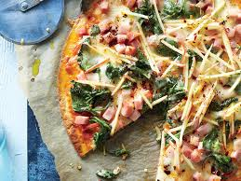
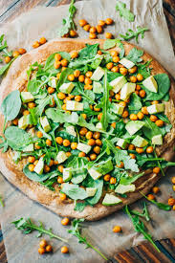
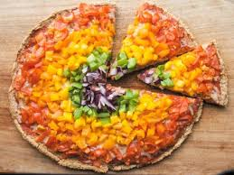
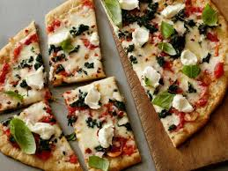
Design a pizza brief
Tesco have asked you to design and make a new pizza aimed at teenagers promoting healthy eating.
Your task is to design, draw and annotate 4 pizza designs that would fit the brief. Please think about the appearance, flavours, textures and use of healthy ingredients for the pizza.
Consider your 4 designs and choose the one you feel will be most successful.

Slide 17
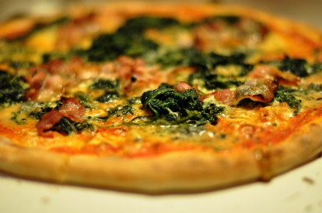
Homework – Designing a Pizza
The word pizza is Italian for pie.
A Margherita Pizza is the most popular pizza followed closely by a Pepperoni Pizza.
Produce 4 different design ideas.
Key words: to help you to check your spelling: tomato, mozzarella, basil, pepperoni, pineapple,
Remember to sketch with a pencil, render and annotate your sketches in detail.
Design 1 | Design 2
Design 3 | Design 4

Slide 18
Design Sheet
Product Name: | Product Design:
Product specification Be a bread based product Healthy – includes healthy ingredients Looks attractive Taste good Golden crust Good shape Base is thin and crisp. Appeal to target market.
Why my product meet design brief? Use the product specification above to help you. | Ingredients I have chosen to add to the basic recipe:
 | Skills I will use

Slide 19
Design Specification for ……….
 | Specification | Design 1 | Design 2 | Design 3 | Design 4
1 | Based on the bread recipe
2 | Healthy – include healthy ingredients
3 | Look attractive
4 | Tastes good
5 | Golden Crust
6 | Good shape
7 | Base is thin and crispy
8 | Appeal to chosen target market
 | TOTALS for each design
Design Proposal
I have chosen to make design number …… because
I am not making design number …… because
I am not making design number …… because
Words/ideas to help for choosing
Got the highest score; most attractive; healthy: can make it healthy but still attractive; have skills to make; easily get the ingredients; challenging; different.
Words/ideas to help for not choosing
Did not score very many marks; difficult to make in the time; unhealthy; flavour may not be as popular; decoration too tricky; not easy to package without getting in a mess; would have to make a template so shapes may not be as accurate; not very original.

Slide 20
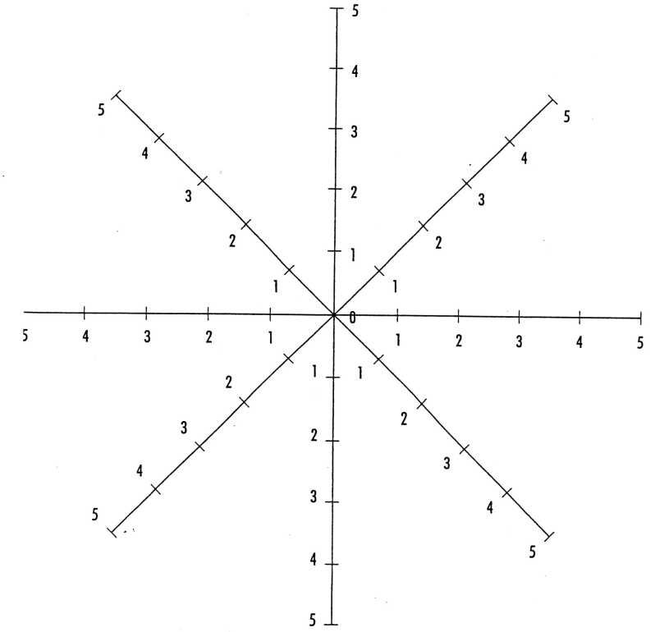
Evaluation
Made safely and hygienically
Complete all the following questions in full sentences.
1 | Did you meet the criteria of your design brief?
2 | Were you well organised? Explain.
3 | Did you find anything difficult?
4 | Could you of done anything differently or better?
5 | Did you learn any new skills?
6 | Underline the practical skills you used: | Kneading - Shaping - Rolling - Glazing - Grating Chopping – Slicing.
7 | Were you pleased with your final result? Why?
Time management
Skills
Shape
Appeal to
Appearance
Colour
Texture

Slide 21
Homework – Produce a fact file on Pasta. Your fact file should include a title - 10 interesting facts – images and a border.
(You can do your work on this page or print off and stick work into your booklet)

Slide 22
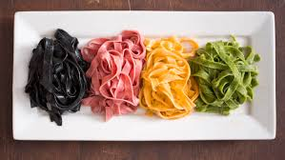
Pasta Quiz
What is pasta made from……………………………………..
Which country has pasta as one of it’s staple foods?.....................................
What does the term ‘al dente’ mean when talking about pasta?.......................................
In what form can you buy pasta?...........................................................................
There are over 100 shapes of pasta. Can you name 5?
......................................................................
………………………………………………………………….
………………………………………………………………….
………………………………………………………………….
……………………………………………………………......
Name 4 dishes that use pasta.
…………………………………….
……………………………………..
……………………………………..
……………………………………..
Some pasta’s come in different colours. What is used to colour them?
………………………… ……………………… ………………….. ……………………………
What type of pasta is known as ‘pillow pasta’?
………………………………………………………………………..

Slide 23
How to cook pasta successfully
Cook the pasta for about 12 minutes until ‘al dente’.
Drain into a colander and serve.
Add a teaspoon of salt and bring it to the boil.
Fill a saucepan ¾ with cold water.
Carefully pour the dry pasta into the boiling water.

Slide 24
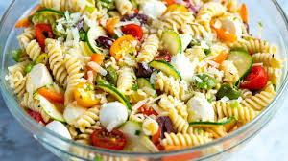
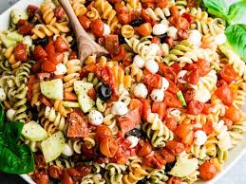
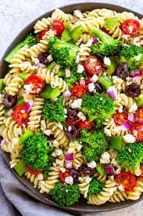
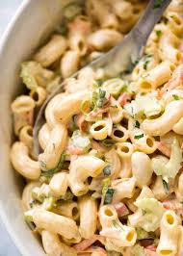
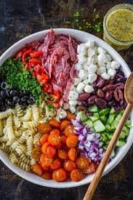
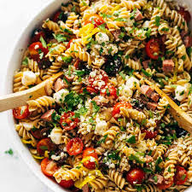
PASTA SALAD
It is important that we eat at least 5 portions of fruit and vegetables a day. We should try to eat a variety of different coloured fruit and vegetables to ensure we get a full range of vitamins and minerals in our diet.
Vitamins and minerals are important to maintain good health.
Design Brief:
You have been asked by a leading food manufacturer to design and make a healthy and attractive pasta salad. The salad should supply a good range of vitamins and minerals.

Slide 25
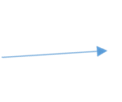
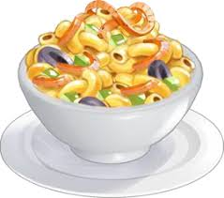
PASTA SALAD DESIGN
Points I will need to consider when choosing a container
Include a suitable pasta shape – it holds the dressing
Include a dressing
Safe to eat
Attractive
Can be eaten
easily
with a fork
Healthy
Colourful – using a range of
Different fruits and vegetables.
Range of textures

Slide 26
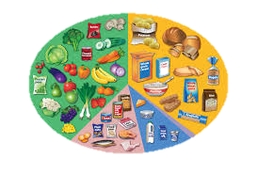
The Eatwell Guide
Carbohydrates Bread, other cereals and potatoes.
This should make up 1/3rd of your days food intake
Fruits and vegetables.
This should make up 1/3rd of your days food intake.
Foods and drinks high in fat and/or sugar.
Eat and drink these foods occasionally and in small amounts
Proteins
Meat, fish and vegetarian alternatives.
2-3 portions a day.
Milk and dairy Foods.
2-3 portions a day.

Slide 27
PASTA SALAD DESIGN
Food Group | Examples
Vegetables | Tomatoes, lettuce, cucumber, spring onions, grated carrot,
Fruit | Fresh or tinned - Pineapple, peach, Dried fruits - raisins
Animal protein – This needs to be cooked and chilled. | Meat: ham , chicken, sausages, bacon, hot dogs Fish: smoked salmon, tinned Tuna/salmon
Vegetable protein | Kidney beans, butter beans, cooked lentils, chick peas, edamame beans Nuts: almonds/walnuts/ pine nuts
Carbohydrates – This needs to be cooked and chilled | Pasta shapes – shells, spirals, tubes
Dressing | Mayonnaise, vinaigrette using oil and vinegar ( red/white wine/balsamic vinegar or lemon juice.

Slide 28
PASTA SALAD
Make your choices - think about colours, flavours and textures that complement each other. What Pasta shape will you use.
Consider what is in your fridge and needs eating up☺
Food Group | Examples
Vegetables
Fruit
Animal protein – cooked and chilled.
Vegetable protein
Carbohydrates – cooked and chilled
Dressing

Slide 29
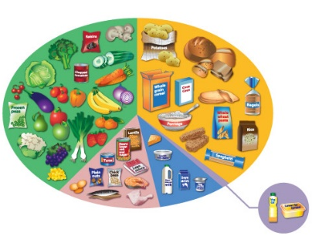
Name of Product
Description of Product
Draw your design idea for the pasta salad above … Make sure that you have annotated how you have included:
Vegetables/Fruit *Dairy or alternatives *Protein (Veg or meat) *Grains / Complex carbohydrates
Label the functions of the ingredients in your salad (Sensory & nutritional)

Slide 30
PASTA SALAD PLANNING
Ingredients Required
Preparation
Equipment Needed
Cooking
Equipment Needed
Serving
Equipment Needed
Success Criteria … what will make my Pasta Salad the best product in the room …
I must demonstrate that …
The product must show …
I will have challenged myself by…

Slide 31
PASTA SALAD PROCESS
PROCESS
Complete this flow chart outlining the main steps to make your design. Include the safety & hygiene.
END

Slide 32
Checklist – Pasta Salad
 | Question | Answers
A | How do you know when the water is hot enough to cook the pasta?
B | Always keep the lid off the saucepan when boiling the pasta. True / False
C | How long do we cook the pasta for?
D | How can we check when the pasta is cooked?
E | Why should we allow the pasta to cool before making the Salad?
F | Why should we use separate chopping boards for vegetables and meat?
G | Give two safety points when using sharp knives | 1. 2.
H | Why should we include a range of different vegetables?
I | What high risk foods could we consider to use in our pasta salads?
K | How and where should we store the Pasta Salad?
L | How would you modify your recipe for Pasta Salad if it was for a Vegetarian?
M | Give 2 examples of dressings that could be put on the pasta Salad? | 1. 2.

Slide 33
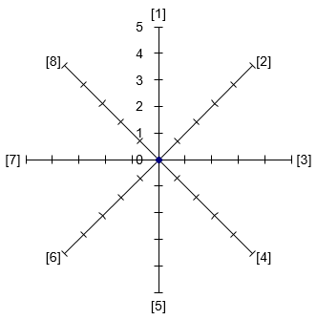
PASTA SALAD EVALUATION
Photo 1: Photo of my design idea
Write the 8 adjectives to describe your ultimate Pasta salad and complete the star chart & evaluation.
What went really well today…
Would have been better if…
Environmental Impact Statement …
Think about sourcing of ingredients, packaging, air miles, carbon foot print, chemicals used …

Slide 34
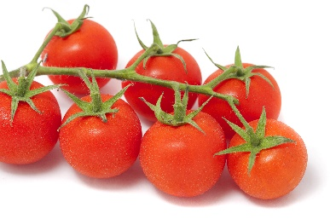
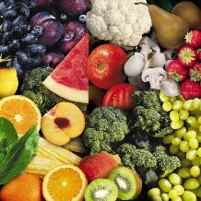
Looking at Fruit and Vegetables
Complete the chart below listing as many different coloured fruits and vegetables that you can think of in the correct columns.
Colour | Fruit | Vegetables
Orange/yellow/white
Red/Purple
Green

Slide 35
Fruit and Vegetables
We should be trying to eat at least 5 portions of a variety of fruits and vegetables every day.
Fruit and vegetables should make up just over a third of what we eat each day.
They can provide fibre, and lots of essential vitamins and minerals.
Eating lots of them may help you maintain a healthy weight – they are naturally low in calories and fat!
Try and choose lots of different coloured fruits and veg – different kinds contain different combinations of
important nutrients our bodies need to stay healthy.
Remember
Unsweetened 100% fruit or veg juice and smoothies, will only count as a maximum of 1 of your 5 A DAY, no matter how much you have!
What counts?
Example portion size
Fresh fruit and vegetables
80g
If you don’t like chopped vegetables, try grating carrots or courgettes into your food to add flavour and texture or make a tomato sauce with added vegetables and blend.
Frozen fruit and vegetables
80g
Canned fruit and vegetables
80g
Dried fruit
30g
100% unsweetened fruit and veg juice
150ml
Smoothies
150ml
Note: Dried fruit can stick to teeth which may lead to tooth decay, so it’s best to keep dried fruit to mealtimes and not between meals.
Menu ideas to increase fruit and veg intake:
Breakfast ideas
Try a new fruit or vegetable each week to increase variety.
Add a chopped banana and strawberries to your morning
wholegrain cereal or porridge.
Enjoy a 150ml glass of unsweetened 100% fruit juice
alongside your breakfast.
Why not pick seasonal fruits and vegetables which are often cheaper and taste the best.
Why eat these foods?
Different fruit and vegetables contain:
Vitamin C - important for maintaining healthy body tissues.
Vitamin A - important for maintenance of normal vision, skin and the immune system.
Folate - important for normal and healthy blood formation.
Fibre – helps to maintain a healthy gut.
Potassium – helps to maintain a healthy blood pressure and is also important for the normal functioning of the nervous system.
Lunch ideas
Sandwiches – add some cucumber, lettuce and tomato Soup – add extra seasonal veg and blend into your soup
Baked potato – with your filling, why not have a side salad
Dinner ideas
You could try adding peas, carrots or spring onions
through your mashed potatoes;
or, sprinkle some extra veg onto your pizza like sweetcorn, pineapple, pepper and/or mushrooms!
This resource is designed for consumers who want to find out more about healthy eating. Last reviewed October 2016. Next review due October 2019.

Slide 37
Using Fruit and Vegetables – Checklist. Write your answers in the space below.
Question | Question | Answer
1 | The Government are encouraging us to eat more fruit and vegetables a day. How many portions a day do they recommend?
2 | Can we include a glass of fruit juice as one of our portions?
3 | True or False? We can include portions of dried, frozen and canned fruit and vegetables as well as fresh.
4 | Why should we eat a ‘rainbow’ of fruit and vegetables?
5 | True or False? Potatoes can be included as one of our portions.
6 | Name a fruit and a vegetable beginning with the letter: A | A
7 | Name a fruit and a vegetable beginning with the letter: B | B
8 | Name a fruit and a vegetable beginning with the letter: C | C
9 | Eating too many snacks and junk foods may lead to health related diseases. Name 2 common diseases | 1. 2.
10 | Snack foods are often high in sugar, salt and fat. Suggest alternative snacks using fruit and vegetables. | 1. 2. 3.

Slide 38
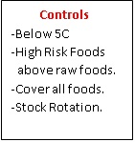
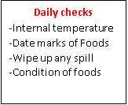
HOMEWORK TASK – Storing Food
 | Question | Answer
1 | What temperature should your fridge be?
2 | Name five high risk foods | 1. 2. 3. 4. 5.
3 | Where should high risk foods be stored in your fridge? | 1. 2.
4 | Name two raw foods that should be stored at the bottom of the fridge? | 1. 2.
5 | Name two raw foods that should be stored at the bottom of the fridge? | 1. 2.
6. | Suggests two hazards that could occur in your fridge? | 1. 2.
7. | Why should you cover all foods when storing them in the fridge?
8 | Suggest two checks you could make to ensure the food in your fridge is safe to eat.
9 | Why are ‘date marks’ on food important?
10 | Why should we store cooked foods above raw foods in the fridge?

Slide 40
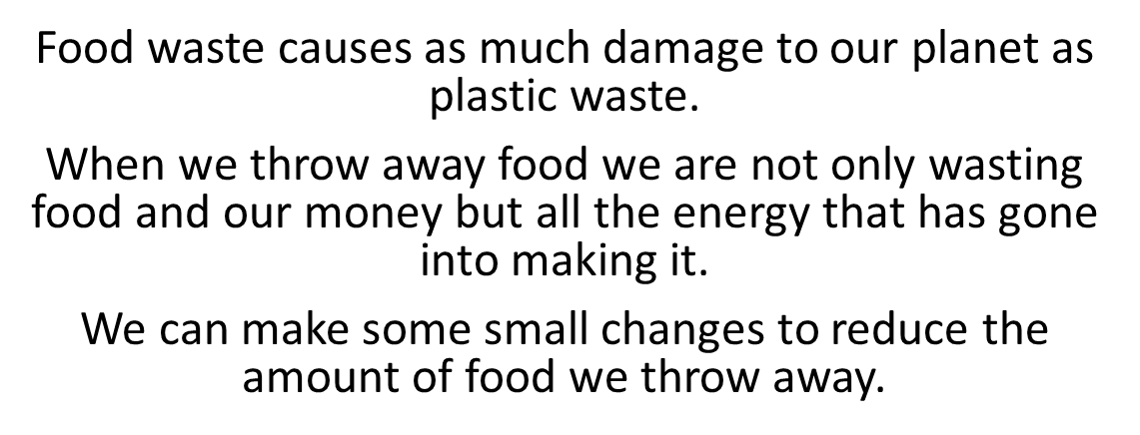
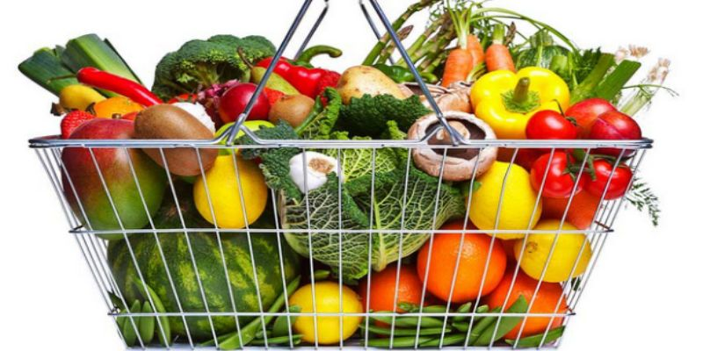
Love Food. Hate Waste.
In England we throw away 7.1m tonnes of food every year from our homes.
A tonne of waste is the weight of a small car!

Slide 41
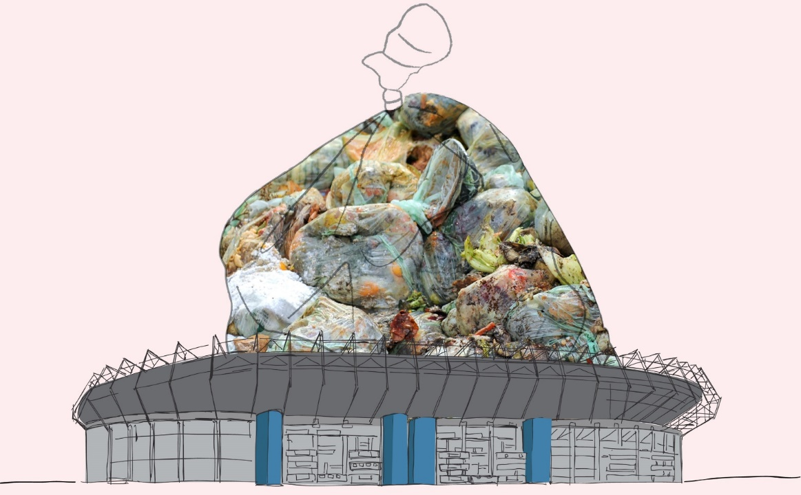
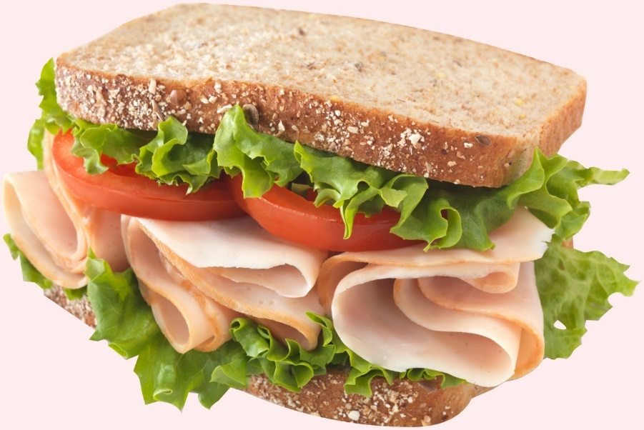
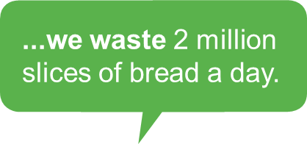
This is enough to fill up Wembley stadium 48 times over.
...more than half of this is food that could have been eaten.
We bin 2 million slices of ham a day.
Notes:
More than half’ refers to the avoidable food waste as opposed to unavoidable food waste.

Slide 42
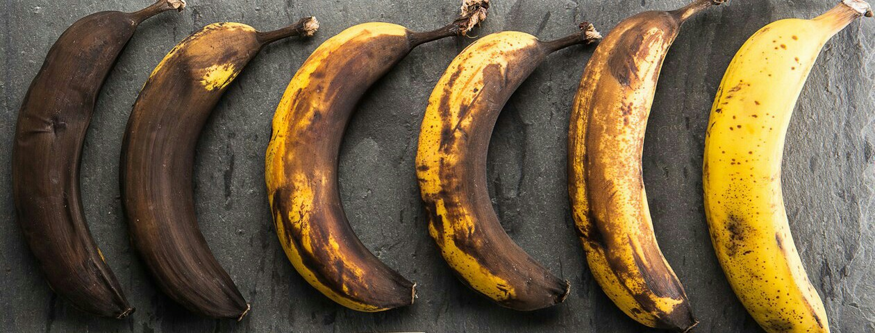
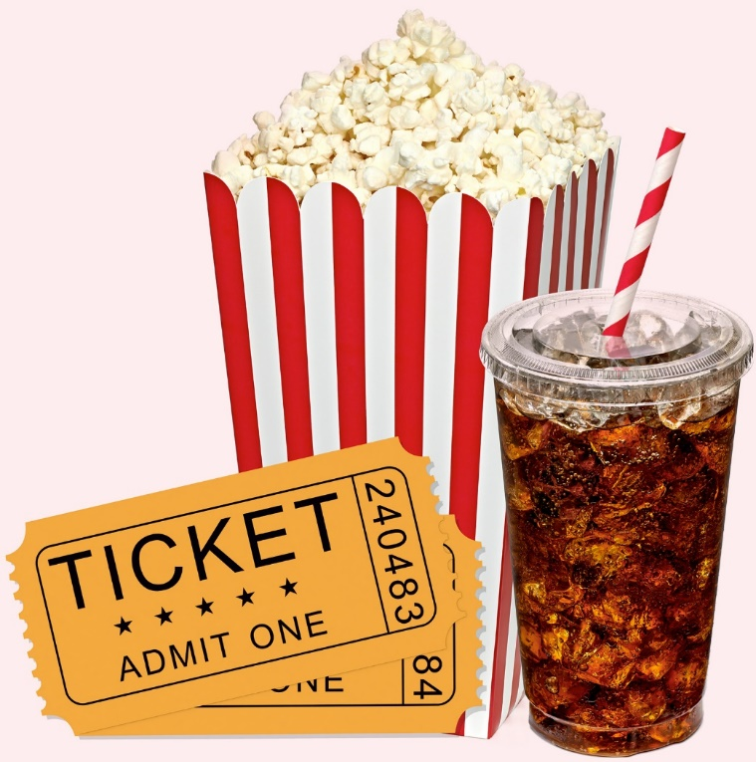
We waste 0.9 million bananas a day.
... That’s a lot of Banana bread that could have been made☺
...enough for 46 trips to the cinema!
The average household of could save around £ 460 year...
Shocking!

Slide 43
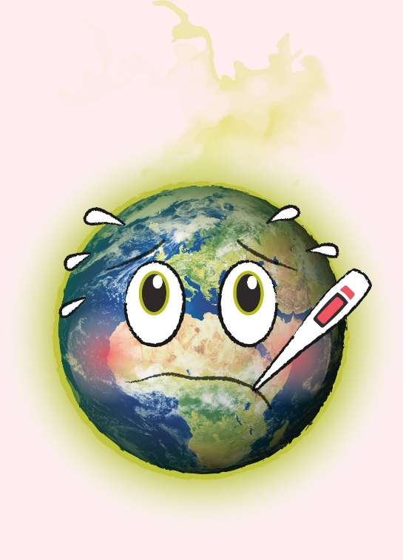
...or a family of 4 we could save around £800 a year.
What would you buy with £800?
Wasted food also lets off harmful gases in landfill...
When we waste food we waste all the energy and natural resources that go into producing it…
...this is bad for our environment

Slide 44
If we saved all the avoidable food waste from the bin in England..
...it would have the same positive environmental impact as taking approximately 1 in 4 cars off the road
Notes:
This refers to CO2 emissions generated by wasting the food in landfill and all the effort that is required to grow and transport food.

Slide 45
Design a poster that will encourage households to reduce food waste and help save the planet

