Slide 1
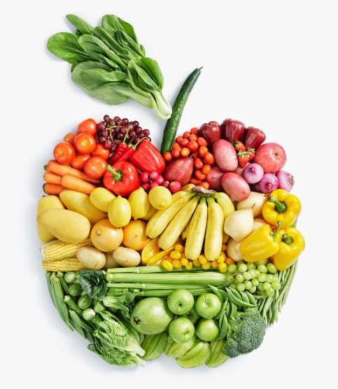
Food Technology
Year 8
Name:
Pathway:
Class:
Recipe Book

Slide 2
Recipe Index
Recipe | Date
Chocolate muffins
Bread Rolls
Pizza
Pasta salad
Roasted vegetables
Bolognese sauce
Banana Bread
Apple tartlets
Victoria Sandwich cake
Pre-practical check list
Place bags in locker areas.
Place planner, recipe booklet and pencil case on your desk.
Take jumper off and put apron on.
Tie hair back.
Roll up sleeves and wash hands
Place ingredients on plastic trays on your work area.
Collect equipment.
Put ALL carrier bags away and stools under the table.
Food Room Rules
Do not run in the food room.
Always carry knives safely with the blade pointed downwards.
Any cuts must be covered with a blue plaster.

Slide 3
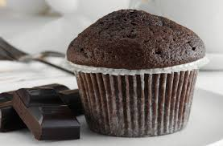
Chocolate Muffins
Ingredients
6 paper Muffin cases
125g Self raising flour, ½ tsp bicarbonate of soda
75g Chocolate chips, 50g Caster Sugar
1 Egg
75 mls. Yogurt - any flavour.
50g Butter or margarine
Method
Heat oven 180 C / Gas 6. Place muffin cases in the muffin tin.
Sift the flour with the bicarbonate of soda ( measure this accurately) in a large bowl. Stir in the chocolate chips and sugar.
Beat eggs in a jug. Melt the butter.
Add the beaten eggs, melted butter and yogurt to dry ingredients.
Stir to combine all ingredients. The mixture SHOULD LOOK LUMPY. Do not overmix this would make your muffins tough.
Fill the paper cases evenly and bake for 20-25 mins until risen and golden brown. Transfer to rack to cool.
Notes:
Click on picture to watch ‘how to make’ video.

Slide 4
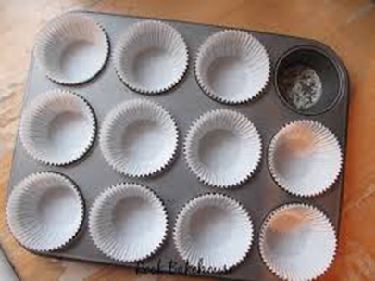
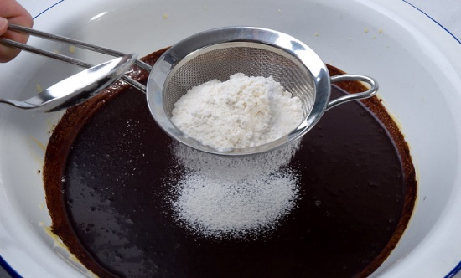
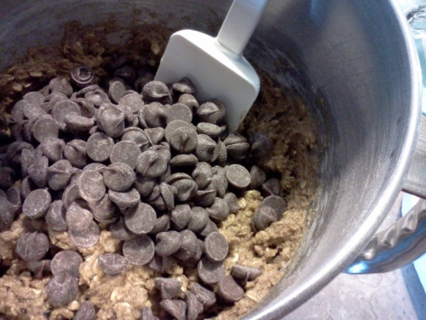
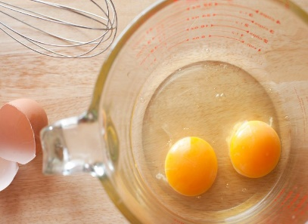
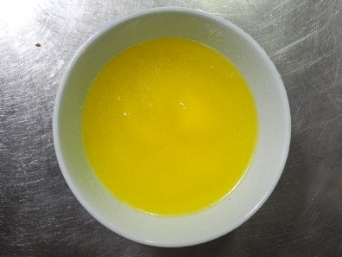
Chocolate muffins
Preheat oven to 180˚ C/gas 6. Place muffin cases in tin. | 2. Sift flour and bicarbonate of soda into the bowl.
3. Stir in chocolate chips and sugar. | 4. Beat eggs in jug. Melt the butter in the microwave.

Slide 5
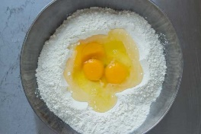
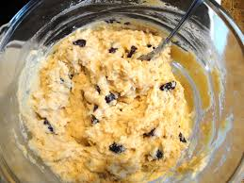
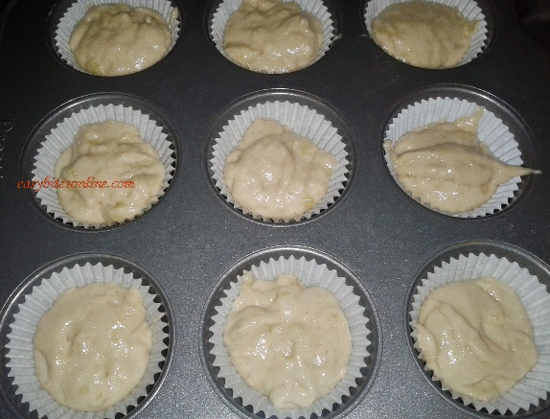
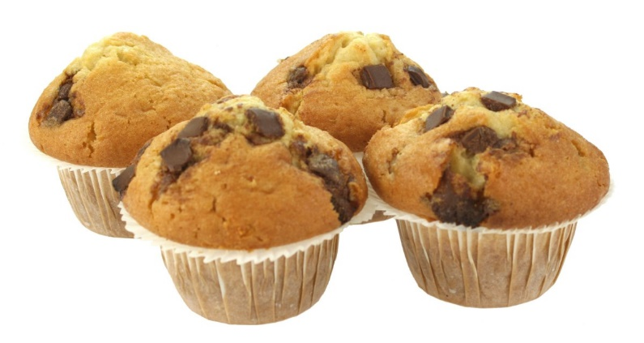
Chocolate muffins
5. Add the beaten eggs, melted butter and yogurt to dry ingredients. | 6. Stir to combine all ingredients. The mixture SHOULD LOOK LUMPY. Do not overmix.
7. Fill the paper cases evenly and bake for 20 -25 minutes until the risen and golden brown. | 8. When cooked, transfer to a wire rack to cool.

Slide 6
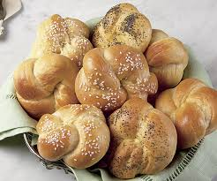
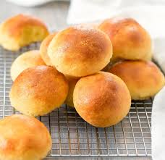
Bread Rolls
Ingredients
225g strong bread flour
1 tsp salt
1 packet (7g) fast action dried yeast
150 mls (approx.) warm water, cling film to cover
Optional: dust with extra flour, oats, poppy seeds or glaze with beaten egg
Method
1. Set oven to 220˚C/gas 8. Grease baking tray
2. Mix the bread flour, add salt and the packet of dried yeast to mixing bowl.
3. Collect 150mls warm water and add to the above ingredients. Mix with a round bladed knife until dough comes together.
4. Place on a floured surface and knead the dough for 10 minutes until smooth and stretchy.
5. Divide the dough into 6 even sized pieces. Shape appropriately. Place on baking tray.
6. Cover loosely with cling film and place in a warm place until the rolls have doubled in size. ( 10 minutes ).
7. Remove the cling film. Glaze with beaten egg or milk and add finishes.
8. Place in the oven and cook for 10-12 mins until the base sounds hollow when tapped and rolls are golden brown.
Notes:
Click on both pictures to watch videos – bigger picture is making the dough, smaller picture is shaping the dough into rolls.

Slide 7
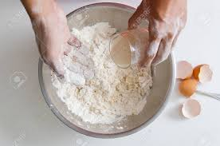
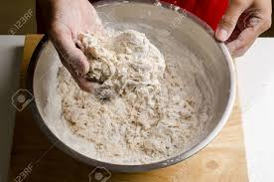
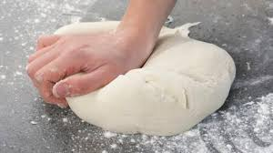
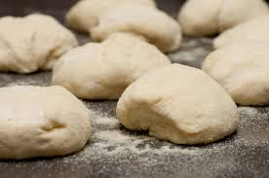
Bread rolls
1. Preheat oven to 220˚C/ gas 8. Grease or line the baking tray. Mix flour, salt & yeast in mixing bowl. | 2. Add approx. 150mls warm water to dry ingredients. Mix with a round-bladed knife until dough comes together.
3. Knead on a floured worktop for 10 minutes until smooth & stretchy. | 4. Divide into 6 pieces and shape.

Slide 8
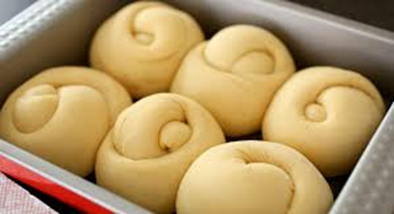
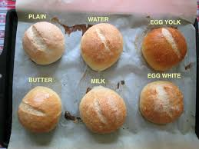
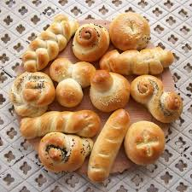
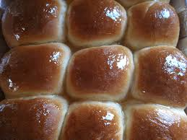
Bread rolls
5. Loosely cover with cling film or a damp tea towel, and leave to prove until they have doubled in size. | 6. Remove cling film and glaze with a beaten egg, or milk and add toppings if using.
7. Bake for 10-12 minutes until golden brown and sound hollow when tapped on the bottom. | 8. Remove from tray and place on cooling rack.

Slide 9
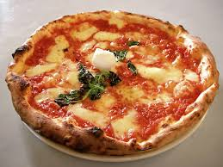
Pizza
Ingredients
150g Strong bread flour
½ teaspoon salt
½ packet fast action dried yeast
Approx. 120ml warm water
Toppings: 4 tbsp. pizza sauce, 1 ball Mozzarella, 150g grated cheese, ham, peppers,
Pepperoni, cooked bacon etc.
Method
1. Set oven to 220˚C/gas 8. Grease baking tray.
2. Put flour, yeast and salt in mixing bowl and mix in approx. 120 mls. warm water.
3. Place on a floured surface and knead for 10 mins. until smooth and stretchy. Place in a bowl and cover with Clingfilm and leave until doubled in size (at least 10 mins).
4. Prepare toppings. Knead dough until smooth. Press or roll out into a circle on the baking tray.
5. Use the back of a spoon to spread the pizza sauce onto the base.
6. Add the toppings – cheese goes on last.
7. Place in oven and cook for 15-20 minutes until the cheese is golden and bubbling.
Notes:
Click on picture for ‘how to make’ video 6.35 minutes

Slide 10
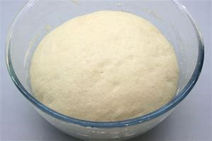
Pizza
1. Preheat oven to 220˚C/ gas 8. Grease or line the baking tray. Mix flour, salt & yeast in mixing bowl. | 2. Add approx. 120mls warm water to dry ingredients. Mix with a round-bladed knife until dough comes together.
3. Knead on a floured worktop for 10 minutes until smooth & stretchy. | 4. Place in a bowl and cover with cling film, and leave until doubled in size.

Slide 11
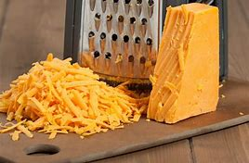
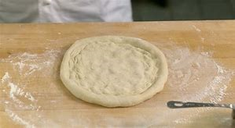
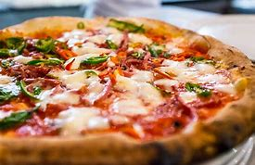
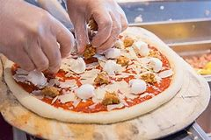
Pizza
5. Prepare toppings. | 6. Remove cling film. Knock back the dough and shape into a circle. Place onto baking tray.
7. Place tomato sauce onto pizza base and add other toppings. Cheese goes on last. | 8. Bake for 10 – 15 minutes until base is cooked and cheese is golden and bubbly.

Slide 12
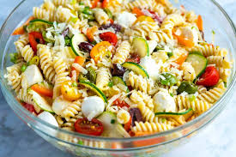
Pasta salad
Ingredients
150g/6oz dried pasta
4cm cucumber, 10 cherry tomatoes
1 red/green/yellow pepper, 2 spring onions / 1 red onion
Optional – green beans, mange tout, cooked chicken, ham, fish.
For the dressing :-4 tablespoons mayonnaise; 4 tablespoons milk; salt, black pepper; 4 fresh chives
Method
1. Fill a large saucepan with water and put onto boil.
2. If using fresh beans, cut in half.
3. Add pasta to the pan and cook for 10 – 12 minutes.
4. Prepare all of your vegetables. In a small bowl mix together the mayonnaise and the milk.
5. Five minutes before the pasta is ready, add the green beans.
6. When cooked, drain the pasta and beans – cool.
7. Add the vegetables to the pasta. Stir in the dressing and the chopped chives.
8. Add any meat, fish etc.

Slide 13
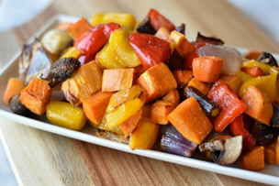
Roasted Vegetables
Ingredients
1 courgette
1 pepper ( any colour)
200g Cherry Tomatoes
1 Onion ( red or white), other vegetables you could use are: aubergine, sweet potato, Broccoli, butternut squash etc.
1 garlic clove
2 tbsp. oil, fresh or dried herbs (thyme, basil, parsley)
Method
Pre heat oven – Electric 180 C / Gas 6
Prepare all vegetable. Cut into bite sized pieces.
Place on a baking tray with the thyme, oil and salt and pepper. Mix ingredients together until all vegetables are covered in oil.
Place in a hot oven for 30 minutes, turning the vegetables after about 15 minutes. Cook until tender and starting to go brown.
Pre heat oven – Electric 180 C / Gas 6
Prepare all vegetable. Cut into bite sized pieces.
Place on a baking tray with the thyme, oil and salt and pepper. Mix ingredients together until all vegetables are covered in oil.
Notes:
Click on video for Jamie Oliver video 3.24

Slide 14
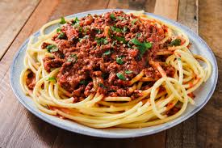
Bolognese sauce
Ingredients
450g minced beef
1 tin (400g) chopped tomatoes, 1 clove garlic
1 onion, 1 carrot (you could also add peppers, mushrooms, celery)
2 tbsp. tomato purée
1 beef stock cube, 1 bay leaf
1 tsp. mixed herbs (fresh or dried) preferably basil
Method
1. Prepare the vegetables – dice the onion, carrot & celery. Slice or crush the garlic.
2. Heat oil in a saucepan over a medium heat. Add the vegetables and cook for 5 mins.
3. Add the meat and break up with a wooden spoon. Cook until meat turns brown.
4. Dissolve the stock cube in 300ml boiling water and add to the meat.
5. Add the purée, herbs and bay leaf and stir well.
6. Bring the mixture to the boil and then reduce the heat and let the sauce simmer for 20-30 minutes. Leave the lid on the pan at an angle to allow the sauce to reduce and thicken.
7. When the vegetables are soft, the sauce is ready. Serve with pasta.

Slide 15
Banana Bread
Ingredients
135g soft light brown sugar
2 eggs
100g bananas, mashed (the older, the better!)
140g plain flour
½ tsp baking powder + ½ tsp Bicarbonate of soda + ½ tsp each ginger and cinnamon
120g butter/margarine, melted
Method
Preheat oven to 170°/gas 4. Line a 1lb loaf tin.
In a mixing bowl, beat the eggs and sugar together. Beat in bananas.
Add the flour, Bicarbonate of soda, baking powder and spices.
Mix thoroughly until all the ingredients are entirely incorporated.
Pour in the melted butter and mix well.
Pour into the tin and bake for 20 – 30 minutes or until firm to touch and a skewer inserted comes out clean.
Leave cake to cool slightly in the tin before turning out
8. Slice and serve with a cup of tea!

Slide 16
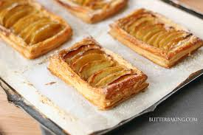

Slide 17
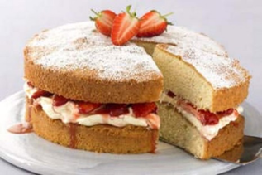
Victoria Sandwich Cake
Ingredients
125g Self raising flour
125g Caster sugar
125g Butter or margarine
2 eggs
3 – 4 tbsp. jam for filling and 1 tbsp. icing for dusting over the top
Method
1. Set oven to 180°C/gas 4. Grease and line 2 16 cm round cake tins.
2. Cream together the sugar and butter with a wooden spoon until light and fluffy.
3. Beat the eggs into the mixture, one at a time. Beat well in between.
4.Sieve the flour into your mixture and then fold in using a metal spoon.
5. Divide the mixture between the two cake tins and carefully spread the mixture out.
6. Bake for 20 minutes until golden brown and well risen. Use the skewer test to check.
7. Turn the cakes out of the tins and leave to cool.
8. Spread jam onto one side and then sandwich together.
9. Sieve icing sugar over the top of the top sponge.

