Slide 1
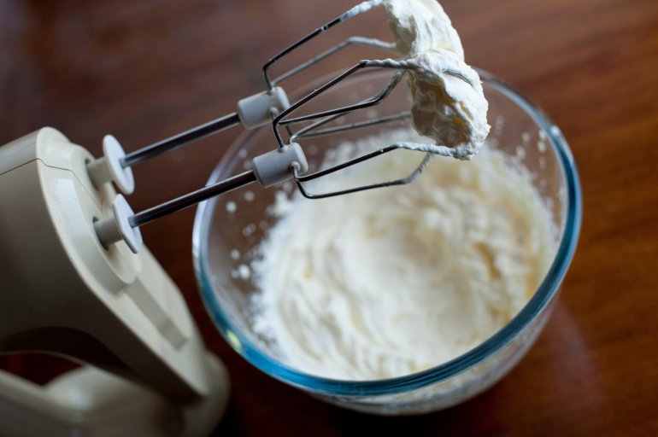
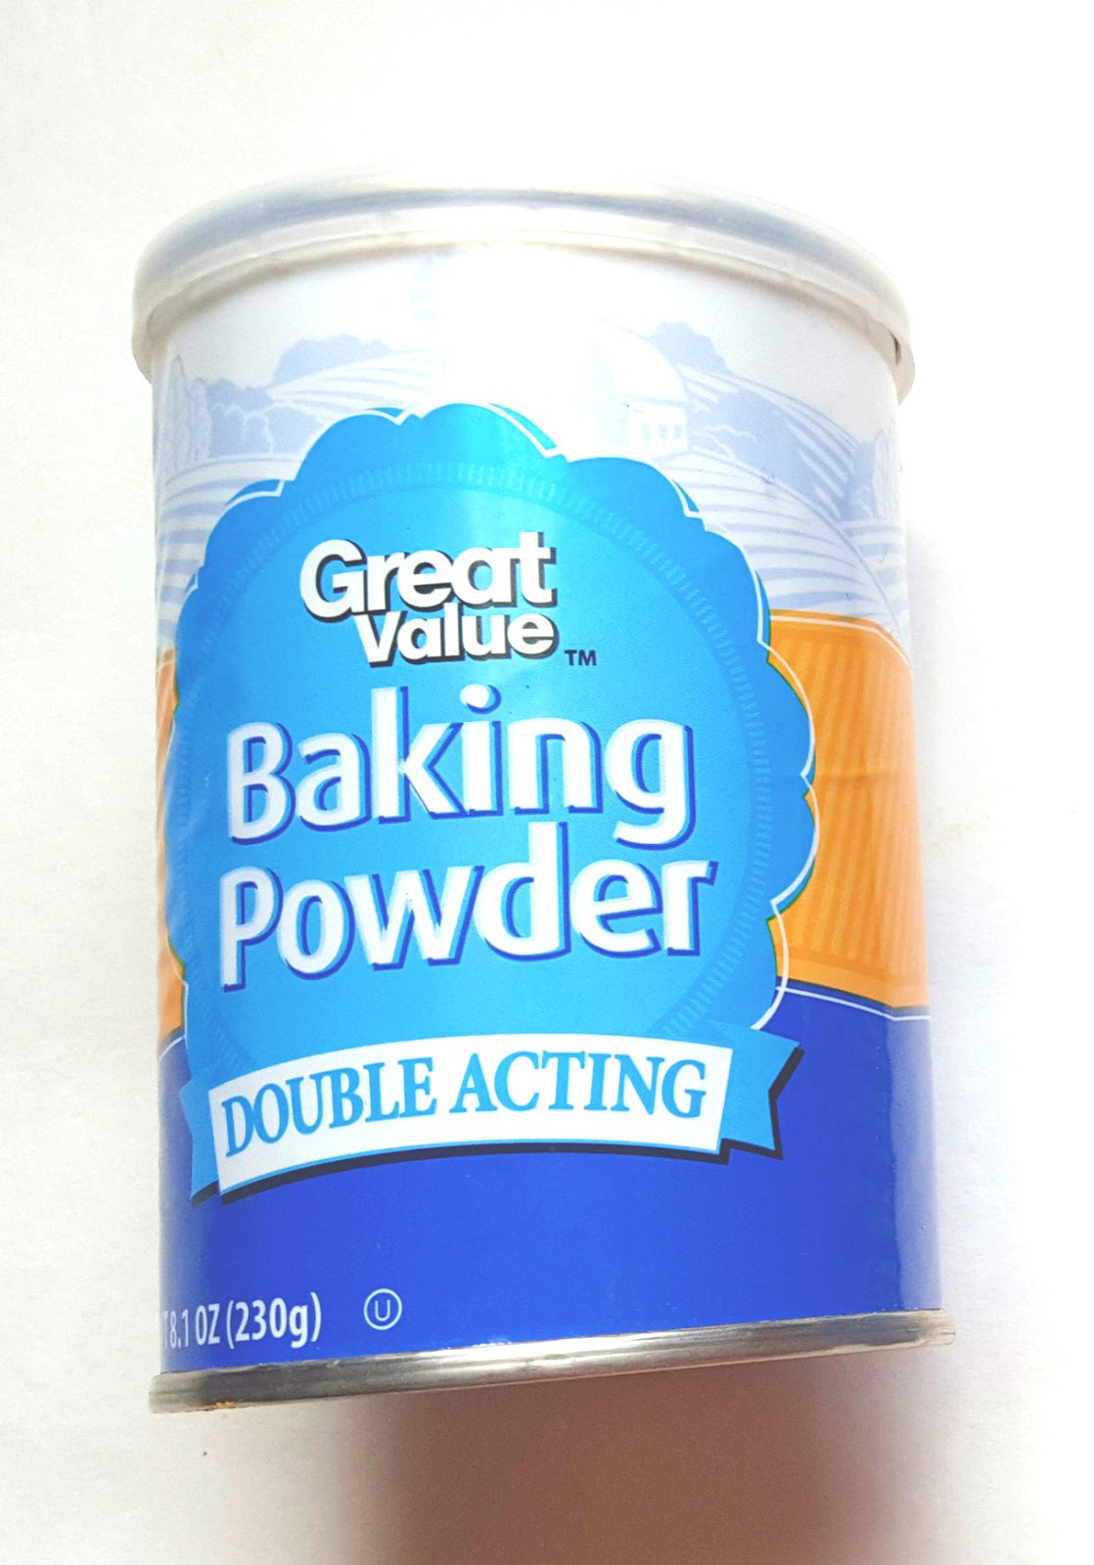
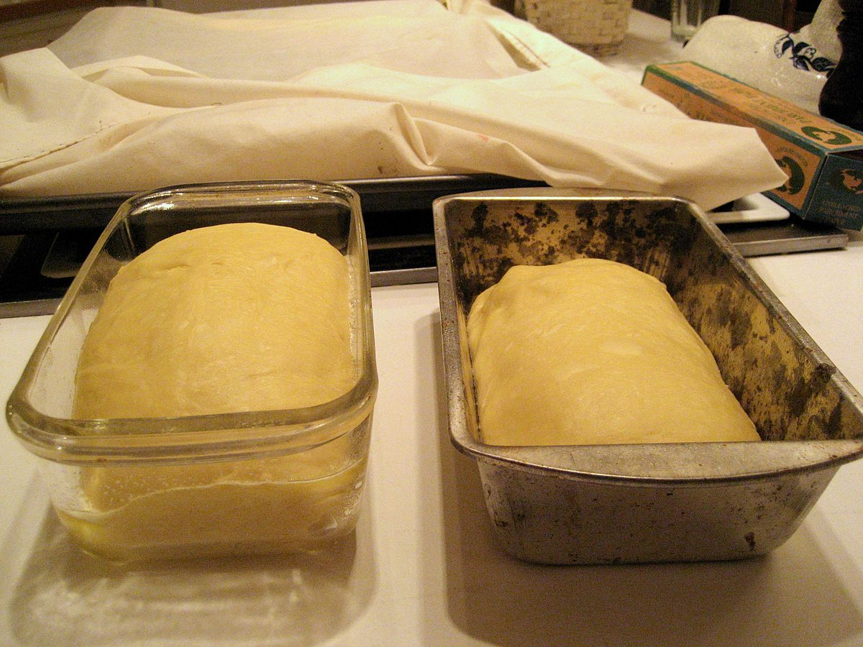
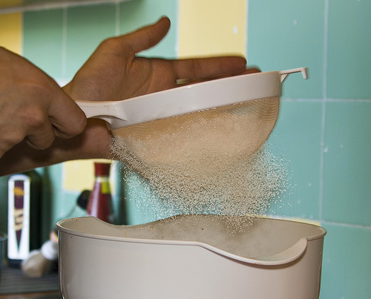
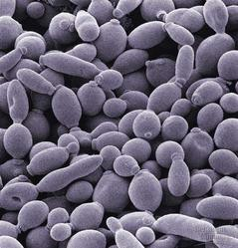
The Science of Cooking Food - Raising agents
LO’s
Why raising agents are used in baking and how they work
The different types of raising agents
What happens if too much raising agent is used
Raising Agents
Mechanical
Something we ‘do’ – creaming, whisking, sieving, kneading etc.
Chemical
Something we ‘add’ – bicarbonate of soda, baking powder
Biological
Something we ‘add’ – yeast, used in bread products and the making of alcoholic drinks
Notes:
Video 5.34 mins

Slide 2
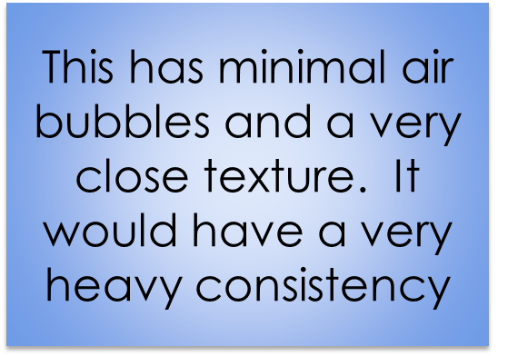
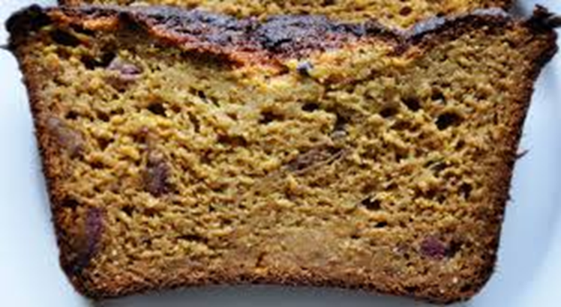
Why are raising agents added into food?
A cake which is cooked without using a raising agent will be moist, stodgy and heavy inside as the mixture has not produced air bubbles to help lift it properly.

Slide 3
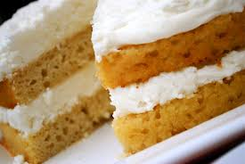
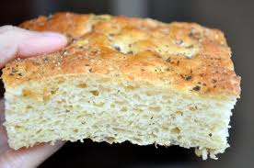
A successful raising agent:
A successful product should have a light texture and the product should have volume.
It should be light and well risen
It should have clear air bubbles

Slide 4
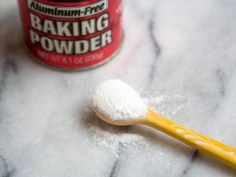
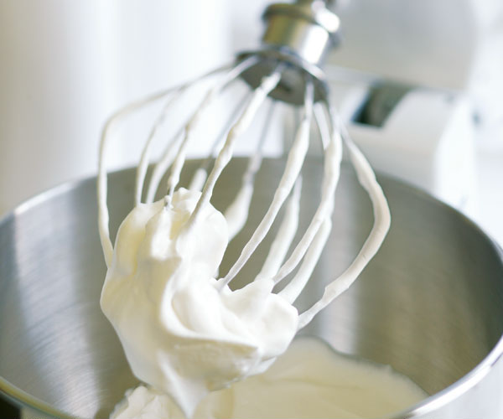
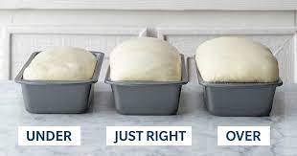
The 3 common raising agents.
Air – mechanical/physical
2. Carbon dioxide - chemical
3. Yeast – Biological

Slide 5
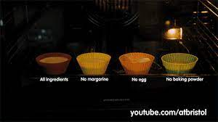
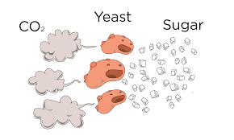
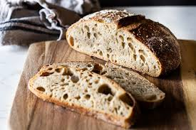
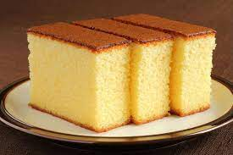
How do raising agents work?
The action of moisture, heat or acidity (or all 3) triggers a reaction with the specific raising agent to produce gas.
Gas expands when heated.
Gas becomes trapped as it bubbles through the mixture.
When heated the bubbles form a firm structure containing tiny holes left by the expanded gas.
This gives products like cake a sponge like texture.

Slide 6
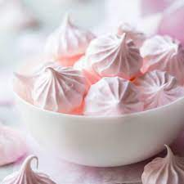
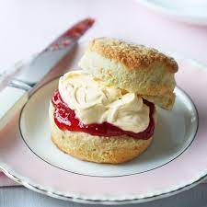
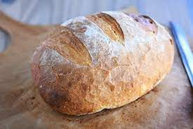
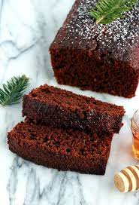
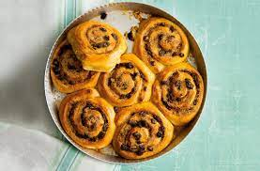
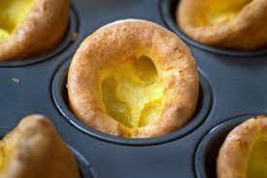
Which raising agent?
Biological – yeast – causes fermentation
Air – whisked in.
Steam – causes gases to expand
Chemical – baking powder and/or bicarbonate of soda.

Slide 7
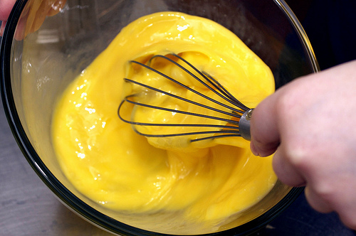
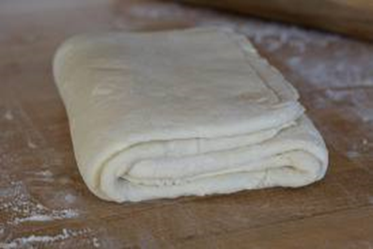
Physical/mechanical - Air
There are 6 mechanical methods.
Incorporated in mechanical ways (e.g. using something else to help the process).
Sieving flour
Creaming fat and sugar
Rubbing fat into flour
Whisking
Beating
Folding/rolling

Slide 8
Chemical raising…...
Carbon dioxide is created when we make cakes. It comes from the self raising flour or baking powder that is used.
The carbon dioxide released makes cakes lighter and fluffier by creating bubbles within the mixture as it cooks.
Self raising flour is a plain flour which has a standard strength raising agent added to it.

Slide 9
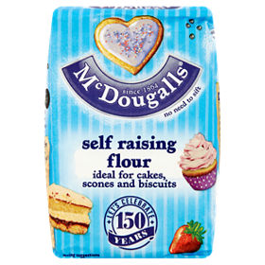
Self raising flour
• A standard strength raising agent
• Good for sponge cakes
• Not suitable for
Scones
Rich fruit cakes
Bread
Pastries and
Biscuits.

Slide 10
Baking Powder
Baking powder contains sodium bicarbonate (alkali) combined with cream of tartar (acid).
The cream of tartar neutralizes the alkaline taste of the bicarbonate of soda.
Starch e.g. rice flour, may be added to absorb any moisture from the atmosphere.
Baking Powder + moisture + heat = C02

Slide 11
Bicarbonate of soda
Sodium bicarbonate and bicarbonate of soda are the same thing!
It is an alkali.
Is sometimes used by itself as the raising agent but has an unpleasant soda taste and causes yellow discoloration.
It is only used in strong flavoured mixtures such as Gingerbread cake.

Slide 12
What are yeasts?
Yeasts are single celled micro-organisms. They are found in the air and on the skin of fruits. Yeasts grow only on sugary foods.
What are micro-organisms?
Micro-organisms
Very small
Living things

Slide 13
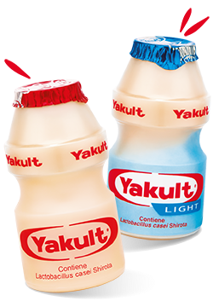
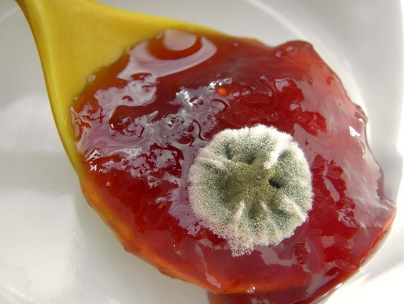
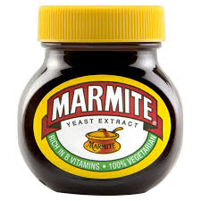
Foods such as fruits, jams, and fruit yoghurts may be fermented by yeasts and become unfit to eat.
Some yeasts are harmless and are used to make bread, alcohol, drinks and savoury spreads.

Slide 14
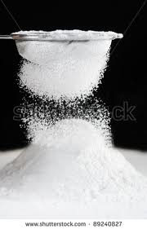
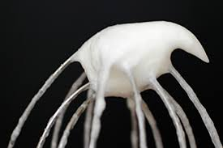
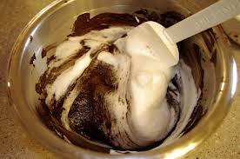
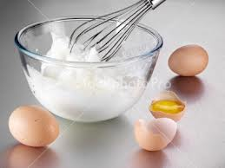
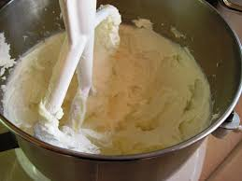
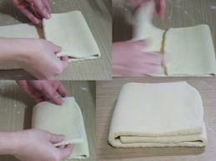
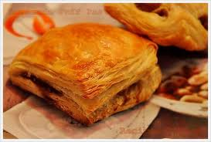
How are raising agents added into foods?
Mechanical | Manually adding air into food products using different techniques | The processes of sieving, whisking, folding, rolling, creaming all mechanically add in air during food production

Slide 15
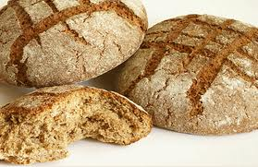
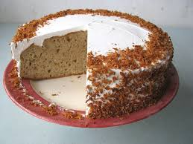
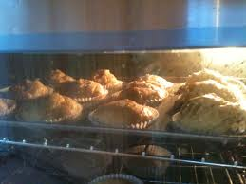
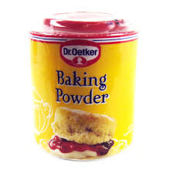
How are raising agents added into foods?
Chemical | Adding a chemical which causes a chemical reaction producing CO2 gas. In an oven the CO2 gas expands and pushes up the mixture. Some of the gas escapes but some is trapped in the mixture as it cooks and sets | Examples in food production include baking powder and bicarbonate of soda. Bicarbonate of soda is used to make soda bread, the bread which does not use yeast as the raising agent. Bicarbonate of soda + cream of tartar = baking powder

Slide 16
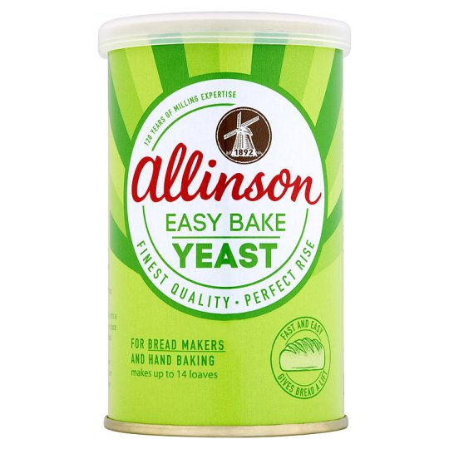
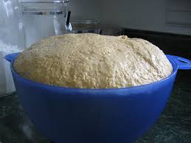
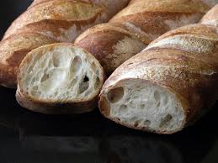
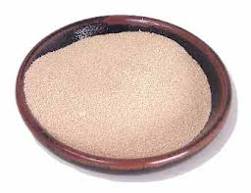
How are raising agents added into foods?
Biological | A biological raising agent is added which produces CO2 gas. | The Fermentation process is activated during bread production when yeast is combined with sugar in a warm moist condition. When the fermented yeast is added to the flour and warm liquid it increases in size during the “proving” stage. Example: Bread

