Slide 1
Year 8 : Freaky Creepy
Lesson 1
Draw an insect of your choice. Find an image to draw from on the internet, use any media that you have available to you , try to fill an A4 page with your drawing.
Lesson 2
Draw the OUTLINE of an insect of your choice. Fill the shape with intricate, detailed patterns in colour or black & white ( the next slide has an example of how I would like you to do this).
Lesson 3 & 4
Create a collage of an insect using any materials that you have available to you. You could use magazines, any paper surfaces, fabric
Use A3 paper, look at the examples for ideas

Slide 2
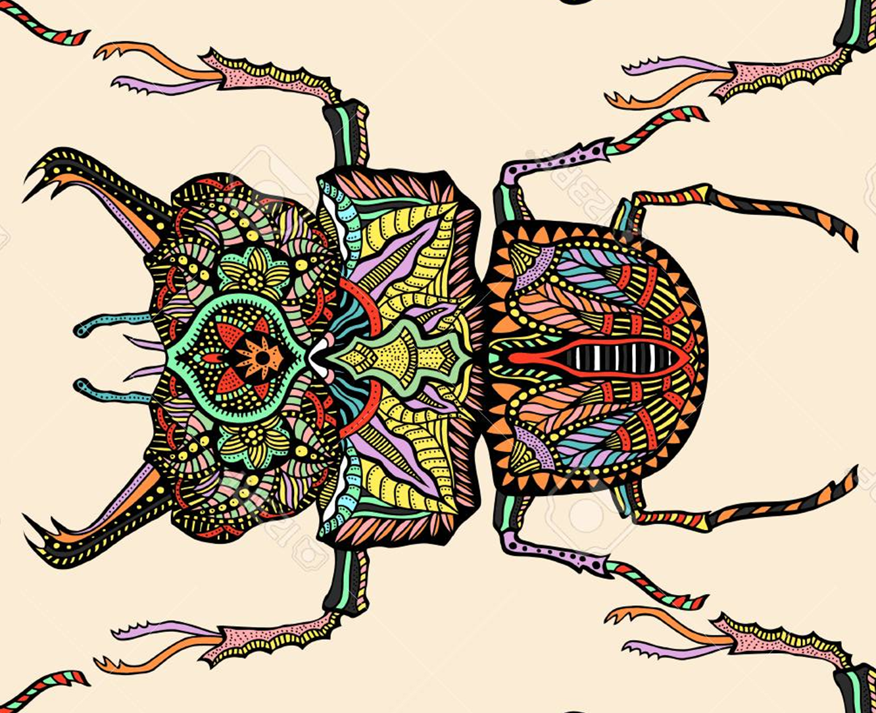

Slide 3
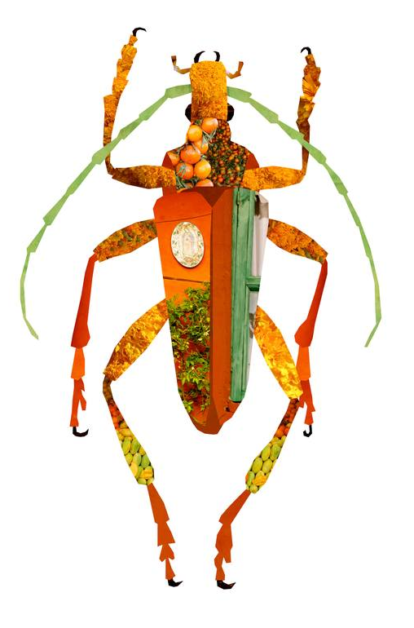
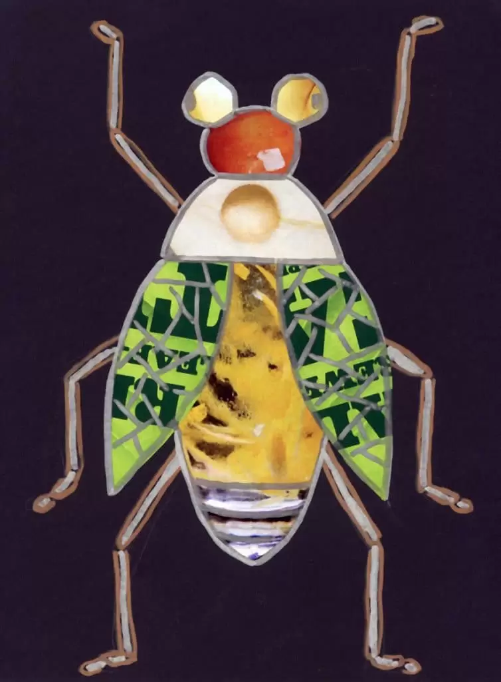
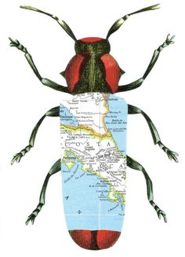

Slide 4
