Slide 1
Japan
Cultural food project
By Eva Shipley

Slide 2
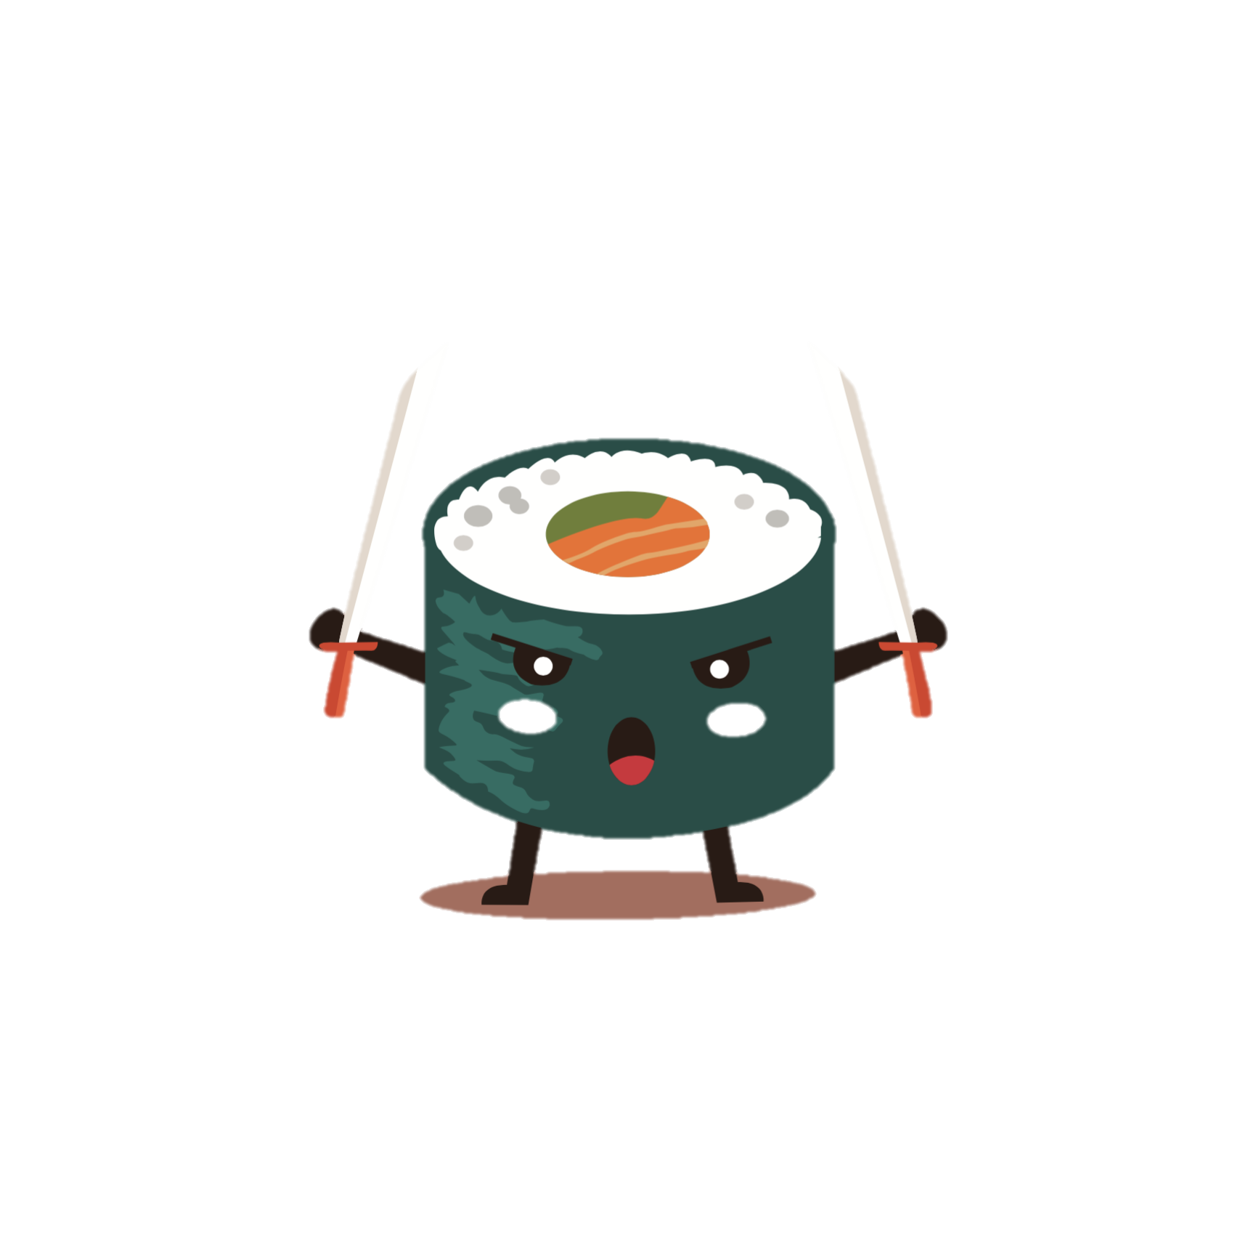
Contents page
Language
Where is japan
Japanese cities
Staple foods
Popular dishes
My chosen dishes

Slide 3
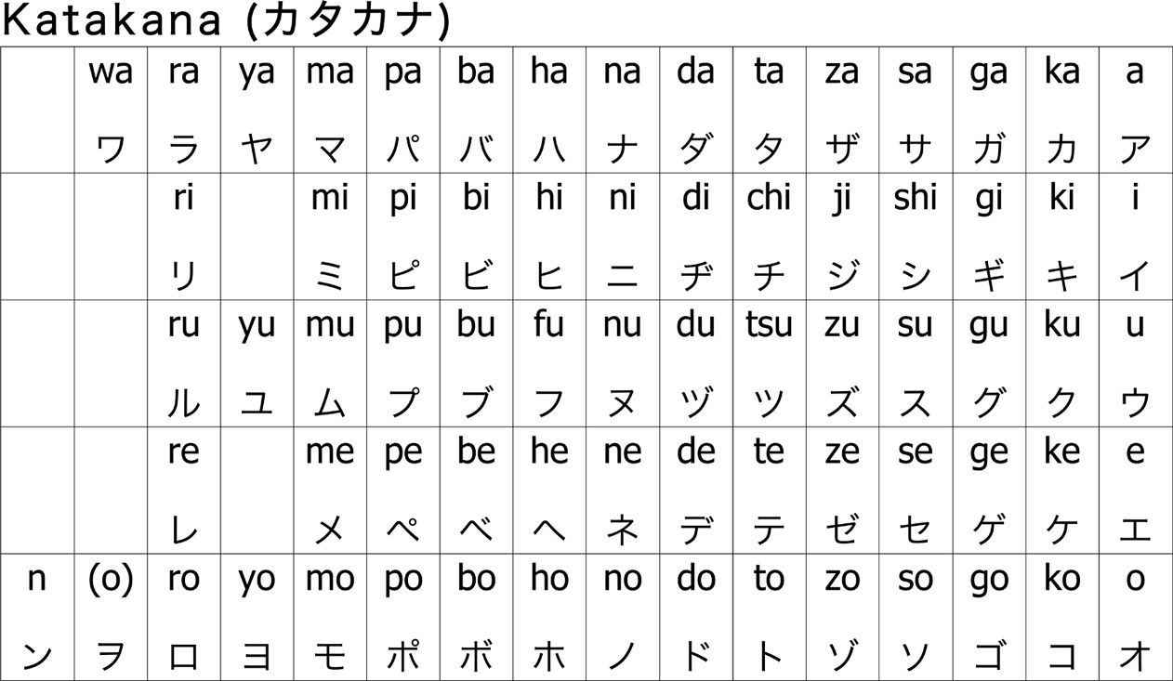
language
Each symbol is a sound of 2 letters
In japan they speak Japanese although they have dialects for different places within japan.
They have a symbol for an idea instead of having a symbol per letter like we have in England.

Slide 4
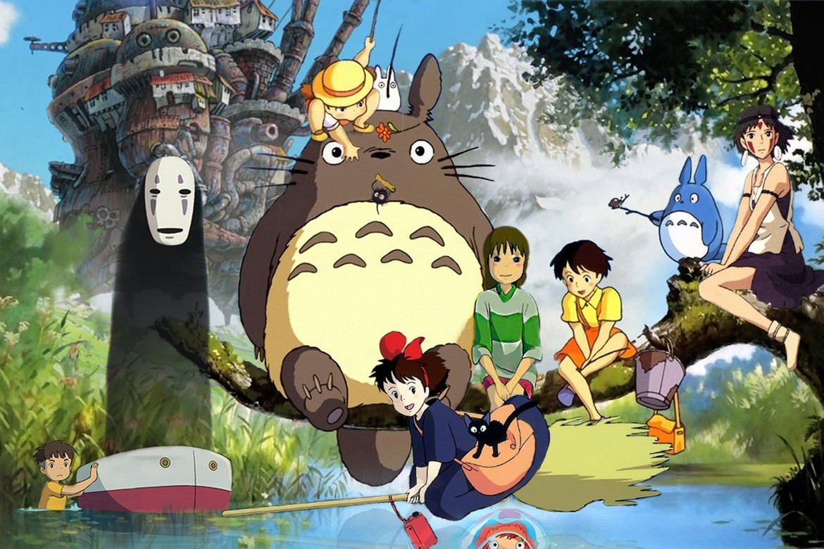
Where is Japan?
Japan has a population of 126.5 million people!
Japan is on the east of Asia.
Hayao miyazaki founded studio Ghibli it’s a big anime company it is like the Disney of japan!

Slide 5
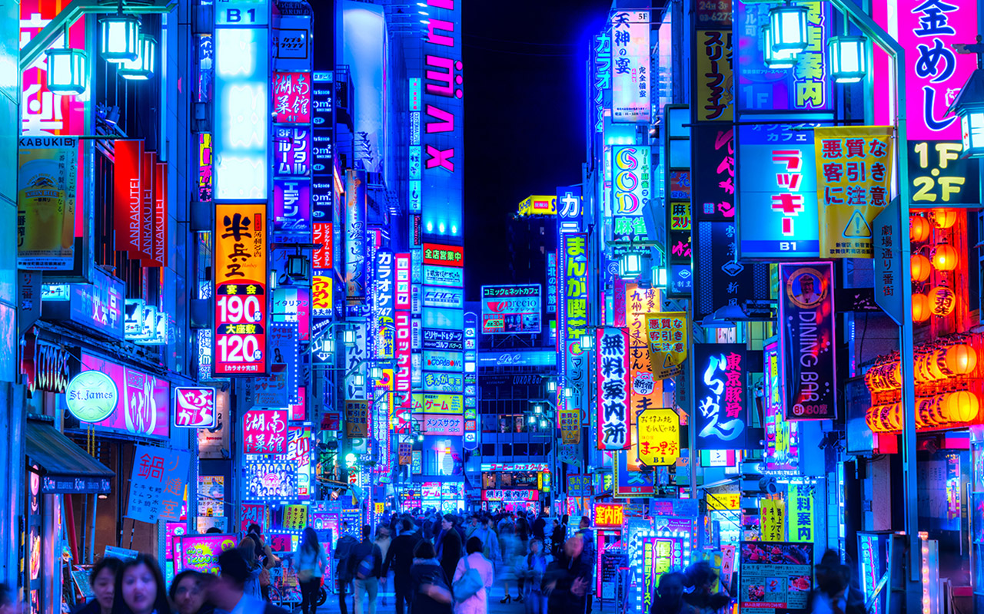
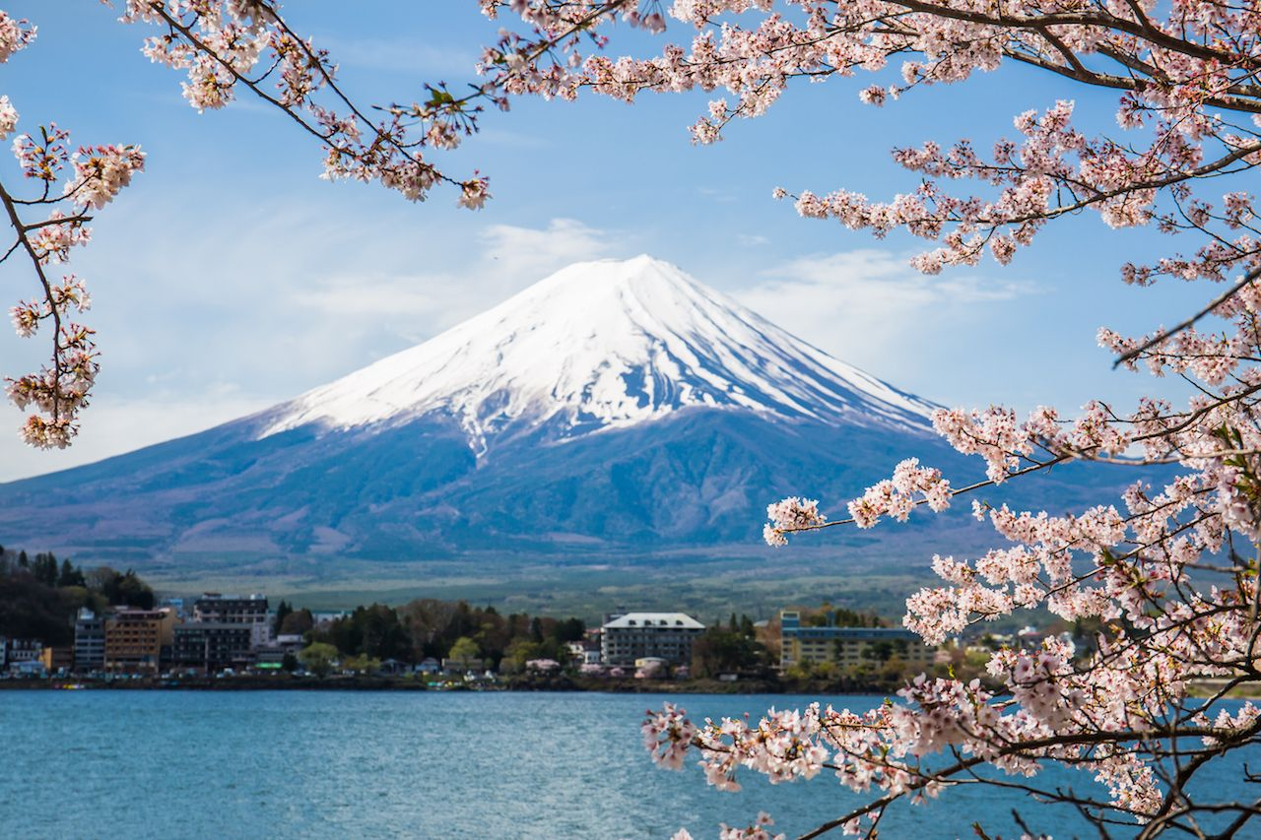
Japanese cities
Tokyo
Is Japans
Capital city and is home to many of the population
Mount Fuji is the biggest mountain in japan it is a very popular tourist spot.

Slide 6
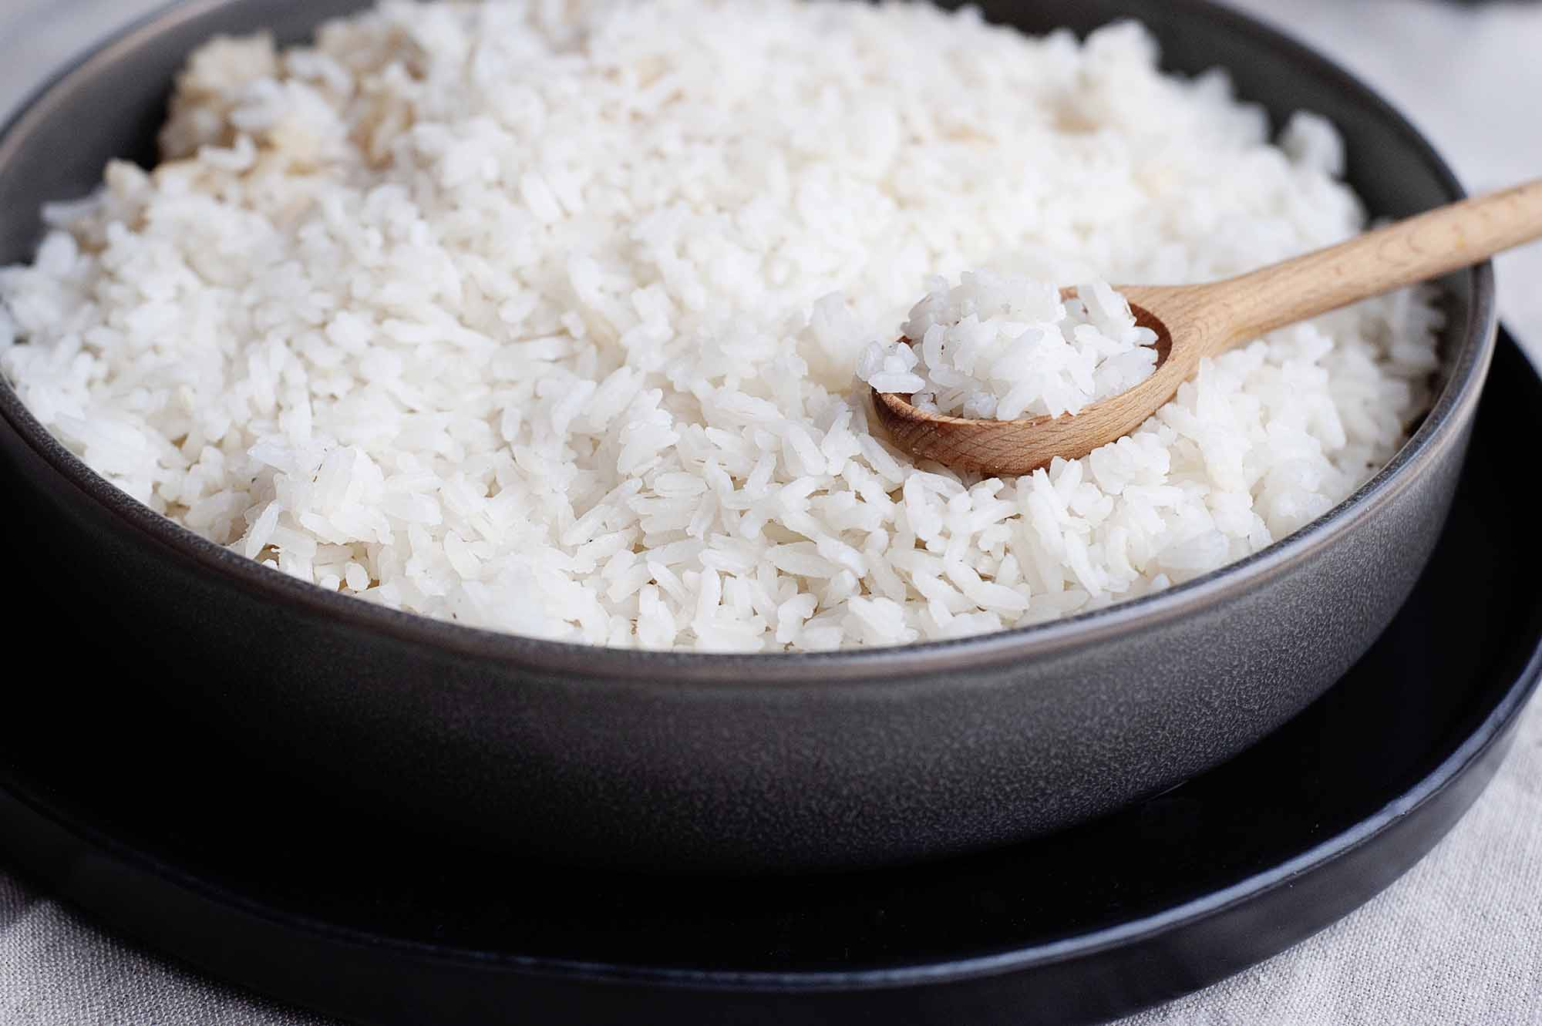
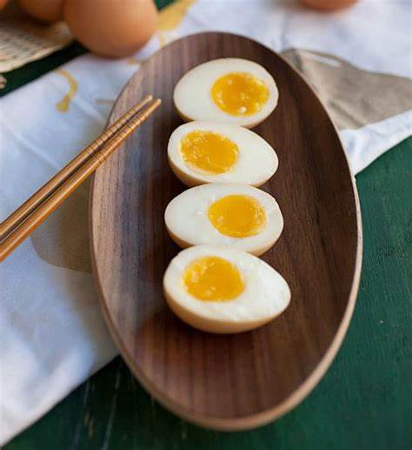
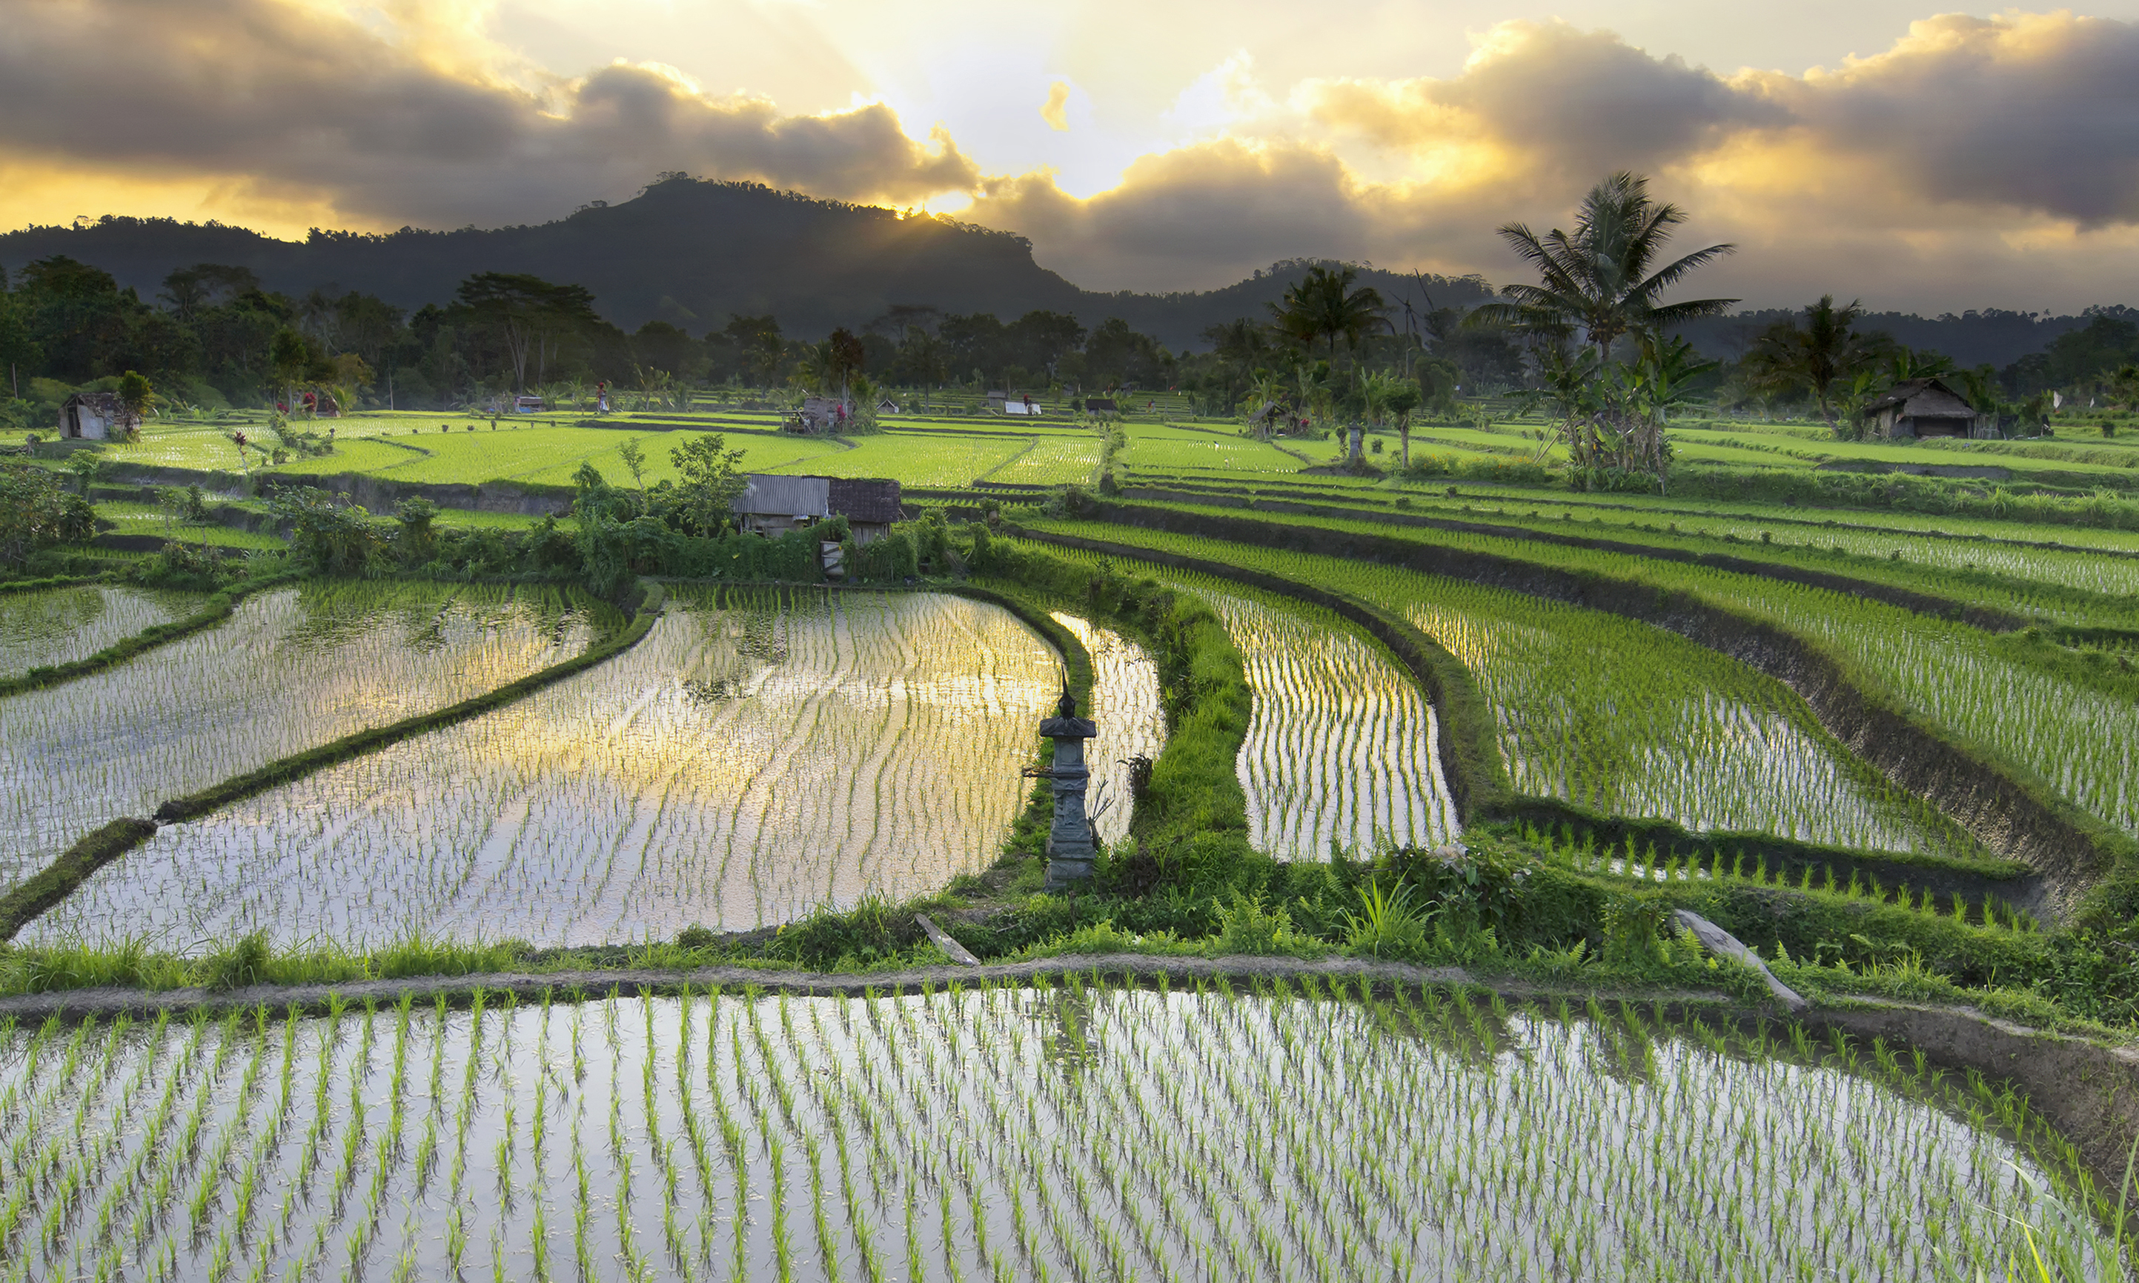
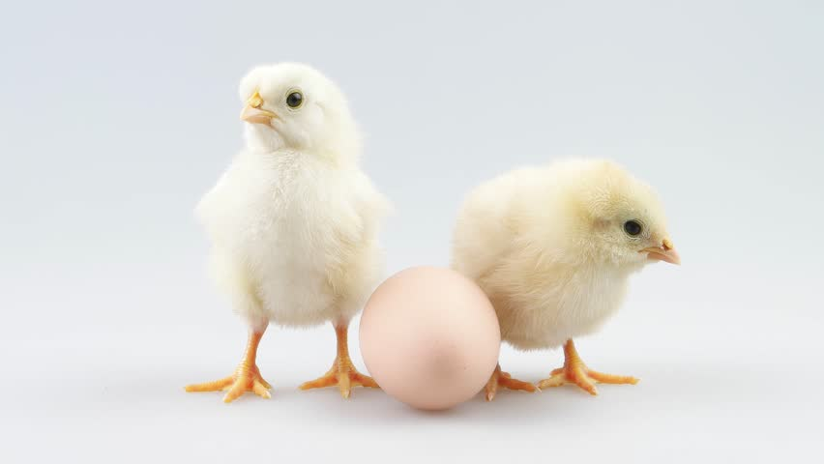
Staple foods
In Japan they eat a lot of rice as it is easily grown in their climate, it is grown in rice field and they are planted under 30cm of water.
Eggs seem to be quite popular in japan as they can be easily accessed, they use it in egg ramen, bento boxes and as an omelette.

Slide 7
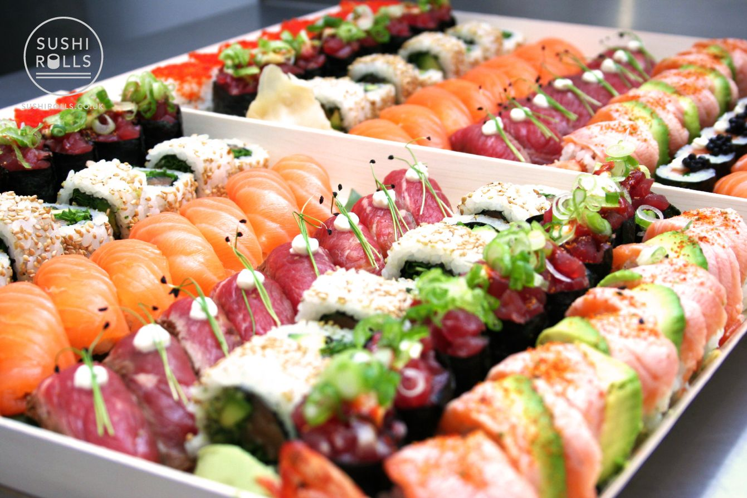
Popular dishes
Ramen is one of the most popular dishes in japan, it is loved as a snack after school or for dinner.
Japan is known for its sushi, it can come in many shapes but is often rice and fish based.

Slide 8
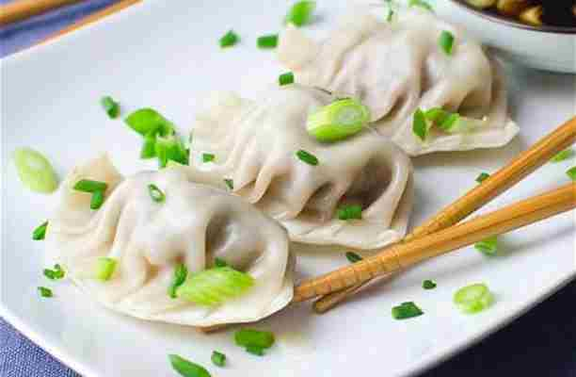
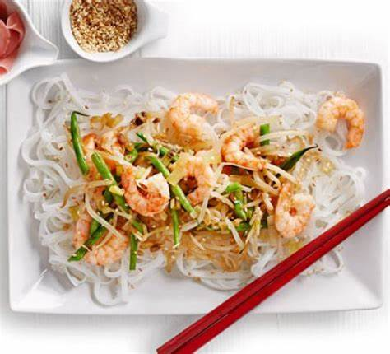
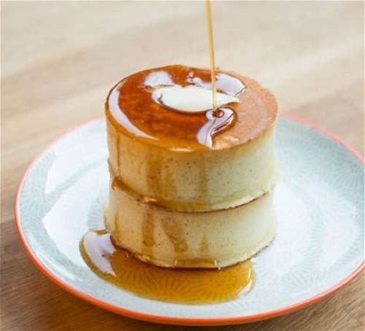
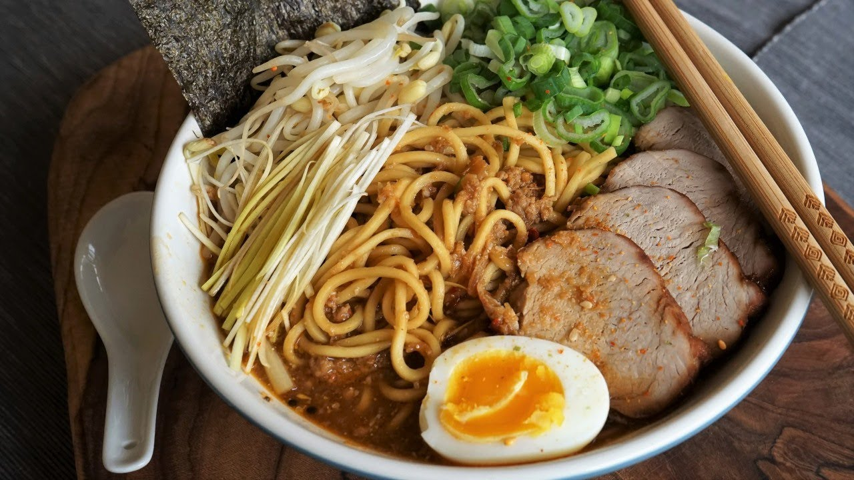
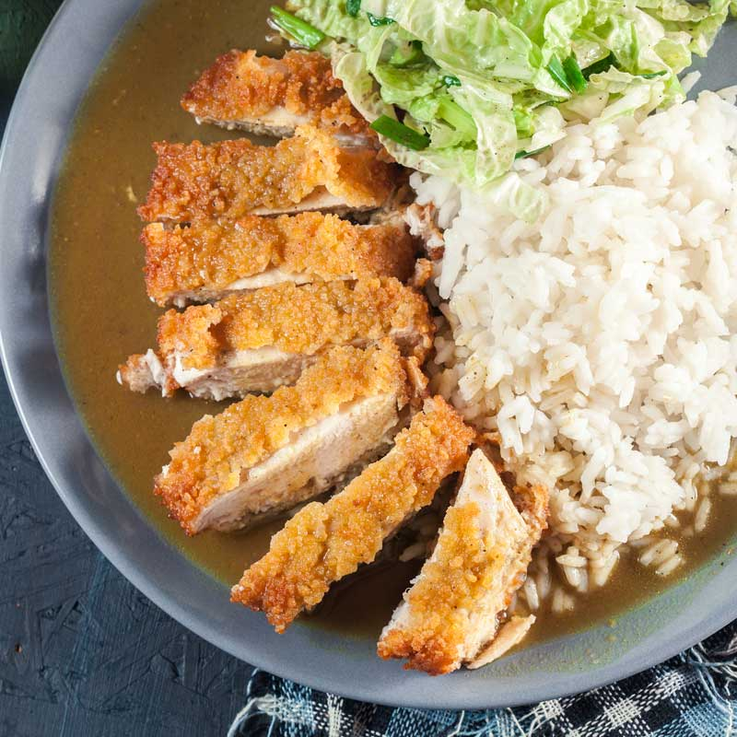
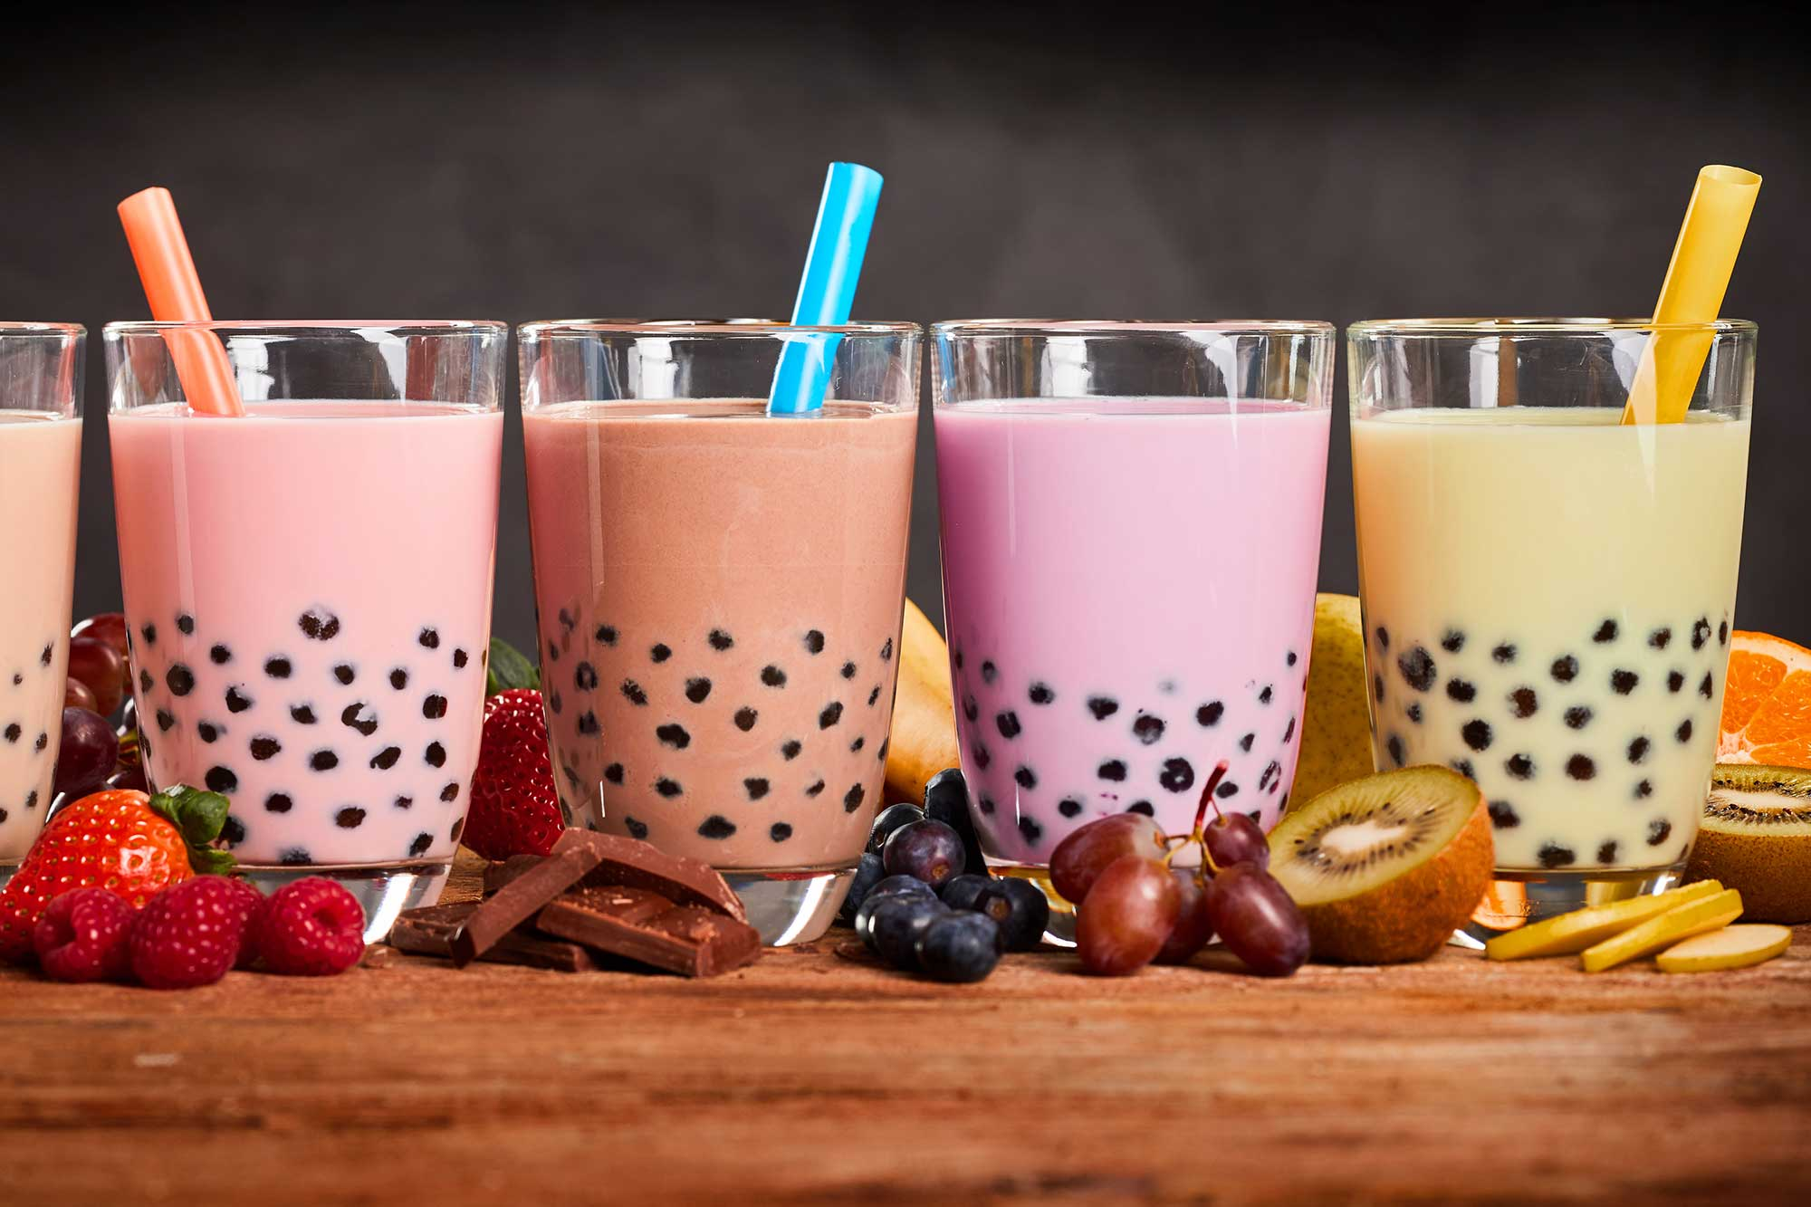
My chosen dishes
Stir fry – I made this because I wanted to try a popular Japanese dish - https://www.bbcgoodfood.com/recipes/simple-stir-fry my stir fry came out well next time I am going to add more sauce.
Ramen-I wanted to make this because it is loved in japan
Bubble tea-I wanted to have a go at making the Boba balls inside - https://www.youtube.com/watch?v=euaazO6bqS0&safe=true I think next time I need to cook them for longer and add less vanilla extract.
Fluffy pancakes-I wanted to have a go at a pudding
Katsu chicken-I have made this recipe twice before but I want to have a go at improving it
Japanese pork gyoza dumplings-this is one of my favourite dishes and I wanted to have a go with the steamer

Slide 9
Annotated picture of my stir-fry
Red peppers
Baby sweetcorn
prawns
ginger
Sweet chilli sauce
Rice noodles
Pak choi
Soy sauce

Slide 10
Nutritional analysis of my stir-fry
The salt showed as high because reduced soy sauce wasn’t an option when making my food label.

