Slide 1
Year 8 Product Design
Project Based Learning
Name
Design & Technology group
Pathway
Project Assessment :

Slide 2
Week by week planner
Welcome to Product Design.
.
Task 1 - Investigate and examine the work of different artists and designers and complete a profile on your favourite. The instructions to follow and success criteria are attached.
Task 2 - Look at the designer profile images and look at some of the products different designers are responsible for.
Task 3 - Complete a mind map exploring the different design options that you can use as the start of a really creative innovation invention design of your own
Week 2
Draw 4 different design ideas for an invention of your own. It could be something that solves a problem, helps a user complete a task safely or more comfortably.
Week 3
Effective communication of design concepts – on slide 24 follow the instructions for effective shading
Week 4
Task 1 Draw your final design and colour it in to best communicate the materials used to make it. Explain your final design answering questions in the template.
Task 2 Explore graphic design.
Complete a profile on a company of your choice and will look at the design of the company logo as part of your research instructions are on slide 49

Slide 3
Week by week planner
Week 5
Task 1 - Design and Technology - Draw the letters for each word using only the shapes and objects associated with Design and Technology. Example and object mood boards are included in the starter resource. See slide 30-33
2. Your Name - Draw the letters of each word using only the shapes and objects associated with your interests and hobbies. For example a letter O could be a football.
Task 2 - You will produce varied and imaginative design ideas for a range of commemorative stamps. Write as many possible ideas for your stamps around the themes in the boxes on slide 39.
For example Nature – Trees, leaves, pebbles, shells, pine cones, fossils.
Task 3 –Follow the instructions for the 4 activities on slide 40.
Week 6
In our lesson today we will continue our journey of discovery into graphic design.
Task 1 – Follow the instructions on slide 43 using the resources on slide 41-42.
Task 2 – Explore design development in product design and complete a profile on a product that is significant to you or us all! Instructions are on slide 51.

Slide 4
Week by week planner
Week 7
Task 1 - using your 4 design development drawings as inspiration and your starting point, design 4 of your own postage stamp designs. Think about what theme(s) you can incorporate into your graphic design and think whether it will be a commemorative, celebratory or informative postage stamp. Your stamp designs can be in the same theme or different. Colour your designs in.
Task 2- Look at your design ideas and select the best or best parts from different ones. Draw your best idea in one of the templates either portrait or landscape and colour it in.
Task 4 – Read the questions and answer them using full sentences. Slide 44
Task 5 - Watch an episode of Richard Hammond Miracles of Nature. In this episode he explores how product design has been inspired by nature, a process called biomimicry.
The link to the video on ClickView is below
https://clickv.ie/w/o42p
Week 8
Task 1 - Design 4 different designs for the trainers. Slide 45 and 46
Use a different theme for each, for example -
Sport, graffiti, music, computer gaming or a theme of your own
Think about and draw what shapes, motifs, patterns you could use for each theme on each of the trainers and colour your designs.
Task 2 - Design 4 different designs for an organic inspired household product Slide 47 and 48
Look at the shapes in the photos and use them in your design for a light, a chair, a table, a household product of your choice.

Slide 5



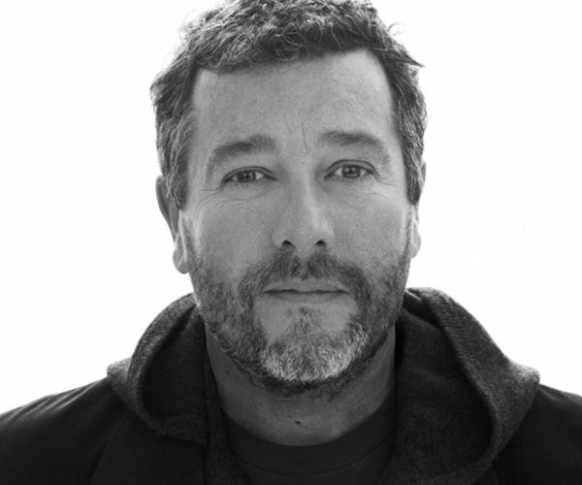

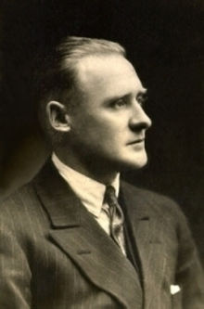

Russell Pinch
PINCH
Philippe Starck
Sir Jony Ive
APPLE
Sir Richard Branson
VIRGIN GROUP
Reginald Joseph Mitchell
SPITFIRE
Sir James Dyson
DYSON

Slide 6
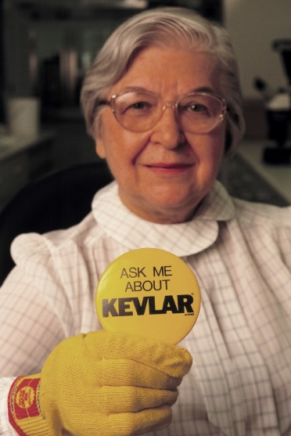
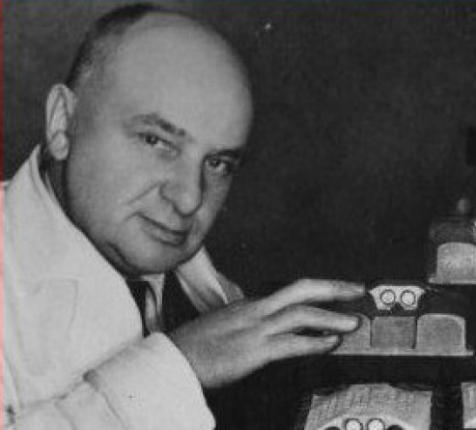
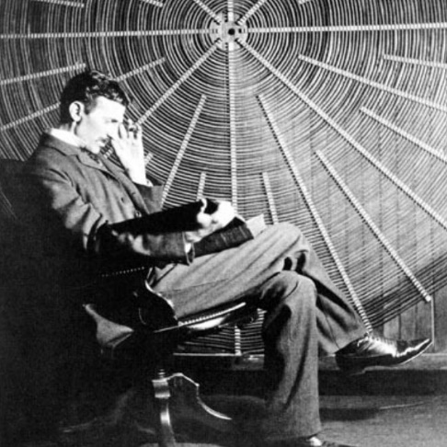
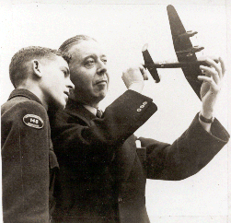


Stephanie Kwolek
KEVLAR
Percy Shaw
CATSEYES
Nikola Tesla
Alternating-Current electrical system
Grace Hopper
COMPUTER SOFTWARE
Roy Chadwick
LANCASTER BOMBER
Mary Anderson
WINDSCREEN WIPER

Slide 7
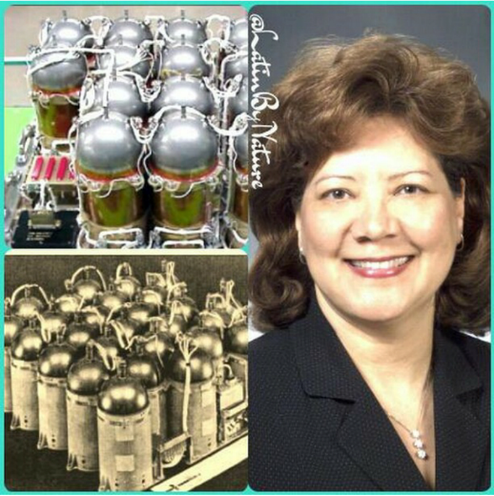

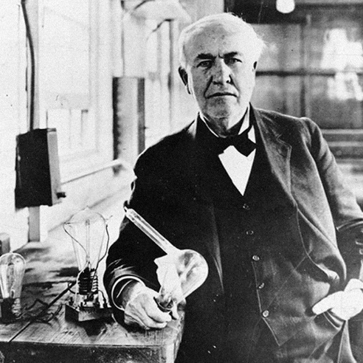
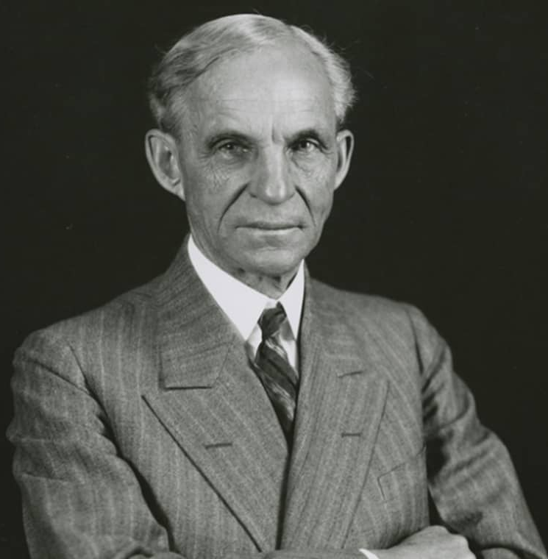
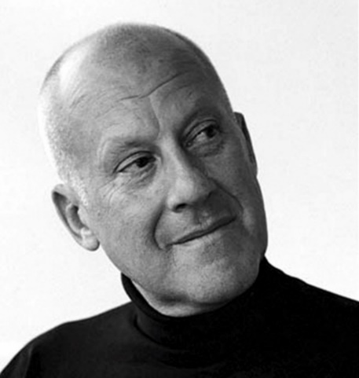
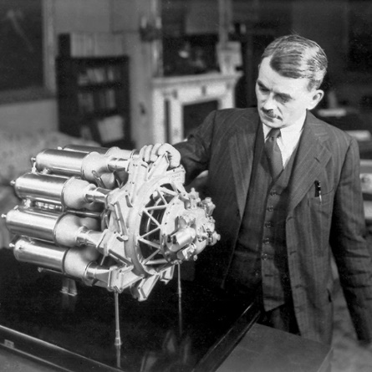
Sir Tim Berners-Lee
WWW - INTERNET
Olga D Gonzalez-Sanabria
SPACE STATION BATTERIES
Thomas Edison
LIGHTBULB
Frank Whittle
JET ENGINE
Henry Ford
FORD
Sir Norman Foster
ARCHITECT

Slide 8






Elon Musk
TESLA
Jeff Bezos
AMAZON
Jamie McDonald
ADVENTUREMAN
Bear Grylls
ADVENTURER
James Ketchell
ADVENTURER
Matt King OBE
LAWYER

Slide 9

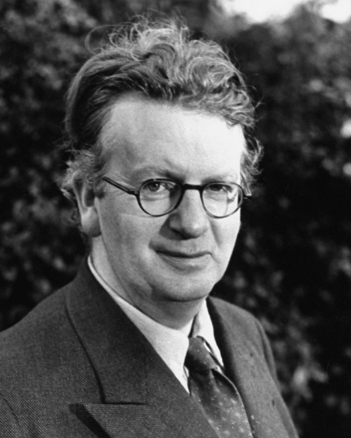
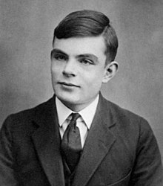
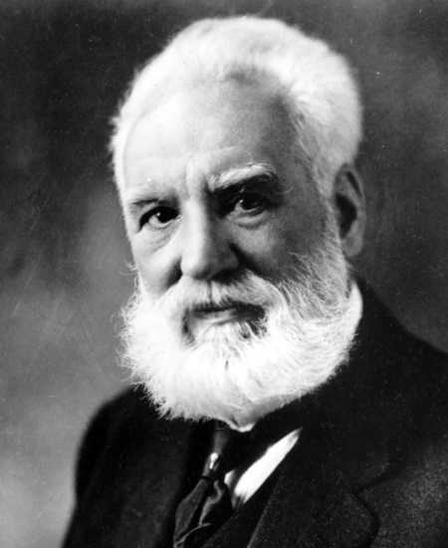
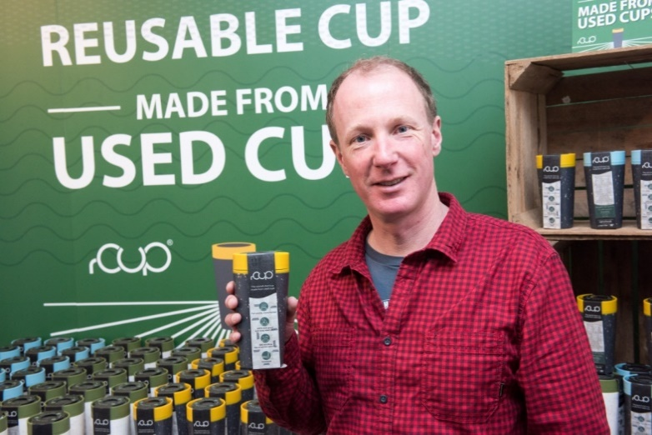

Bill Gates
MICROSOFT
Alan Turing
MATHEMATICIAN
John Logie Baird
TELEVISION
Tony Tetro
WORLDS GREATEST ART FORGER
Alexander Graham Bell
TELEPHONE
Dan Dicker
A SHORT WALK – ECO PRODUCTS

Slide 10
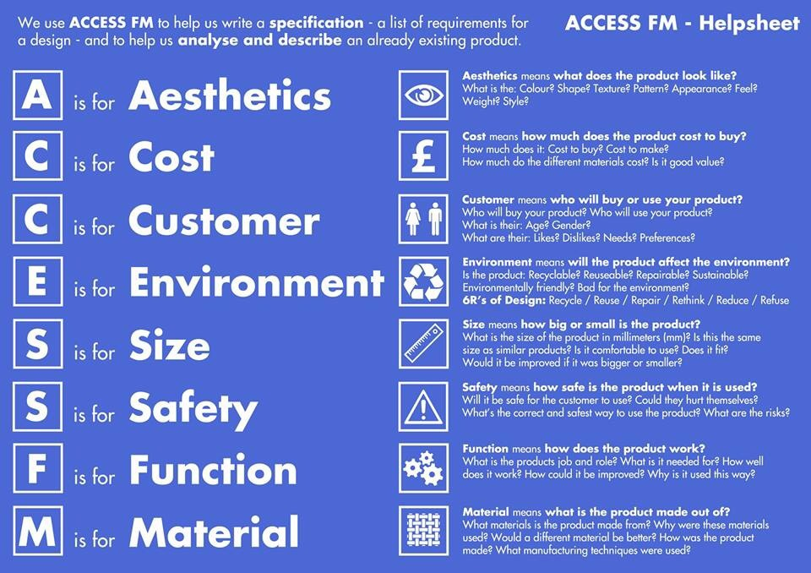

Slide 11
idea 1
idea 2
The best / worst bits of my design are ….and because…to make them better I will…
The best / worst bits of my design are ….and because…to make them better I will…
idea 3
idea 4
The best / worst bits of my design are ….and because…to make them better I will…
The best / worst bits of my design are ….and because…to make them better I will…

Slide 12
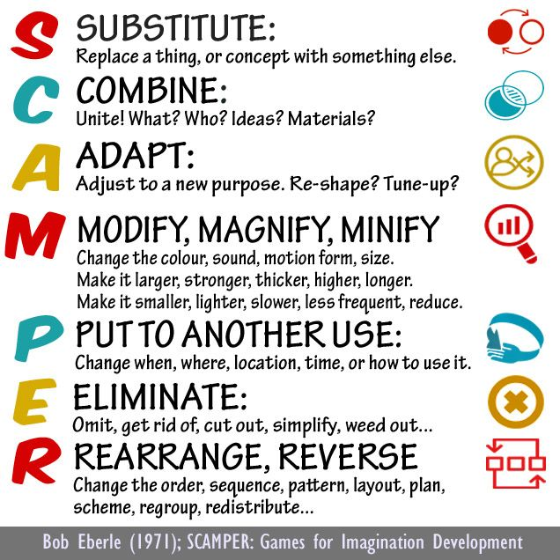

Slide 13
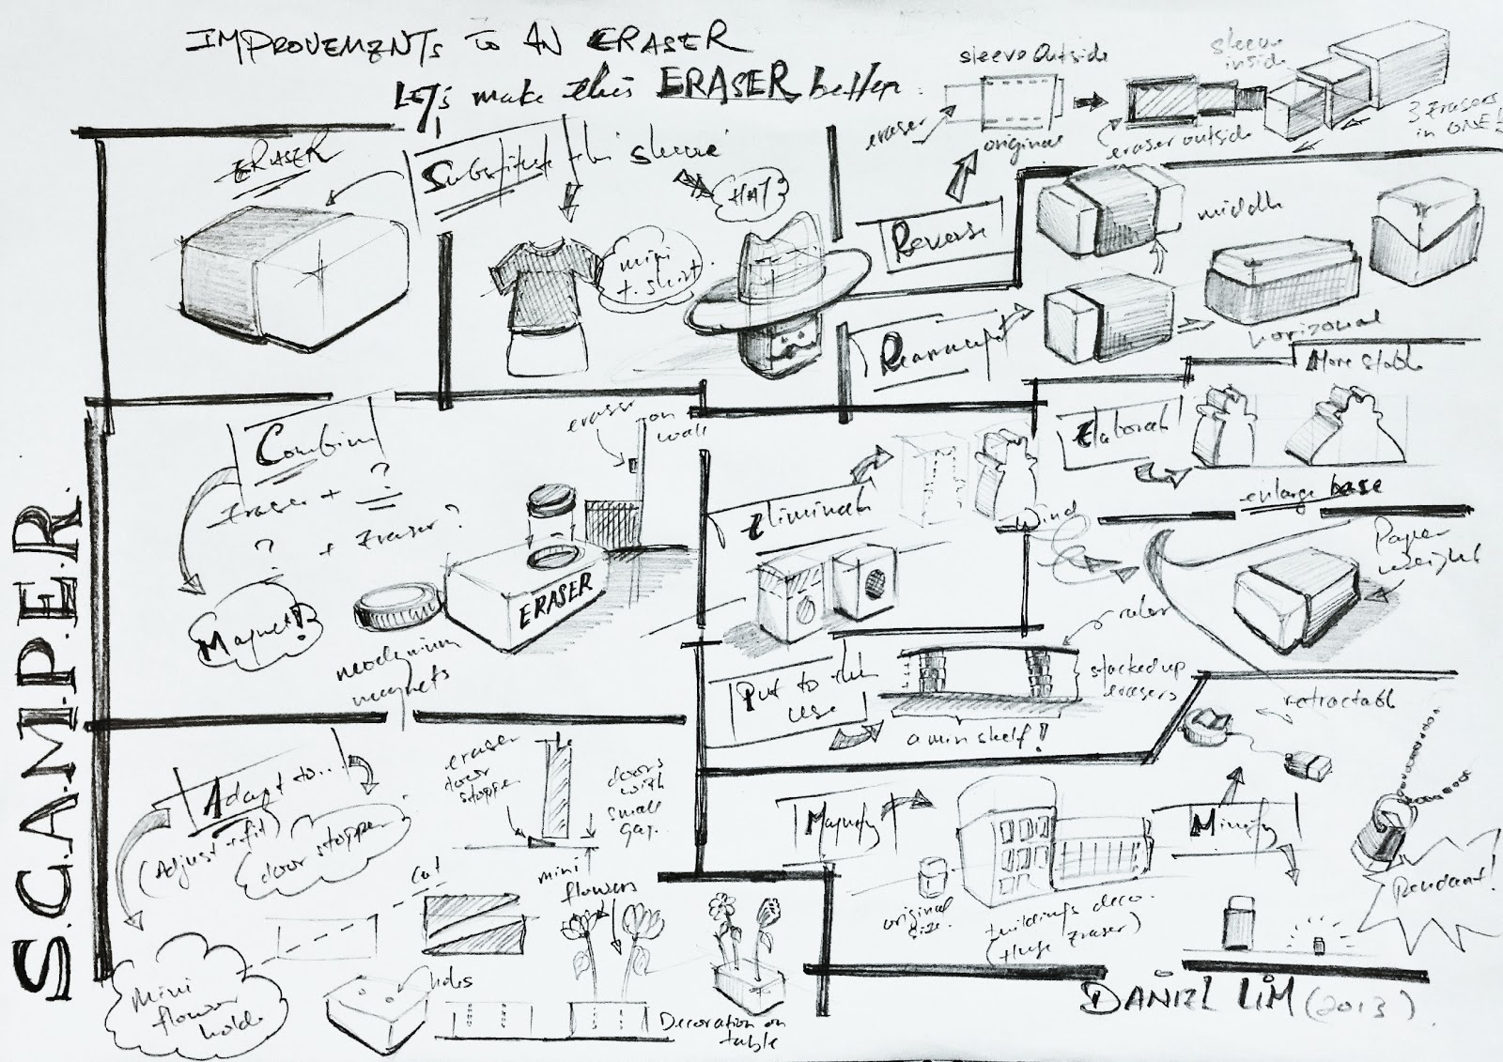

Slide 14
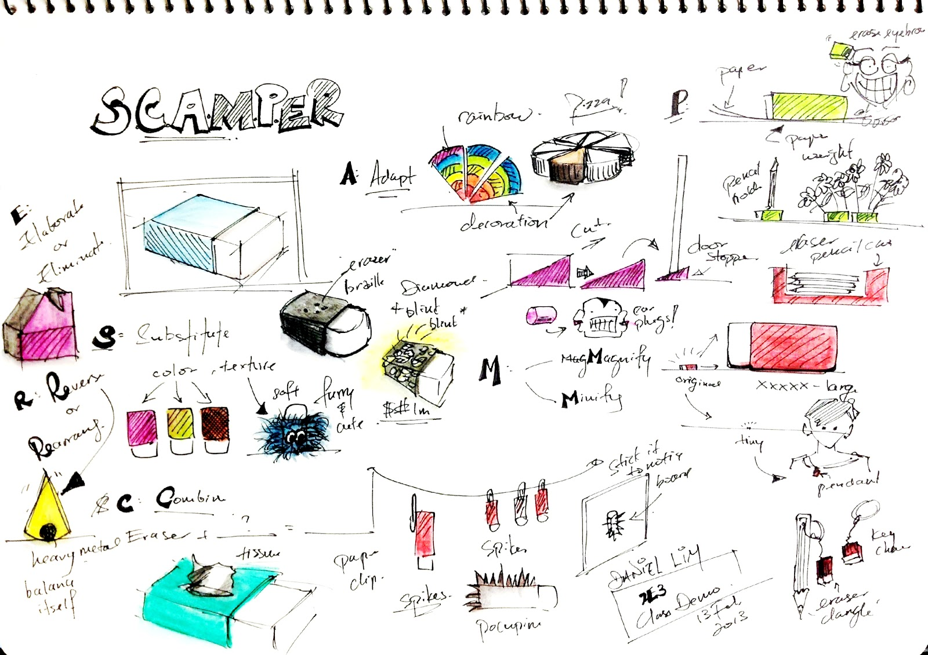

Slide 15
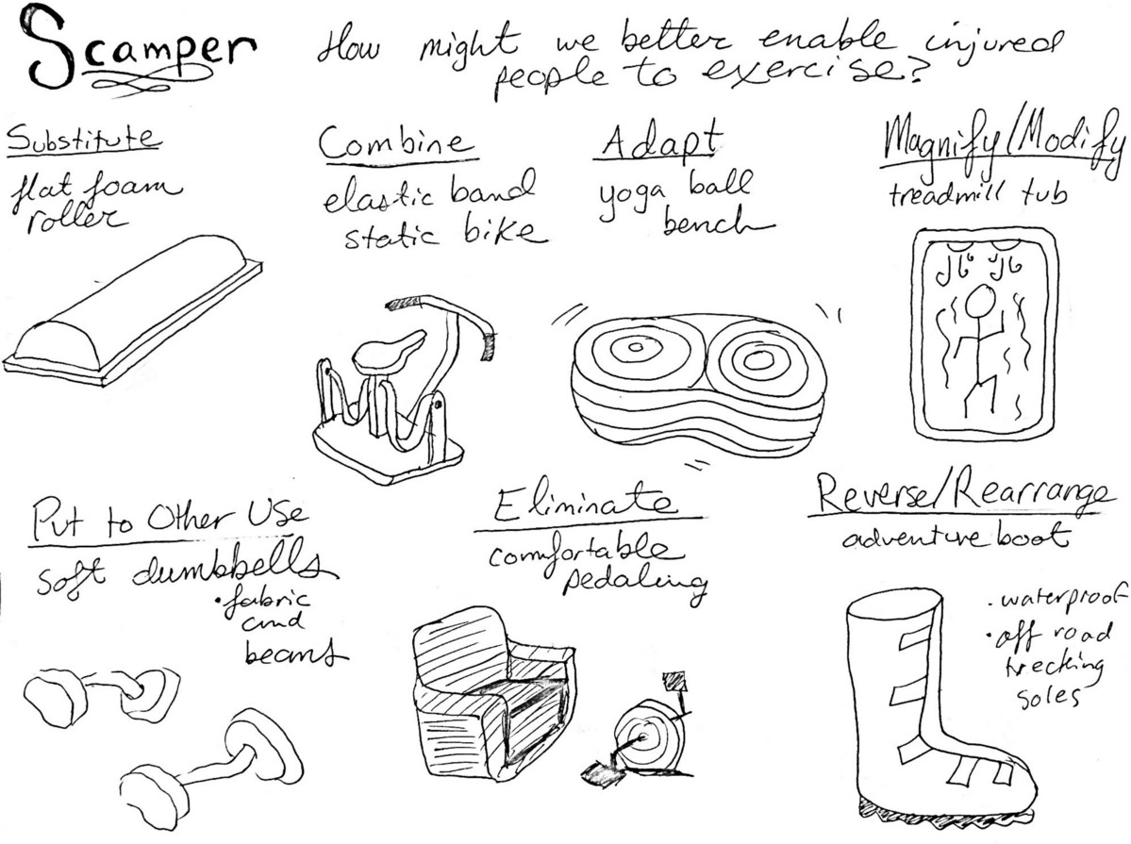

Slide 16
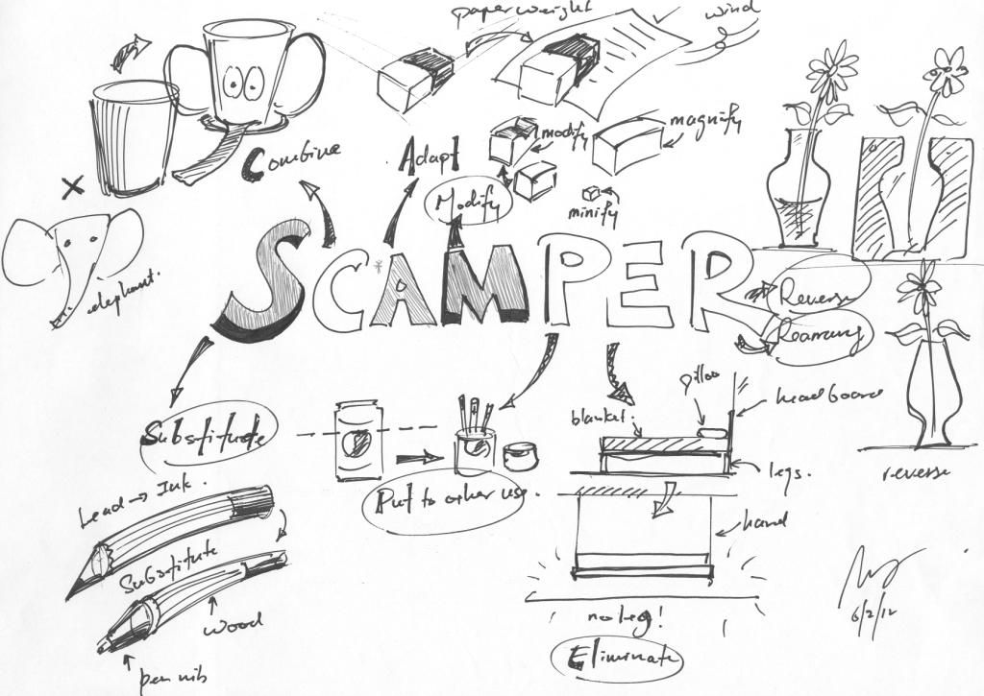

Slide 17
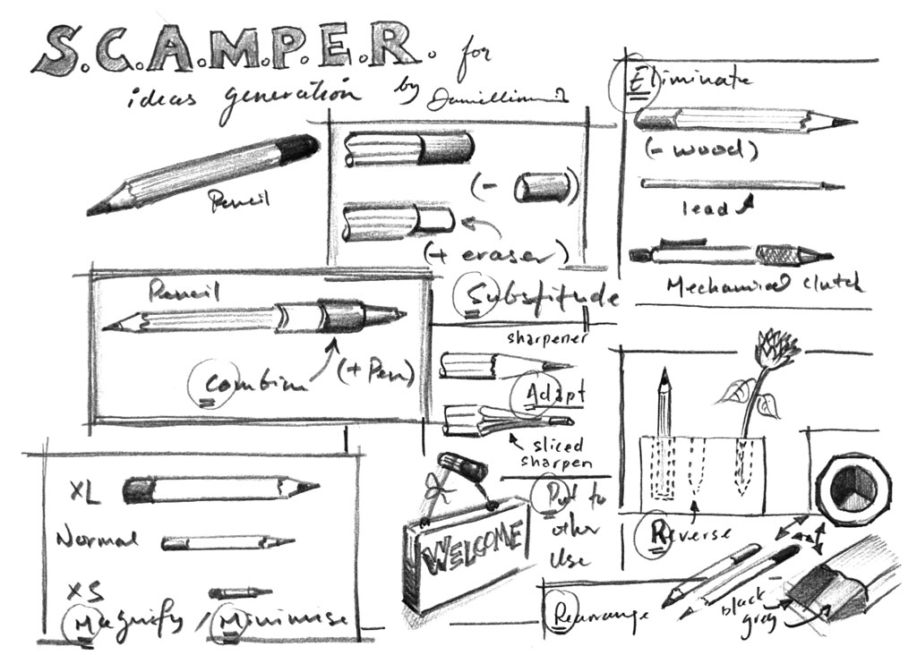

Slide 18
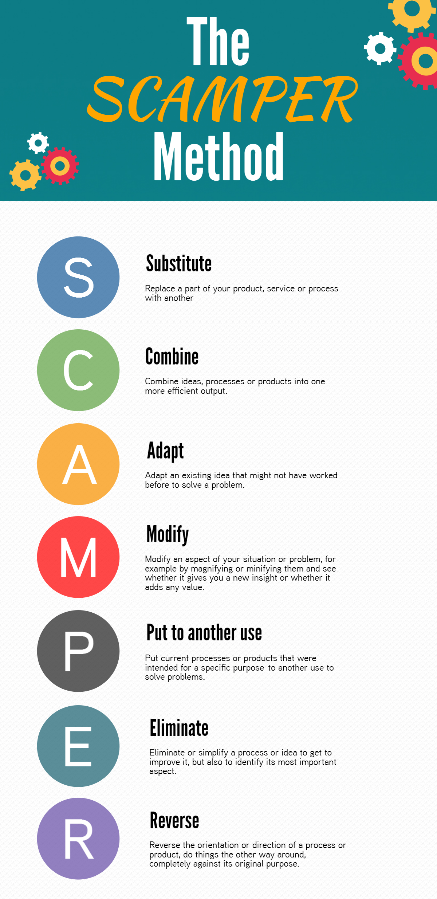
DEVELOPING A DESIGN
ADD – add bits to the design
SUBTRACT – take bits away from the design
SQUASH – make bits smaller in the design
STRETCH – make bits bigger in the design

Slide 19
Design development 5
Design Development of Initial Idea number
Design development 1
Stretch
Make something(s) bigger in your initial idea
What has changed?
Has it improved the design?
Add something(s) to your initial idea
My original initial idea
Design development 4
What has changed?
Has it improved the design?
Squash
Make something(s) smaller in your initial idea
Design development 2
Subtract
take away something(s) from your initial idea
Mirror
Repeat something(s) from your initial idea
What has changed?
Has it improved the design?
Design development 3
What has changed?
Has it improved the design?
What has changed?
Has it improved the design?

Slide 20
Design development 5
Design Development of Initial Idea number
Design development 1
Stretch
Make something(s) bigger in your initial idea
What has changed?
Has it improved the design?
Add something(s) to your initial idea
My original initial idea
Design development 4
What has changed?
Has it improved the design?
Squash
Make something(s) smaller in your initial idea
Design development 2
Subtract
take away something(s) from your initial idea
Mirror
Repeat something(s) from your initial idea
What has changed?
Has it improved the design?
Design development 3
What has changed?
Has it improved the design?
What has changed?
Has it improved the design?

Slide 21
1.What is your best design idea?
2. What inspired it?
3. How has your final design idea developed and improved from your original initial idea?
Your final design drawing in middle of the page
Draw and colour in your final design idea
4. What are the unique selling points / features of your design?
6. Who it is for? Where it will be used?
5. What colours, materials have been used?
Final design idea

Slide 22



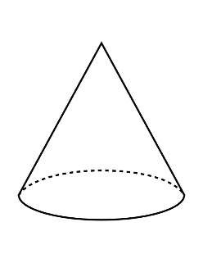
Rendering
Shade considering the light direction
Shade from dark to light
Shade from light to dark
Shade dark – light - dark
Make a line of ///////////
Shade a robot
Fill box using curved strokes
Fill box using dots
Add your light source and shade x2 cones
Fill box using zigzags

Slide 23
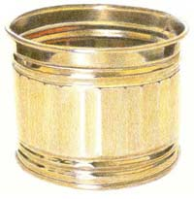
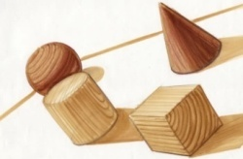
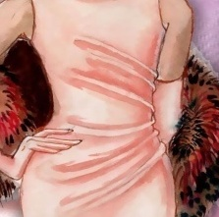
Shading, Rendering and Texture
Equipment list
Sharp pencil(s) HB, 2-4B and 2-4H
Sharpener
Rubber
Sharp coloured pencils
Texture – Pencils and Colour Only
A texture is how an object feels. How can we translate something we feel into something we see?
The material and surface dictate how much light is reflected.
Hard Surfaces like metal and glass are reflective so use sharp crisp edges with strong contrast.
Soft Surfaces like woods do not reflect much light so use soft shading and blending.
Rough Surfaces like fabrics will have mixed light reflection and so a mixture of sharp contrast with soft blending should be used.
Shading – Pencil Only
Shade the box from dark to light using the flat edge of your sharp pencil
Shading
Fabric
Shading – Pencil Only
Shade the box dark, light to dark using the flat edge of your sharp pencil
Rendering – Colour Pencil Only
As before use your shading technique to render with one colour from light to dark
Select 2 colours and blend those 2 colours from 1 to another (E.G. Blue from the left, shading 6 squares right. Green from the left, shading 6 squares left)
Blend 2 or more colours smoothly
Sketch your initials as block capital letters and show off your new rendering and shading skills
1
2
3
Wood
Glass
4
Metal
Plastic
A
R
V
S
D
M
P

Slide 24
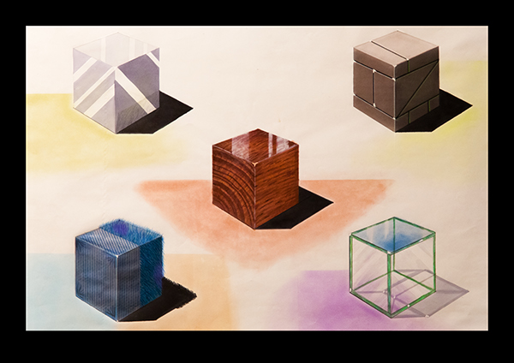

Slide 25


Slide 26
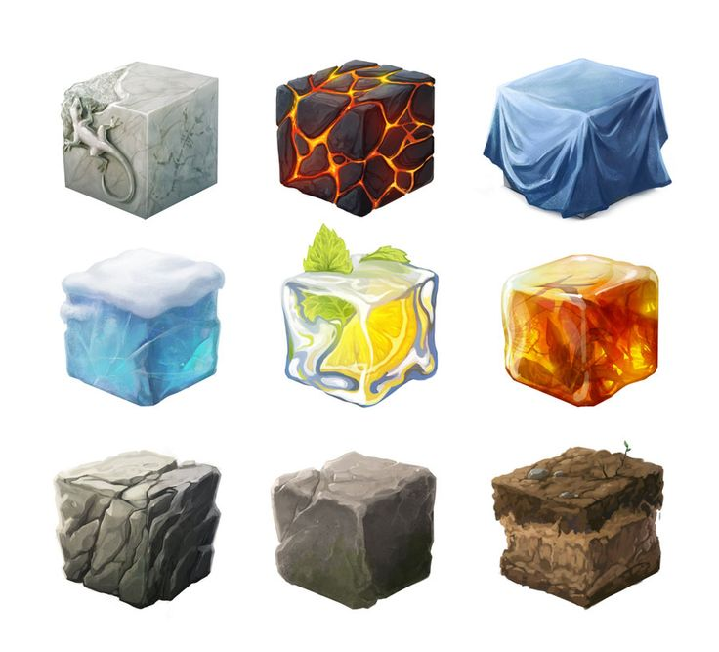

Slide 27
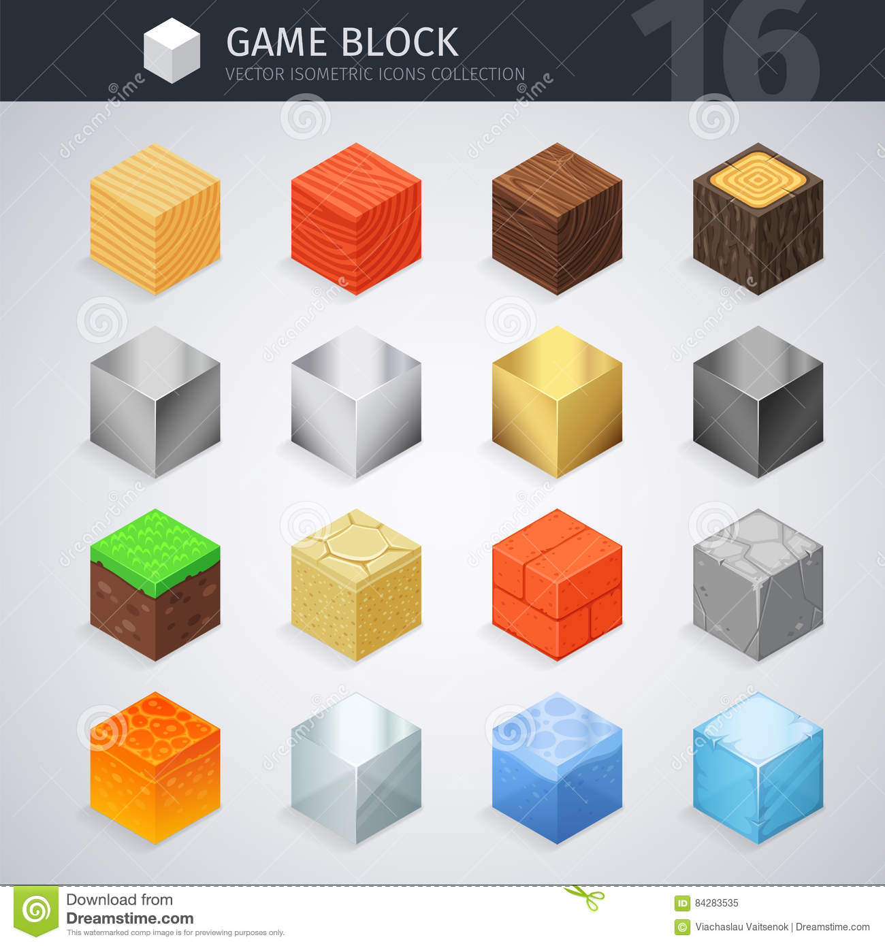

Slide 28
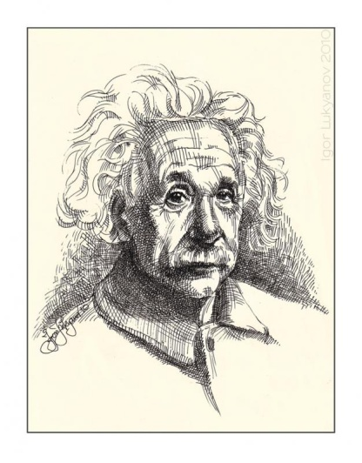
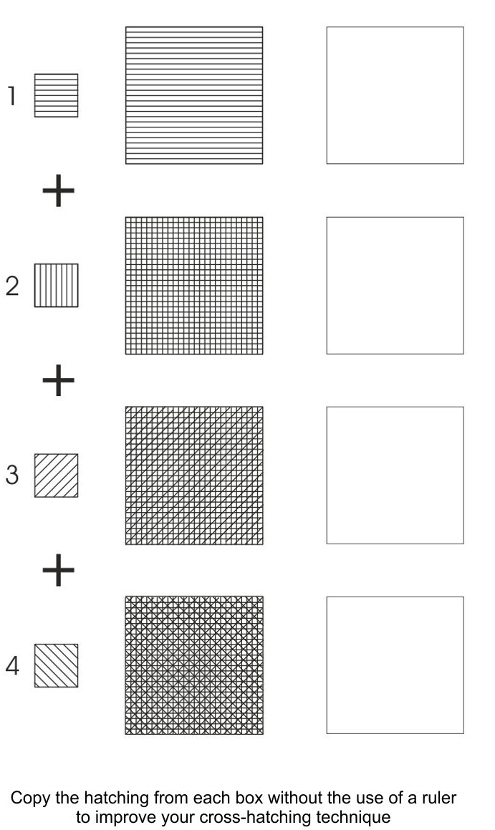
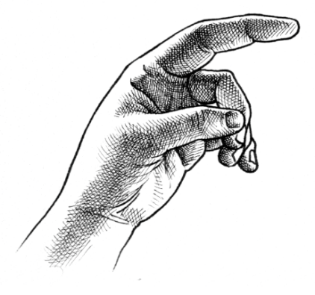

C. Cross Hatching
C. Cross Hatching
Cross-hatching is a method of line drawing that describes light and shadow. If you examine the value scale below, you can see how the light end uses a simple pattern of parallel lines spaced widely apart to represent light. The dark end layers criss-crossing lines to create a feeling of shadow.
Cross-hatching is a method of line drawing that describes light and shadow. If you examine the value scale below, you can see how the light end uses a simple pattern of parallel lines spaced widely apart to represent light. The dark end layers criss-crossing lines to create a feeling of shadow.

Slide 29

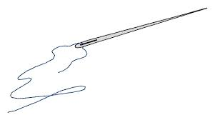




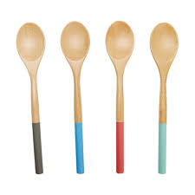

Challenge = Using symbols, machines, tools and safety symbols, design a new sign for ‘Design and Technology’ or ‘Food’ or ‘Textiles’.
Take inspiration from the images below and from the example on the next. You could draw, use a computer or model it using ‘bits and bobs’ (e.g. screw drivers) from around your house… be as creative as possible but stay safe. I look forward to seeing what you create.

Slide 30
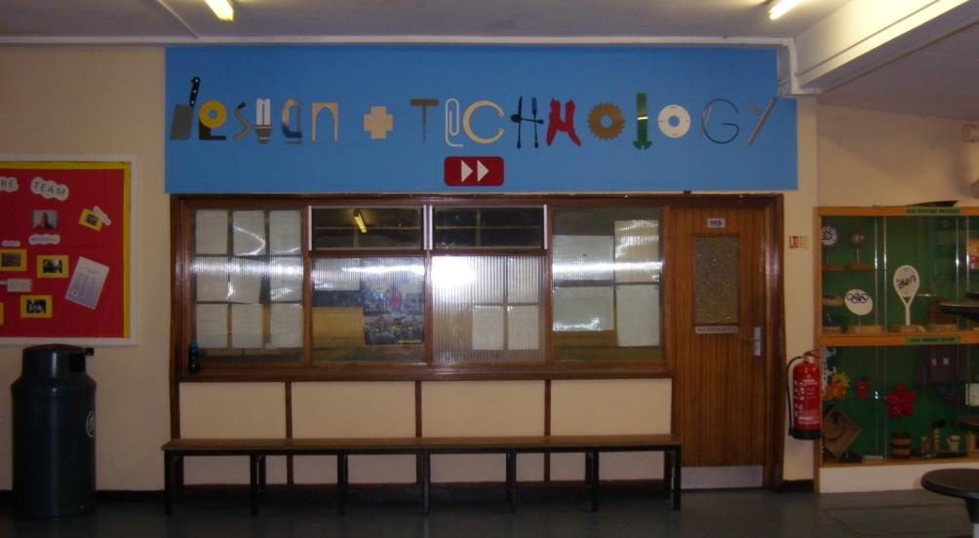
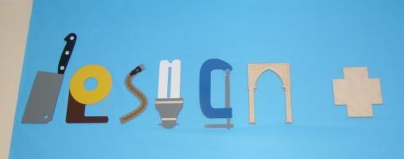

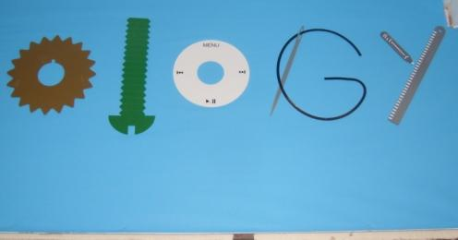

Slide 31



Slide 32


Slide 33
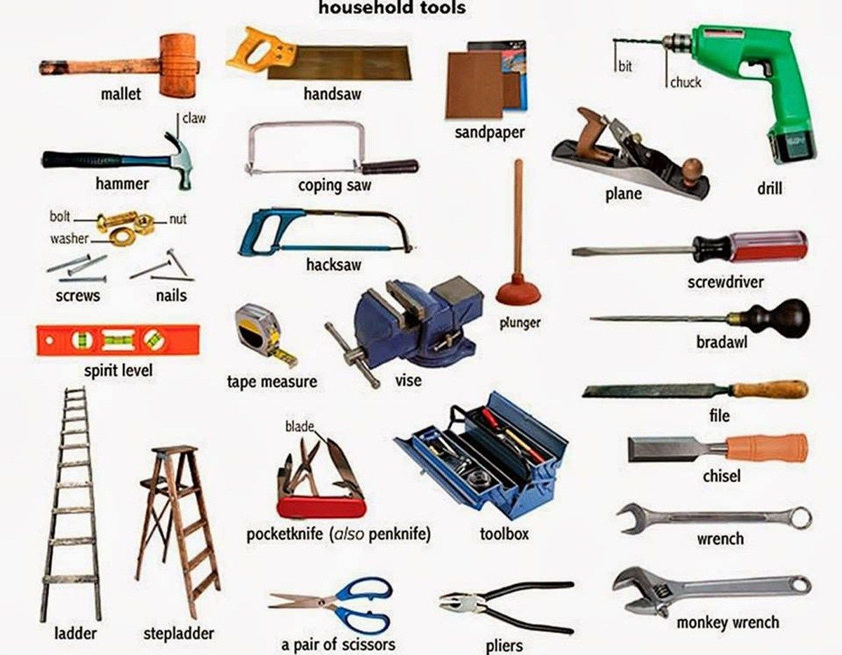

Slide 34
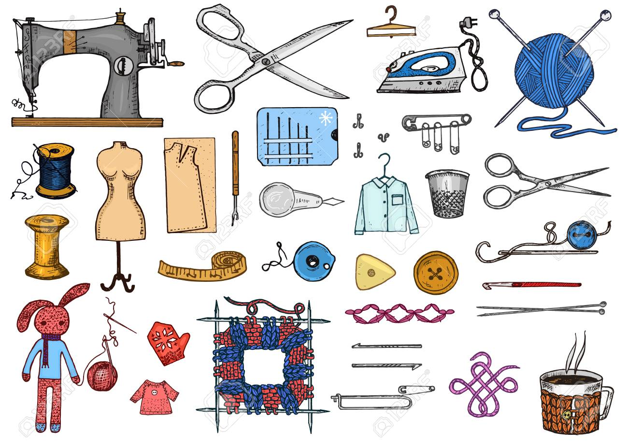

Slide 35
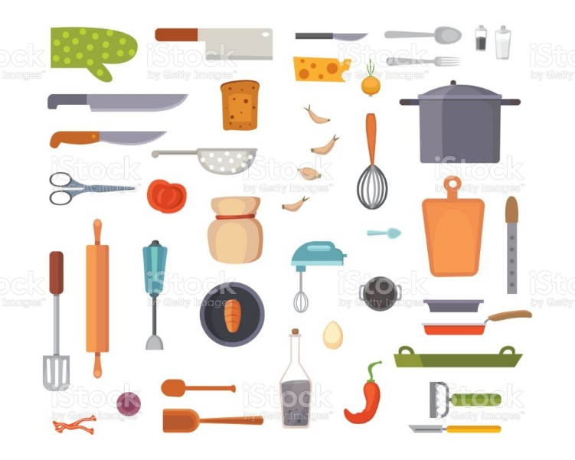

Slide 36
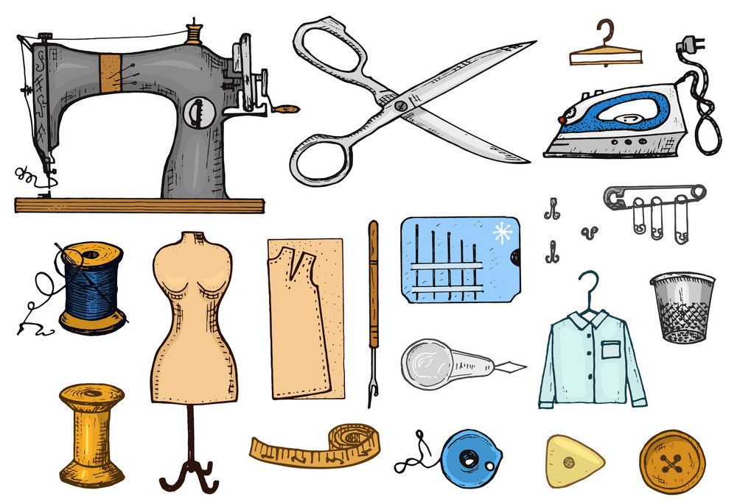

Slide 37



Slide 38
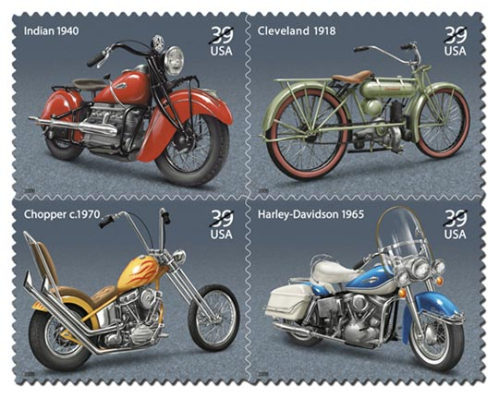
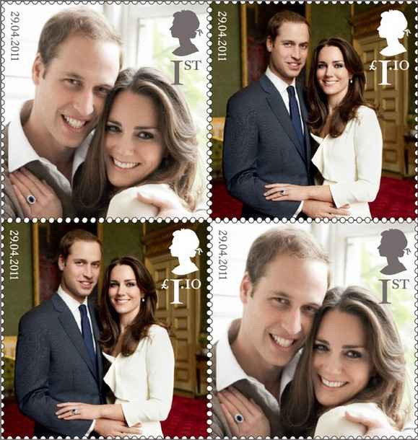
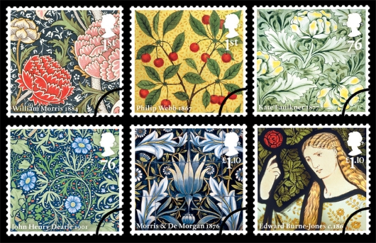
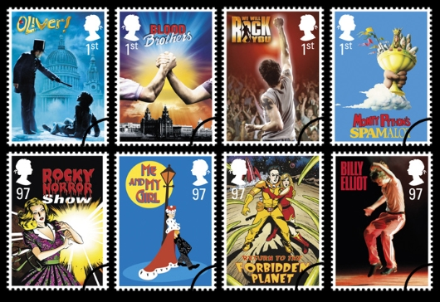
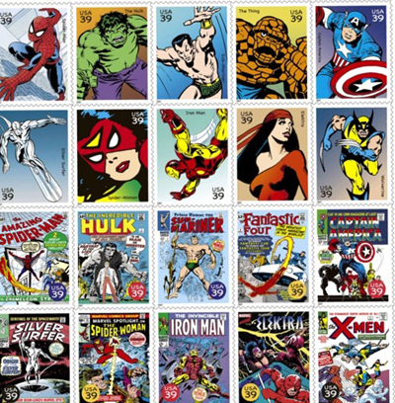
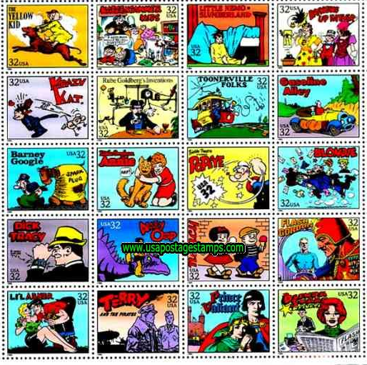

Research and Mind map page, P3, M3, D3
Science
Objectives: You will produce varied and imaginative design ideas for a range of commemorative stamps.
Task 1: Write as many possible ideas for your stamps around the themes in the boxes.
Films
Art / artists
Technology
Famous places
Nature
Countries
Cars / bikes
Famous people
Cartoons
Royal family
Planets
Sports

Slide 39



Drawing pages
Task 3 – Choose a stamp from the examples
Task 1 – Choose one of these stamps to copy
Task 2 – Copy it as accurately as possible in the box
below and colour it in
Task 4 – Copy it as accurately as possible in one of these boxes

Slide 40


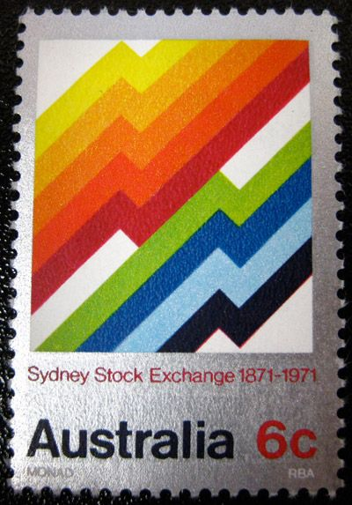



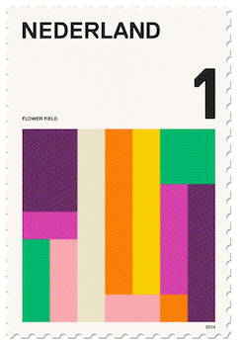


Slide 41






Slide 42
Design Development - Choose 4 of your favourite stamp designs from the examples.
Develop each one using some of the development opportunities from Scamper
DEVELOPING A DESIGN
ADD – add bits to the design
SUBTRACT – take bits away from the design
SQUASH – make bits smaller in the design
STRETCH – make bits bigger in the design

Slide 43
Final design – Draw your best design and colour it in.
It could be one of your design developments or a different design of your own.

Slide 44
Explanation pages
You need to explain and evaluate what you did, how you did it and what you think of the outcomes. Here’s a few questions to get you started
Where did you get your inspiration for your design ideas?
What tools, techniques and materials did you use to produce your design ideas and your final piece?
What do you think of the range of design ideas that you drew. Do they look professional? Would they fit within the Post Office mailing style?
How does your final piece compare with the designs you first drew. Are they different and if so explain why.
How does your final piece compare with existing commemorative stamps on the market. Are you pleased with the outcome. How could you improve it further?

Slide 45




Slide 46
1. Design 4 different designs for these trainers.
Use a different theme for each, for example -
Sport, graffiti, music, computer gaming.
Think about and draw what shapes, motifs, patterns you could use for each theme on each of the trainers.
2. Colour your designs.

Slide 47













Product Design task: Biomimicry
Aims: To provide you with the skills to design and present design ideas that are inspired by organic forms and the natural world – Biomimicry
Introduction: ORGANICS are looking for a new range of designs for household products. ORGANICS has asked that your designs should be inspired from taking inspiration from the natural world and can include shapes, patterns, textures, colours in the photos featured.
Specification
1. Design 4 different designs for an organic inspired household product
2. Look at the shapes in the photos and use them in your design for a light, a chair, a table, a household product of your choice.

Slide 49
Homework – when completed stick over this page
1
In Design and Technology we would like you to understand and appreciate the work of product designers, fashion designers, engineers, chefs.
Task: You are to complete a profile on a designer and 1 example of their work
Things to include:
Who is she / he?
What is she / he famous for?
Examine in detail one example of their work and explain why you have chosen it
What do you think about her / his design style?
Explain how you could further develop the design to enhance the aesthetics / function / ergonomics
How should I present it?
On A4 paper
Remember a title and any sub-titles
Remember to support your written work with some images
Remember to put your name on your work
Homework Success Criteria
+ You have followed and included all of the “things to include” and presented your work very well by using titles, sub titles and images or drawings to support your written work. All written work must be in your own words and include your own opinions.
= You have followed and included some of the “things to include” and presented your work well by using a title and images or drawings to support your written work. All written work must be in your own words.
- You have followed and included few of the “things to include”. Your work may not be presented appropriately as it will be missing titles, sub titles or your name. There will be lots of information that is copied and pasted from the internet with no opinions of your own

Slide 50


Slide 51


Slide 52
Homework – when completed stick over this page
2
In Design and Technology we would like you to understand and appreciate the work of different companies
Task: You are to complete a profile on a company
Things to include:
What is the company?
Why have you chosen the company?
What is the company logo?
Is there a hidden meaning/message in the logo?
How should I present it?
On A4 paper
Remember a title and any sub-titles
Remember to support your written work with some images
Remember to put your name on your work
Homework Success Criteria
+ You have followed and included all of the “things to include” and presented your work very well by using titles, sub titles and images or drawings to support your written work. All written work must be in your own words and include your own opinions.
= You have followed and included some of the “things to include” and presented your work well by using a title and images or drawings to support your written work. All written work must be in your own words.
- You have followed and included few of the “things to include”. Your work may not be presented appropriately as it will be missing titles, sub titles or your name. There will be lots of information that is copied and pasted from the internet with no opinions of your own

Slide 53


Slide 54
Homework – when completed stick over this page
3
In Design and Technology we would like you to understand and appreciate products
Task: You are to complete a profile on a product that is significant to you or all of us!
Things to include:
What is the product?
Who is the designer / design company?
Why have you chosen the product?
What are the unique selling points of the product?
What is the significance of the product to you or all of us!
Can you develop the design even further to make it even better?
How should I present it?
On A4 paper
Remember a title and any sub-titles
Remember to support your written work with some images
Remember to put your name on your work
Homework Success Criteria
+ You have followed and included all of the “things to include” and presented your work very well by using titles, sub titles and images or drawings to support your written work. All written work must be in your own words and include your own opinions.
= You have followed and included some of the “things to include” and presented your work well by using a title and images or drawings to support your written work. All written work must be in your own words.
- You have followed and included few of the “things to include”. Your work may not be presented appropriately as it will be missing titles, sub titles or your name. There will be lots of information that is copied and pasted from the internet with no opinions of your own

Slide 55
Homework – when completed stick over this page
4
In Design and Technology we would like you to understand and appreciate systems
Task: You are to complete a profile on a system that is significant to you or all of us!
Examples include, WiFi, LiFi, 5G, Internet, Bluetooth, Holography
Things to include:
What is the system?
Who is the designer / design company?
Why have you chosen the system?
What are the unique selling points of the system?
What is the significance of the product to you or all of us!
Can you develop the system even further to make it even better?
How should I present it?
On A4 paper
Remember a title and any sub-titles
Remember to support your written work with some images
Remember to put your name on your work
Homework Success Criteria
+ You have followed and included all of the “things to include” and presented your work very well by using titles, sub titles and images or drawings to support your written work. All written work must be in your own words and include your own opinions.
= You have followed and included some of the “things to include” and presented your work well by using a title and images or drawings to support your written work. All written work must be in your own words.
- You have followed and included few of the “things to include”. Your work may not be presented appropriately as it will be missing titles, sub titles or your name. There will be lots of information that is copied and pasted from the internet with no opinions of your own

