Slide 1
Design and make task: Salad in a Jar.

Slide 2
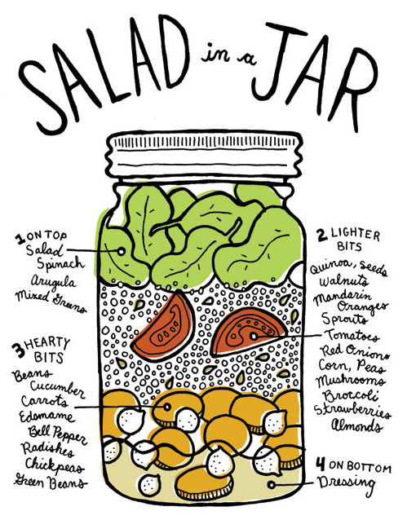
SALAD IN A JAR DESIGN
Its important that we eat at least 5 portions
of fruit and vegetables a day. We should try to eat a variety of different coloured fruit and vegetables to ensure we get a full range of vitamins and minerals in our diet.
Vitamins and minerals are important to maintain good health.
Design Brief :
You have been asked by a food manufacturer
to design and make a healthy and attractive salad
in a jar. The salad should supply a good range of vitamins
and minerals.

Slide 3
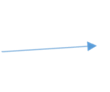
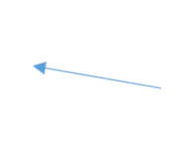
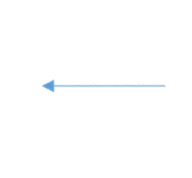
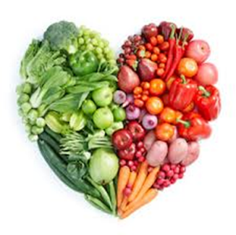
SALAD IN A JAR DESIGN
Points I will need to consider
for my salad
Use a range of fruits
and vegetables
Colour
Incorporate
attractive
layers
Texture
Include a dressing
Taste good
Include a carbohydrate :
this will fill you up.
Include a protein food

Slide 4
SALAD IN A JAR DESIGN
Advantages of making a salad in Jar
Suitable for packed
lunches and snacks.
It is a meal in its self
Easy to eat with a fork
It can use up leftovers
in the fridge
to prevent waste)
It is easy to store
in the fridge for later
You can easily change the design
to meet what you have in your fridge

Slide 5
Advantages of making a Salad in a jar
Points I will need to consider when designing my Salad in a Jar – this will be your Product Specification

Slide 6
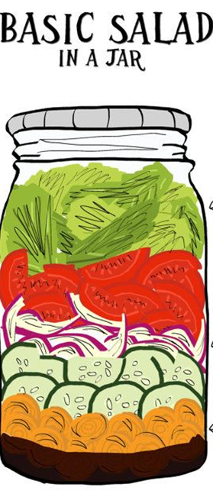
What points do you need to consider to make sure your
Salad in a Jar is successful.
A Specification is a checklist to help you
when you are designing.
Use Slide 7 to help you.
 | Specification
1
2
3
4
5
6
7
8

Slide 7
SPECIFICATION -SALAD IN A JAR DESIGN
Range of textures
Colourful layers
Healthy
Taste good
Include a range of fruits
and vegetables.
6.Include a protein food.
7.Include a carbohydrate
8. Include a dressing

Slide 8
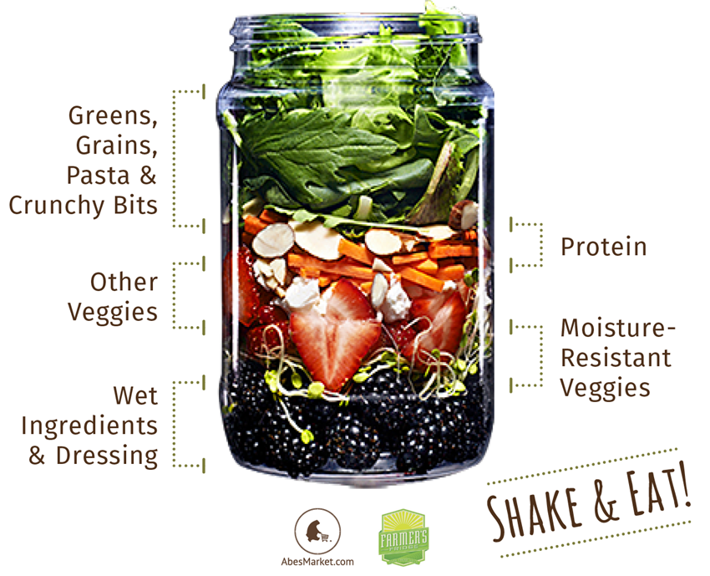

Slide 9
SALAD IN A JAR DESIGN

Slide 10
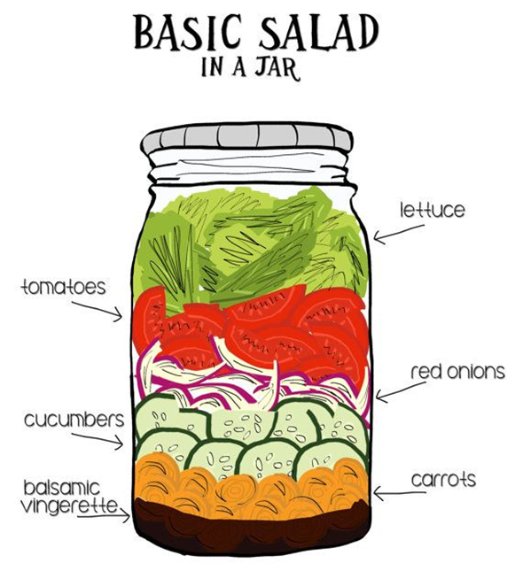

Slide 11
SALAD IN A JAR DESIGN
Food Group | Examples
Vegetables | Tomatoes, lettuce, cucumber, spring onions, grated carrot, olives, sweetcorn, onion, celery, beetroot, peas, green beans.
Fruit | Fresh or tinned - Pineapple, peach, Dried fruits – raisins, apricots Pomegranate
Animal protein – This needs to be cooked and chilled. | Meat: ham , chicken, sausages, bacon, hot dogs ,cheese, hard boiled eggs. Fish: smoked salmon, tinned Tuna/salmon
Vegetable protein | Kidney beans, butter beans, cooked lentils, chick peas, endame beans, houmous Nuts: almonds/walnuts/ pine nuts
Carbohydrates – This needs to be cooked and chilled | Pasta shapes – shells, spirals, tubes Couscous, cooked potato Rice – wholegrain, basmati,
Dressing | Mayonnaise, vinaigrette using oil and vinegar ( red/white wine/balsamic vinegar or lemon juice)

Slide 12
SALAD IN A JAR – suggest ingredients you could use for your Salad in a Jar.
You could do this as a mind map or draw or down load images of the foods

Slide 13
SALAD IN A JAR DESIGN
Make your choices –
think about colourful layers and flavours and textures that compliment each other.
Consider what is in your fridge and needs eating up☺
Food Group | Examples
Vegetables
Fruit
Animal protein – cooked and chilled.
Vegetable protein
Carbohydrates – cooked and chilled
Dressing

Slide 14
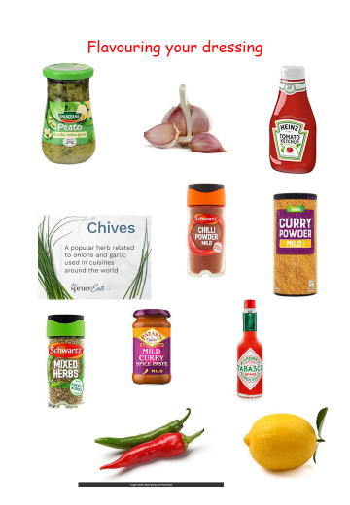

Slide 15
Flavourings I could use in my dressing
Dressings I could use
Flavourings I could consider

Slide 16
SALAD IN A JAR DESIGN

Slide 17
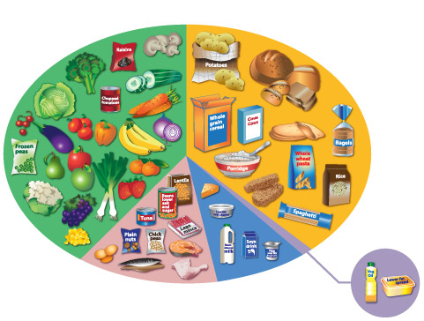
Name of Product
Description of Product
Draw your design idea for the jar salad above … Make sure that you have annotated how you have included:
Vegetables/Fruit *Dairy or alternatives *Protein (Veg or meat) *Grains / Complex carbohydrates
Label the functions of the ingredients in your salad (Sensory & nutritional)

Slide 18
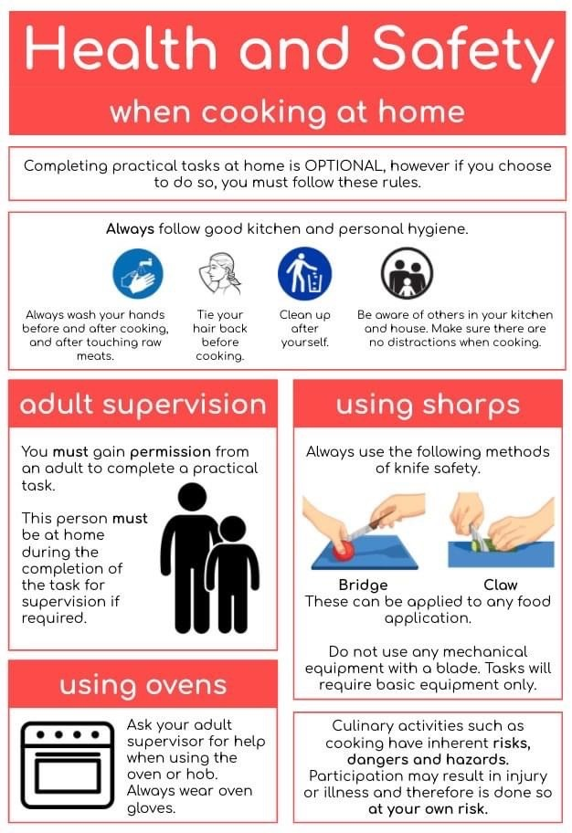

Slide 19
SALAD IN A JAR PLANNING
Ingredients Required
Preparation
Equipment Needed
Cooking
Equipment Needed
Serving
Equipment Needed
Success Criteria … what will make my Salad in a Jar the best product in the room …
I must demonstrate that …
The product must show …
I will have challenged myself by…

Slide 20
SALAD IN A JAR DESIGN
Points I will need to consider
when choosing a container
Tight fitting lid
Container must be clean
Glass jar –
You can easily see
the layers of salad.
Correct size and
shape for a snack.
Easy to fill
and eat from.
Clear plastic container –
You can easily see
the layers of salad.
Container needs to be
see through
so you can see
the layers.
Recycle an old clear plastic
yoghurt or take away
carton.

Slide 21
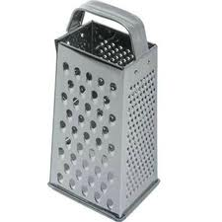
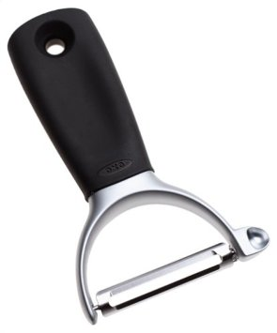
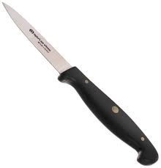
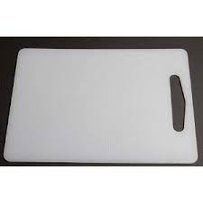
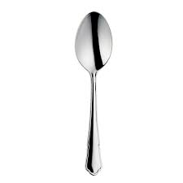
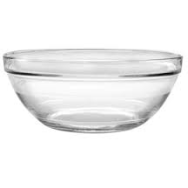
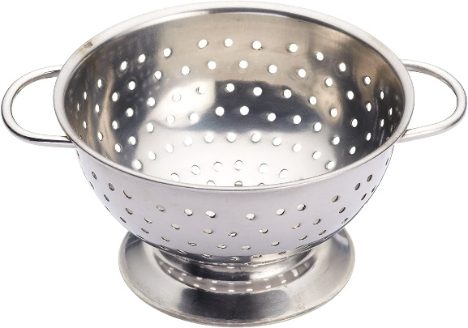
Equipment you might need for your Salad in a jar

Slide 22
Wear a clean apron and wash hands before cooking
Take care when using sharp knives
Use correct chopping board
Take care when using hob/boiling pans when cooking pasta rice etc
Use the lid to cover the salad and store in the fridge to keep salad safe to eat.
Wash up in hot soapy water. Take care when washing sharp knives.

Slide 23
Wash hands, put on an apron. Collect ingredients and equipment
Prepare / Cook your pasta/rice/potatoes/couscous/noodles.
They need to be cold when placed in salad
Prepare dressing – what ingredients did you use and how did you do it? Place in bottom of jar.
Prepare all vegetables and fruit – name them and how did you do it – slice/dice/grate.
Prepare protein food – name the one you used and how you will prepare it.
Once all ingredients are prepared, layer up the ingredients in the jar. What order did you put the in?
Store with lid on in the fridge.

Slide 25
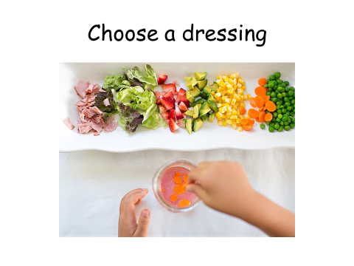

Slide 26
SALAD IN A JAR PROCESS
PROCESS
Complete this flow chart outlining the main steps to make your design. Include the safety & hygiene.
END

Slide 27
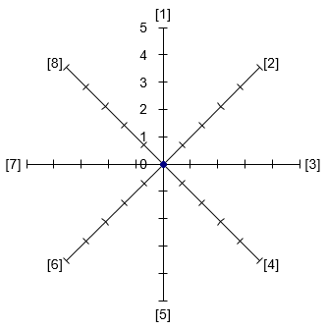
SALAD IN A JAR EVALUATION
Photo 1: Photo of my design idea
Write the 8 adjectives to describe your ultimate salad in ajar and complete the star chart & evaluation.
What went really well today…
Would have been better if…
Environmental Impact Statement …
Think about sourcing of ingredients, packaging, air miles, carbon foot print, chemicals used …

