Slide 1




Year 7 Graphics
Coat of Arms
Week 3

Slide 2
Recap…
Last lesson we looked at colour and the different emotions / feeling it can suggest.
Next you identified at least 3 words that describe you, and matched these to a colour.
Finally you made a list of hobbies/ interests and researched possible clip art images that represent these hobbies / interests.

Slide 3
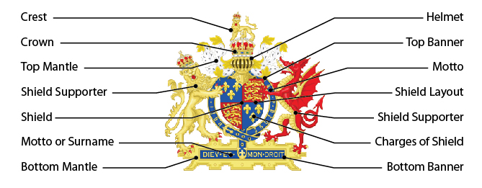
Today we are going to focus on the shape of shields and a family motto

Slide 4


Task 1 - Research different shape shields
Be mindful of the fact that you will have to draw your own shield so think carefully before
selecting very detailed / complicated shape designs!

Slide 5


Task 1 (part 2)
Research different banner shapes
This is where your family motto will go

Slide 6
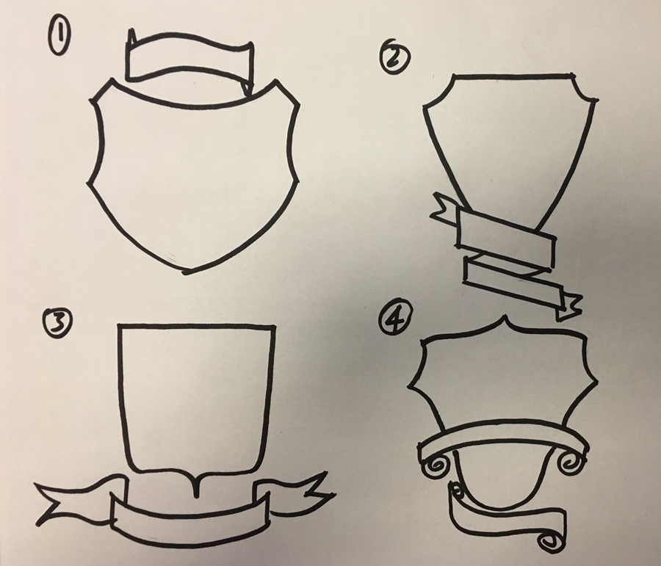
Task 1 (part 3) – Hand drawing
You now need to decide which shape shield and banners go well together. Using your research create 4 different combinations of shield and banner.
No need to add colour at this stage

Slide 7
Family motto – what is it?
A motto is usually a short sentence or phrase chosen as encapsulating the beliefs or ideals of an individual, family, or institution.
For example our school motto is
‘Striving for excellence’
Another school uses the motto
‘From Strength to Strength’
And another uses
‘Do to others what you want them to do to you’

Slide 8
Some examples of family mottoes
You don’t need to have the best of everything. Make the best of everything you have
Be happy with what you have, while working for what you want
You are stronger than you seem, braver than you believe, and smarter than you think
We may not have it together, but together we have it all
Have Courage and Be Kind
Don’t wait for storms to pass, dance in the rain

Slide 9
Some examples of family mottoes
Always there to always care.
Always loving and supporting each other no matter what.
Strive to show kindness.
Respect everyone's perspective.
Love, honesty, and trust.
We value empathy and understanding.
We show strength through our thoughtful words.
Constantly growing and learning.

Slide 10
Some examples of family mottoes
Choice, not chance determines your destiny
Do the right thing, even when no one is looking.
Broken crayons still color
Never let success get to your head. Never let failure get to your heart
People are more important than things.
Try a little harder to be a little better
You only fail when you stop trying

Slide 11
What will your family motto be?
You may already have a family motto, maybe someone in your family has a catch phrase that they use ….
Come up with a family motto for your coat of arms.

Slide 12
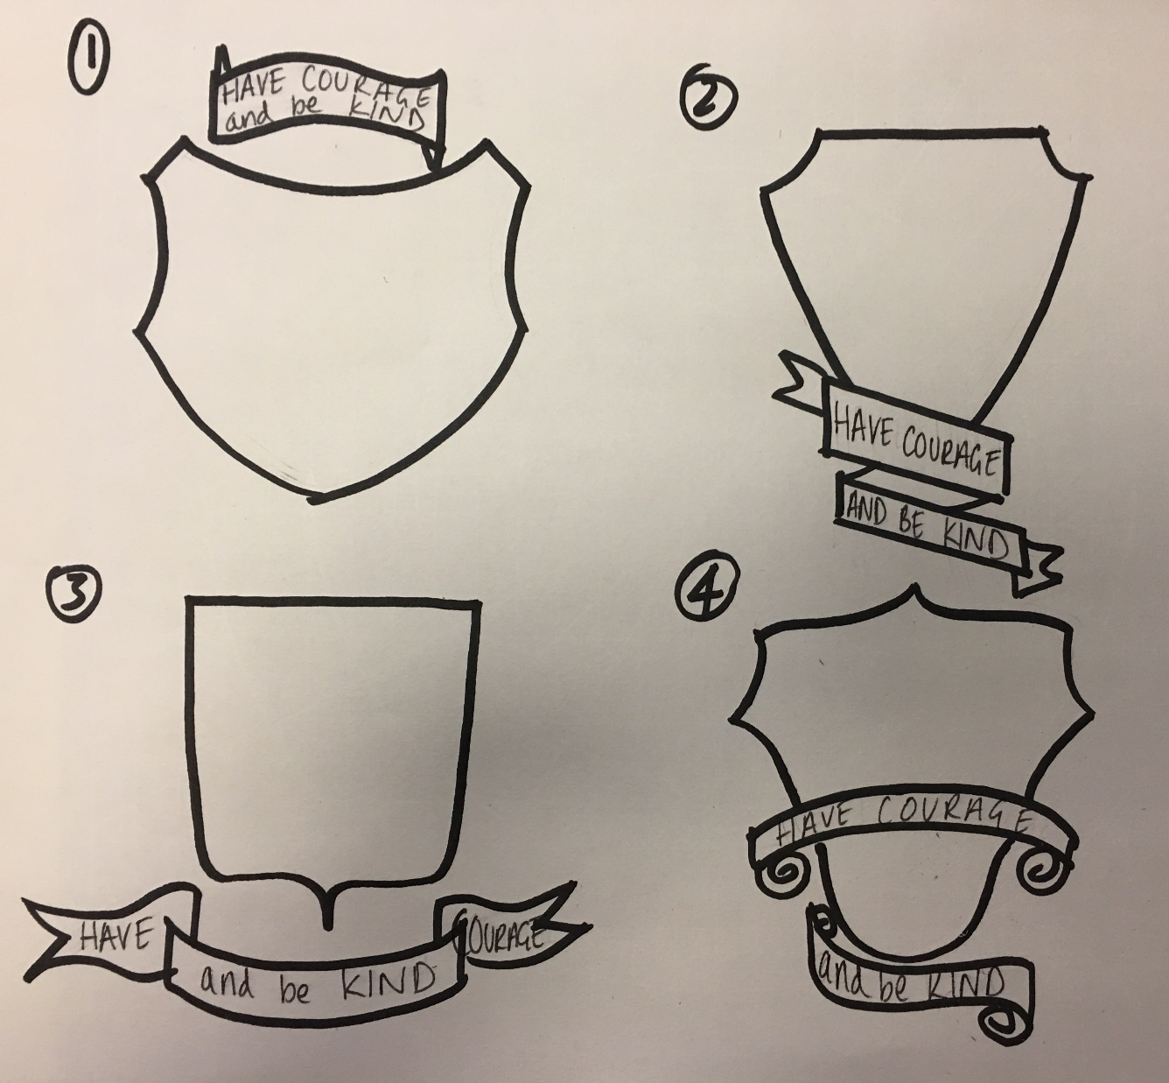
Task 3 – Add your motto to the banner on each of your 4 shield designs

Slide 13
Task 4
Remember the animal you chose from the first lesson?
Well you are going to have to draw that animal in a standing position to support your shield.
To help you with this, research your chosen animal in a standing position. Prepare one ppt slide of images. Where possible print off.
For example I Googled - lion standing up on hind legs
The following slide shows some of the examples I found

Slide 14





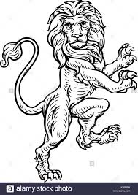
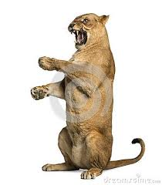
Standing lion research
As you can see they vary in their appearance from cartoon to detailed illustration to photographs

Slide 15
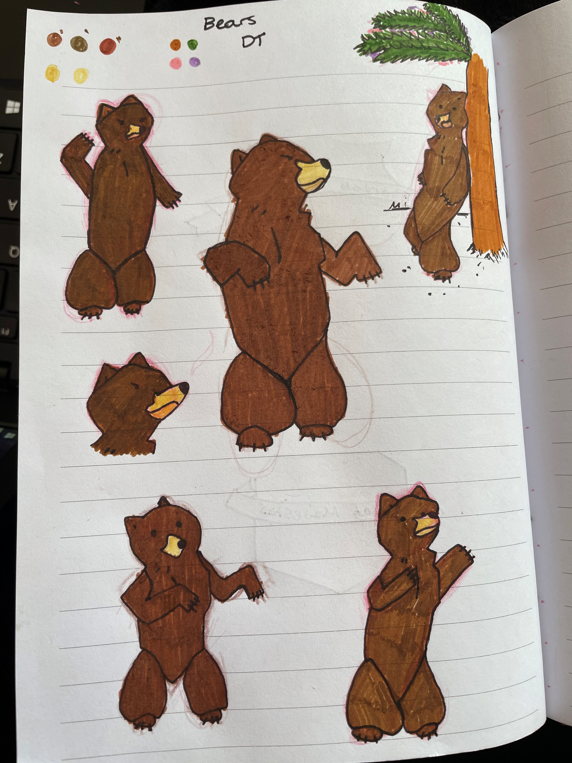
Have ago at drawing your chosen animal standing up.
Pupil example of animal standing up

Slide 16


Slide 17


Slide 21


Slide 22


Slide 25


Slide 26


Slide 31



Slide 32



Slide 33




Slide 34




