Slide 1




Year 7 Graphics
Coat of Arms

Slide 2
Recap…..
Last lesson we identified animal characteristics and chose an animal to represent our self / family

Slide 3
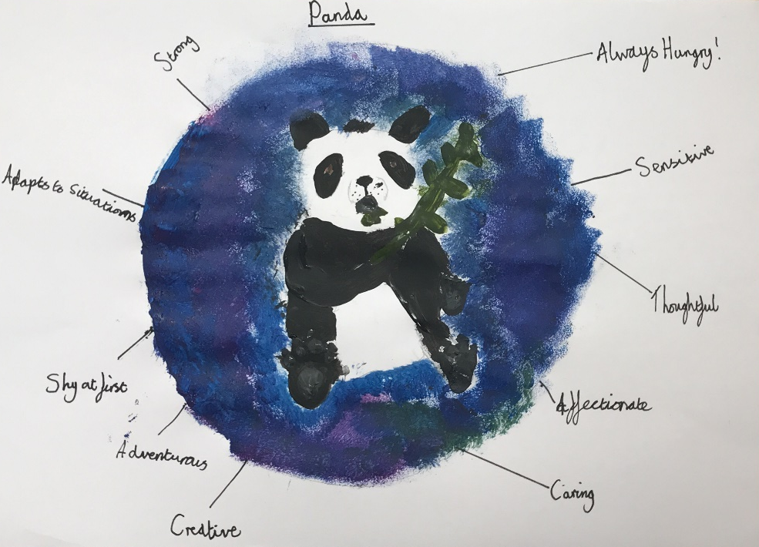

Slide 4
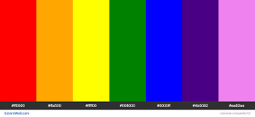
Week 2
This week we are going to focus on colour

Slide 5

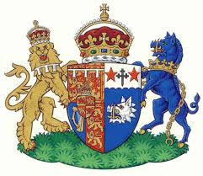

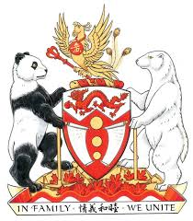

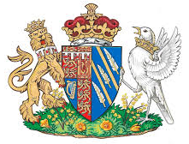
Existing Coat of Arms

Slide 6
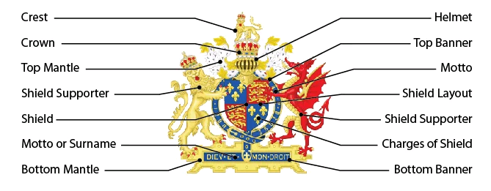
Anatomy of a Coat of Arms
A typical classic coat of arms features several distinct elements, including a shield, supporters, design motifs, and motto.

Slide 7
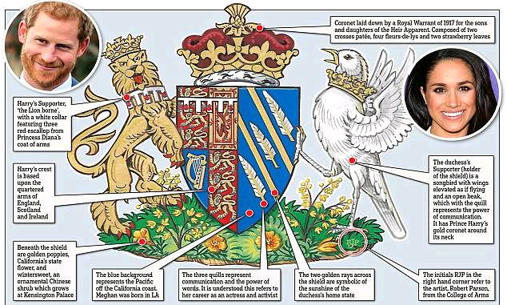
The Coat of Arms of the Duchess of Sussex includes subtle nods towards Meghan's native California

Slide 8
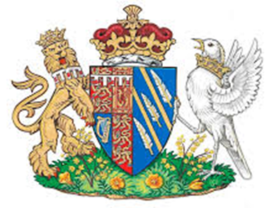
Meghan Markle worked closely with the College of Arms to design her own Coat of Arms which represents her personally and her American roots.
The blue background of the shield represents the Pacific Ocean off the California coast.
The two golden rays across the shield are symbolic of the sunshine of the Duchess's home state.
The three quills represent communication and the power of words.
Beneath the shield on the grass sits a collection of golden poppies, California's state flower, and wintersweet, which grows at Kensington Palace.

Slide 9
What colour?
Coats of Arms will often include a selection of colours.
RED
GREEN
YELLOW
PURPLE
ORANGE
WHITE
BLACK
BLUE
What feelings / emotions do you associate with each of these colours?

Slide 10
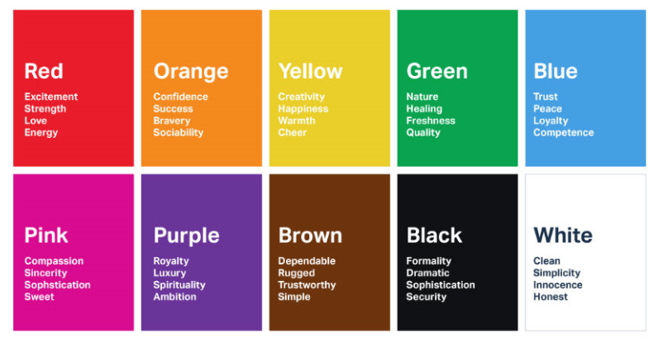

Slide 11
Week 2 / Task 1
Match each of these words to the appropriate colour.
I would like you to present this information in a creative way.
RED
Fear
Calm
Warning
Serene
Blood
Environment
Anger
Envy
Natural
Coward
Dreams
Weak
Repentance
Warmth
Pure
Energy
Hygienic
Happy
Clean
Goodness
Evil
Cold
Cool
Sinister
Mourning
Ice
Death
Chilled
Darkness
Mystery
GREEN
YELLOW
PURPLE
ORANGE
BLUE
WHITE
BLACK
Feel free to add your own words to this list!

Slide 12

Week 2 / Task 2 - Who are you?
Which of the following words best describes your character (the way you are)? Do they have a colour…?
Honest
Shy
Helpful
Trustworthy
Peaceful
Strong
Serious
Interesting
Aggressive
Hard Working
Pleasant
Intelligent
Kind
Cunning
Funny

Slide 13
Week 2 / Task 2 cont.
Identify up to 5 words that describe your character and provide a colour to reinforce each of the words.
For example someone who considers themselves to be...
Trustworthy
Interesting
Hard Working
Blue is associated with peace, water, tranquillity, and reliability. And it offers a sense of security. It's also the most common colour used by conservative brands looking to promote trust in their products.
Purple is associated with luxury, royalty, dreams, mystery and elegance. Light shades of purple are soothing and work well for beauty orientated advertising.
Red. While red signifies danger it can be used to good effect in marketing campaigns which need to evoke strong emotions. Red is associated with passion and love but its strong intensity also signifies excitement, determination and courage.

Slide 14

Design motifs
What kind of motifs will go on your Coat of Arms?
We have already discovered that Meghan’s motifs are two golden rays across the shield which are symbolic of the sunshine of the Duchess's home state.
The three quills represent communication and the power of words. It is understood this refers to her career as an actress and activist

Slide 15
Design motifs
To help you decide what kind of motifs to use for your Coat of Arms make a list of your favourite sport / hobby / interests. (this can also include your family's interests)
For example mine would include
Horse ridding
Photography
Baking
Once you have your list research Clip Art images that will help you to create your motif in a future lesson.

Slide 16


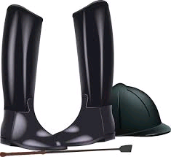
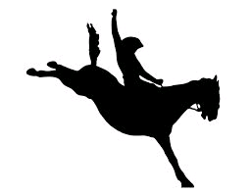






Week 2 / Task 3 Clip Art Research
Horse Riding
Photography
Baking

