Slide 1




Year 7 Graphics
Coat of Arms

Slide 2
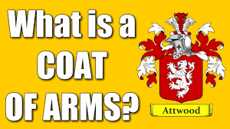
https://www.youtube.com/watch?v=osbMXZstL4o

Slide 3
What did you learn?
A Coat of Arms is an arrangement of heraldic symbols, shapes and colours on a ………..?
True or False? - They were developed to distinguish knights in battle.
Medieval Knights used their decorated shields to mark an …………. Instead of a tribe or nation.
Designs were placed on the
  Fur Coat
  Sur Coat
  Long Coat
they wore to protect their armour from the elements.

Slide 4
What did you learn?
5. Knights originally designed their own coat of arms granted by the crown to individuals. Who did they pass them onto?
6. What is the most important part of the coat of arms and is often displayed by itself?
7. It was mainly Aristocracy who were allowed to use arms except in ………….. Where all classes of citizens were allowed their use.
8. Which two country's are Coats of Arms still regulated?

Slide 5
Answers
A Coat of Arms is an arrangement of heraldic symbols, shapes and colours on a SHIELD
True or False? - They were developed to distinguish knights in battle.
Medieval Knights used their decorated shields to mark an INDIVIDUAL instead of a tribe or nation.
Designs were placed on the
  Fur Coat
  Sur Coat
  Long Coat
they wore to protect their armour from the elements.

Slide 6
Answers
5. Knights originally designed their own coat of arms granted by the crown to individuals. Who did they pass them onto? Their SONS
6. What is the most important part of the coat of arms and is often displayed by itself? The Shield
7. It was mainly Aristocracy who were allowed to use arms except in GERMANY Where all classes of citizens were allowed their use.
8. Which two country's are Coats of Arms still regulated? ENGLAND & SCOTLAND

Slide 7
Additional Information…. 12min clip
https://www.youtube.com/watch?v=zexpH6GCOh8

Slide 8

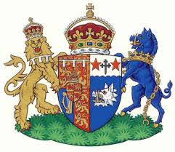




Existing Coat of Arms look at these examples and see how many different animals you can identify.

Slide 9


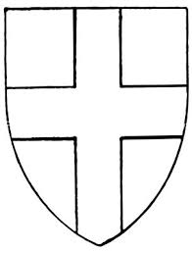



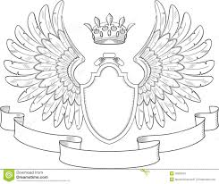
Examples of blank templates for a Coat of Arms.

Slide 10
How do you go about designing a Coat of Arms?
A Coat of Arms is normally composed of pictures and symbols.
The aim is to create an atmosphere or to build a meaning into the Coat of Arms.
For example, some Coats of Arms suggest strength, others suggest knowledge and wisdom.
Answering the following questions will help you ‘build’ your own Coat of Arms.

Slide 11
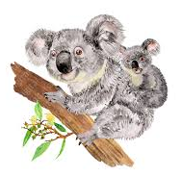
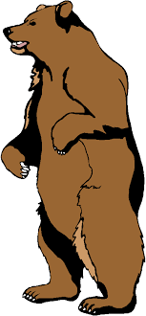
Week 1 – Animal Qualities / Characteristics
Animals are often included in a Coat of Arms. Each of the animals below has certain qualities / characteristics.
Identify between two and four qualities / characteristics for each animal.
Koala
Bear
Elephant
Kangaroo

Slide 12
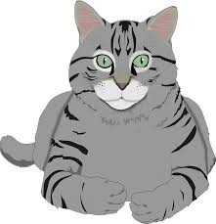

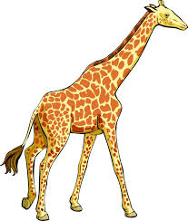
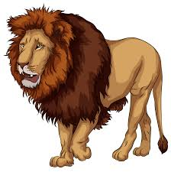
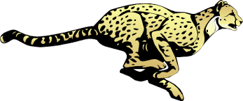
Grey Hound
Domestic Cat
Tiger
Lion
Cheetah
Giraffe

Slide 13
Graphics is all about presentation
Therefore I would like you to take time and care over your presentation of the task set.
How you chose to present the information is up to you-
For example you could-
Present as a table including pictures of the animals
Draw the animals yourself and list the characteristics below each animal

Slide 14
The following slide has some of the qualities / characteristics filled in to help you get started.

Slide 15
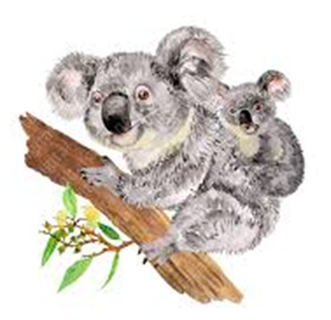
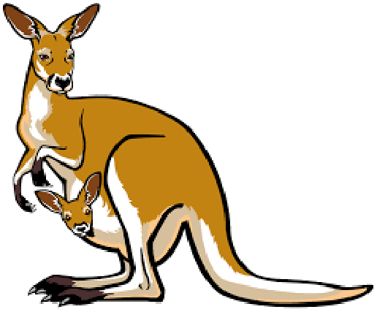
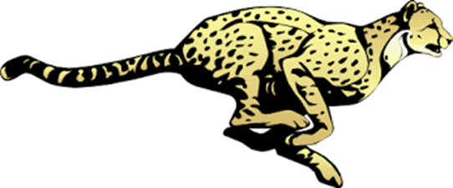
Animal | Characteristic 1 | Characteristic 2 | Characteristic 3 | Characteristic 4
Koala
Bear | Strong | Dangerous | Aggressive | Frightening
Elephant
Kangaroo
Grey Hound | Very Fast | Dedicated | Friendly
Domestic Cat
Tiger
Lion | Majestic | Lazy
Cheetah
Giraffe | Shy

Slide 16
Differentiation.
If you find that you are struggling with this task then try using some of the words listed below and match them to the appropriate animal. Note some characteristics may apply to more than one animal.
Illusive
Majestic
Extremely fast
Tall
Loving
Cuddly
Strong
Long Memory
Fast
Friendly
Peaceful
Aggressive
Dedicated
Cunning
Dangerous
Lazy
Hunter
Aloof
Slow
Very fast
Frightening
Large
Unusual
Nine Lives
Unsteady
Malicious
Powerful
Savage
Ancient
Loyal

Slide 17
Week 1 / Task 2
Which animal are you?
You now need to decide which animal(s) best represent you and your family. You can use one of the animals mentioned in the task you have just completed or you can choose a different animal(s)
Select an animal and explain why its characteristics apply to you.
Again think about your presentation -you could draw your chosen animal and then write a paragraph explaining your reason for why its characteristics apply to you.
You could present it in the format of a mind map with the animals name / picture in the middle and the key characteristics written around the out side.
You can present the work by hand or by computer.

Slide 18
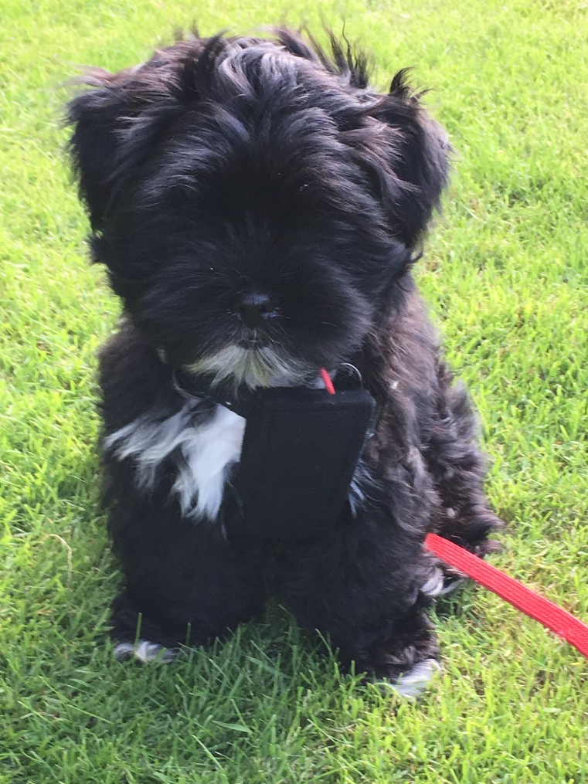
Chosen Animal – Lhasa Apso
Devoted
Friendly
Energetic
Lively
Intelligent
Fearless
Steady
Spirited
Assertive
Alert
Playful
Mischievous
Regal
Independent
Of the listed characteristics for a Lhasa Apso I feel the following best apply to me
Devoted / Friendly / steady / mischievous / independent.

Slide 19
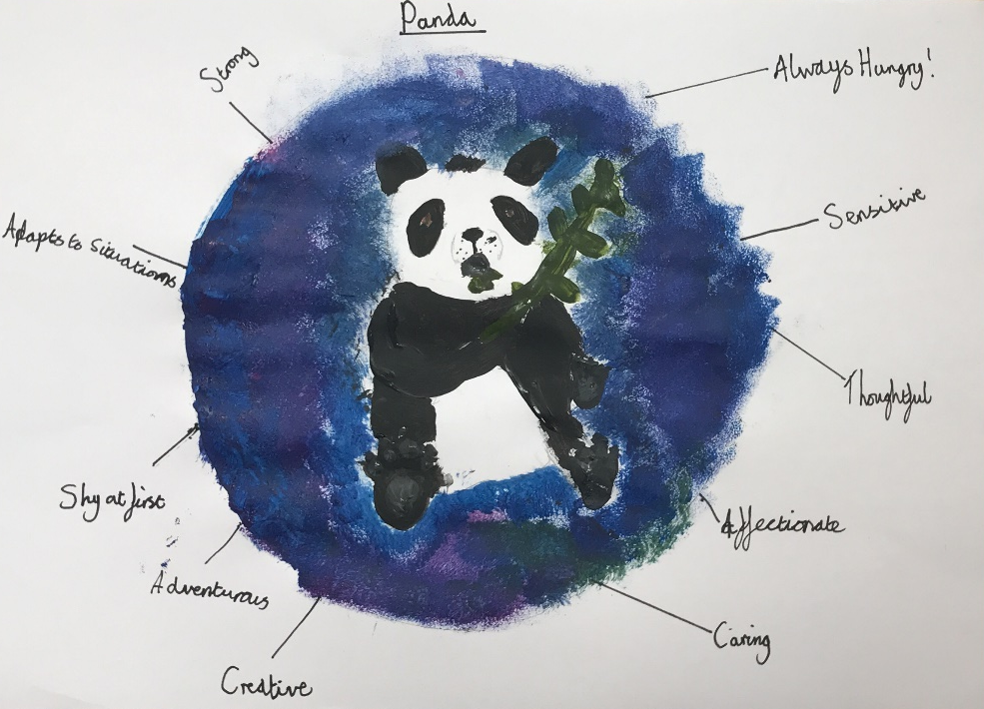

Slide 20
