Slide 1
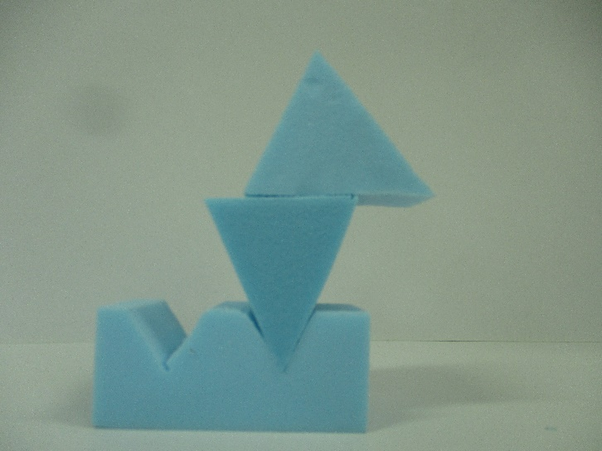
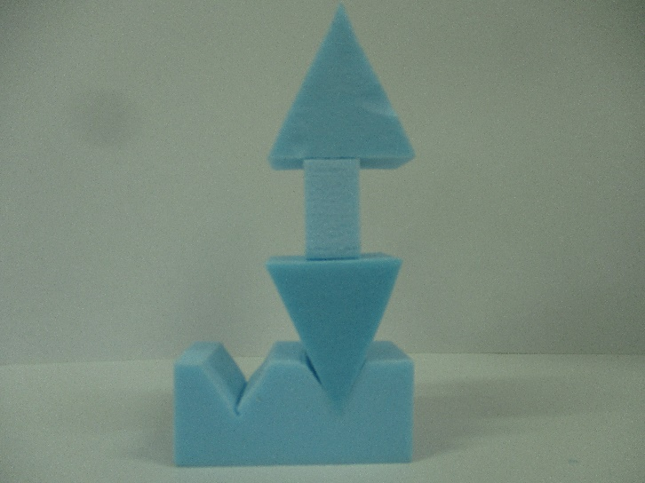
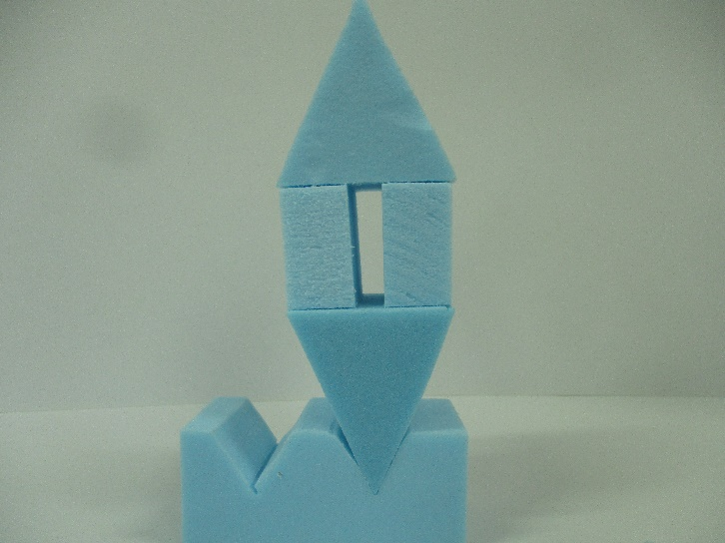
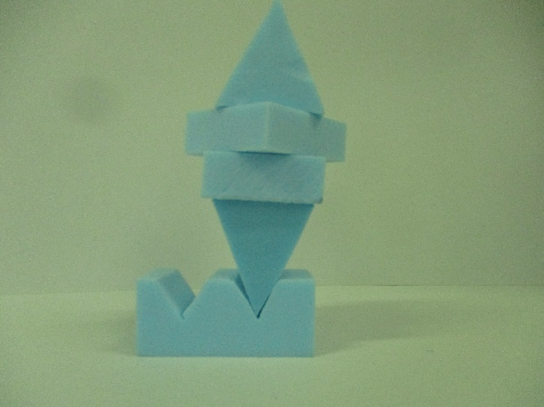
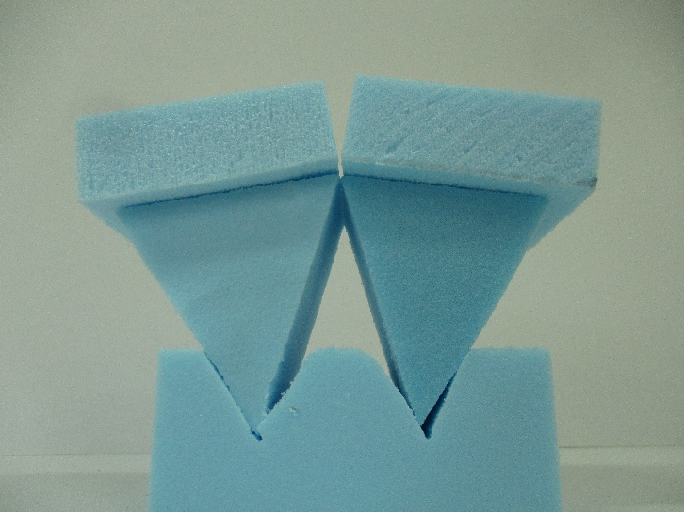
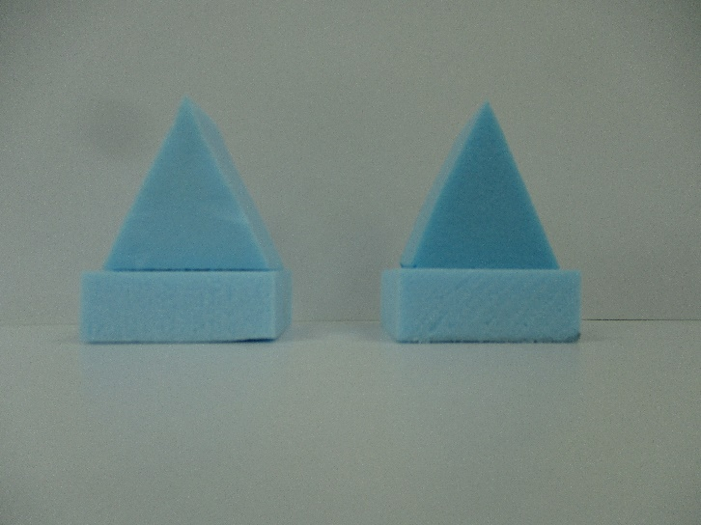
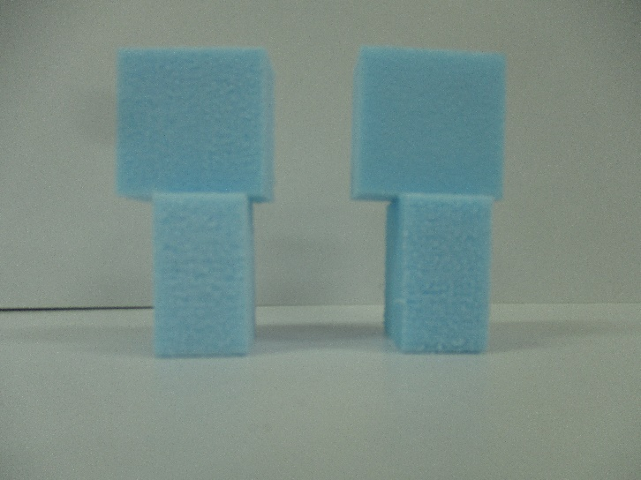
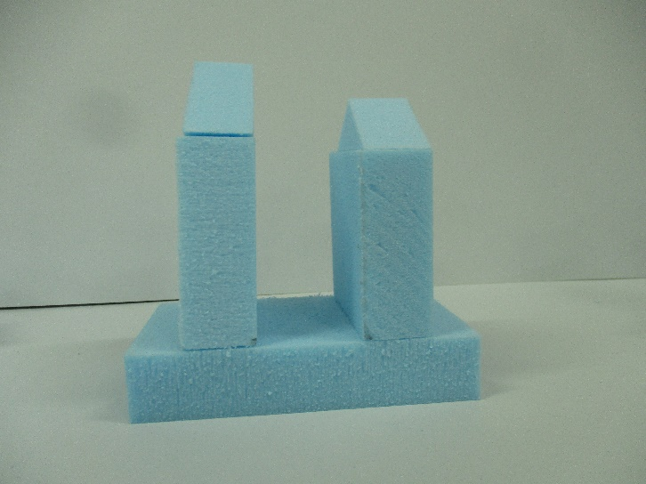
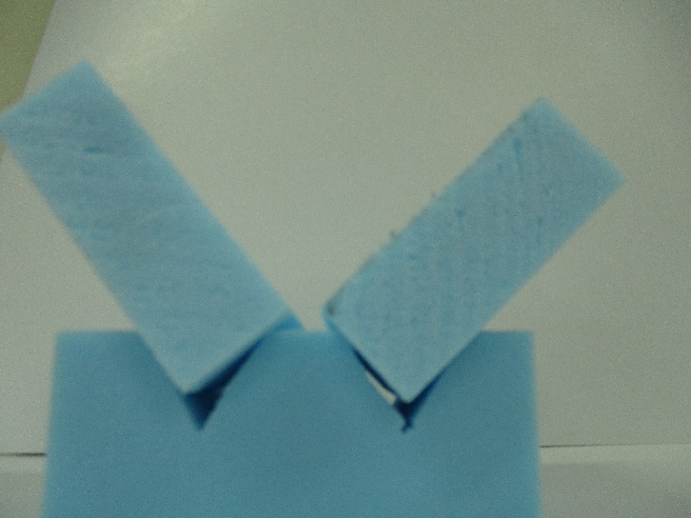
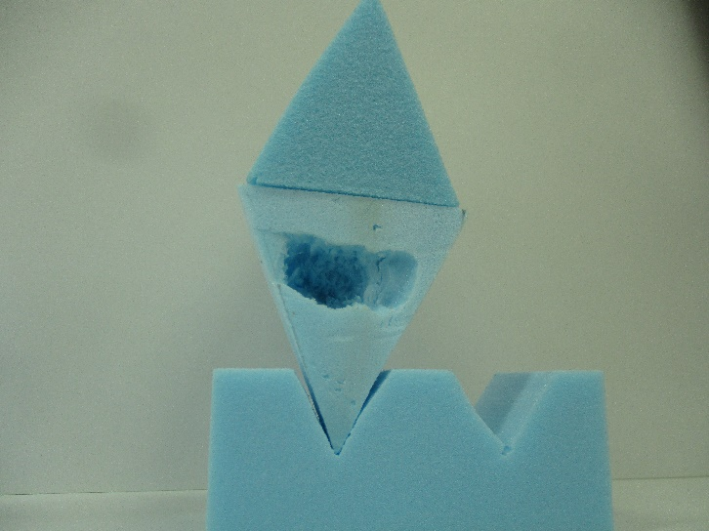
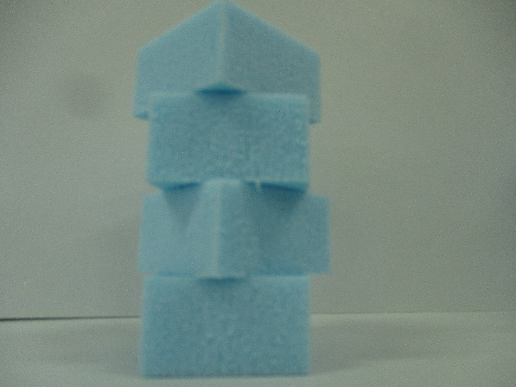
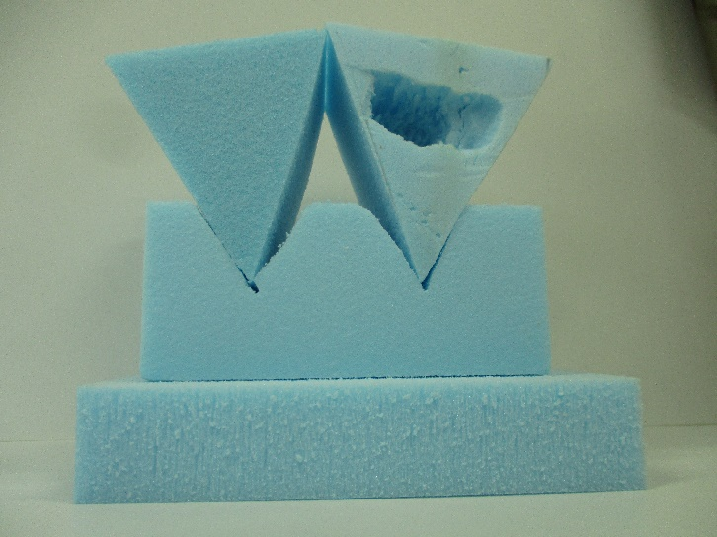
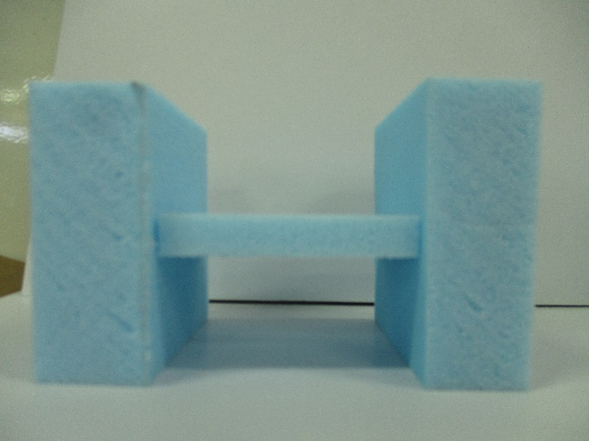
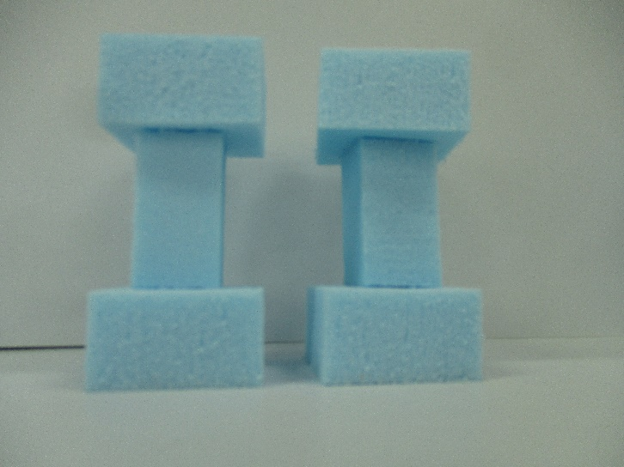
Concept Modelling and Design Experimentation

Slide 2
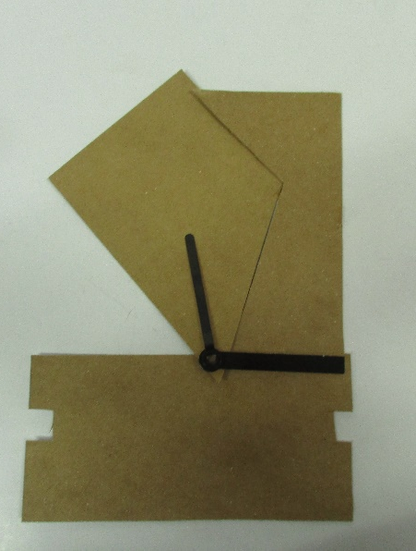
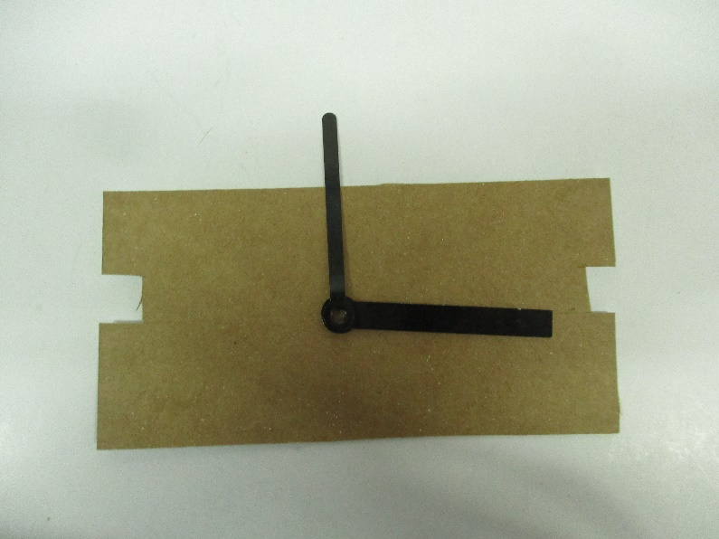
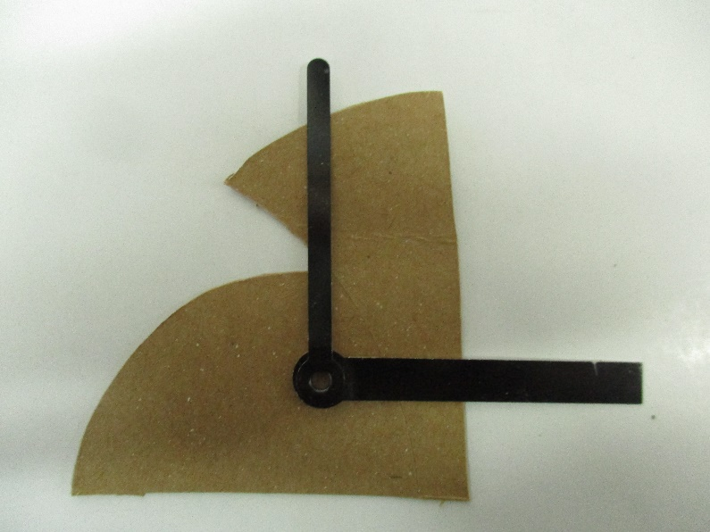
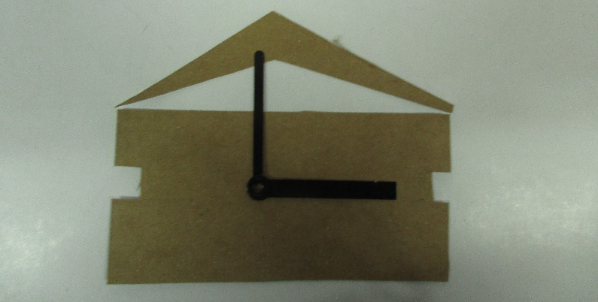
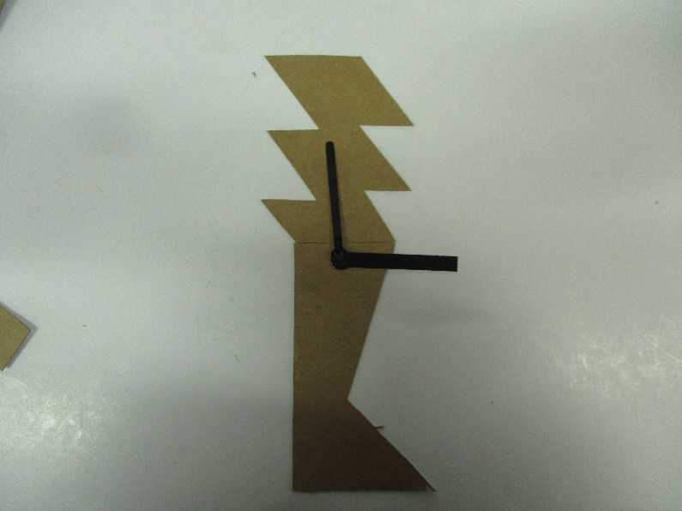
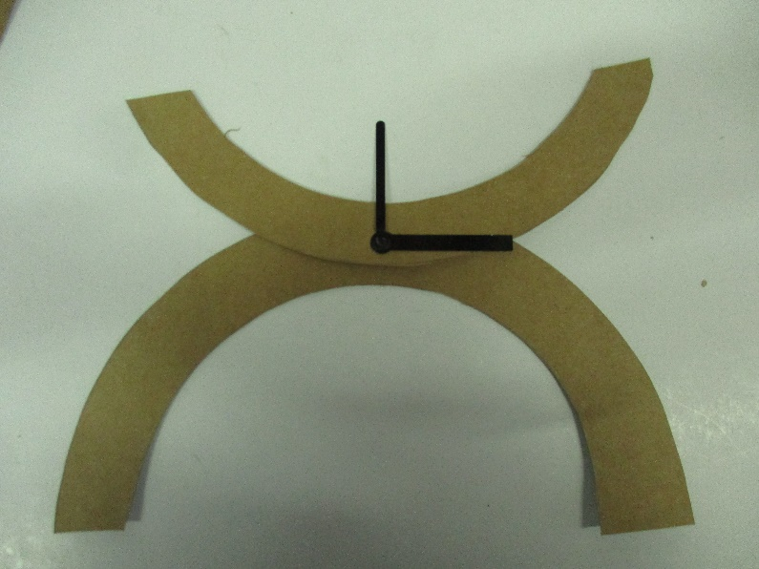
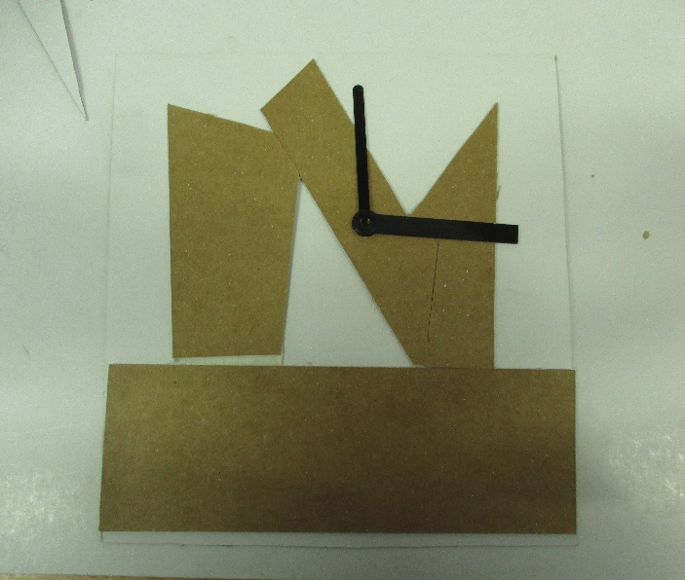
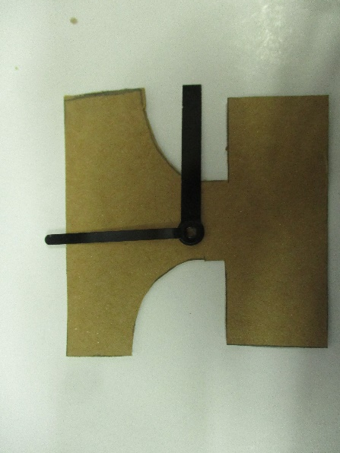
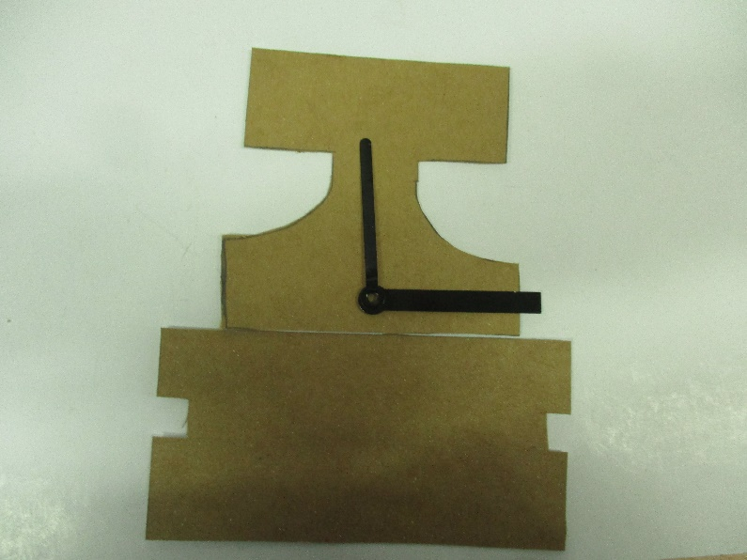
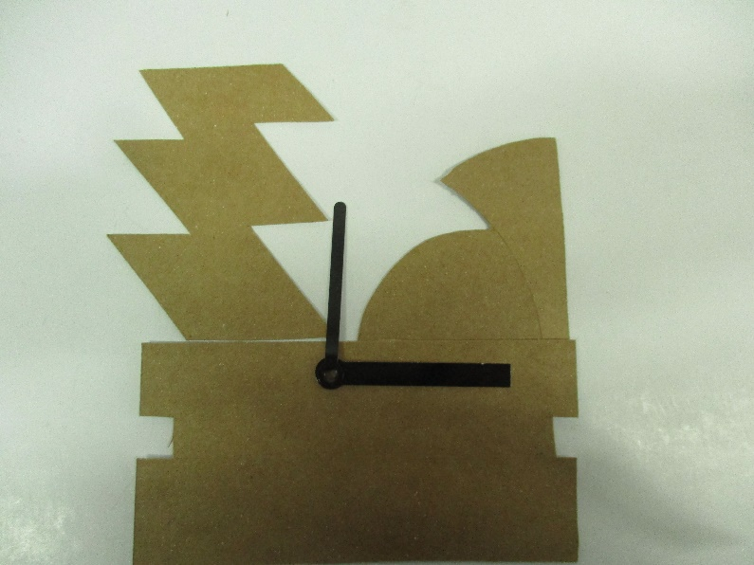
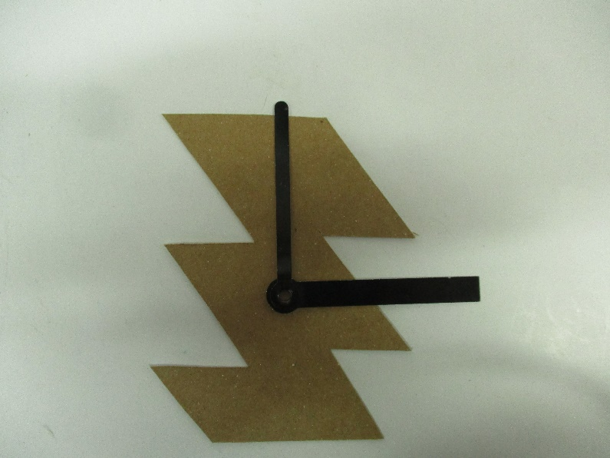
Concept Modelling
Questions to answer around you’re the photos of your concept models.
What have you made and how would it work?
What tools, equipment and processes did you use to make your model?
What do you think of your concept design model– does the design need further development to improve it?
What materials, tools, equipment and processes do you think you will use in making the full size version?
Concept Modelling and Design Experimentation

Slide 3
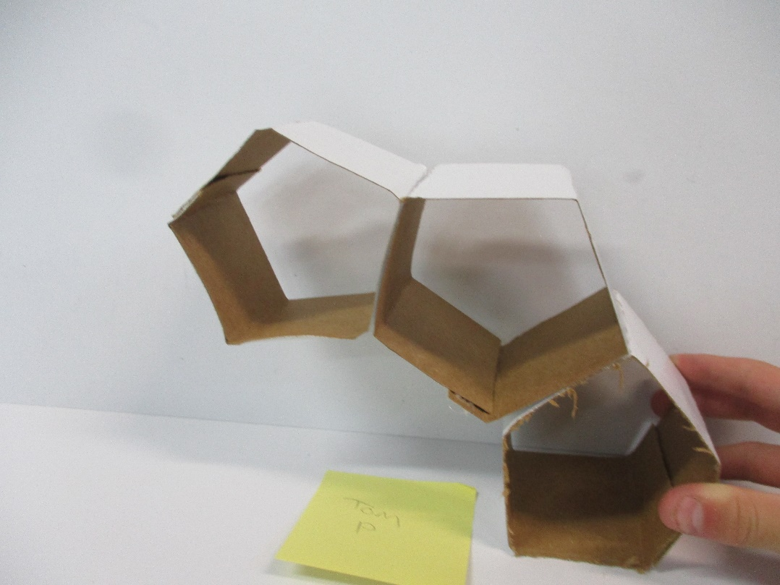
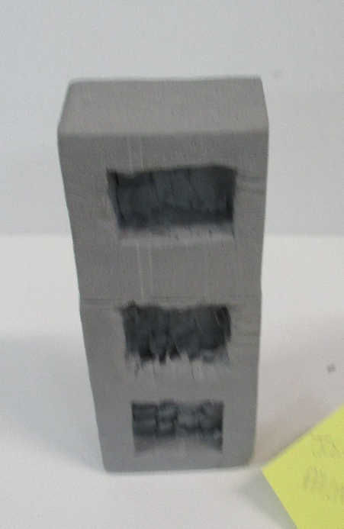
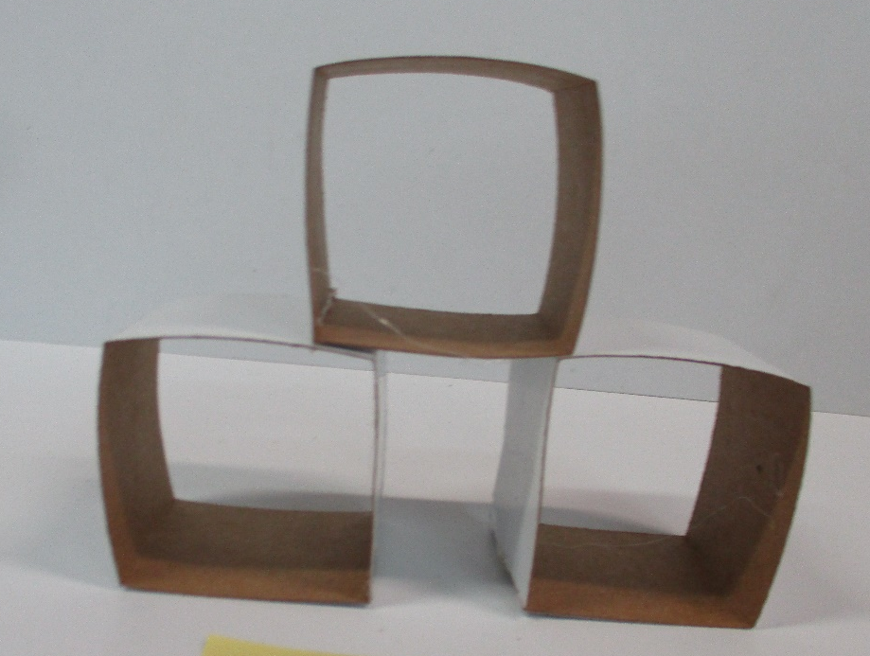
1. This is a storage unit. It would be wall mounted
2. I used scissors and hot glue to make it.
3. I like the shape but could make it better by adding two more storage pods
4. I would make it using pine and cut the wood to a 30 degrees angle
4. I make it like how I made the butchers block
3. I could put a door on the front of each storage box
Concept Modelling and Design Experimentation
3. I could put a divider in one storage box
Concept Modelling
Questions to answer around you’re the photos of your concept models.
What have you made and how would it work?
What tools, equipment and processes did you use to make your model?
What do you think of your concept design model– does the design need further development to improve it?
What materials, tools, equipment and processes do you think you will use in making the full size version?
3. I could put a drawer into one storage box

Slide 4
Concept Modelling and Design Experimentation
Concept Modelling
Questions to answer around you’re the photos of your concept models.
What have you made and how would it work?
What tools, equipment and processes did you use to make your model?
What do you think of your concept design model– does the design need further development to improve it?
What materials, tools, equipment and processes do you think you will use in making the full size version?

Slide 5
Design Development Modelling
Development Modelling
You need to make at least 2 more concepts. Choose your best 1 or 2 design ideas
Either
For your best idea, make 2 concepts models showing two different developments to the design to further improve the idea
Or
2. Make a concept model for each of your 2 best ideas showing a development in each of them

Slide 6
1. Why this is your best idea and the one that you have chosen to make?
2. What design style has inspired your idea and how have you incorporated the characteristics of the style into your final design?
3. How has your design changed, developed and improved since your first idea?
Your final design drawing in here
Final Design
4. Explain your idea - who it is for, where will it be used, what will it be used for, what will it store etc
5. What colour, materials, making methods are you likely to use to make your final idea?
(6. Go around your final design with a fine liner and colour you design in)

Slide 7
Concept Modelling
Questions to answer around you’re the photos of your concept models.
What have you made and how would it work?
What tools, equipment and processes did you use to make your model?
What do you think of your concept design model– does the design need further development to improve it?
What materials, tools, equipment and processes do you think you will use in making the full size version?
Concept Modelling
Questions to answer around you’re the photos of your concept models.
What have you made and how would it work?
What tools, equipment and processes did you use to make your model?
What do you think of your concept design model– does the design need further development to improve it?
What materials, tools, equipment and processes do you think you will use in making the full size version?
Concept Modelling
Questions to answer around you’re the photos of your concept models.
What have you made and how would it work?
What tools, equipment and processes did you use to make your model?
What do you think of your concept design model– does the design need further development to improve it?
What materials, tools, equipment and processes do you think you will use in making the full size version?
Concept Modelling
Questions to answer around you’re the photos of your concept models.
What have you made and how would it work?
What tools, equipment and processes did you use to make your model?
What do you think of your concept design model– does the design need further development to improve it?
What materials, tools, equipment and processes do you think you will use in making the full size version?

