Slide 1
Concept Modelling and Design Experimentation
Concept Modelling
Questions to answer around you’re the photos of your concept models.
What have you made and how would it work?
What tools, equipment and processes did you use to make your model?
What do you think of your concept design model– does the design need further development to improve it?
What materials, tools, equipment and processes do you think you will use in making the full size version?

Slide 2
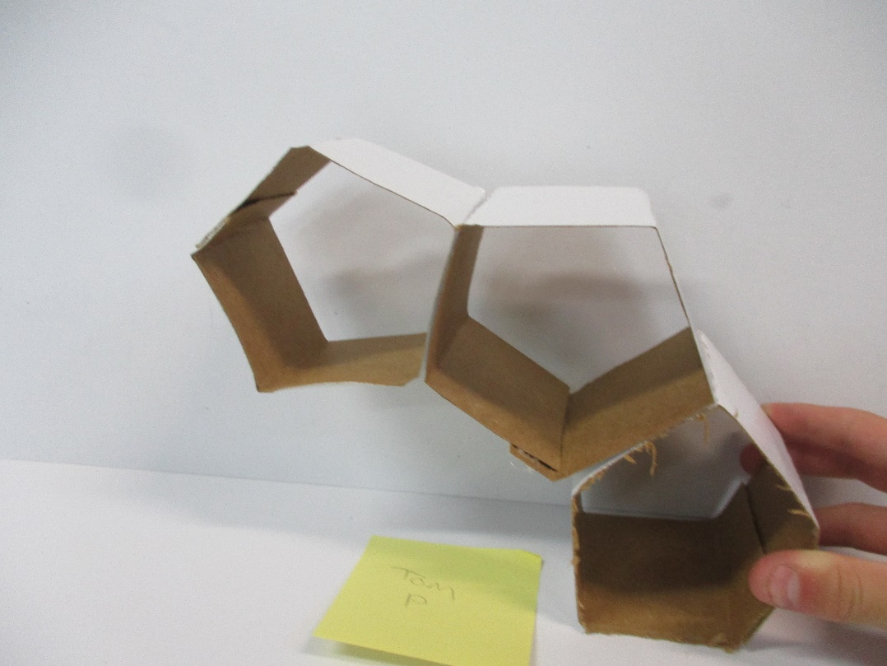
1. This is a storage unit. It would be wall mounted
2. I used scissors and hot glue to make it.
3. I like the shape but could make it better by adding two more storage pods
4. I would make it using pine and cut the wood to a 30 degrees angle
4. I made it like how I made the butchers block
3. I could put a door on the front of each storage box
Concept Modelling and Design Experimentation
3. I could put a divider in one storage box
Concept Modelling
Questions to answer around you’re the photos of your concept models.
What have you made and how would it work?
What tools, equipment and processes did you use to make your model?
What do you think of your concept design model– does the design need further development to improve it?
What materials, tools, equipment and processes do you think you will use in making the full size version?
3. I could put a drawer into one storage box

Slide 3
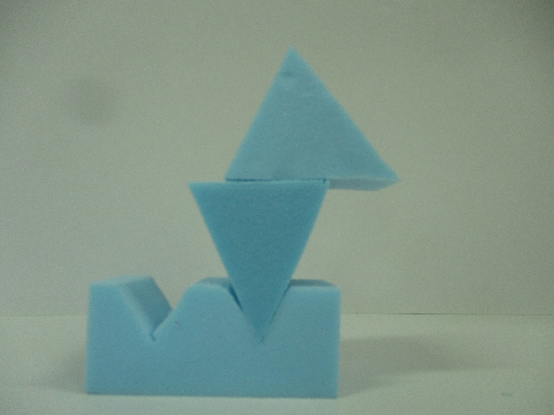
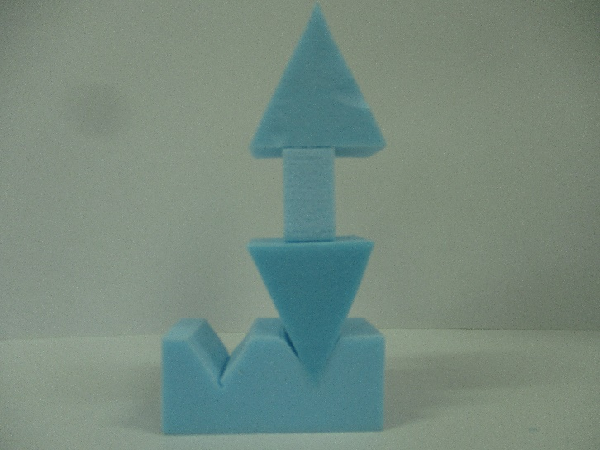
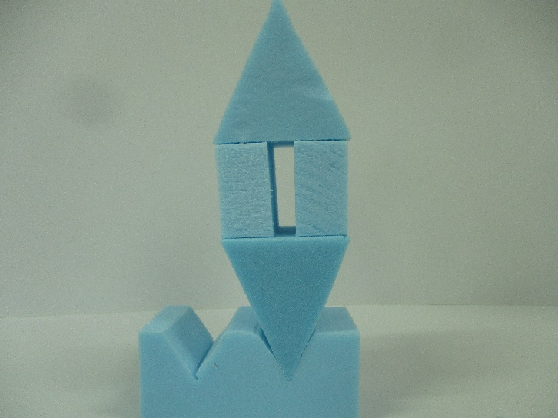
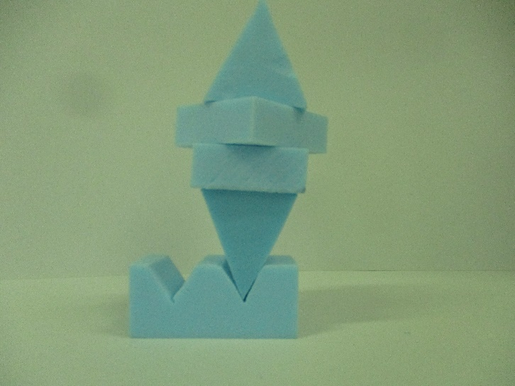
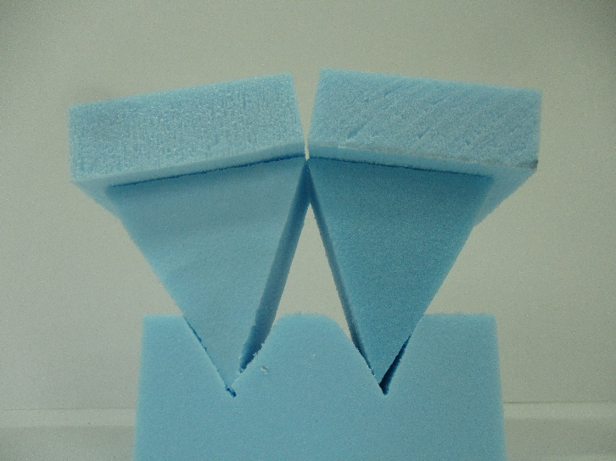
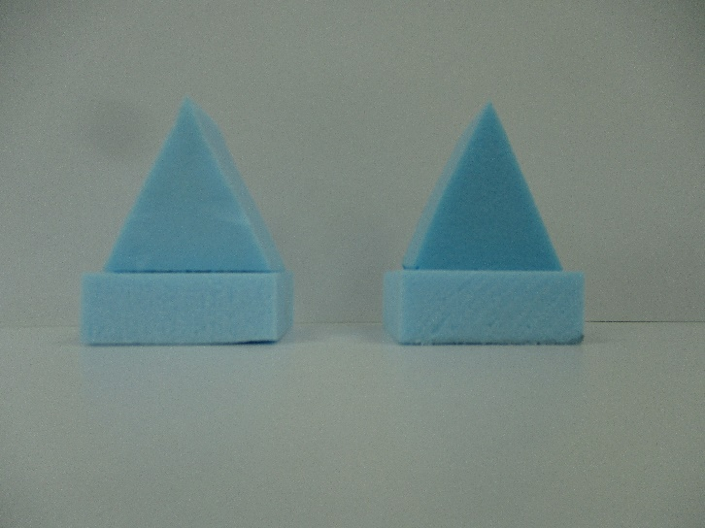
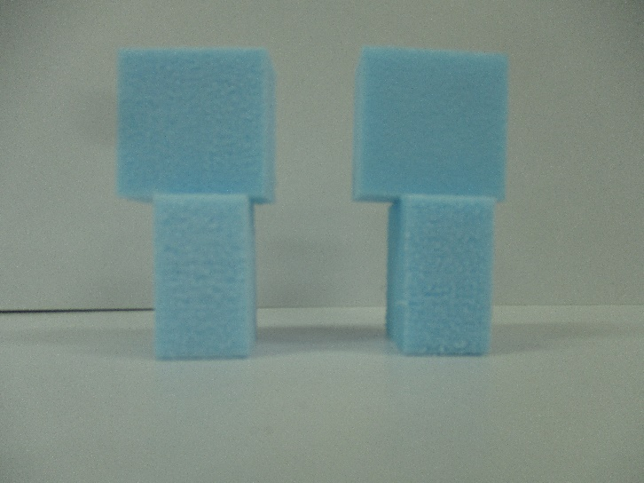
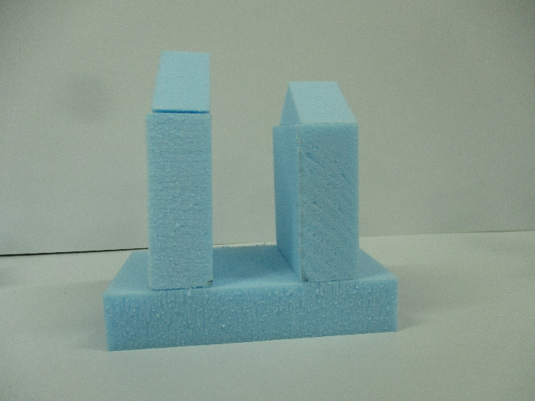
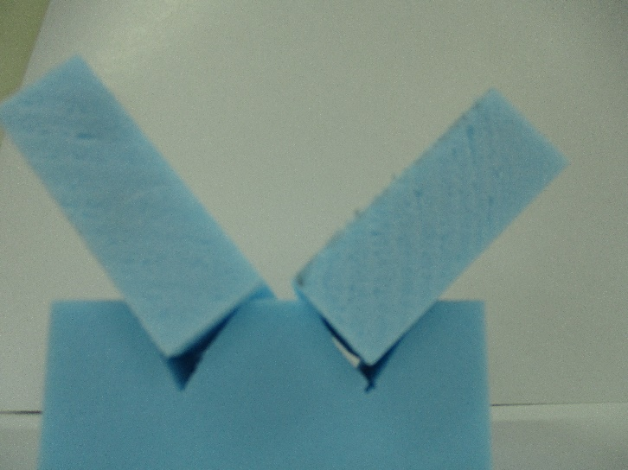
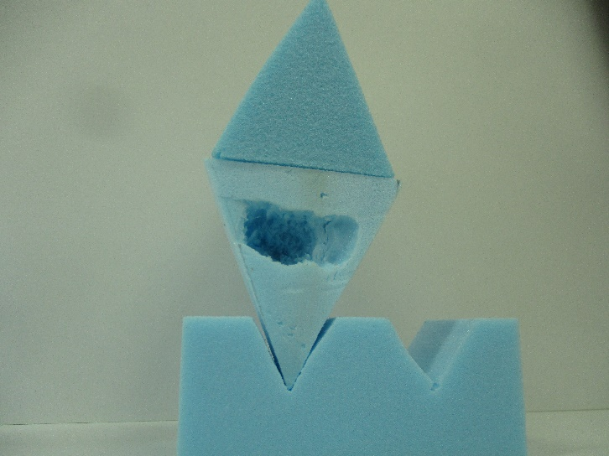
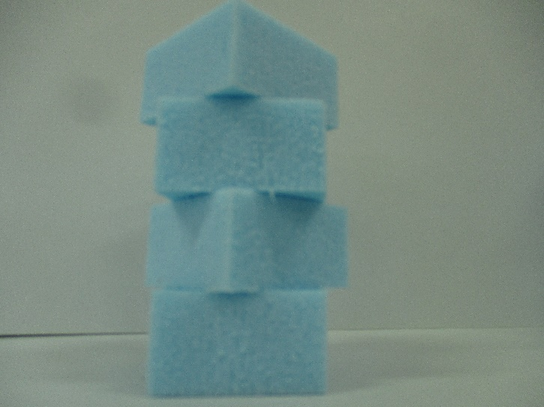
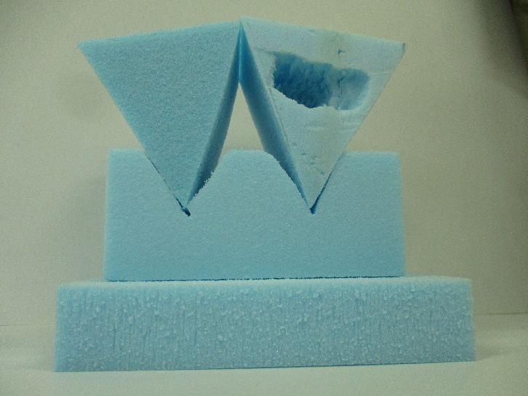
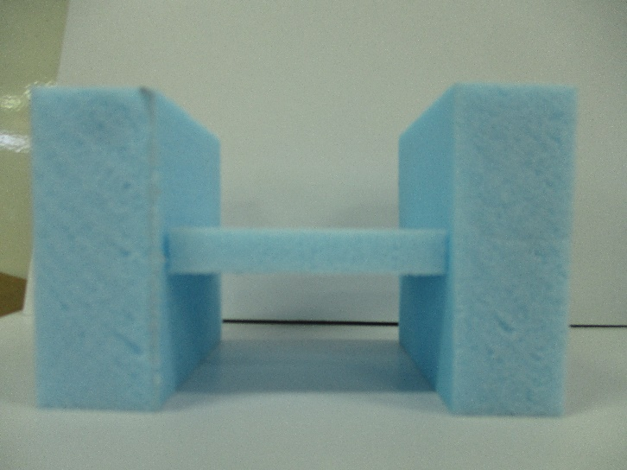
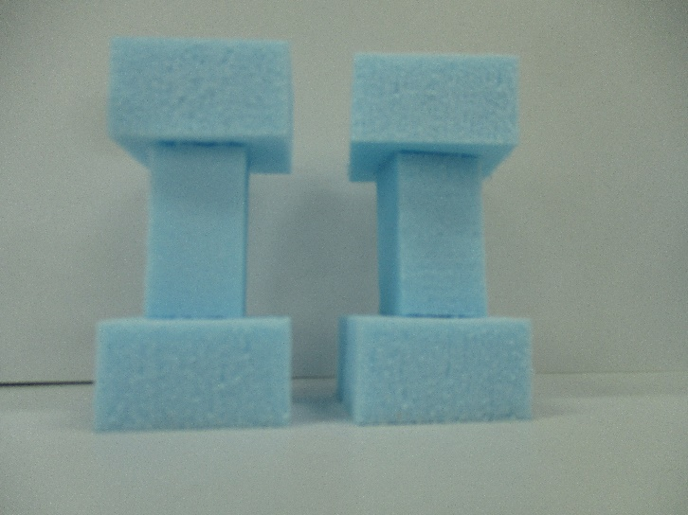
Concept Modelling and Design Experimentation

Slide 4
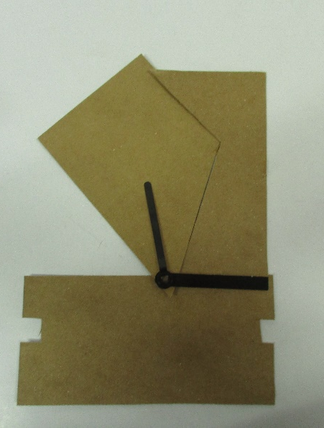
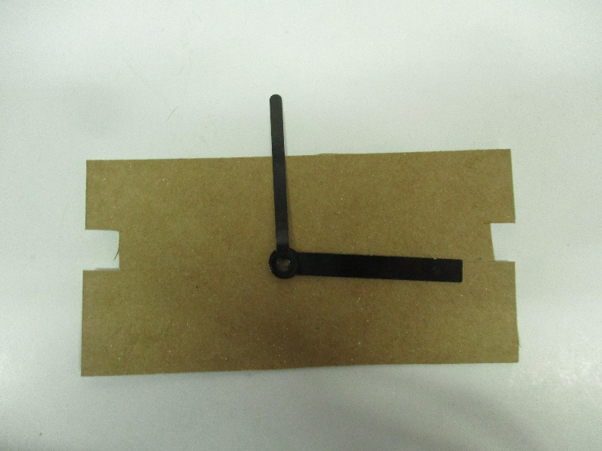
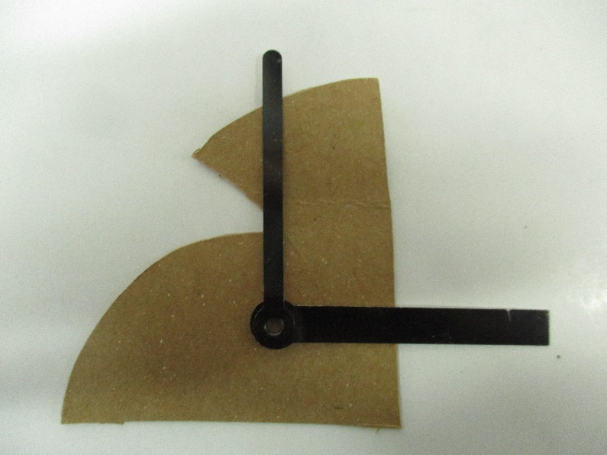
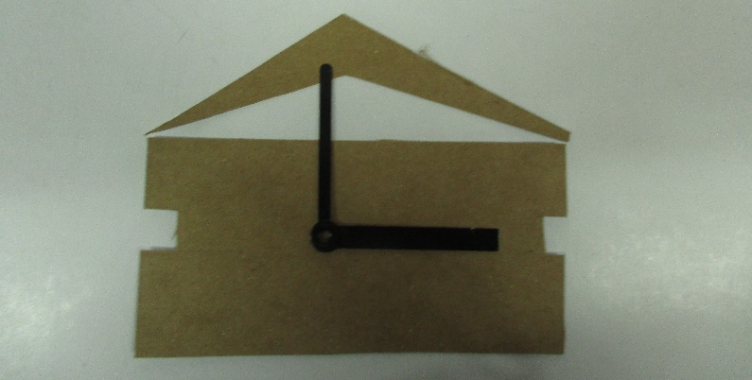
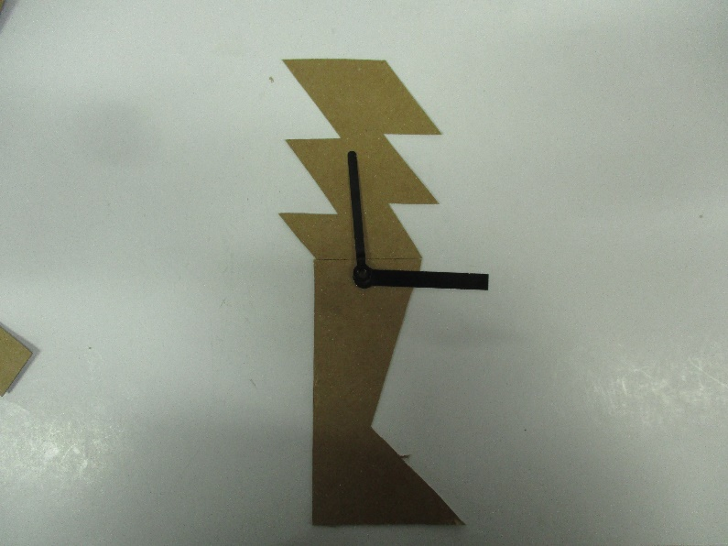
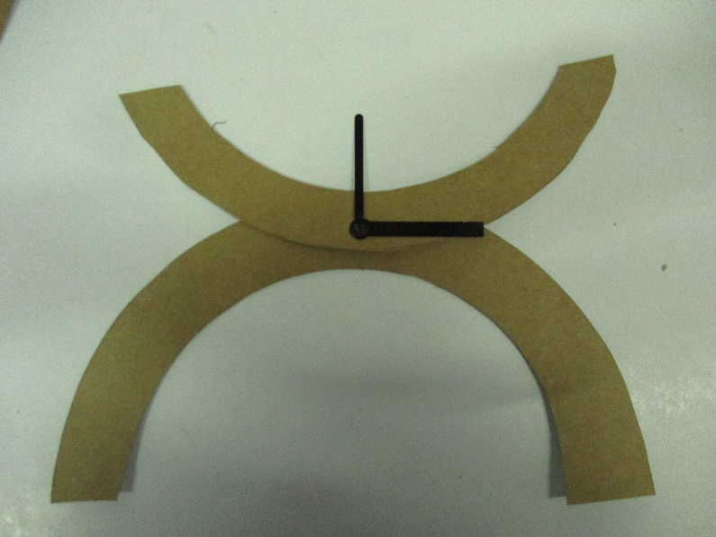
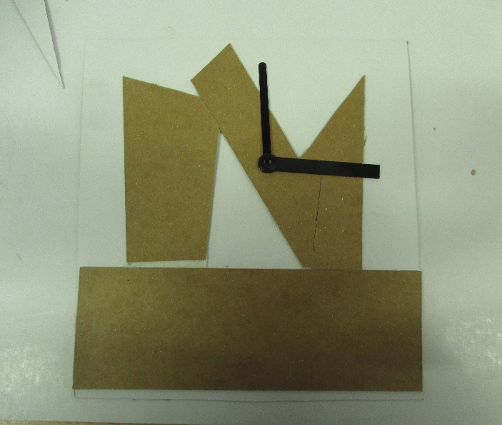
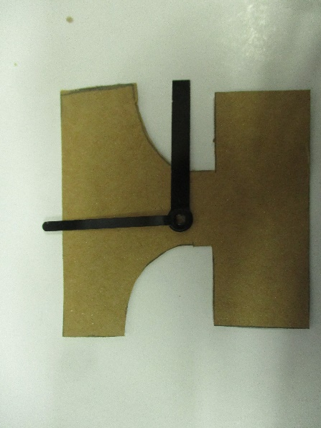
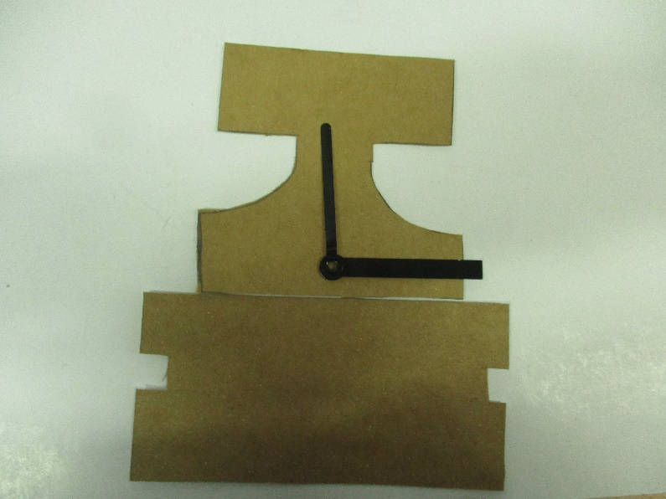
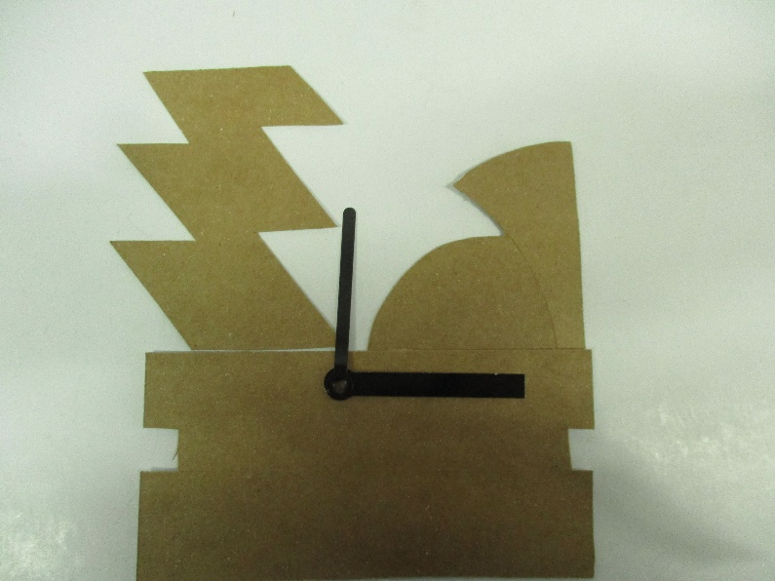
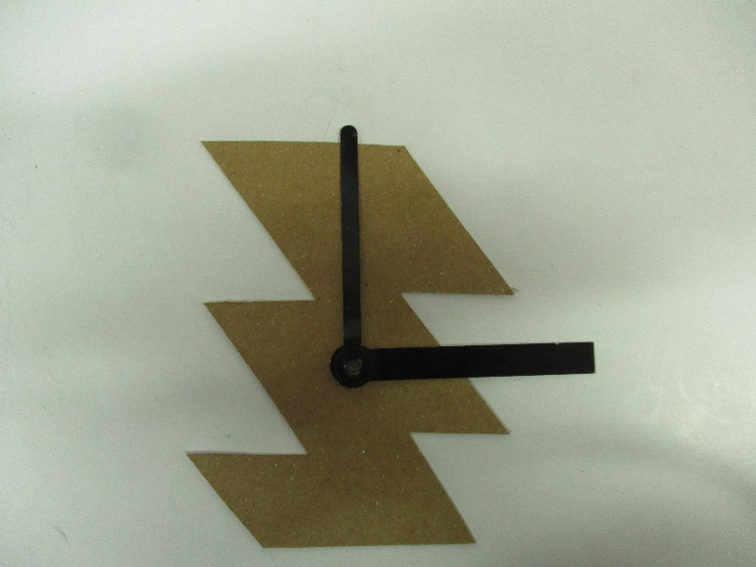
Concept Modelling
Questions to answer around you’re the photos of your concept models.
What have you made and how would it work?
What tools, equipment and processes did you use to make your model?
What do you think of your concept design model– does the design need further development to improve it?
What materials, tools, equipment and processes do you think you will use in making the full size version?
Concept Modelling and Design Experimentation

