Slide 1
Lesson 3 -BREAKFAST IN A JAR DESIGN
Its important that we start the day with a healthy breakfast. This sets us up for the day providing us with energy, fibre, protein and vitamins and minerals.
Choose one of your 4 designs as your Final Design giving reasons for your
choice.
2. Produce a sketch of your final
design. Slide 2. It should be
rendered (coloured in) and annotated
(labelled)
3. The sketch should show all the
layers/ colours/ingredients etc.
4. Make a plan of how you will make
your salad in a jar. Complete Slide 3.
5. Read Slide 4,5 and 6 and try and
write a plan using the framework on
Slide 7.
6. Use your plan and if possible have a
go at making your Breakfast in a Jar.
Email me a photo!

Slide 2
Name of Product
Description of Product
Draw your design idea for the breakfast in a jar … Make sure that you have annotated how you have included: fruits – protein ( yoghurt) – Carbohydrates –Cereals – Fibre – seeds- nuts-
Comment on textures/colours etc

Slide 3
BREAKFAST IN A JAR PLANNING
Ingredients Required
Preparation
Equipment Needed
Cooking
Equipment Needed
Serving
Equipment Needed
Success Criteria … what will make my Breakfast in a Jar the best product in the room …
I must demonstrate that …
The product must show …
I will have challenged myself by…

Slide 4
Wear a clean apron and wash hands before cooking
Take care when using sharp knives
Use correct chopping board
Take care when using hob/boiling pans when cooking pasta rice etc
Use the lid to cover the breakfast product and store in the fridge to keep salad safe to eat.
Wash up in hot soapy water. Take care when washing sharp knives.

Slide 5
Wash hands, put on an apron. Collect ingredients and equipment
Select your chosen fruit.
Select your chosen cereals/granola etc
Place yoghurt/fromage frais in bottom of jar.
Prepare all fruit – name them and how did you do it – slice/dice/grate.
Once all ingredients are prepared, layer up the ingredients in the jar. What order did you put the in?
Store with lid on in the fridge.

Slide 6
BREAKFAST IN A JAR PROCESS
PROCESS
Complete this flow chart outlining the main steps to make your design. Include the safety & hygiene.
END

Slide 7
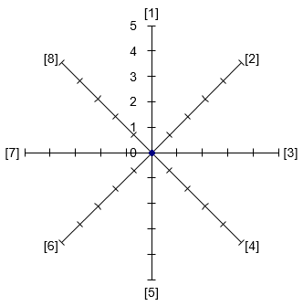
BREAKFAST IN A JAR EVALUATION
Photo 1: Photo of my chosen design idea
Write the 8 adjectives to describe your ultimate breakfast in ajar and complete the star chart & evaluation.
What went really well today…
Would have been better if…
Environmental Impact Statement …
Think about sourcing of ingredients, packaging, air miles, carbon foot print, chemicals used …

