Slide 1
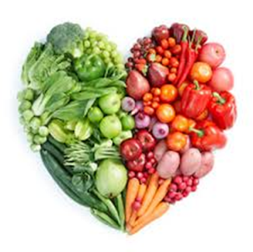
Lesson 2 -Breakfast in a Jar.
To show an understanding of the design brief..
Produce a specification for your breakfast in a jar.
Show an understanding of where we get energy, protein, fibre and vitamins and minerals from when planning your product.
Produce 4 different Breakfast in a jar designs. Using your knowledge and understanding of healthy eating from previous folder work to produce an interesting range of 4 designs.
Produce excellent design work, rendered and annotated.

Slide 2
BREAKFAST IN A JAR DESIGN
Its important that we start the day with a healthy breakfast. This sets us up for the day providing us with energy, fibre, protein and vitamins and minerals.
What you need to do:
Read and understand the Design Brief - slide 4
Produce a Design specification .Slide 6.This is a list of points you would expect the salad to be – Use slide 5 to help you.
Consider what ingredients you could put in your Breakfast in a Jar. Slide 9. If you google Breakfast in a jar /images it will give you more ideas.
Produce a mind map or use template of jar
to show foods you could consider to put in
your product .
Example - Slide 9.
You can use Template slide 10 to help.
Produce 4 different designs showing your knowledge of ingredients. Remember label and add colour to your sketches.
YOU MUST HAVE THE FOUR DESIGNS COMPLETED FOR NEXT LESSON

Slide 3
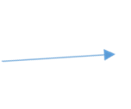
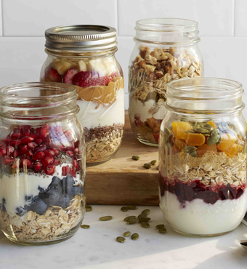
BREAKFAST IN A JAR DESIGN
Advantages of making a Breakfast in Jar
Suitable for a quick breakfast or
a breakfast on the go.
It is a complete
breakfast in
a jar
Easy to eat with a
spoon
It can use up leftovers
fruits and
yoghurt in fridge
to prevent waste.
You can easily change the design
to meet what you have in your fridge
It is easy to store
in the fridge for later

Slide 4
Design Brief:
You have been asked by a local food manufacturer to design and make a Breakfast in a Jar. The product should promote healthy eating and encourage customers to eat a healthy breakfast at the start of the day.

Slide 5
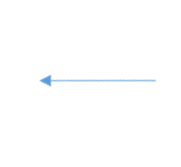
BREAKFAST IN A JAR DESIGN
Points I will need to consider
for my breakfast in a jar
Use a range of fruits
Colourful
Incorporate
attractive
layers
Include a range
of textures
Taste good
Include a fibre
Include a protein food
Include a carbohydrate :
this will fill you up.

Slide 6
SPECIFICATION -BREAKFAST IN A JAR DESIGN
Using the previous slide can you write a Specification
for your Breakfast in a Jar. A specification is a checklist of
what the product should be .
1
2
3
4
5
6
7
8

Slide 7
SPECIFICATION -BREAKFAST IN A JAR DESIGN
Your specification should look something like this:
Range of textures
Colourful layers
Healthy
Taste good
Include a range of fruits .
6.Include a protein food.
7.Include a carbohydrate
8. Include Fibre

Slide 8
BREAKFAST IN A JAR DESIGN
Make your choices – add more ideas to the table below or present the work like slide 9.
Think about colourful layers and flavours and textures that complement each other.
Consider what is in your fridge and needs eating up☺
Food Group | Examples
Fruits | Fresh-blue berries, kiwi fruit… Dried- banana, raisins….. Tinned- peaches….
Protein foods Eg yoghurt | Natural or flavoured yoghurt .. Fromage Frais
Foods rich in Fibre | Seeds – Nuts – Oats – Breakfast cereals -
Carbohydrates – to give us energy | Breakfast cereals – Granola – Muesli – Oats -

Slide 9
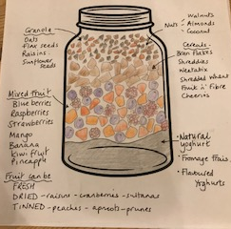
BREAKFAST IN A JAR DESIGN- ingredients I could use.

Slide 10
You could use this template to show all the ingredients
you could use or do a mind map

Slide 11
BREAKFAST IN A JAR DESIGN
1
2
3
4
I have chosen Design Number _______
My reasons for choice _________________________________________________________
_________________________________________________________________________________________________________________

