Slide 1
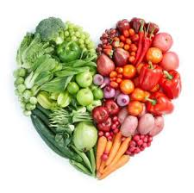
Year 7 Nutrition
Nutrition is the study of Food.
The food we eat is made up of Nutrients .
Nutrients are needed by the body to keep us healthy.
Its important we eat a healthy balanced diet with all the essential nutrients our body needs.

Slide 2
What you need to do:
Read through the presentation.
Slide 3 – Why we eat Food – think of all the reasons why we eat food – Use the key words on slide to help you. You could put a photo of yourself in the middle then put all your ideas around it. Like a mind map.
Slide 4 – Read through the table showing all the nutrients we need. Design an informative poster showing all the Nutrients, why we need them and where we get them from. Remember to give your work a title, use colour and include images if you want to. This can be done on computer or by hand. Slide 6 shows how you could do this poster.
Slide 7 – read through and then answer questions on Slide 8.
Extension work – Word search slide 9

Slide 3
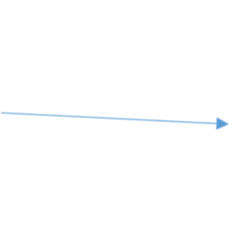
Why do we eat Food?
KEY WORDS
Health
Energy
Growth and Repair
Warmth
Keep us alive
Resist infection
Make us happy
To celebrate special times/traditions

Slide 4
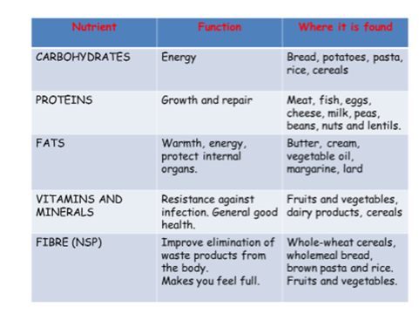
The body needs the following nutrients found I the food we eat

Slide 5
Produce a informative poster to show the 5 main groups of nutrients. Why we need those nutrients and where we can find them in our diet. Use slide 3 to help you.
Your poster should have a title : Nutrition
Include the 5 main groups of nutrients: Carbohydrates – Proteins – fats – Vitamins and minerals – Fibre.
Your poster should have a border and include images.
You could do your poster as a mind map, a table or make up your own design. It can be done free hand or on the computer.

Slide 6
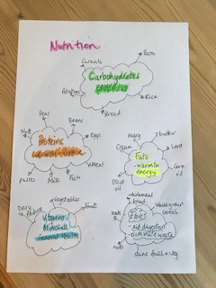
This is an example of how you
could do the poster.
For each of the 5 nutrients - state what the nutrient is needed for by the body and which foods are a good supply of these nutrients.

Slide 7
Fruit and Vegetables
We should be trying to eat at least 5 portions of a variety of fruits and vegetables every day.
Fruit and vegetables should make up just over a third of what we eat each day.
They can provide fibre, and lots of essential vitamins and minerals.
Eating lots of them may help you maintain a healthy weight – they are naturally low in calories and fat!
Try and choose lots of different coloured fruits and veg – different kinds contain different combinations of
important nutrients our bodies need to stay healthy.
Remember
Unsweetened 100% fruit or veg juice and smoothies, will only count as a maximum of 1 of your 5 A DAY, no matter how much you have!
What counts?
Example portion size
Fresh fruit and vegetables
80g
If you don’t like chopped vegetables, try grating carrots or courgettes into your food to add flavour and texture or make a tomato sauce with added vegetables and blend.
Frozen fruit and vegetables
80g
Canned fruit and vegetables
80g
Dried fruit
30g
100% unsweetened fruit and veg juice
150ml
Smoothies
150ml
Note: Dried fruit can stick to teeth which may lead to tooth decay, so it’s best to keep dried fruit to mealtimes and not between meals.
Menu ideas to increase fruit and veg intake:
Breakfast ideas
Try a new fruit or vegetable each week to increase variety.
Add a chopped banana and strawberries to your morning
wholegrain cereal or porridge.
Enjoy a 150ml glass of unsweetened 100% fruit juice
alongside your breakfast.
Why not pick seasonal fruits and vegetables which are often cheaper and taste the best.
Why eat these foods?
Different fruit and vegetables contain:
Vitamin C - important for maintaining healthy body tissues.
Vitamin A - important for maintenance of normal vision, skin and the immune system.
Folate - important for normal and healthy blood formation.
Fibre – helps to maintain a healthy gut.
Potassium – helps to maintain a healthy blood pressure and is also important for the normal functioning of the nervous system.
Lunch ideas
Sandwiches – add some cucumber, lettuce and tomato Soup – add extra seasonal veg and blend into your soup
Baked potato – with your filling, why not have a side salad
Dinner ideas
You could try adding peas, carrots or spring onions
through your mashed potatoes;
or, sprinkle some extra veg onto your pizza like sweetcorn, pineapple, pepper and/or mushrooms!
This resource is designed for consumers who want to find out more about healthy eating. Last reviewed October 2016. Next review due October 2019.

Slide 8
Use the help sheet on Slide 5 and answer the following questions
1 | How many portions of fruit & vegetables should we eat a day?
2 | How many glasses of fruit juice can we include in our 5 portions?
3 | It is recommended that we eat fresh fruit & vegetables. What other types of fruit & vegetables can we include in our 5-a-day?
4 | Why should we eat a ‘rainbow’ of fruit & vegetables?
5 | Why should we choose ‘seasonal fruit’?
6 | We eat fruit and vegetables as they provide the following nutrients. | Why do we need these nutrients?
 | Vitamin C
 | Vitamin A
 | Folate
 | Fibre
 | Potassium
7. | Suggest 3 ways to easily increase our fruit and vegetable intake a day | 1. 2. 3.

Slide 9
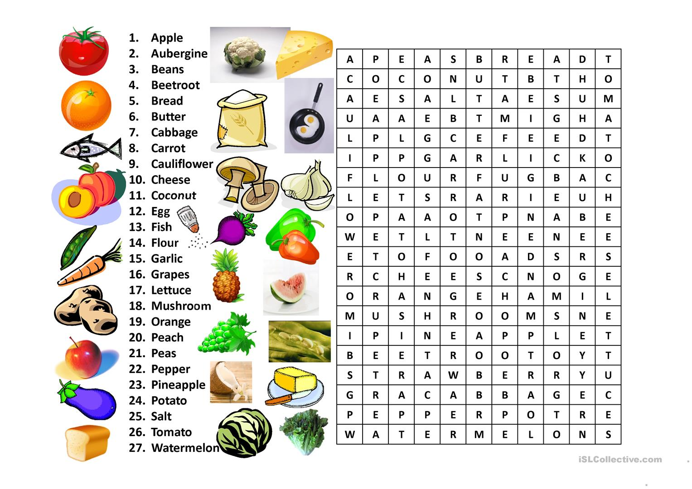
Wordsearch

Slide 10
Fruit and Vegetables – think of different coloured fruit and vegetables
Red fruit | Yellow/orange fruit | Green fruit
Red vegetables | Yellow/orange vegetables | Green vegetables

