Slide 1
Today…
You will be able to explain why breakfast is an important meal and what makes a healthy breakfast.
You will be able to use the knowledge of Nutrition you have gained during your time in Food Technology.
You will produce a fact file of ten interesting facts on ‘Breakfast’
What do you have for breakfast?
Record your breakfasts over the next week.

Slide 2
Did you know?
The word "breakfast" is derived from the phrase "breaking the fast." We fast (don’t eat) while we sleep and breaking that fast is the first meal of the day.
Breakfast is served in the morning. Its important to be healthy as it sets us up for the day ahead.

Slide 3
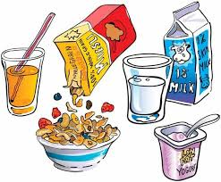
Breakfast…
Why is breakfast important?
Why might teenagers skip breakfast?
What makes a healthy breakfast?

Slide 4
Title: A Healthy Breakfast
Copy out the points and complete. Use key words at bottom on slide to help you
Breakfast is an important meal because it gives us e_______ for the day, improves our mental performance and provides nutrition for good h________.
For example, a bowl of c_____ and m______ would be a great choice.
Milk is a rich source of both protein and calcium. Teenagers need calcium for healthy t_______ and b________, and protein for growth.
Cereal is a rich source of c______________ which gives us energy, and cereals also provide us with f________, vitamins and minerals.
Notes:
Key words – Fibre – health – cereal – carbohydrate – energy – teeth – bones -milk

Slide 5
Title: A Healthy Breakfast
Check your answers
Breakfast is an important meal because it gives us energy for the day, improves our mental performance and provides nutrition for good health
For example, a bowl of cereal and milk would be a great choice.
Milk is a rich source of both protein and calcium. Teenagers need calcium for healthy teeth and bones, and protein for growth.
Cereal is a rich source of carbohydrates which gives us energy, and cereals also provide us with fibre, vitamins and minerals.

Slide 6
Research
Produce a Fact file on Breakfasts.
You need to find 10 interesting facts about Breakfast.
Your work should include a border and images.
Submit this piece of work on SMH.

Slide 7
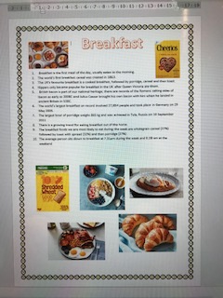
Think about the presentation of your
fact file.
Collect your facts from different
web sites.
Use google search or look on
breakfast cereal product boxes
If you copy and paste facts make
sure you read the fact first!
You can do this piece of work by
hand or on computer.

Slide 8
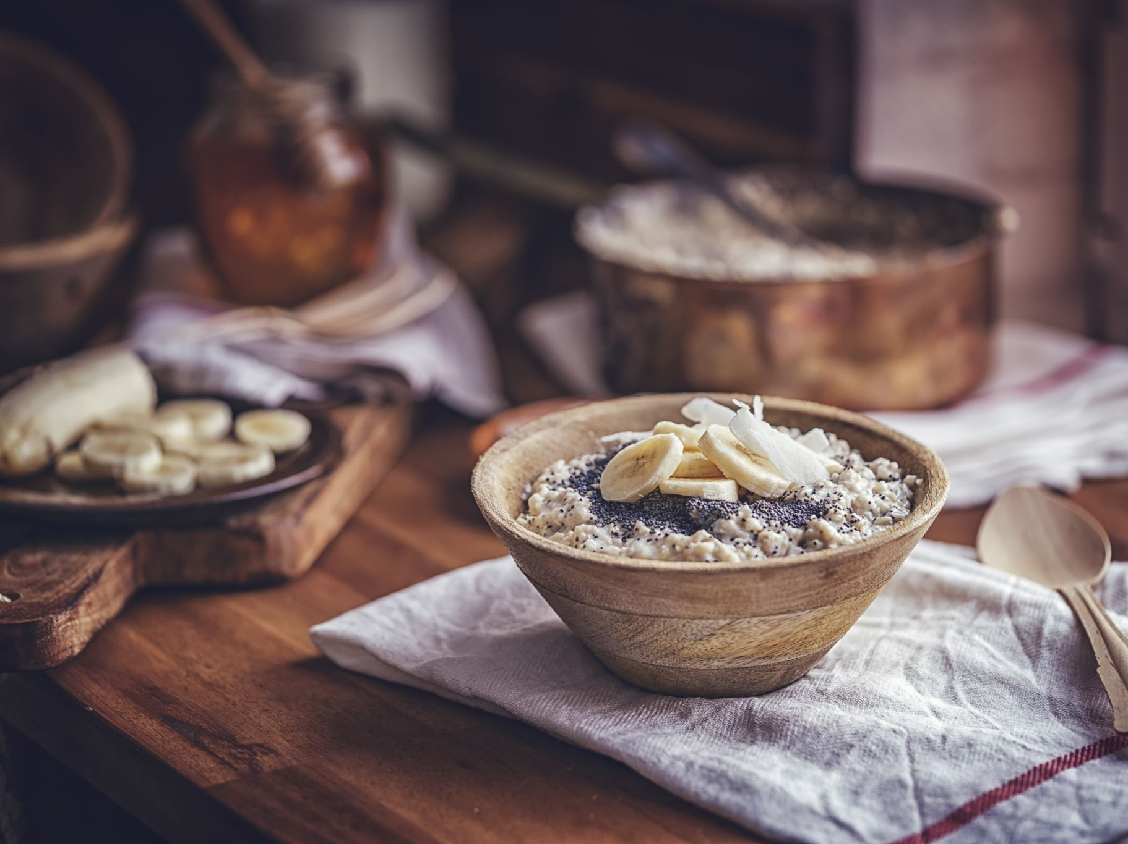
What do you have for breakfast?
Record your breakfasts over the next week. See next slide for a chart layout.
Include drinks. If you skip breakfast leave it blank
.

Slide 9
What did you have for breakfast? ( Include drinks)
 | Mon | Tues | Wed | Thurs | Fri | Sat | Sun
BREAKFAST

