Slide 1

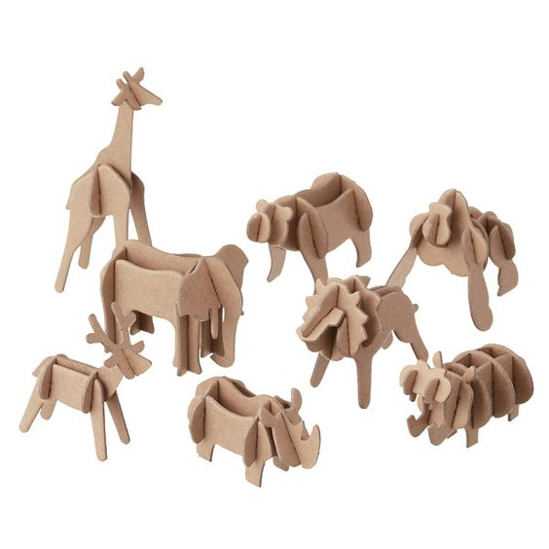
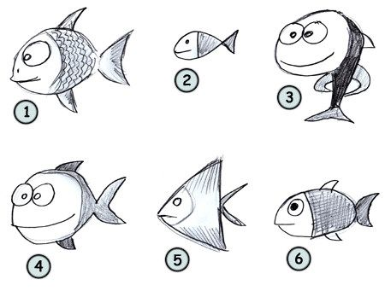
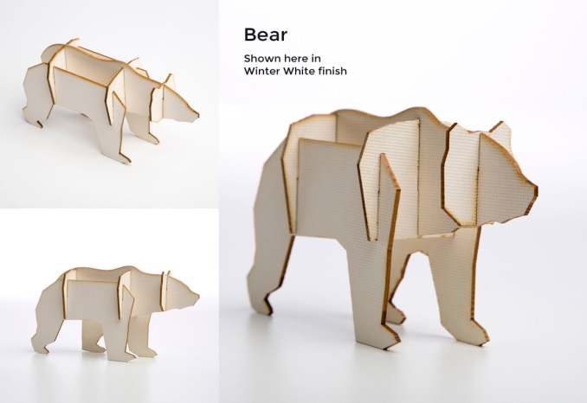
DT Systems & Control
Young Enterprise Project
Bristol Zoo Promotional Gift
Slot Together Toy
Name
DT Group
Tutor Group
Pathway Target Pathway
Young Enterprise Project
Practical Assessment :
Final Assessment :

Slide 2
Design Brief
You are a self employed designer and you design and make products for a range of clients.
Bristol Zoo & the World Wildlife Federation have contacted you and asked you to design and make a range of slot together toys.
The toys must be of endangered species that the zoo and the WWF promotes and protects through it’s conservation work.
You have recently bought a laser cutter and you will use the laser cutter to make the slot together toy.

Slide 3
Week 1 task 1- Use Google search to find definitions for the project key words listed below. The first two have been completed for you
Key Word definition
Prototype-first example or model
Mass production- producing goods in large quantities at a low cost per unit. Product are usually standard sizes and are produced on an assembly line.
Batch production-
One-off (bespoke) production-
Sketch Up-
2d Design-
Procedure-
Flow diagram-
Bitmap-
Vector-
Extrude-
Mechanism-
Laminate-
Plywood-
Thermosetting plastic-
Thermoplastic-
Computer aided design-
Computer aided manufacture-
Laser cutting-
Packaging Net-

Slide 4
Week 1 task 2-
For this project you will use CAD (computer aided design) & CAM ( computer aided manufacture) to produce your product. Complete the following research pages.
Laser cutter- using pictures and text explain what a laser cutter is used for and how it works. To do this you will need to find a picture of a laser cutter and copy and paste below. You can watch a video on how a laser cutter works by using this link:
https://www.youtube.com/watch?v=YbOPErh5ReI
Teacher comments:

Slide 5
Week 1 -Give examples of CAD & CAM in the space below. Use pictures and text and use your own words, do not copy and paste.
What is CAD?
What is CAM?
Place illustration here
Place illustration here
:

Slide 6
Week 2 & 3- Research of endangered species
Use the following links for Bristol Zoo and the World Wildlife Federation to complete the research on the next page. You are asked to answer 4 questions which are:
What animal is this?
Why is it endangered?
What area(s) of the world is the animal from?
What is Bristol Zoo/WWF doing to help protect this animal?
Web address for WWF
Web address for Bristol Zoo
https://bristolzoo.org.uk/
https://www.wwf.org.uk/
Go to:
Adopt
Adopt for me
Choose your animal
Go to:
Save wildlife
Conservation research
Our field conservation projects

Slide 7
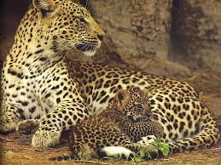
Bristol Zoo research
Before you begin to design your slot together toy you must research endangered animals that are supported by Bristol Zoo or The World Wildlife Federation Use images and text.
What animal is this? Why is it endangered? What area(s) of the world is the animal from? What is Bristol Zoo/WWF doing to help protect this animal?
Animal
Place illustration here

Slide 8
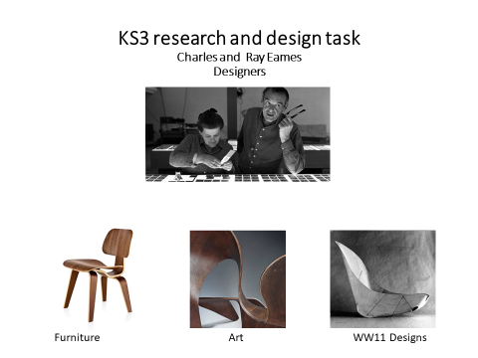
Week 4 task
Plywood
12

Slide 9
Week 4 task Charles and Ray Eames
Designers
Go to the following web link (copy & paste the link) www.eamesoffice.com and open the website for Charles and Ray Eames
Charles and Ray Eames were very important and influential designers. They pioneered the use of plywood. The reason we are looking at them is because we are going to use plywood for your slot together toy. I want you to broaden your knowledge of designers and materials and this exercise will help you to do that.
Task 1: Choose 3 pieces of work from Charles and Ray Eames website. Click on the tab ‘The Work’ and choose one design from Furniture and one from WW11 Designs and one from Art
Analysis of the work
Write about the work using the following points
Describe the key features of the work? Look at things such as shape, materials, function.
What do you like about the work? What do you dislike about the work?
Task 2:
Design something such as a car, vase, swimming pool, building, hairdryer in the style of Charles and Ray Eames…….it can be anything you like but use the things you have noted about Eames’s work to produce your own design.
To help you do this I have provided an example of how you could do this. I have used the designer James Dyson as an example.

Slide 10
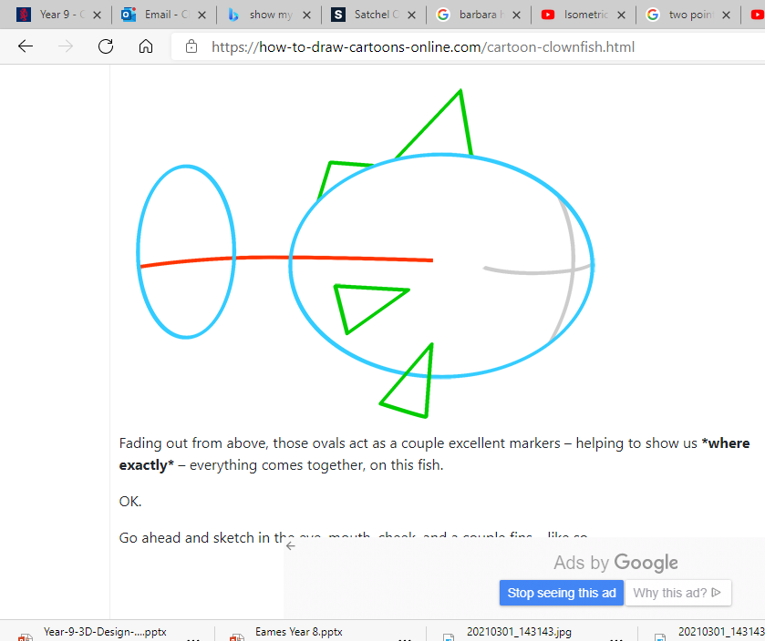
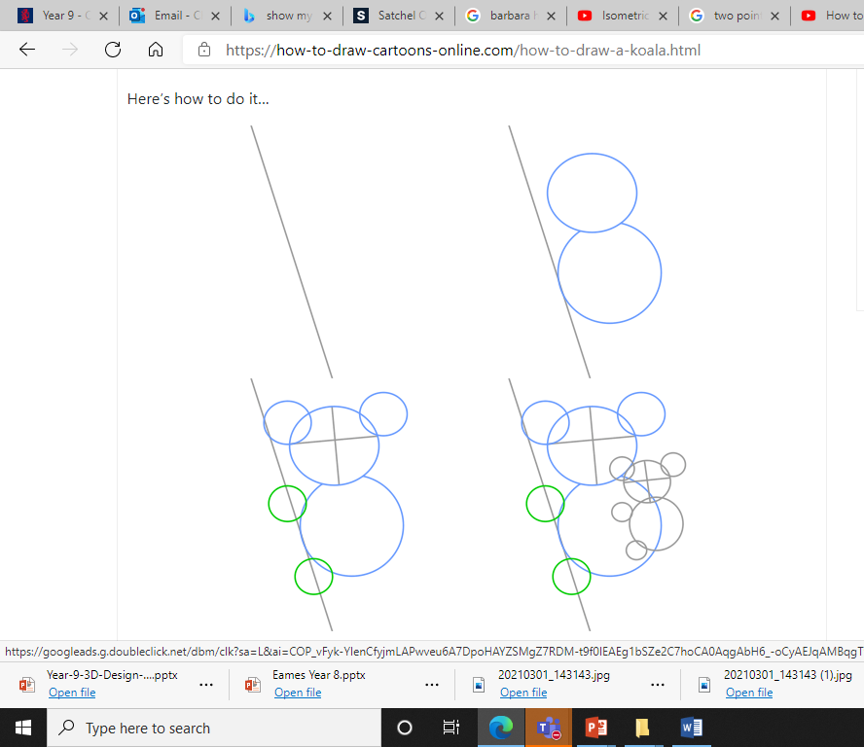
https://how-to-draw-cartoons-online.com/cartoon-animals.html
Choose from beginner, intermediary, advanced and complete the step by step instructions to draw a cartoon of the animal.
You should aim to complete a minimum of four different animals across the different levels.
The reason you are doing this task is to learn how to simplify the task of drawing an animal. Take careful note when drawing of the use of simple shapes such as circles, squares, triangles, ovals and how they are used to construct the shape of the animal.
This will help you when you design your own slot together toys which will be your next task.
Week 5 task Cartoon drawing
Go to this web link:

Slide 11
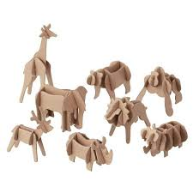
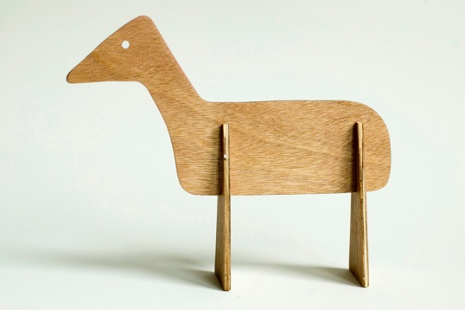
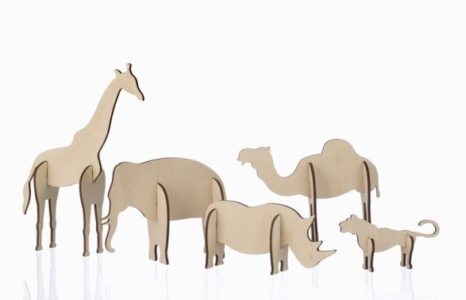
Week 6 task 1:Slot together toy research Use Google search engine to find examples of wooden slot together toys. Find examples and copy and paste below. Three examples have been pasted below. Note how different they are. The toy on the left is very simple and only uses 3 very simple parts. The toys in the middle image use more shape and detail and use a very simple construction. The toys in the third image are much more complex and use more parts.

Slide 12
Week 6 task 2 : In the spaces provided draw, colour and label 4 different design ideas for a slot together toy.
Your ideas should be creative and imaginative.
Idea 1
Idea 2
Idea 3
Idea 4

Slide 13
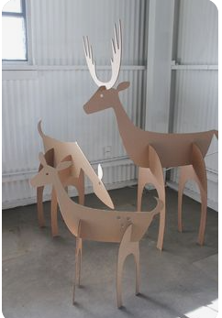
Week 7 - task Card modelling
Choose your best idea from week 6 and make a card model of your animal. Remember you need to cut out all the different parts that will make the slot together toy. This is an example of a card model of a slot together toy. Card from recycled packaging such as cereal boxes or brown box card will be fine for this task.
Photograph your card model and place photograph here.

Slide 14
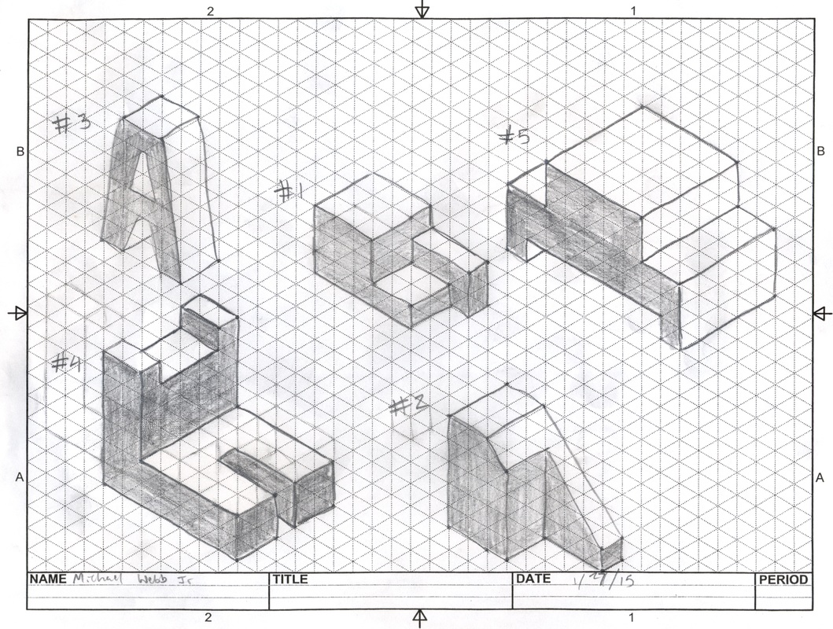
Week 8 task- Isometric Drawing is a way of drawing things in 3 dimensions. This week is a drawing task where you will follow a You Tube tutorial
Copy and paste the link below and follow the instructions. You will need to print the next slide so you have a copy of the isometric paper to do the task. If you unable to print the isometric paper you can do task on plain paper. Follow the video carefully and use pause frequently to complete the task.
Extension-If you finish the task within lesson time practice drawing more shapes. On the next slide I have attached a picture of various geometric shapes that you can copy
https://www.youtube.com/watch?v=LY5OqKhEP9k
Isometric drawing example

Slide 15
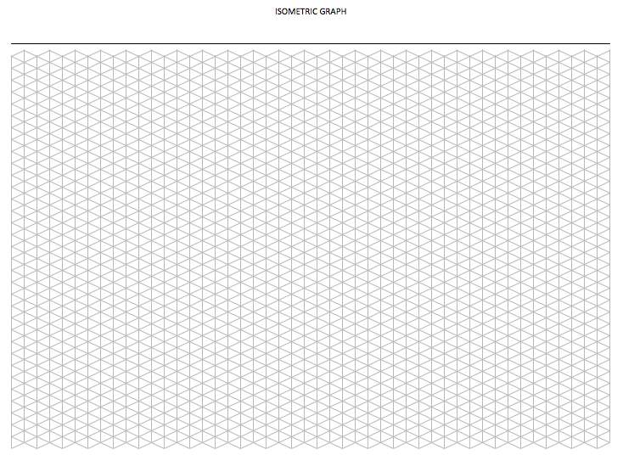
Week 8
Isometric Paper

Slide 16
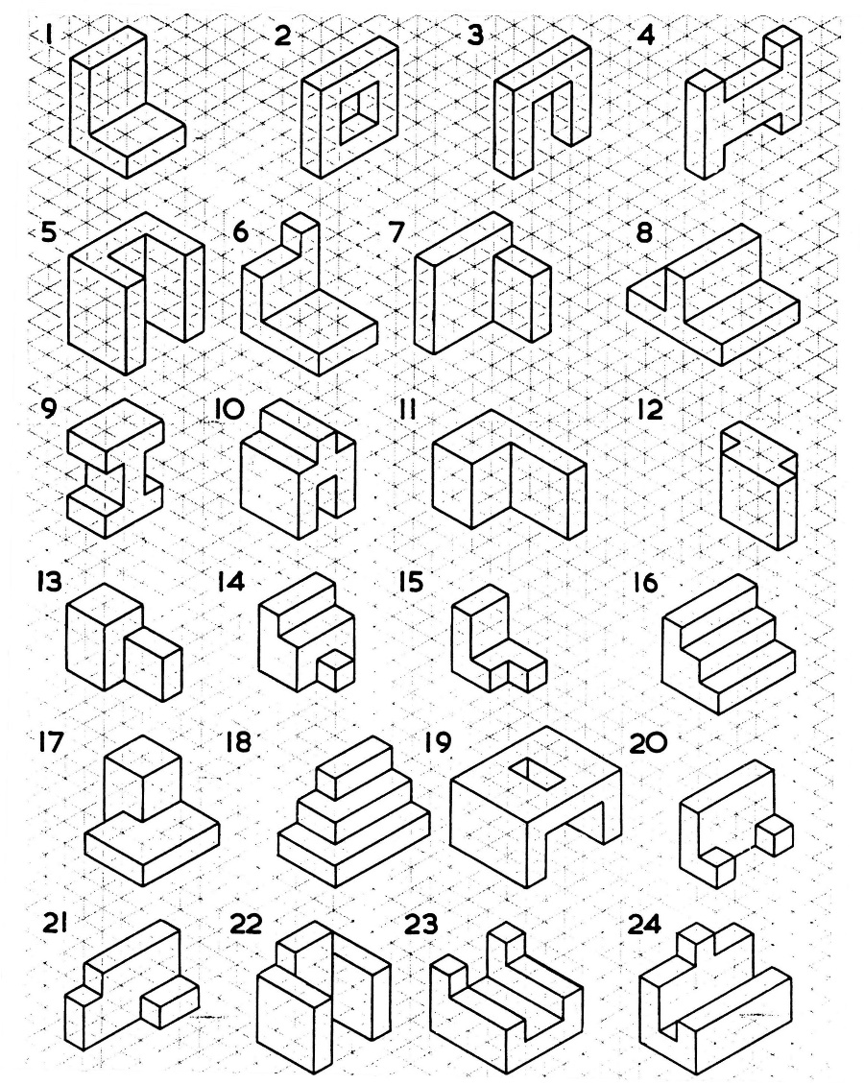
Week 8-Extension task

Slide 17
Week 8 task- Draw a version of your card model in isometric projection. Don’t worry if it’s not right straight away but have a go at using isometric projection!

Slide 18
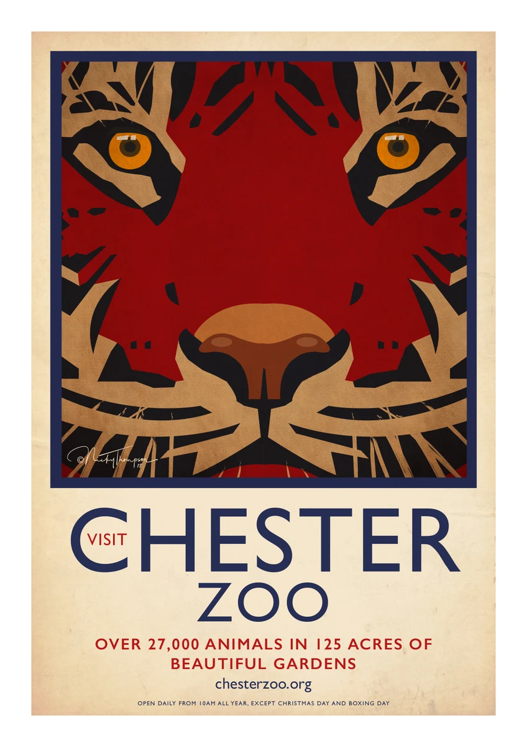
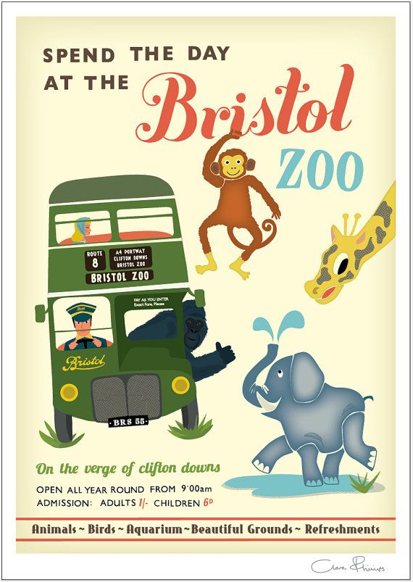
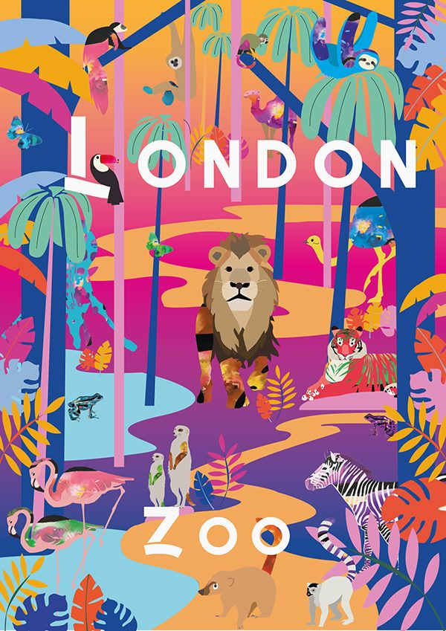
Week 9 & 10 extension task
Create a point of sale poster for your slot together toy. The poster should include the following:
A picture of the animal you have chosen
A written explanation of why the animal is endangered and what is being done to help
A clear title
A bar code or price and a recycling logo
An eye catching presentation
Here are some examples !

Slide 19
Week 9& 10Extension task
Bristol Zoo slot together toy Evaluation
Complete the following evaluation points:
What was the project about? Refer to the design brief and say what you are making and the reason why.
Describe in detail what you have learnt-research, cartoon drawing, isometric drawing, laser cutter, CAD & CAM
How could you improve your slot together toy design? Think about details such as scale, complexity of the construction and the overall look of the animal.

