Slide 1
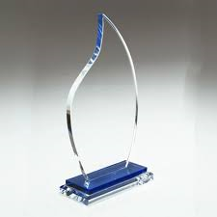


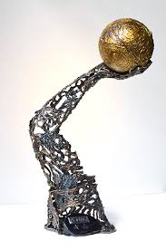

Component 1 -project 2
Questions
1. Awards
Artists, craftspeople and designers are sometimes commissioned to create three-dimensional awards that acknowledge victory or achievement. Figurative or abstract sculptures are used by some arts organisers to celebrate achievements in film and literature. Medals are given to armed forces in recognition of service. Awards are often given to individuals for charitable work. Trophies are presented to honour achievement in such areas as sport, music and recreational activities.
Research appropriate examples and design and make a commemorative trophy, medal or sculpture to recognise achievement in ONE of the following:
Sport
The arts
Citizenship

Slide 2
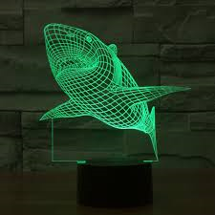
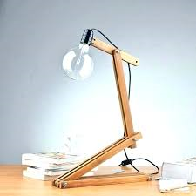
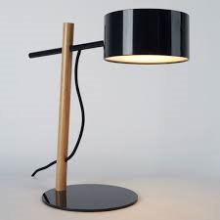
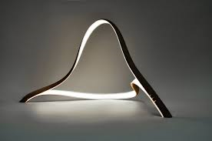
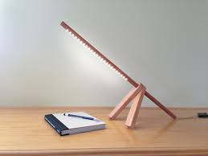
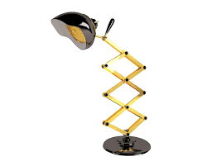
2. Light
Artists and designers have manipulated light either natural or electric to meet the needs of humans from stained glass windows in churches and cathedrals to desktop lights for the home or office.
Design a light suitable for the home

Slide 3
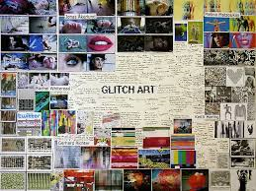
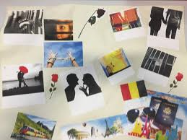
3D Design
Single lesson-50 mins
Task:
Complete brainstorming sheet to high standard. This means a comprehensive response to each question as discussed and modelled.
Select one question and produce at least 1 A3 moodboard in your sketchbook. The moodboard should look like this:
Awesome ! Not awesome

Slide 4
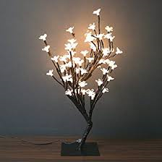
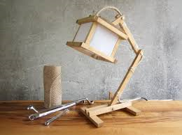
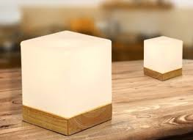
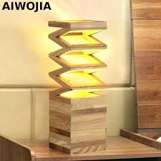
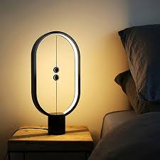
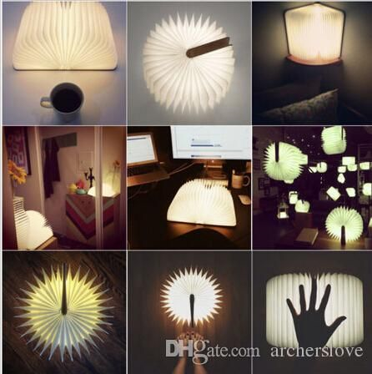
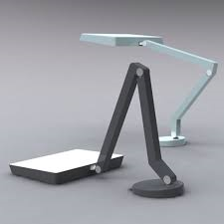

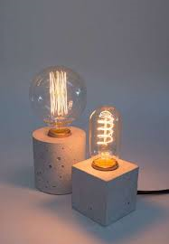
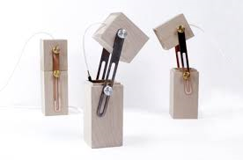
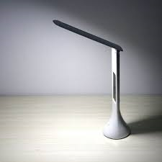
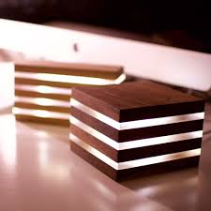
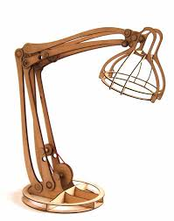


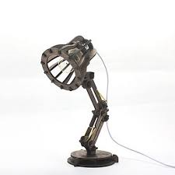
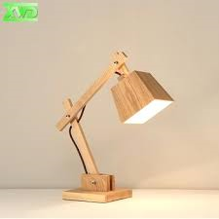

Slide 5
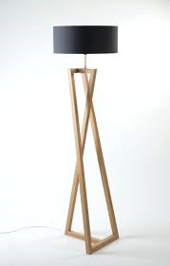
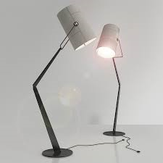
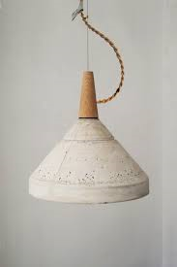

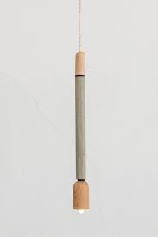
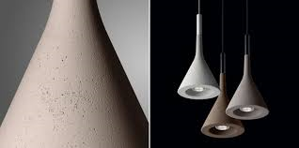
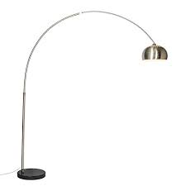
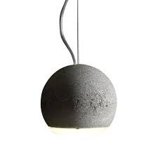
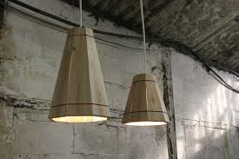
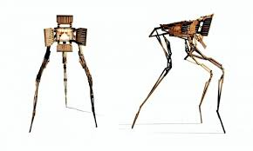
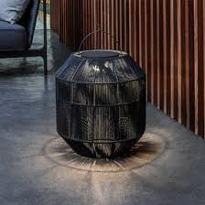

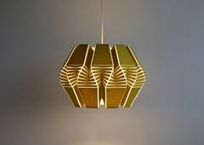
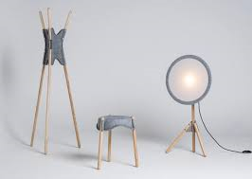

Slide 6


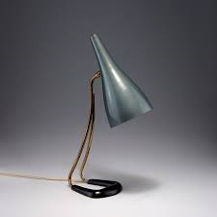
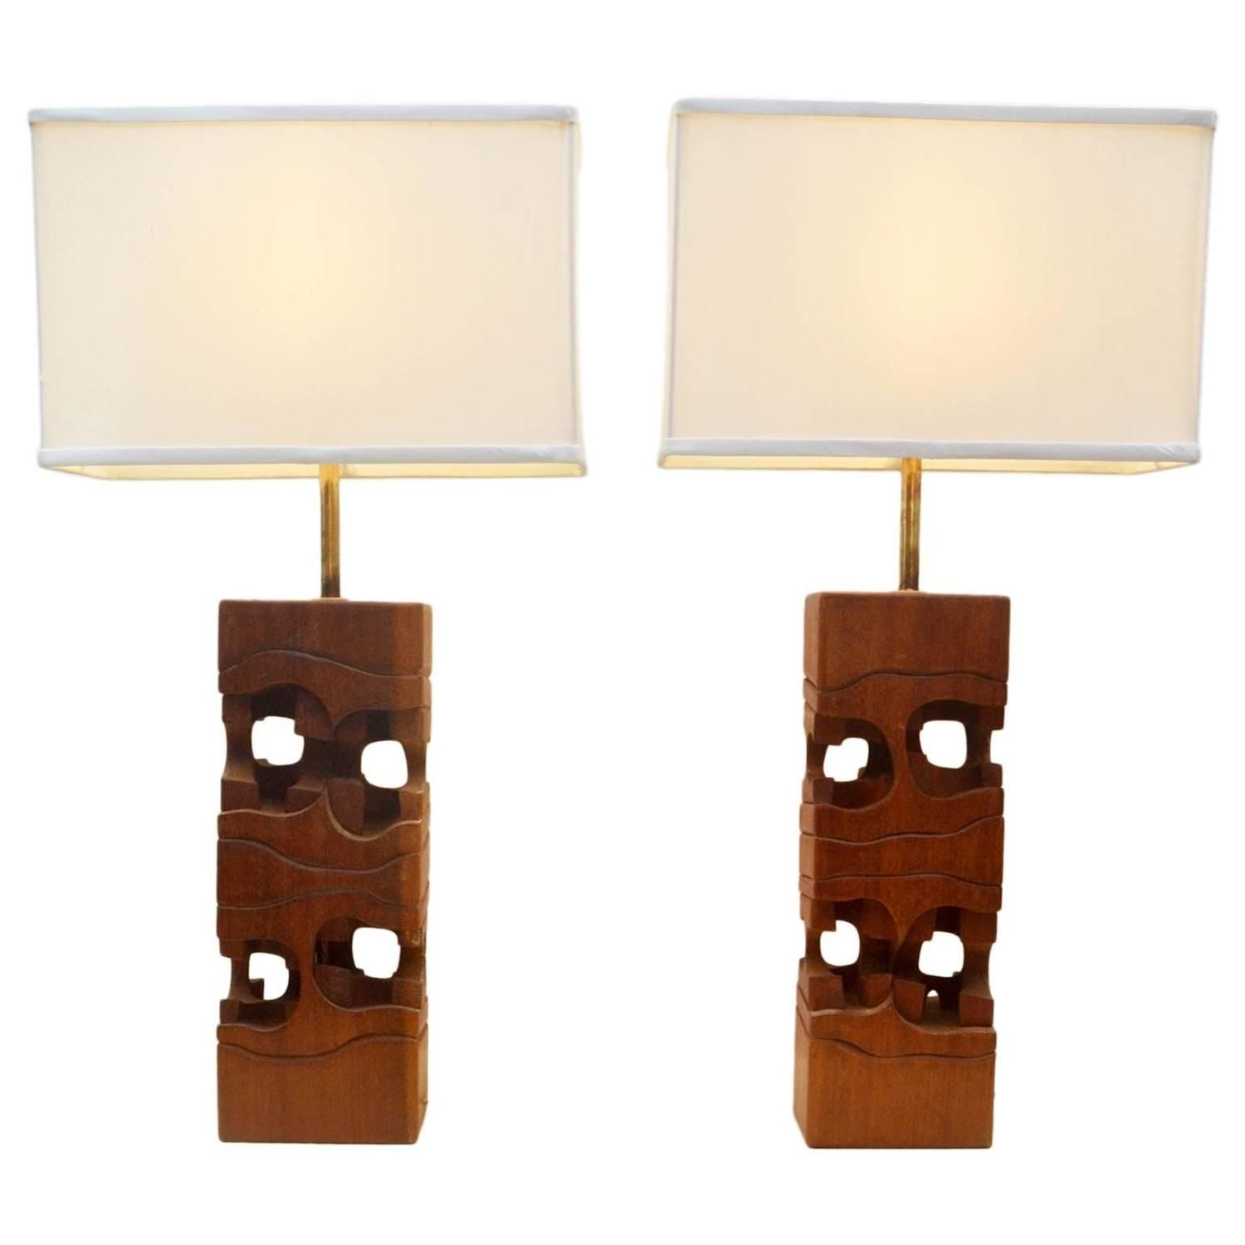
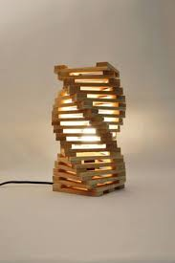

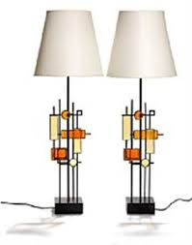
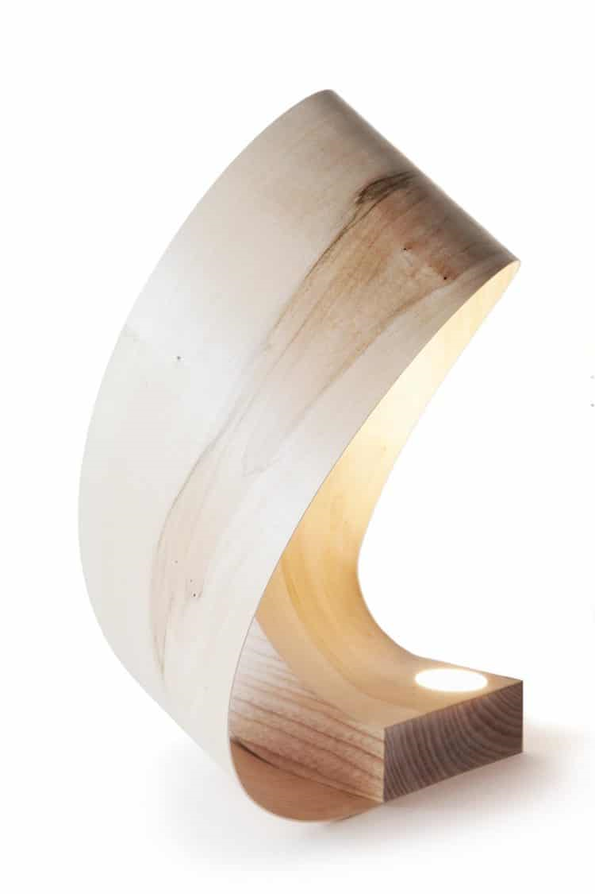

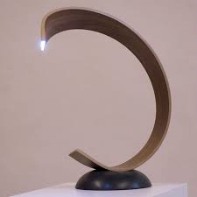
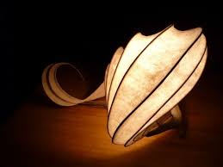
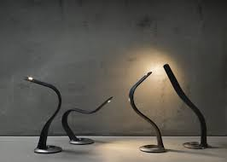
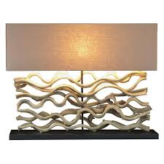
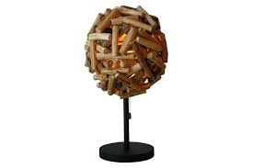
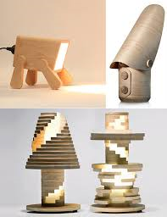
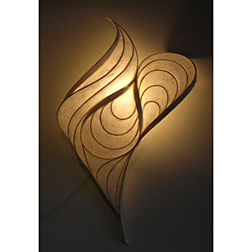
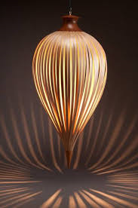
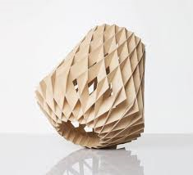



Slide 7
















Slide 8
3D Design 12th June 2018 (AO1)
Last lesson you were given these tasks:
Complete brainstorming sheet to high standard. This means a comprehensive response to each question as discussed and modelled. (AO1)
Select one question and produce at least 1 A3 moodboard in your sketchbook. The moodboard should look something like this: (AO1)
For today’s double lesson you are going to extend your research to link to specific artists/designers. (AO1)

Slide 9
Assessment objective 1 explained
Develop ideas through investigations demonstrating critical understanding of sources.
What does this mean?!
Develop ideas through investigation-
Look at the work of artists/designers and record in your sketch books.
How can you demonstrate this?
Primary source- sketches, take photographs, visit museums, galleries, designers, artists
Secondary sources- internet, books, Pinterest
Demonstrating critical understanding of sources-
Use the research effectively by making sure you use the research to generate ideas
Link your design and ideas to specific research
How can you demonstrate this?
Good sketchbook presentation-clear and explicit links using annotations and sketches

Slide 10
Possible artists and designers for your research for LIGHT:
Thomas Heatherwick
Ross Lovegrove
Alex Earle
Yu Jordy Fu
Zaha Hadid
Zhili Liu
Pieke Bergmans
Ingo Maurer
Foscarini
Bethan Gray
Sebastian Bergne
Rupert Blanchard
Curiousa and Curiousa

Slide 11
Possible artists and designers for your research for AWARDS:
Anthony Caro
Richard Deacon
Anish Kapoor
Jacob Epstein
Anthony Gormley
Barbara Hepworth
Thomas Heatherwick
Naum Gabo

Slide 12
Possible Design movements you could use as inspiration
Go to O Drive -Design & technology folder -3D Design folder -project 2 folder -design movements timeline pdf for more information

Slide 13
Annotating your research
Annotating your research is a very important part of AO1. You have chosen specific artists/designers relevant to the question you have selected and annotations show why you have chosen the work as your inspiration.
Annotations should include the following:
Comments on type of material-wood, concrete, metal, plastic-why do you think this material has been used and why?- aesthetics, colour, finish, strength
Comments on style-is it simple, complex, elegant, quirky ?
Comments on form-describe the shape
Comments on function-what does it do?
How do you feel when you look at the work?
Why do you like it?
All of the above are really important as this creates a thread that ties the project together. The features that you are describing will in theory be things that are evident in your own designs.

Slide 14
Your designs
Now you have completed your research and used annotations to describe it you are to now start designing. You must keep in mind the research and the annotations when you are doing your designs.
Task:
Make sure you are working in your sketchbook in chronological order!!!!!
I page – designs based on your first artist/designer
1 page- designs based on your second artist/designer
1 page- designs based on your third artist/designer
1 page- designs based on your fourth artist/design
Your designs should reflect the work of the artist/designer you have researched.
This does not have to be explicit as in copying the work of the artist/designer but it could be characterised by features of their work such as the shape or use of colour for example.
It is then important that you continue annotating your work-this allows you to make the links you have made become clear and obvious to the examiner.

Slide 15
Annotating your initial ideas
Sentence starters
This is a drawing I made of……..
This idea links to the artist…(insert artist name)……………through the use of ………………….(e.g. shape, colour, technique)
These ideas are inspired by (insert artist name) because of the use of………..
One good element of this idea is…..
The best feature of this idea is………
I am not happy with………
One thing I could improve is………
The least successful thing about this idea is…….
This idea explores the use of e.g. curves and pattern
This idea has got me thinking about how I can use………
I have a better idea of how I can use……
To develop this idea I can add/change the shape of/ use a different material

Slide 16
Your designs
Now you have completed your research and used annotations to describe it you are to now start designing. You must keep in mind the research and the annotations when you are doing your designs.
Task:
Make sure you are working in your sketchbook in chronological order!!!!!
I page – designs based on your first artist/designer
1 page- designs based on your second artist/designer
1 page- designs based on your third artist/designer
1 page- designs based on your fourth artist/design
Your designs should reflect the work of the artist/designer you have researched.
This does not have to be explicit as in copying the work of the artist/designer but it could be characterised by features of their work such as the shape or use of colour for example.
It is then important that you continue annotating your work-this allows you to make the links you have made become clear and obvious to the examiner.
Task: Using one page of your sketch book develop one design from each artist/designer initial ideas.
What you are aiming to do is to show the examiner how you think. This means thinking about materials and how you can use them. You can also make models and experiment with materials at this point. Remember this is what this course is about. What the examiner wants to see is an inquisitive mind.
SCAMPER is an excellent tool to help you develop your ideas

Slide 17

Developing ideas using SCAMPER

Slide 18


Slide 19


Slide 20


Slide 21


Slide 22



Modelling
Modelling your ideas in 3D is a great way to explore your sketched ideas.
Models serve many purposes and allow you to explore and investigate the suitability of your designs for things such as:
Materials
Form
Construction details
Aesthetics
Models also allow you to evidence AO2 & 3
AO1. Develop ideas through investigation
AO2. Refine work by exploring ideas
AO3. Record ideas
AO4. Present a personal response

Slide 23
Analysis of your developed ideas/models
You need to analyse your models to show the examiner your thoughts about your work.
Why did you make it?
To get ideas about…
To get me thinking about…
To explore the idea….
To examine the shape/form/texture/pattern of…
To analyse the style of….
To try the technique….
To practise….
To develop my skills….
How good is it? /What are you pleased with?/What could you improve?
I am pleased with the way….
One good element of this work is….
I am not happy with….
The best feature of the work is…
One area I could improve is….
The least successful part of this work is…..
I wish I had….

Slide 24
Sketch book check list
Opening page of quick examination of all 4 questions-1 page
Moodboard/spider diagram examining chosen question-1 page
Research with comprehensive analysis x 4 artists-4 pages
Sketches for initial ideas I page per artist-4 pages
Development of initial ideas I per artist-at least 2 pages
Modelling with comprehensive annotation explaining what the models are and how they have helped to form your ideas-at least 2 pages
Further sketches of final idea-these can also be in SketchUp-1 page
Hand sketched Isometric drawing of final piece with colour -1 page
2 D Design drawings with all scaled measurements printed off and stuck in sketch book- 1 page
Making diary/journal-photographs of making process and annotations explaining the process- 1 page minimum
Photographs of final product-1 page
Evaluation- 1 page with photo
20 pages in total

Slide 25
Evaluation guide
Evaluation should include:
Introduction paragraph explaining what the project is
Why did you choose this title?
What can you say about the research and your chosen artists-why did you choose them?
What did you learn from your initial ideas?
How do your ideas link to your research?
What did you learn from your models?
Why did you choose the materials you have used to make your final piece?
What did you learn from the process of making?
What did you learn overall from this project?
What would you change about this project if you were to do this again?

