Slide 1
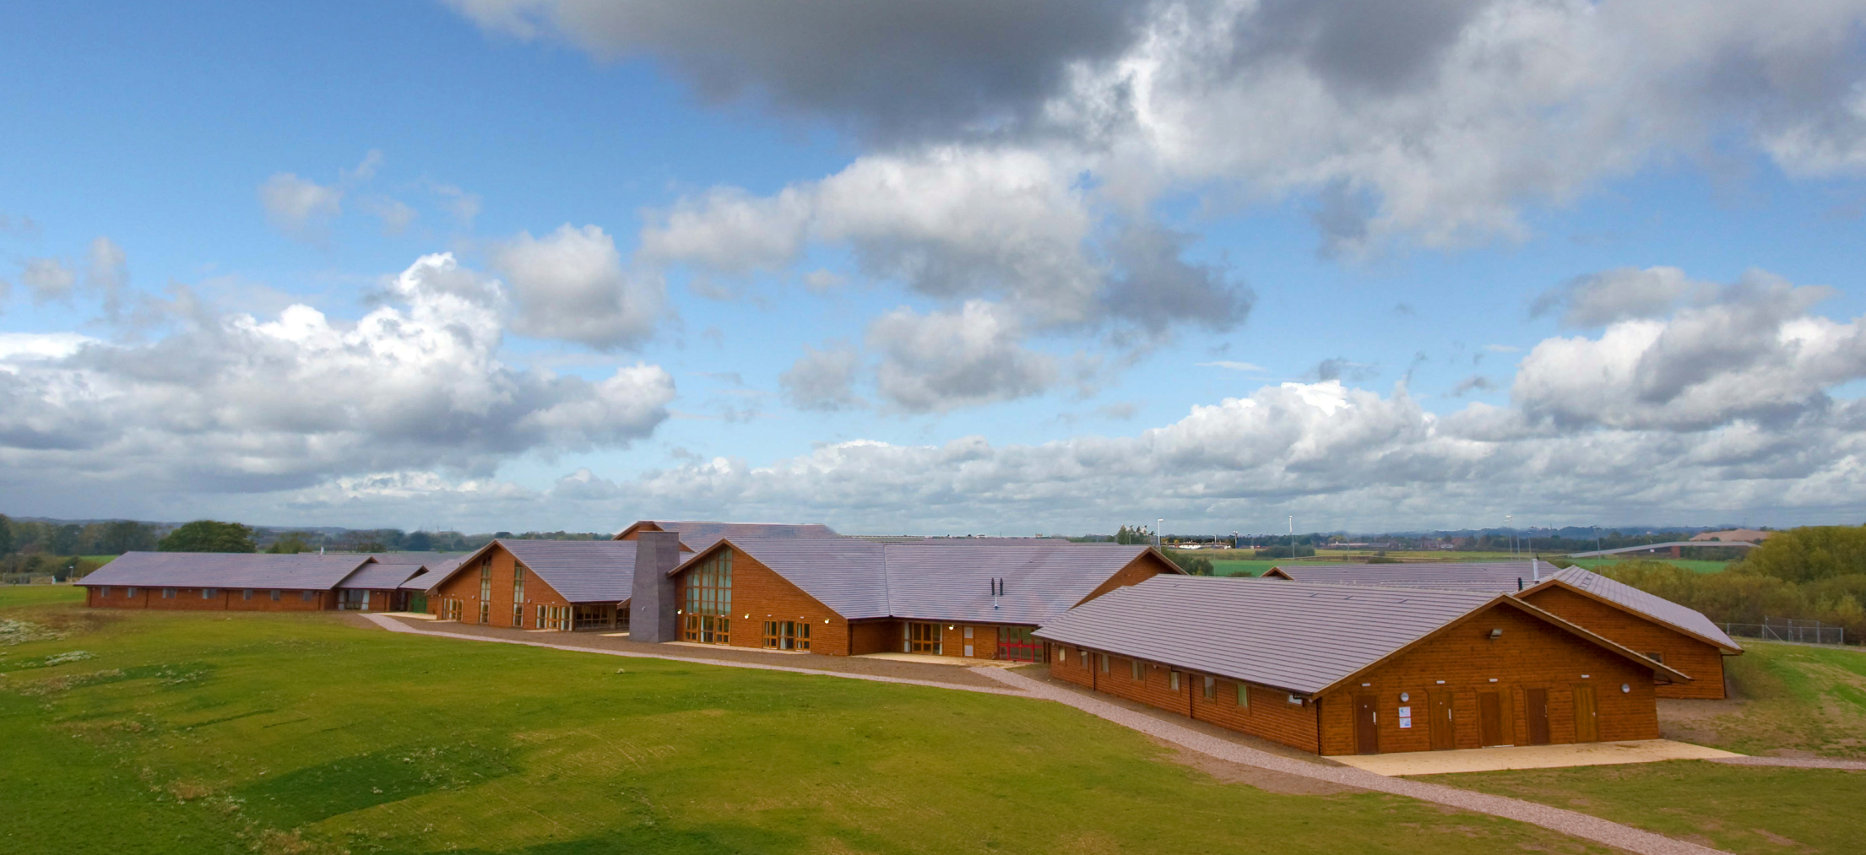
Whitemoor Lakes, Action Centres
Year 7 Residential
27th June – 1st July 2022

Slide 2
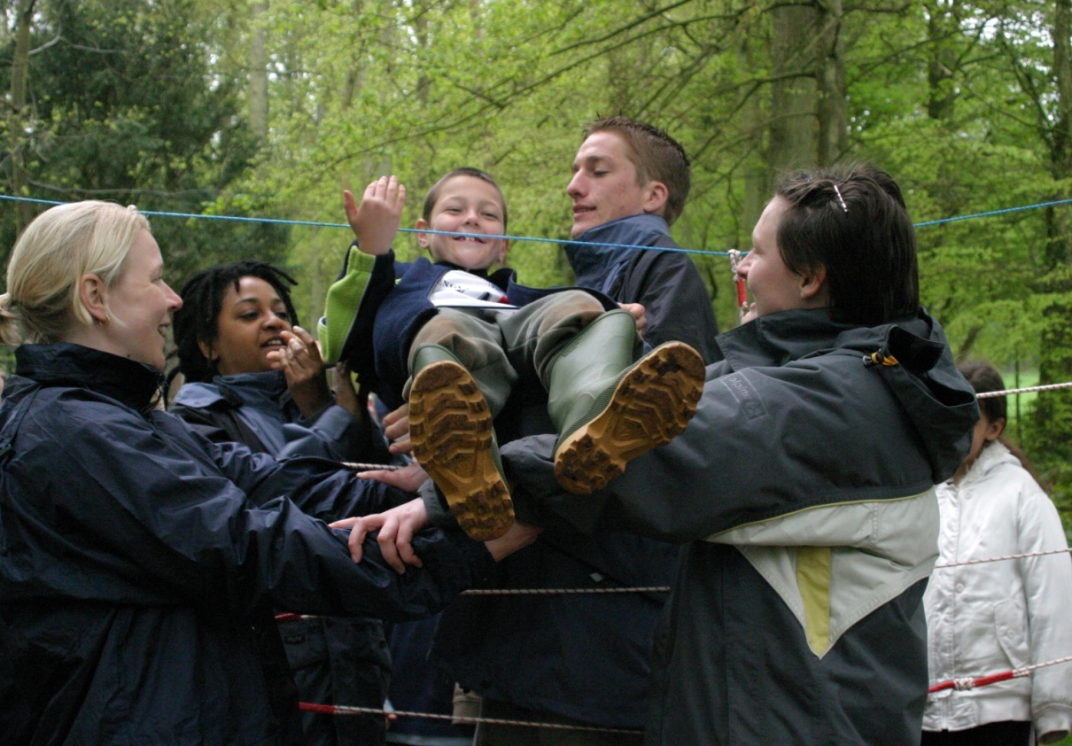
Aims of the Visit
Personal and Social Development
Teamwork
Friendships
Teacher and Pupil Trust
Fun!!

Slide 3
Trip Dates
27th - 29th June: 7A, 7D, 7F, 7G. Staff: Mrs Stone, Mrs Brown, Mrs Muir, Mrs Hussey, Miss Colledge, Mrs Christopher and Mr Baker.
29th June – 1st July:7B, 7C, 7E.
Staff: Miss De Carles, Mr Edwards, Mrs Couchman, Mr Lee and Miss Colledge.

Slide 4
Whitemoor Lakes & Action Centres
Whitemoor Lakes and Action Centres UK/NAYC have a combined experience of over 50 years in looking after people.
Organising and hosting residential holidays for almost 300 affiliated youth groups. Welcoming around 150,000 people from around the World to the centers each year.
Their experience help groups achieve the aims of their residential whilst providing the right environment for positive and long lasting impact.

Slide 5
The site
The centre is on the very edge of the National Forest; situated off the A38 just 10 miles north-east of Birmingham, only a few minutes from the M6 Toll Road and adjacent to the National Memorial Arboretum.

Slide 6
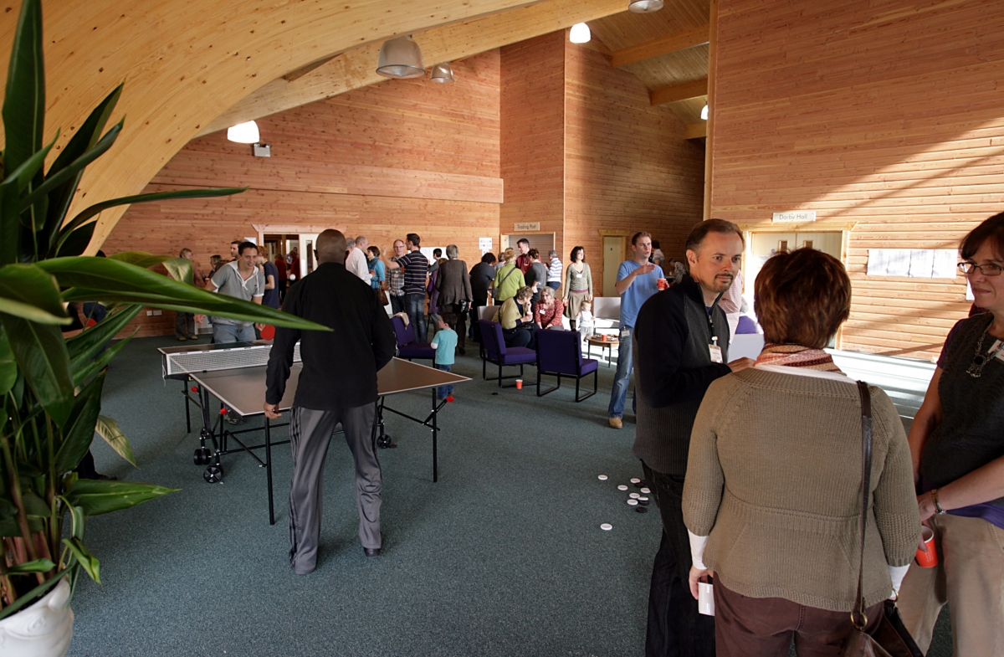
The new 6,000 m² Centre includes:
Reception / Recreation Area / Training Room – an exciting building to form the core of our new state-of-the-art facilities.
Dining Room, Kitchen, Meeting Rooms – an attractive pine-clad facility to prepare and enjoy good home cooked food – and a place for 300 to meet for conferences.
6 Bedroom Wings accommodating 8 groups and up to 300 guests – contemporary rooms with en suite bathrooms, and facilities for various kinds of disabilities and special needs. Each wing has its own group lounge with kitchenette.
High quality environmentally sustainable buildings.

Slide 7
Itinerary
Day 1 Leave Kingshill at 9.00 am
Arrive Whitemoor Lakes at 11.30 am
Picnic lunch
2-3.30 Activity one
4-5.30 Activity two
Dinner at 6.00 pm
Evening activity at 7.30 pm
In rooms at 9.30 pm, lights out at 10pm

Slide 8
Itinerary
Day 2 Rise and shine and after
Breakfast 2 lots of activities
Lunch
2 activities then dinner followed by the evening activity
Diary writing and hot chocolate!
In rooms at 9.30 pm, lights out at 10 pm

Slide 9
Itinerary
Day 3 Rise and continue to shine
Breakfast at 8.00 am followed by 2 activities
Lunch at 12.30 pm
Coach departs for Kingshill at 1.00 pm
Arrive Kingshill by 3.00 pm (hopefully!!!)

Slide 10
Activities
Each group stays with one instructor and one member of staff.
Day activities – climbing, canoeing, high ropes, problem solving, archery, raft building, challenge course, abseiling and zip wire.
Evening – Wide range of games, campfire

Slide 12
Accommodation
Rooms of 4-5
All ensuite
Different lodges for boys and girls
Staff distributed throughout

Slide 13
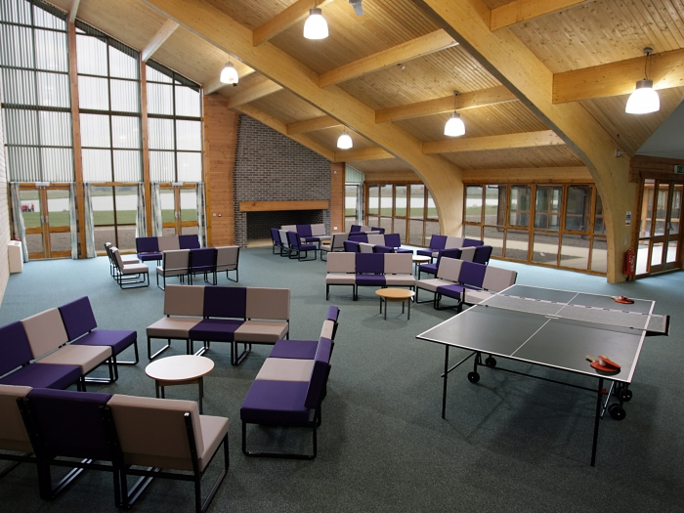

Slide 14
Food
Packed lunch and evening meal on day one.
Breakfast, lunch, dinner and tuck-shop visit on day two.
Breakfast and lunch on day three.
Students need their own water bottle
Meals are nutritious and well balanced.

Slide 15
Equipment List
Bedding is provided
Something other than jeans for activities
Long trousers and sleeves needed for many activities
Waterproofs and sunscreen
A Plastic bag (bin bag) for muddy and wet clothes
Please no tight leggings unless with shorts on top
A pair of trainers that are really old is always a good idea!

Slide 16
Medication
Students who need them must carry inhalers.
Students who take medication should label it with clear instructions as to when and how much to take and give it to their tutor unless they have arranged otherwise with me.
For any pupils with health plans lodged in school, all staff on the trip will be made aware of their needs.
Please speak to your child’s tutor if you have any concerns.

Slide 17
What Not To Take
No mobile phones. You will be given details of how to contact the centre in an emergency and there is a pay phone if your child really needs to hear your voice.
No electronics or mobile phones, we cannot take responsibility if they are lost.
Money for phone and tuck-shop, £2-3 maximum.

Slide 18
Standard of behaviour
Primary concern is everyone’s safety
Follow instructions of Whitemoor Lakes staff
Courtesy and politeness

Slide 19
Security
The centre has a main gate with barrier. There is security staff on duty 24 hours a day.
Centre staff patrol the area outside the pupil bedrooms after lights out.
There is no access to the general public.
Students should not come outside between 9.30 pm and 7 am unless the fire alarm goes off or a member of staff tells them to go outside.
Anyone breaking these simple rules can expect to be sent home

Slide 20
Insurance
Whitemoor Lakes has comprehensive insurance for all activities. In addition Kingshill School has full cover for all travel and personal insurance.

Slide 21
Diary
The students will have a diary to fill in whilst on their visit.
There will be a competition for the best diary when we return to school.

Slide 22
COVID POLICY
The centre has a strict COVID policy that adheres to Government advice
There are multiple hand sanitizer stations which are easily accessible
The site and equipment is regularly vigorously cleaned

Slide 23
Thank You
Thank you for taking the time to listen to my presentation
Please email me if you have any worries or queries
lcolledge@cirencesterkingshill.gloucs.sch.uk

