Slide 1
Welcome
Year 11 Study Skills
Session Outcome: to take away practical strategies to improve your revision at home and to better understand how we will be supporting you at school

Slide 2
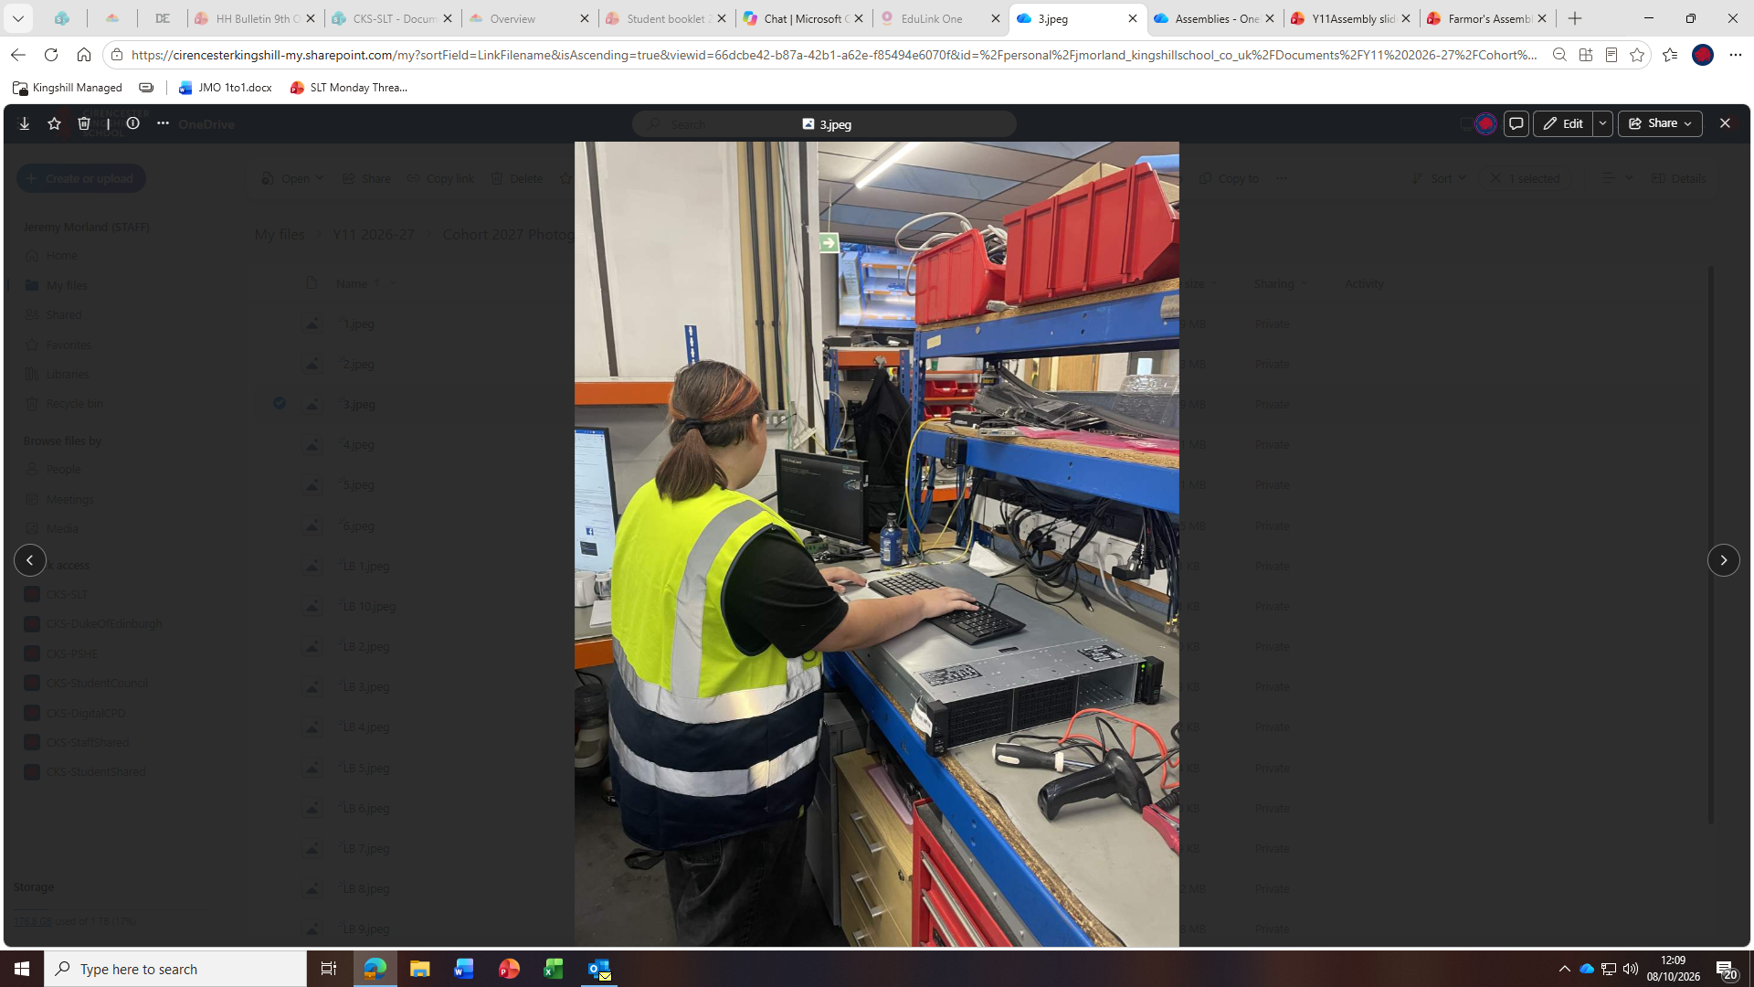
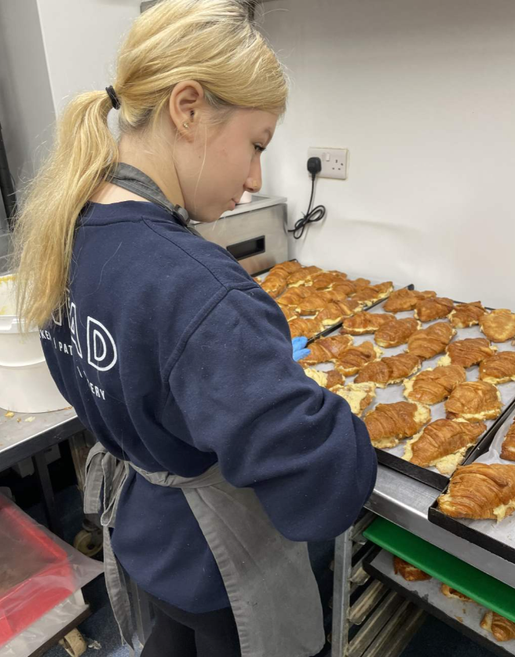
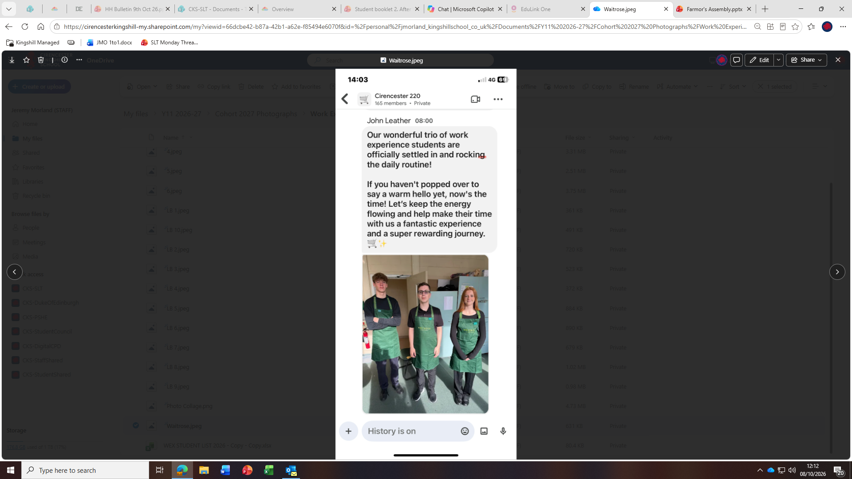
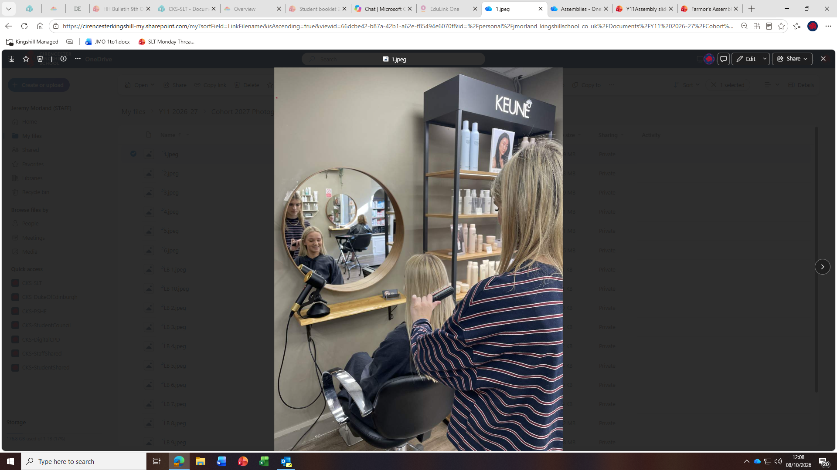
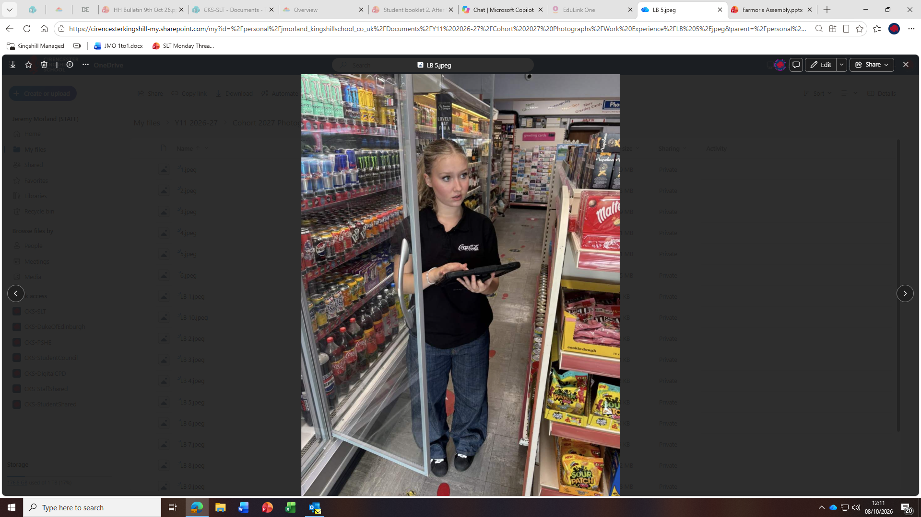
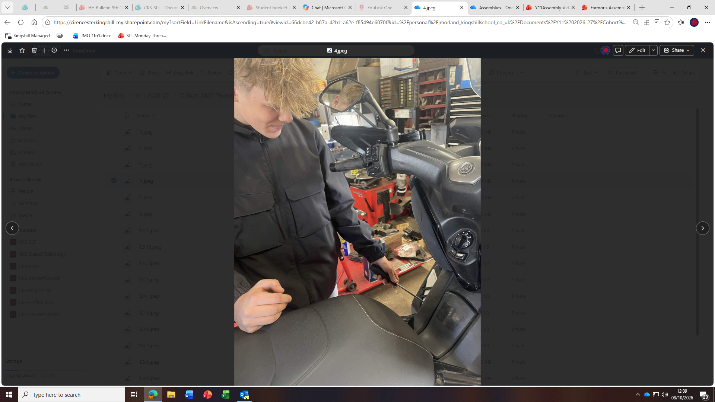

Slide 3


Slide 4
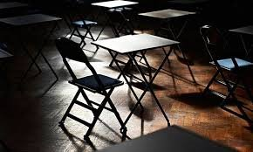
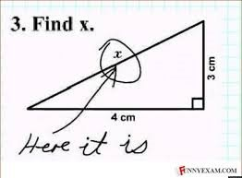
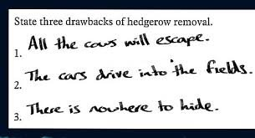
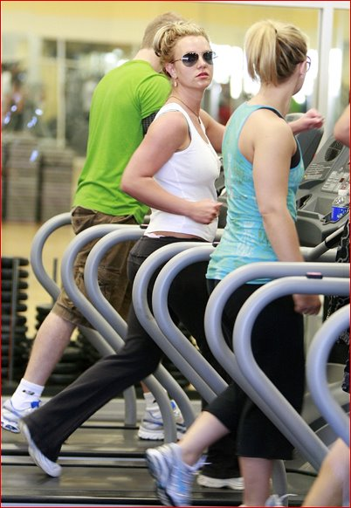
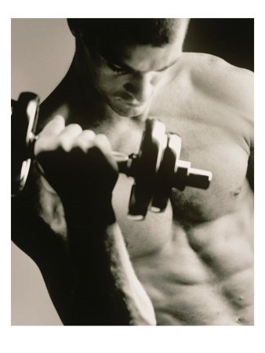
Things that you know you know | Things that you don’t know you know
Things that you don’t know you don’t know | Things that you know you don’t know

Slide 5



Getting into a routine at home
Start small
Focus on a few key routines (bedtime, phones, homework, revision) and build from there
Praise Progress
Acknowledge effort. Positive reinforcement goes a long way
Sleep, Screen and Curfews
Teenagers need 8-10 hours of sleep to focus and feel their best

Slide 6
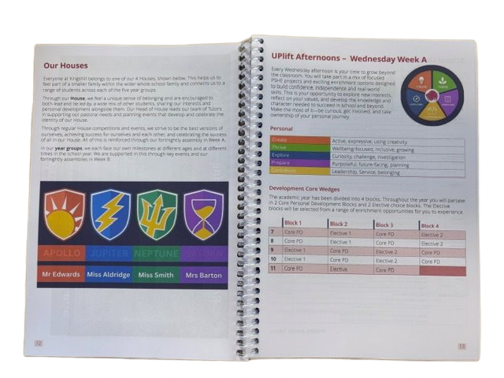
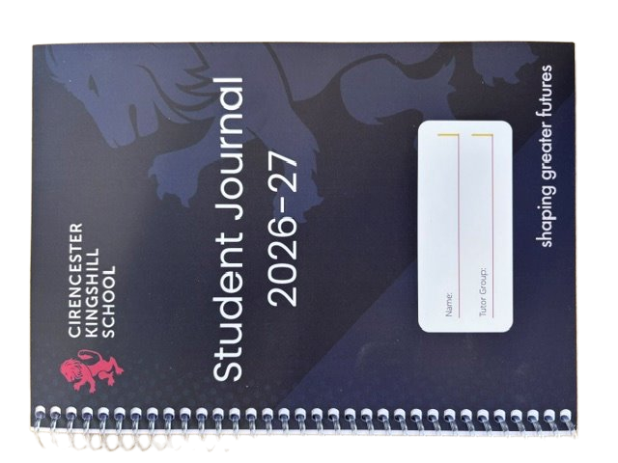

Slide 7
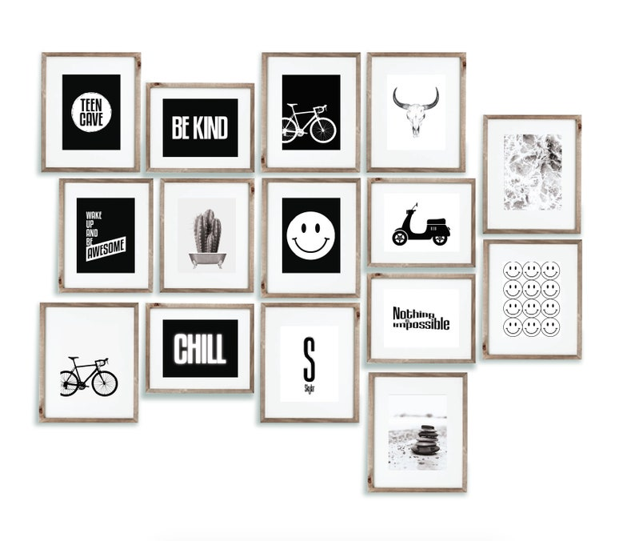

Slide 8
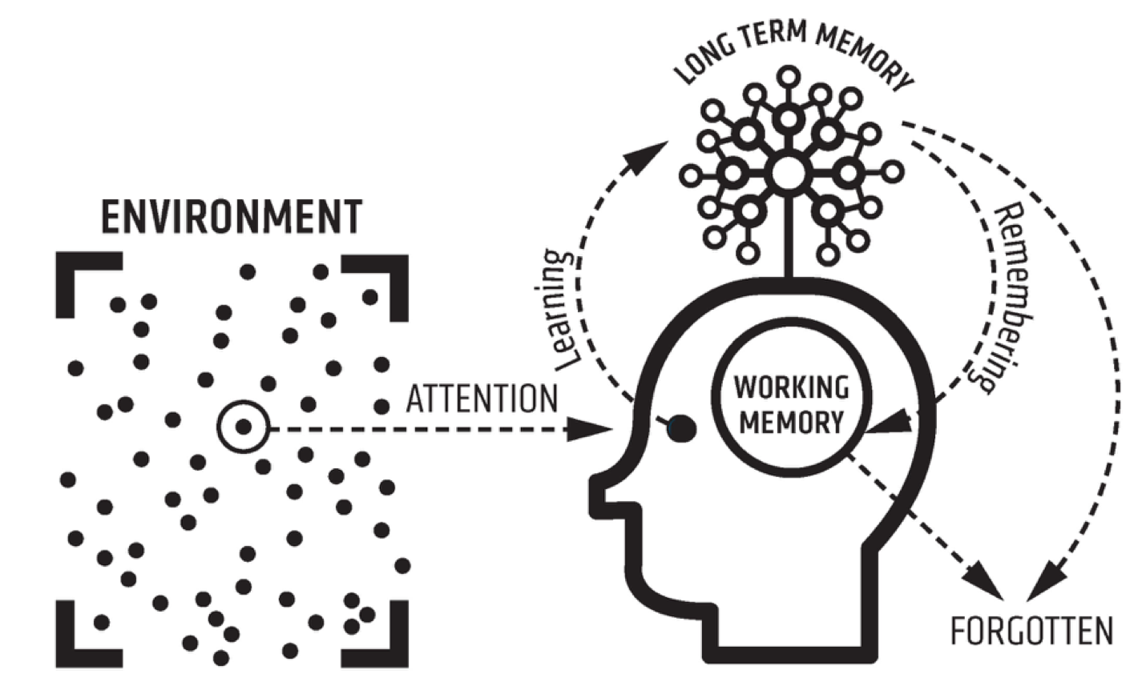

Slide 9
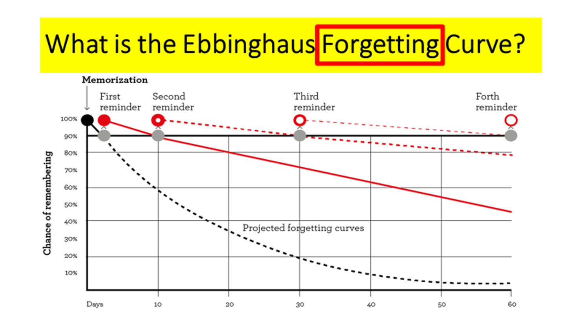
Forgetting Curve

Slide 10
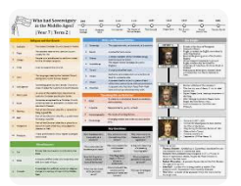


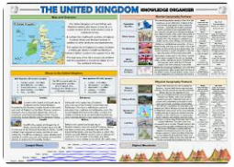
Subject Knowledge Organisers
Do Now Activity – questions to test previous learning
Homework – questions to test recall or revision task

Slide 11
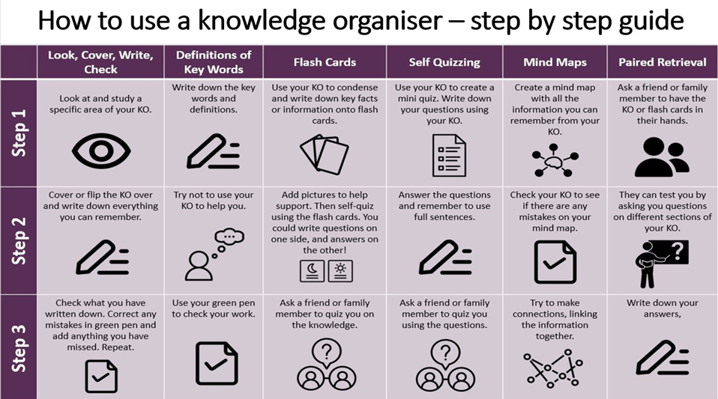

Slide 12
November Mocks
Practical subjects will have mocks before Christmas and will be advised separately
Subject | What topics will the students need to revise?
Computer Science | Programming / Algorithms/ Flowcharts/ Pseudocode/ Computational Skills
Drama | How would they direct An inspector Calls. Evaluation of live theatre. The Lion the Witch and the Wardrobe or Hades Town
English | English Language Paper 2 non-fiction and persuasive writing
Enterprise | Marketing & Finance sections of your revision guide
Food | Choux, bread making, primary processing, nutrients, different dietary needs, food spoilage
Geography | Paper 1 - Hazards, Living World, Coasts and Rivers
History | Medicine and Elizabeth
Maths | Students need to revise the topics they have found difficult. The end of year 10 QLAs they were given and progress sheets in the back of their books show the topics they need to practice
MFL | French - modules 1-5 German - Modules 1-5 Spanish - Modules 1-5
Music | Revise the Knowledge Organisers shared in TEAMS. There will also be revision cards and other materials shared. Students might find it useful to listen to unfamiliar musical styles including Classical, Romantic, Film Music and Popular Musical Styles they are unfamiliar these might include Rock, Pop, Musical Theatre / Blues. While listening to the music they can use the knowledge organiser to link what they are hearing with the content of the KO. Students will also need to revise the 2 set pieces Toto Africa and Bach Badinerie. Revision Links will be shared via TEAMs as well as a revision lesson prior to the mocks.
PE GCSE | Chapter 1 Anatomy and Physiology / Body System - All content Chapter 2 Levers / Planes Axis / Mechanical Advantages / Movement analysis - All Content Chapter 3 Training - All Content Chapter 4 Sports Psychology - All Content Chapter 5 - Socio - Cultural Factors Only Chapter 6 Health Factors / Nutrition / Active Lifestyles - All Content
Science | ALL PAPER 1 CONTENT. Biology = Cell structure and transport, organisation, transport, Infection and response, Photosynthesis and respiration. Chemistry = Atomic structure and the periodic table, Structure and bonding, Quantitative chemistry, Chemical changes and energy changes. Physics = Energy Stores and transport, Electrical circuits and mains electricity, Particle model of matter and radioactivity.

Slide 13
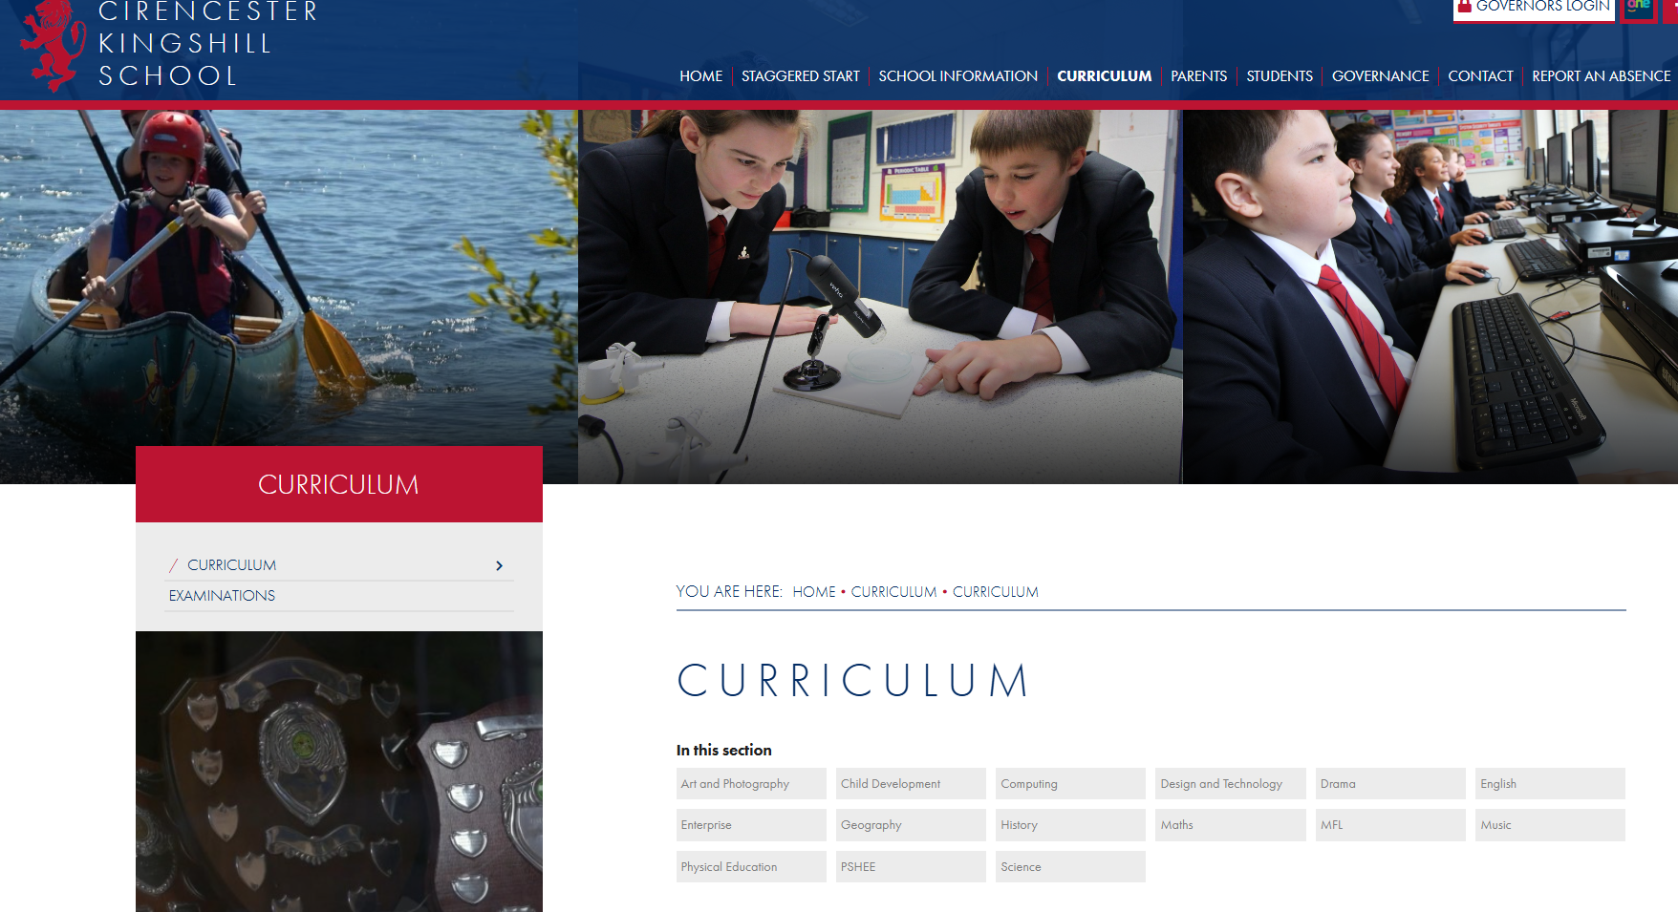

Slide 14
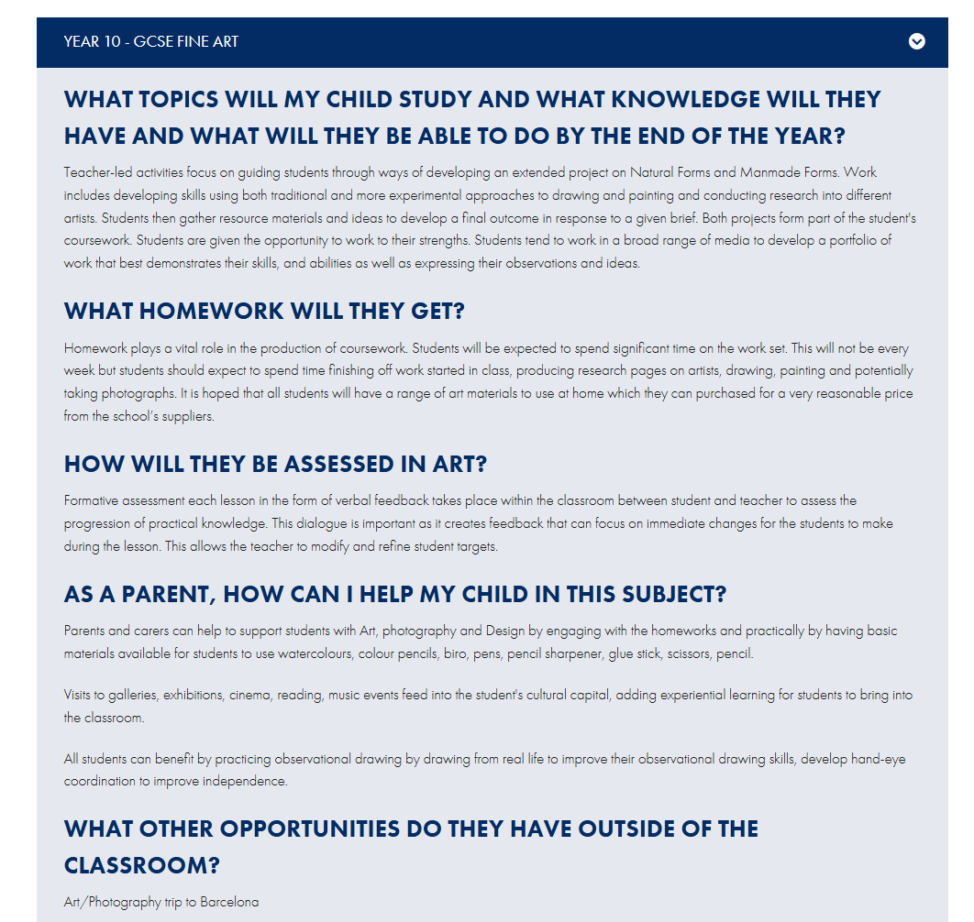

Slide 15

The biggest revision fails ….
two

Slide 16
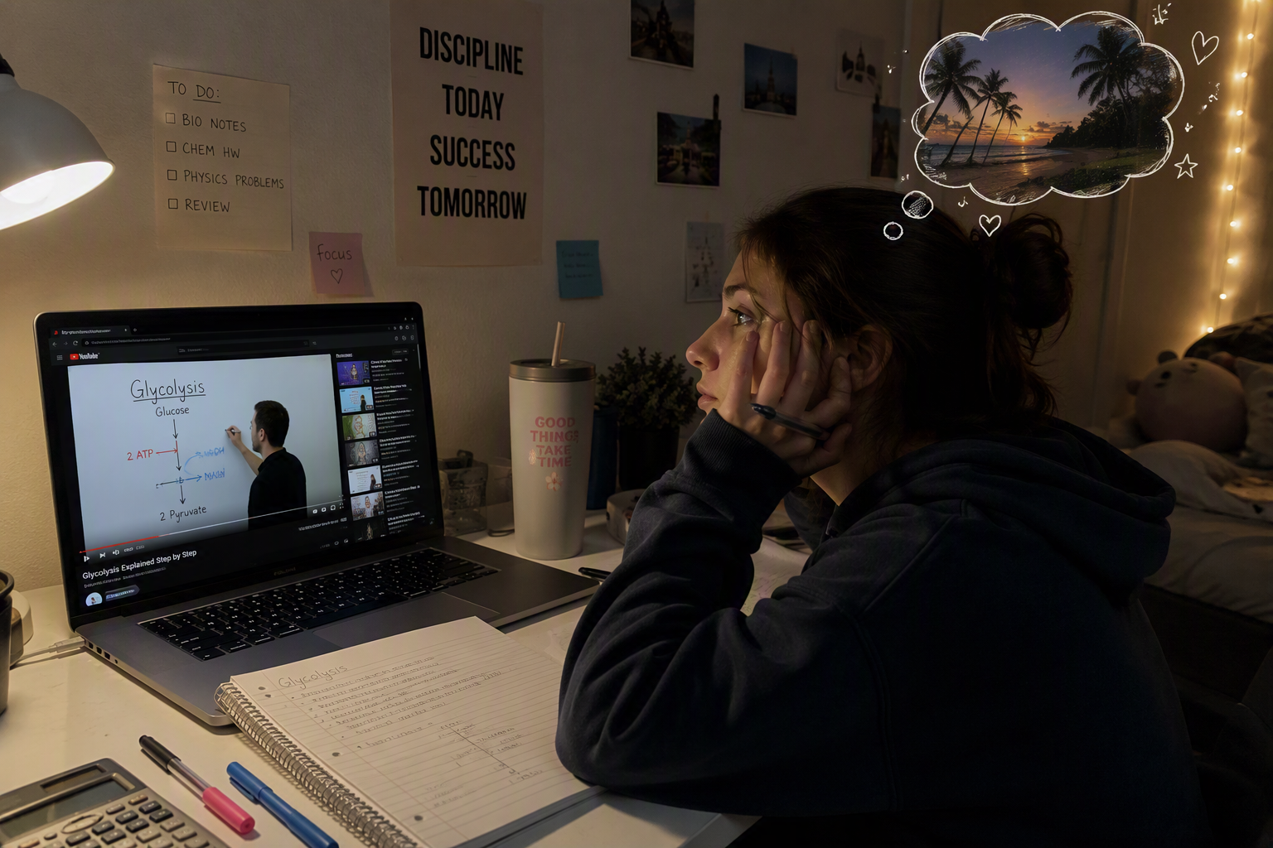
And passively watching revision videos

Slide 17
So … what works better?
Work out what you don't know
2) Don't cram - review at spaced intervals (timetable)
3) Explain the material to yourself and others
4) Take frequent, low stakes tests practice tests

Slide 18
BLURTING!
Blurting helps you identify what you don't know. Use it for each topic you need to study:
Pick a topic
Write down everything you know – the BLURT!
Compare your blurt to your knowledge organiser, textbook, exercise books, notes etc
Study what you missed out

Slide 19
Don't cram - review at spaced intervals (timetable)
Term Time revision: (each block = 35-45 minutes)​
Include Task – (precise details!) And testing/checking
Mon | Tues | Wed | Thurs | Fri | Sat | Sun
School!
Aim for 2 specific revision sessions most evenings and around 4 over a weekend (these could be linked to HW). Think about the best times for you! = approx 10 hours a week

Slide 20
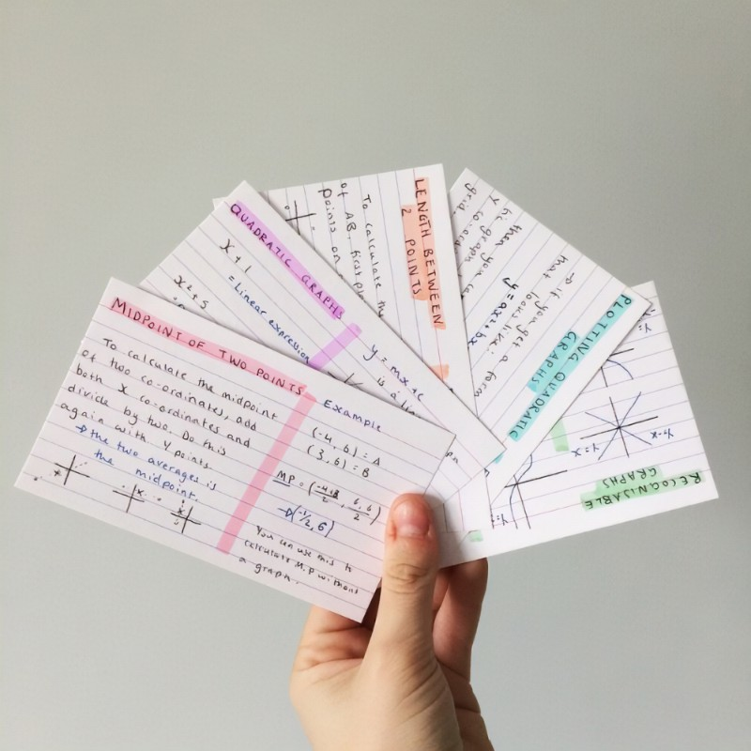
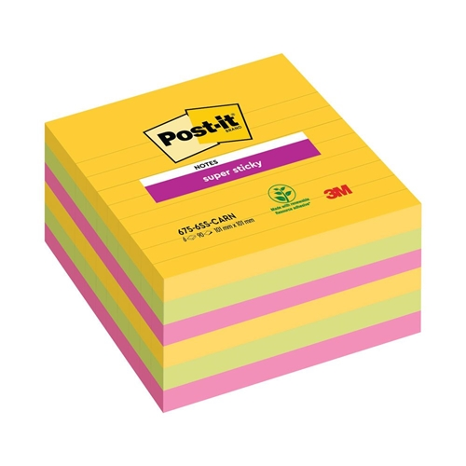
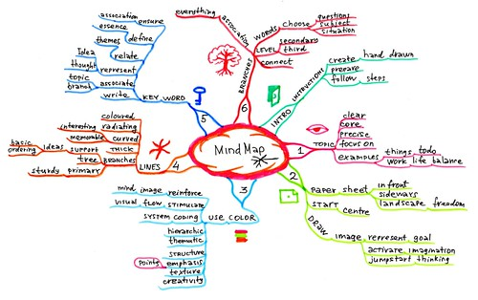
Explain the material to yourself and others
LOOK – COVER – WRITE - CHECK

Slide 21


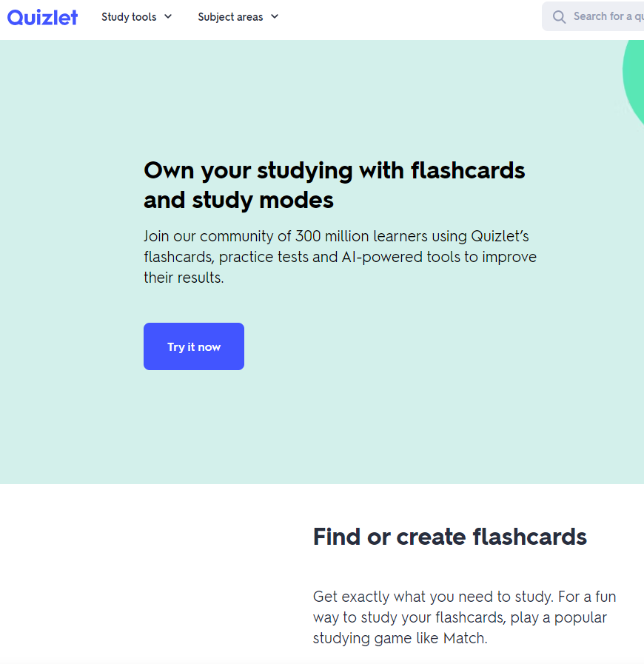

Take frequent, low stakes tests practice tests

Slide 22
Making Revision a Habit
Make it obvious – set up a study space so it's easy to get started and hard to miss!
Make it attractive – give yourself a reward after every session
Make it easy – have your resources to hand
Make it satisfying – day by day you can track your progress

Slide 23
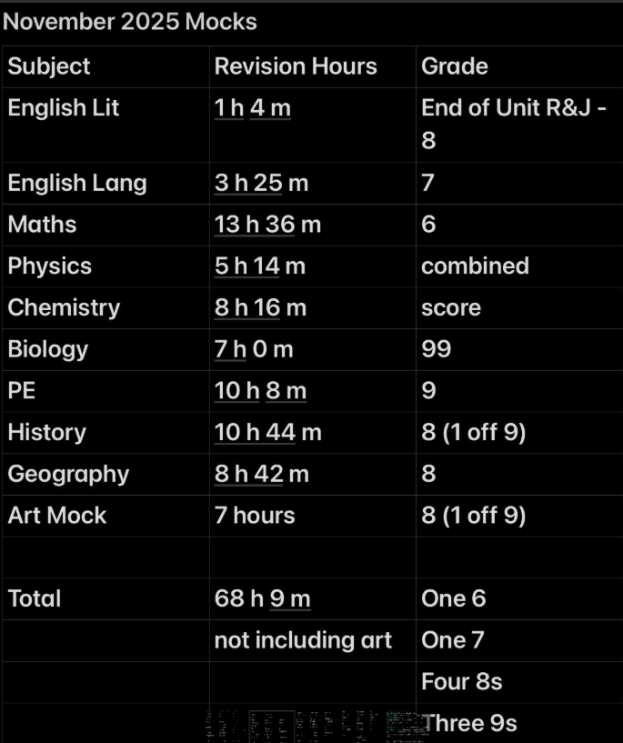
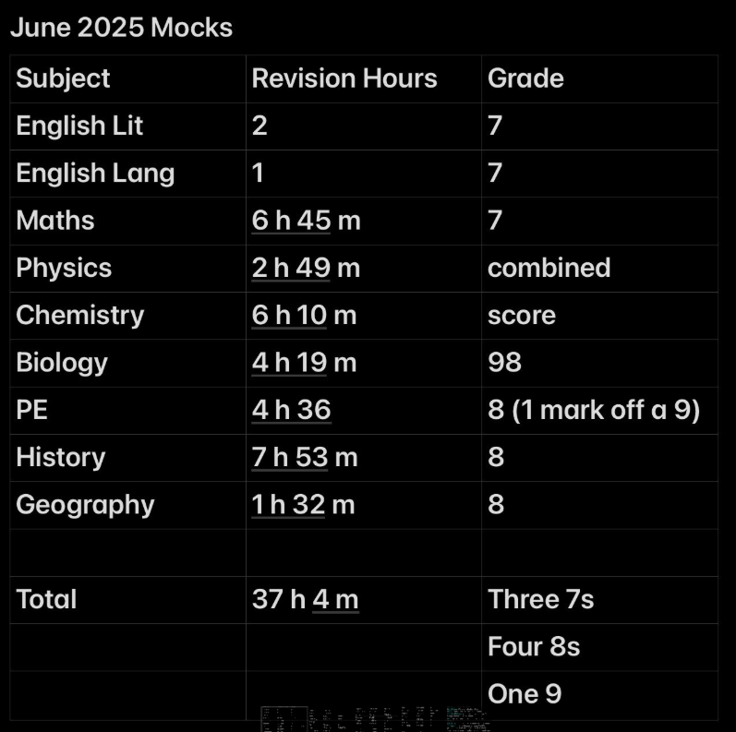

Slide 24
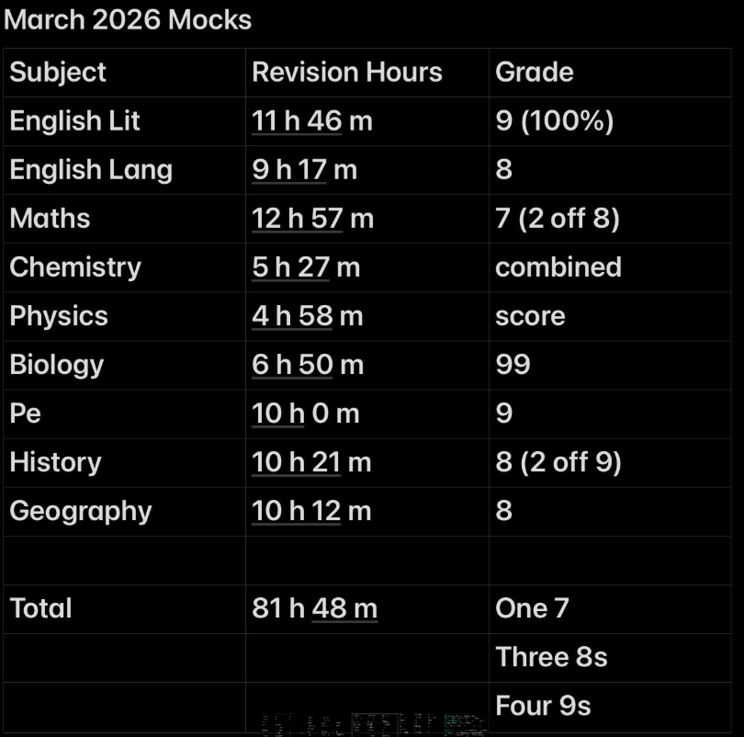
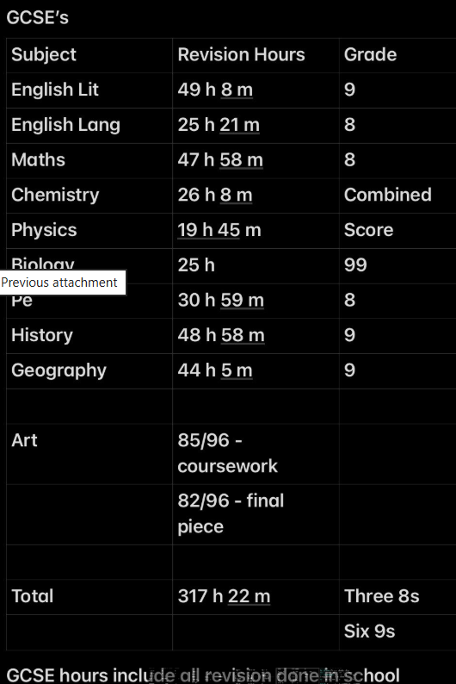

Slide 25
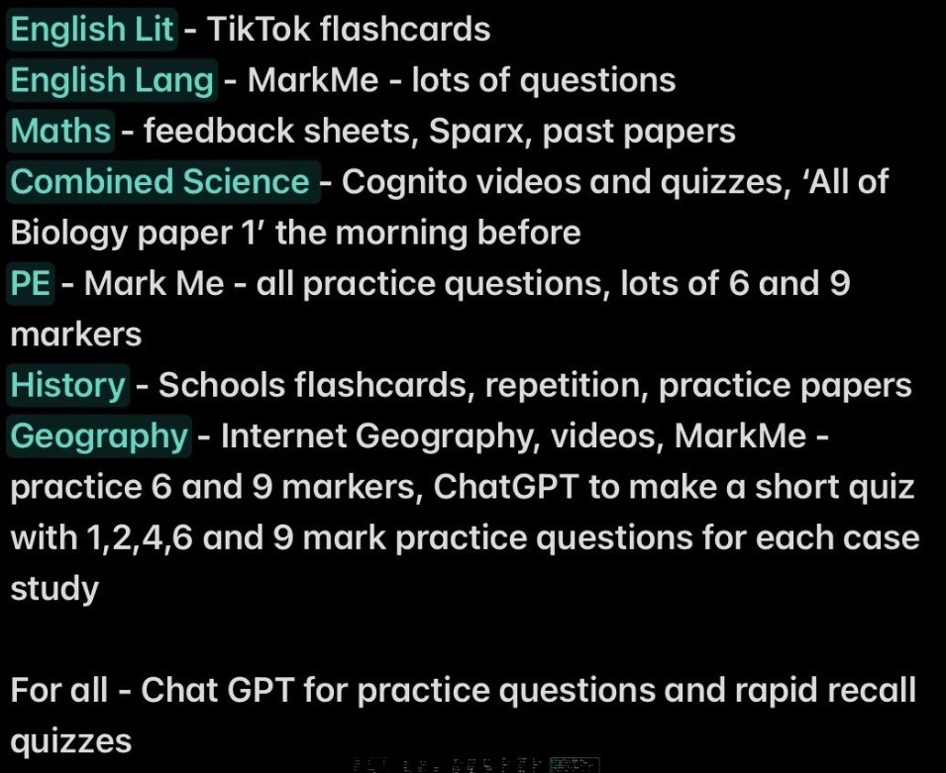

Slide 26
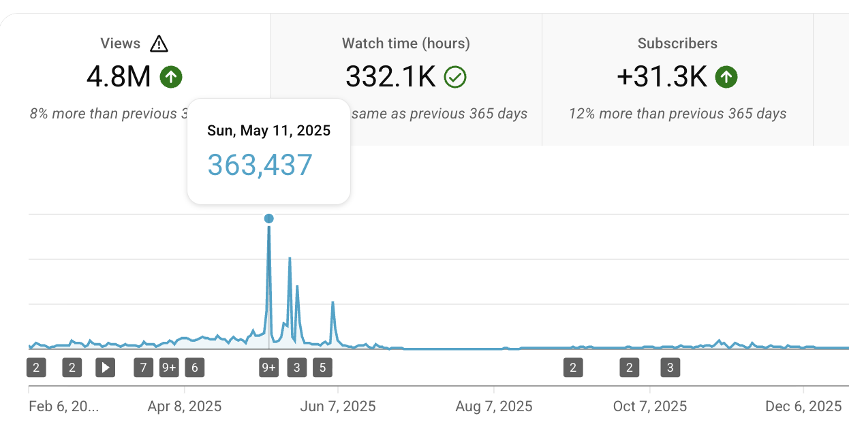

Slide 27
How do you know it's working?
Mock Exams – November & March
Parents' Evening – 15 December & 24 March
Reports – November, January, April
Exams commence Monday 10 May 2027 – 23 June

Slide 28



Slide 29
Supporting your child…
Balance: challenge and support
Nagging = retreat!
Encourage routine
Minimise distractions
Show an interest: let them teach you and quiz them!
Build in rewards: short and long term

Slide 30
Thank You
Slides will be available on the school website

