Slide 1
Welcome
Year 11 Study Skills
Session Outcome: to learn practical strategies to improve revision at home and share ways to support our young people during this period

Slide 2
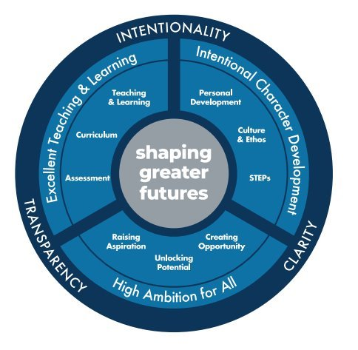
Here at Kingshill, success does not happen by chance !

Slide 3
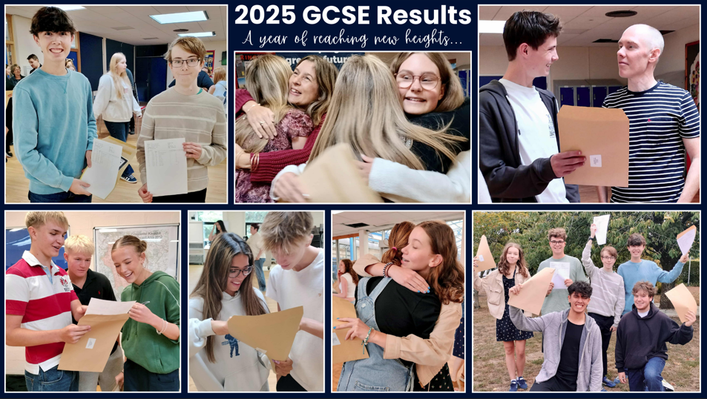

Slide 4




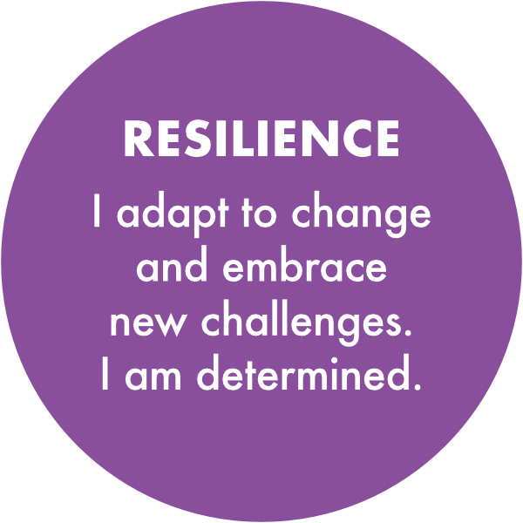

Our STEPs
Our Kingshill STEPs
underpin our culture and
develop our personal
character so that we can
flourish to be the best
version of ourselves.

Slide 5
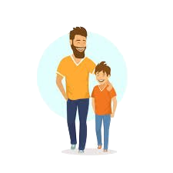


Getting into a routine at home
Involve your child
Teenagers are more likely to follow routines they've helped create. Ask for their input
Start small
Focus on a few key routines (bedtime, screen time, homework) and build from there
Use visual reminders
Weekly planner or checklist on the fridge makes routines visible and easier to follow

Slide 6



Getting into a routine at home
Be consistent, but flexible
Life happens – allow for changes, but return to the routine quickly
Praise Progress
Acknowledge effort. Positive reinforcement goes a long way
Sleep, Screen and Curfews
Teenagers need 8-10 hours of sleep to focus and feel their best

Slide 7
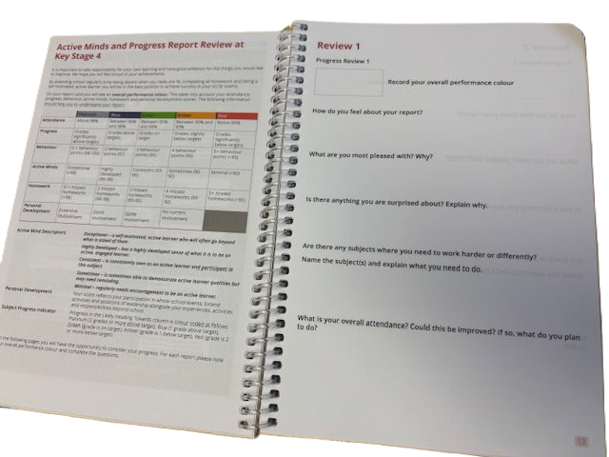
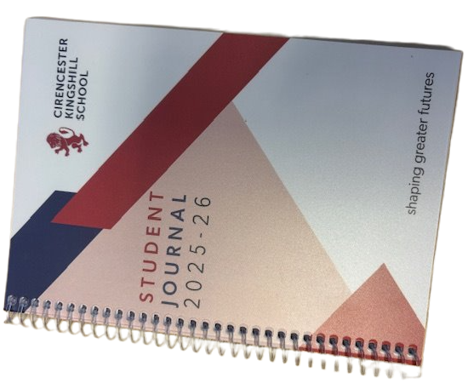

Slide 8
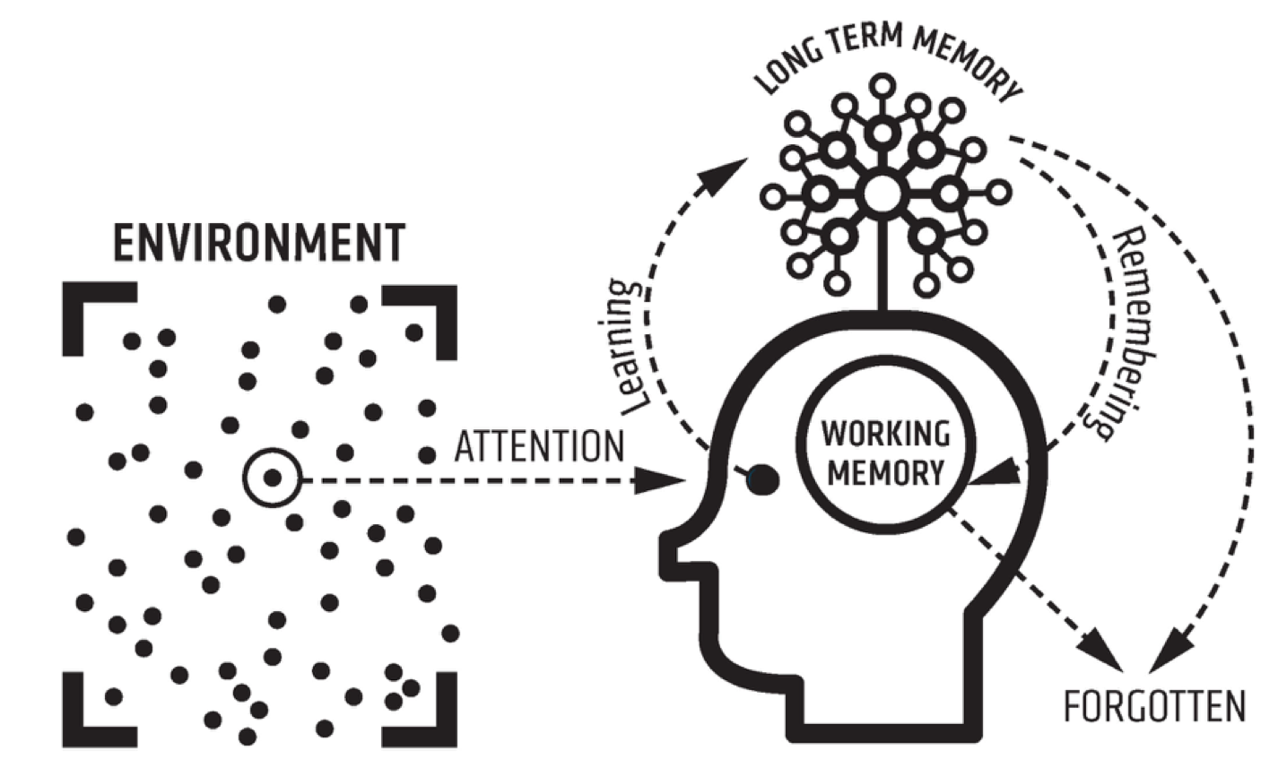

Slide 9
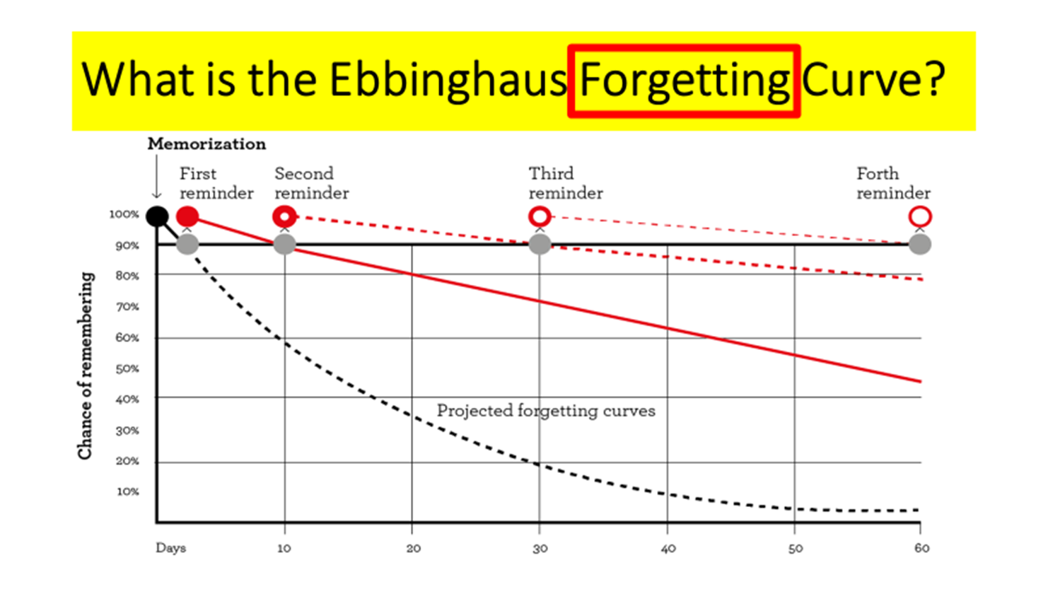
Forgetting Curve

Slide 10
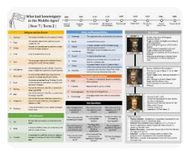


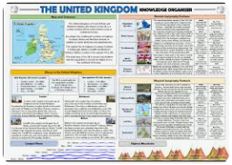
Subject Knowledge Organisers
Do Now Activity – questions to test previous learning
Homework – questions to test recall or revision task

Slide 11
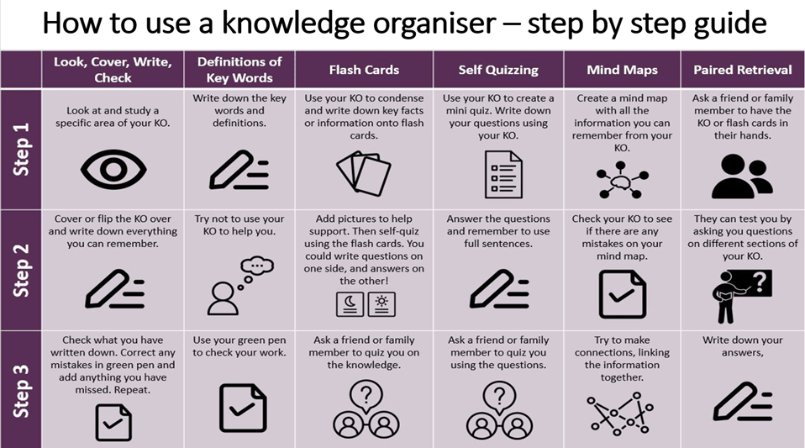

Slide 12
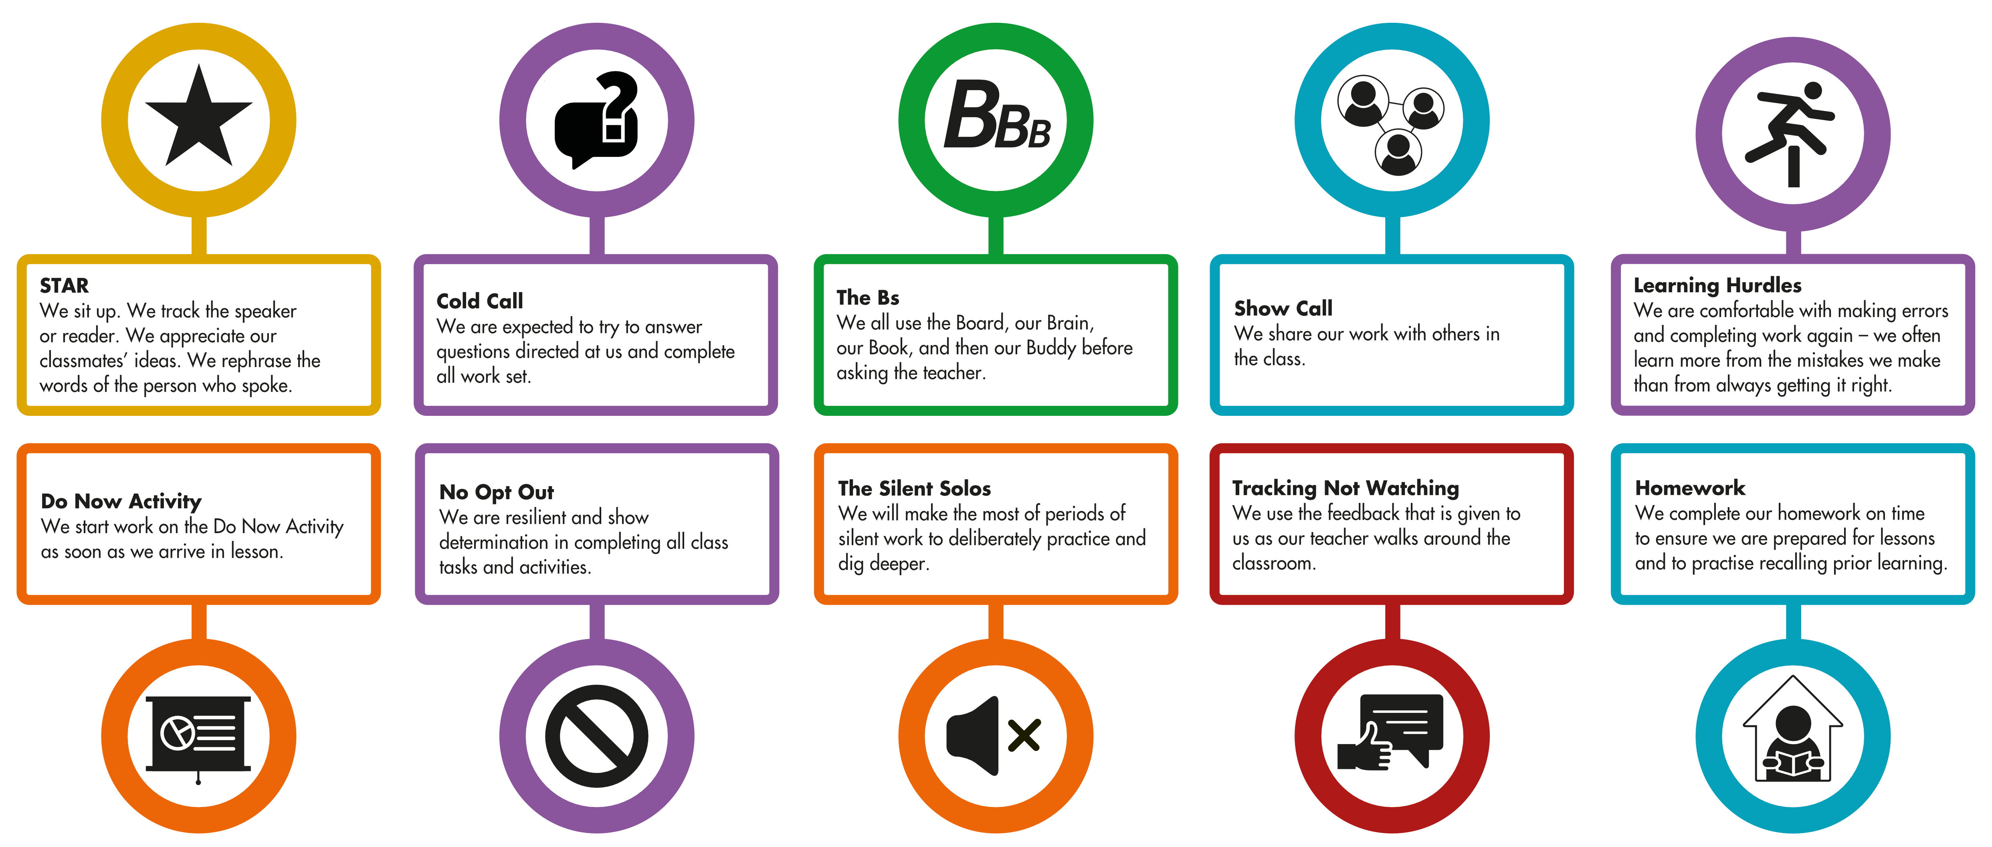
ACTIVE MINDS – Helping you in school

Slide 13
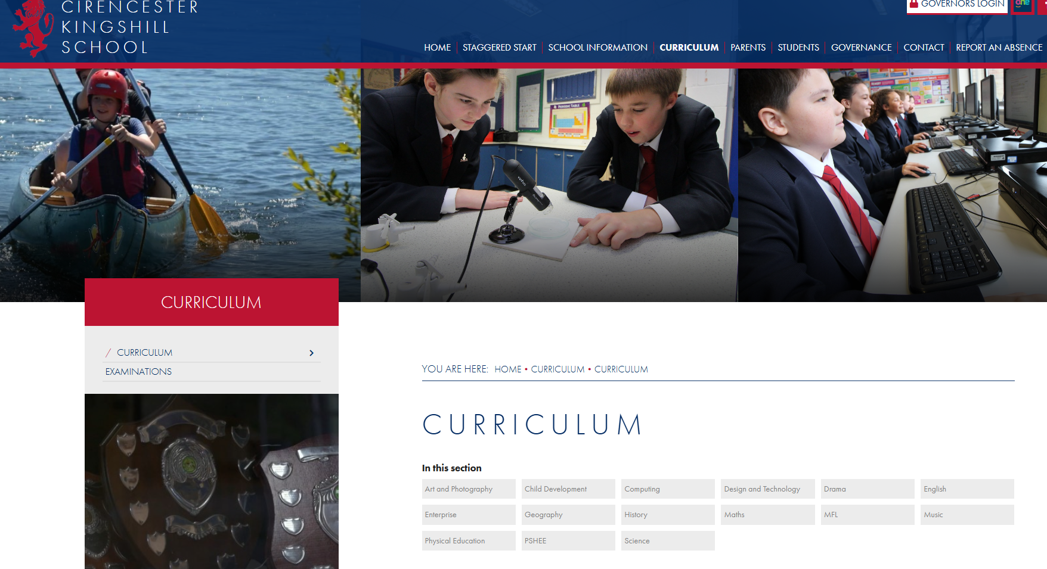

Slide 14
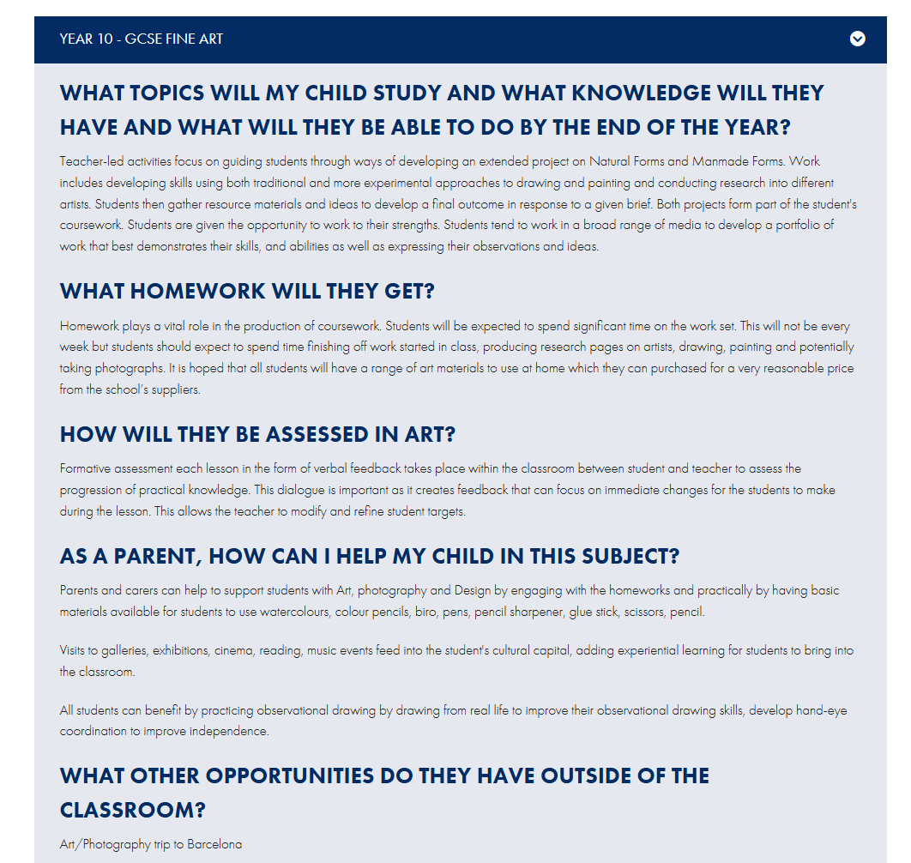

Slide 15
November Mocks
Practical subjects will have mocks before Christmas and will be advised separately
Subject | What topics will the students need to revise?
Computer Science | Programming / Algorithms/ Flowcharts/ Pseudocode/ Computational Skills
Drama | How would they direct An inspector Calls. Evaluation of live theatre. The Lion the Witch and the Wardrobe or Hades Town
English | English Language Paper 2 non-fiction and persuasive writing
Enterprise | Marketing & Finance sections of your revision guide
Food | Choux, bread making, primary processing, nutrients, different dietary needs, food spoilage
Geography | Paper 1 - Hazards, Living World, Coasts and Rivers
History | Medicine and Elizabeth
Maths | Students need to revise the topics they have found difficult. The end of year 10 QLAs they were given and progress sheets in the back of their books show the topics they need to practice
MFL | French - modules 1-5 German - Modules 1-5 Spanish - Modules 1-5
Music | Revise the Knowledge Organisers shared in TEAMS. There will also be revision cards and other materials shared. Students might find it useful to listen to unfamiliar musical styles including Classical, Romantic, Film Music and Popular Musical Styles they are unfamiliar these might include Rock, Pop, Musical Theatre / Blues. While listening to the music they can use the knowledge organiser to link what they are hearing with the content of the KO. Students will also need to revise the 2 set pieces Toto Africa and Bach Badinerie. Revision Links will be shared via TEAMs as well as a revision lesson prior to the mocks.
PE GCSE | Chapter 1 Anatomy and Physiology / Body System - All content Chapter 2 Levers / Planes Axis / Mechanical Advantages / Movement analysis - All Content Chapter 3 Training - All Content Chapter 4 Sports Psychology - All Content Chapter 5 - Socio - Cultural Factors Only Chapter 6 Health Factors / Nutrition / Active Lifestyles - All Content
Science | ALL PAPER 1 CONTENT. Biology = Cell structure and transport, organisation, transport, Infection and response, Photosynthesis and respiration. Chemistry = Atomic structure and the periodic table, Structure and bonding, Quantitative chemistry, Chemical changes and energy changes. Physics = Energy Stores and transport, Electrical circuits and mains electricity, Particle model of matter and radioactivity.

Slide 16

The biggest revision fail ….

Slide 17
Why highlighting and rereading your notes/books is ineffective

Slide 18
They are popular study techniques but amongst the least effective
Lee/Dunlosky et al., 2013

Slide 19
You become familiar with the material and your confidence increases
But this creates a false sense of mastery and can discourage critical thinking
Adescope et al., 2017; Dunslosky et al., 2013, Trev

Slide 20
So … what works better?
Work out what you don't know
2) Don't cram - review at spaced intervals (timetable)
3) Explain the material to yourself and others
4) Take frequent, low stakes tests practice tests

Slide 21

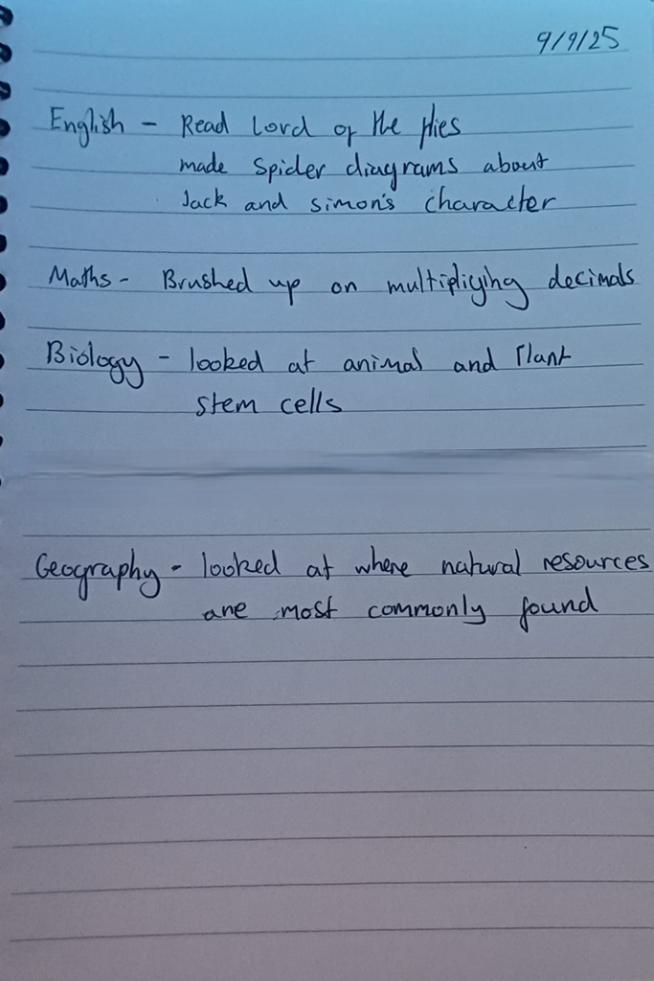
The Power of Daily Recap

Slide 22
GEOGRAPHY
Combination of physical and human characteristics:
Food – higher availability in richer countries
Water – amount of rainfall available
Energy – natural resources available
EXAMPLE -- Bangladesh – good physical characteristics, poorer human ones (education)

Slide 23
Making Daily Recap a Habit
Make it obvious – set up a study space so it's easy to get started and hard to miss!
Make it attractive – give yourself a reward after every daily recap
Make it easy – each day is a separate page
Make it satisfying – day by day you can track your progress

Slide 24

Next Level Unlocked – BLURTING!

Slide 25
BLURTING!
Blurting helps you identify what you don't know. Use it for each topic you need to study:
Pick a topic
Write down everything you know – the BLURT!
Compare your blurt to your knowledge organiser, textbook, exercise books, notes etc
Study what you missed out

Slide 26
Term Time revision: (each block = 35-45 minutes)​
Include Task – (precise details!) And testing/checking
Mon | Tues | Wed | Thurs | Fri | Sat | Sun
School!
Aim for 2 specific revision sessions most evenings and around 4 over a weekend (these could be linked to HW). Think about the best times for you!

Slide 27
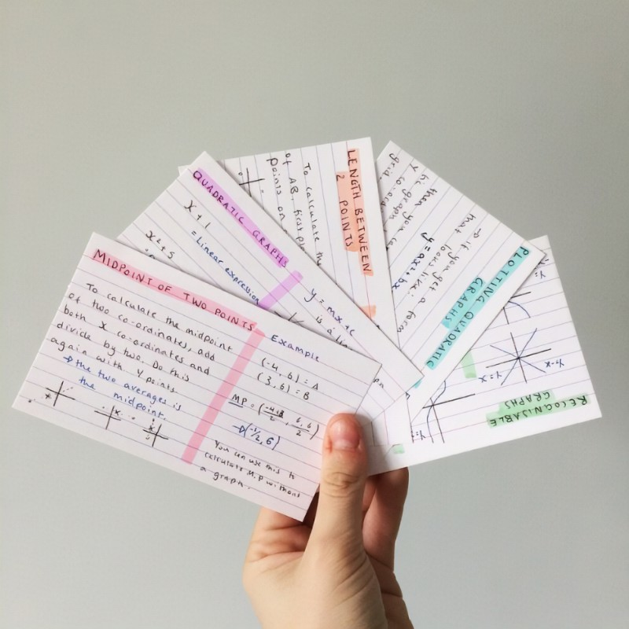
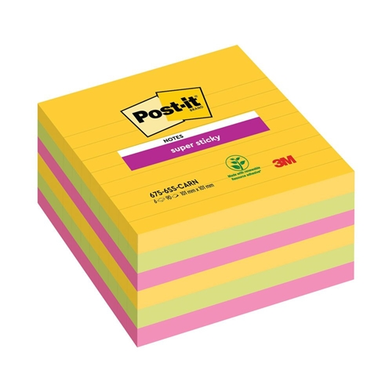
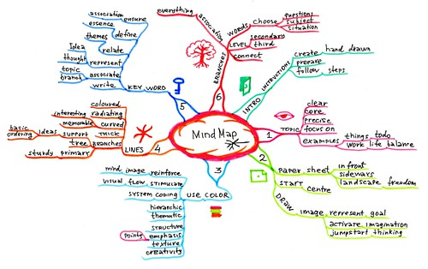
Explain the material to yourself and others

Slide 28


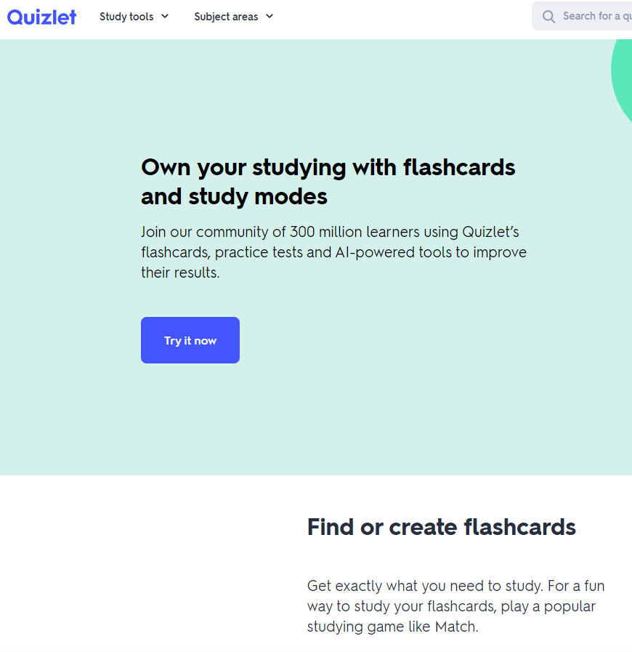

Take frequent, low stakes tests practice tests

Slide 29
How do you know it's working?
Mock Exams – November & March
Parents' Evening – 16 December & 26 March
Reports – November, January, April
Exams commence Monday 4 May 2026

