Slide 1
Welcome to our
Starting Key Stage 4 Information Evening

Slide 2
A slide coming to make us smile...

Slide 4
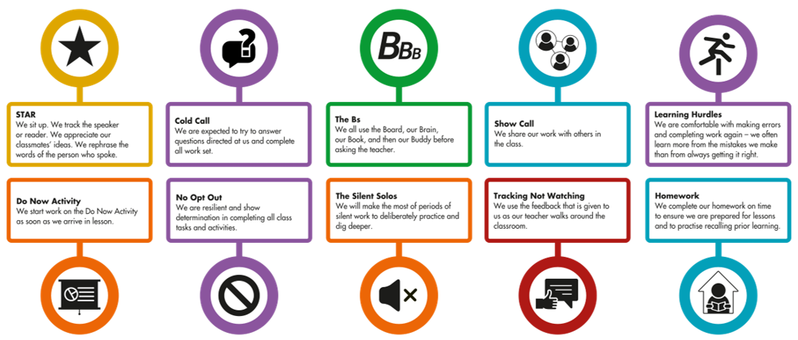

Slide 5
The Legacy of Cohort 2024
+0.2

Slide 6
Session Outcomes
You will leave us this evening knowing:
How Key Stage 4 is different to Key Stage 3
Understanding our approach to supporting academic progress
Understanding the importance of character development
Knowing how you can support your own young person with effective routine and through the use of Edulink

Slide 7
How is KS4 Different? Y10 Curriculum Information
Curriculum tab on school website

Slide 8
What topics will my child study?
What knowledge will they have and what will they be able to do by the end of the year?
What homework will they get?
How will they be assessed?
As a parent, how can I help my child in this subject?

Slide 9
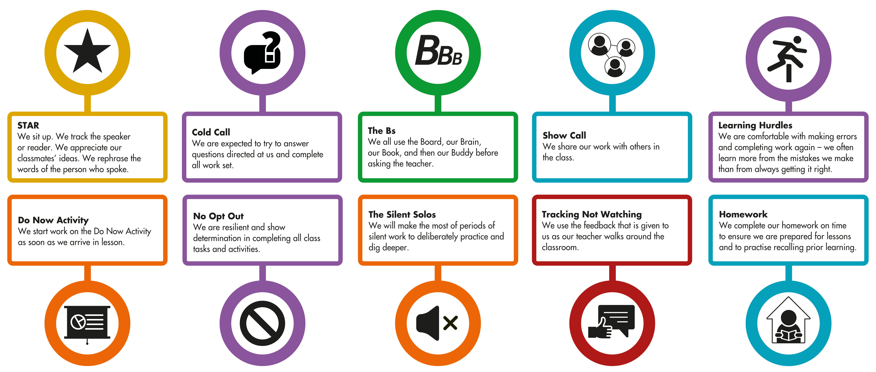
ACTIVE MINDS – Supporting Academic Progress

Slide 10
Welcome to Key Stage 4 Information Evening
AT HOME: Homework expectations, study routine, managing distractions

Slide 11
Edulink
What is it and how do I use it?

Slide 13
The power of data

Slide 14
Edulink
Attendance
Behaviour totals
Homework
Timetable
Reports

Slide 15
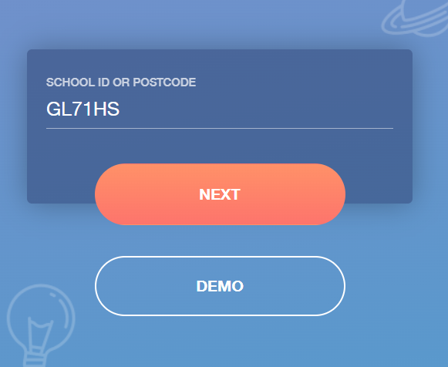
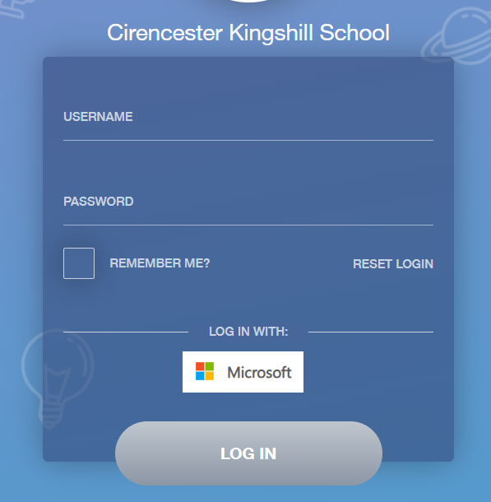
How to log in ...

Slide 16
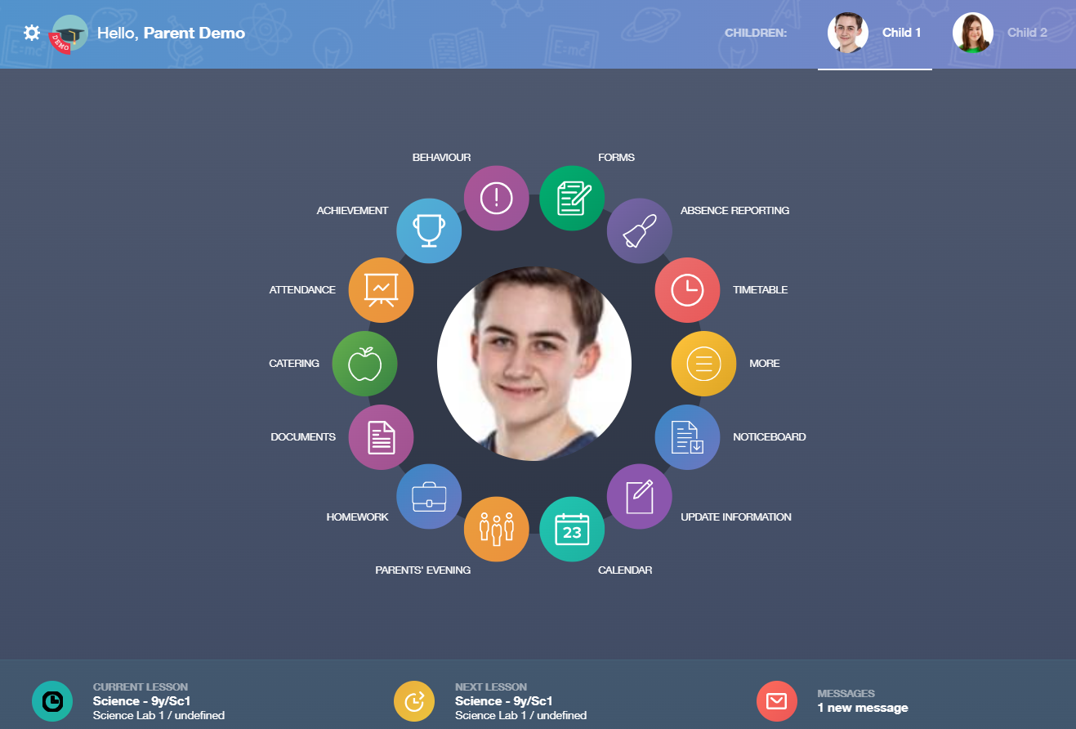
Multiple children, one log in
Your child's attendance
Timetable
Your child's homework
In App messaging

Slide 17
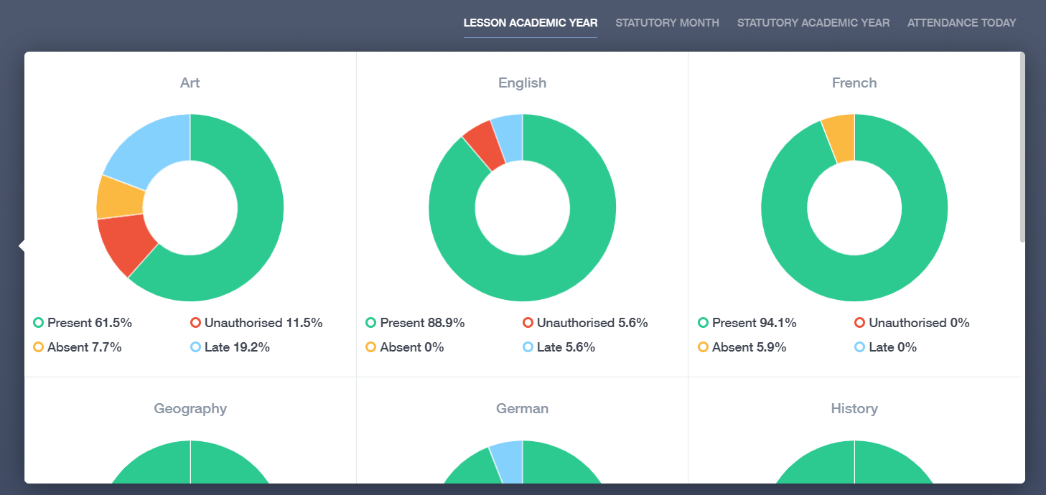
Attendance

Slide 18
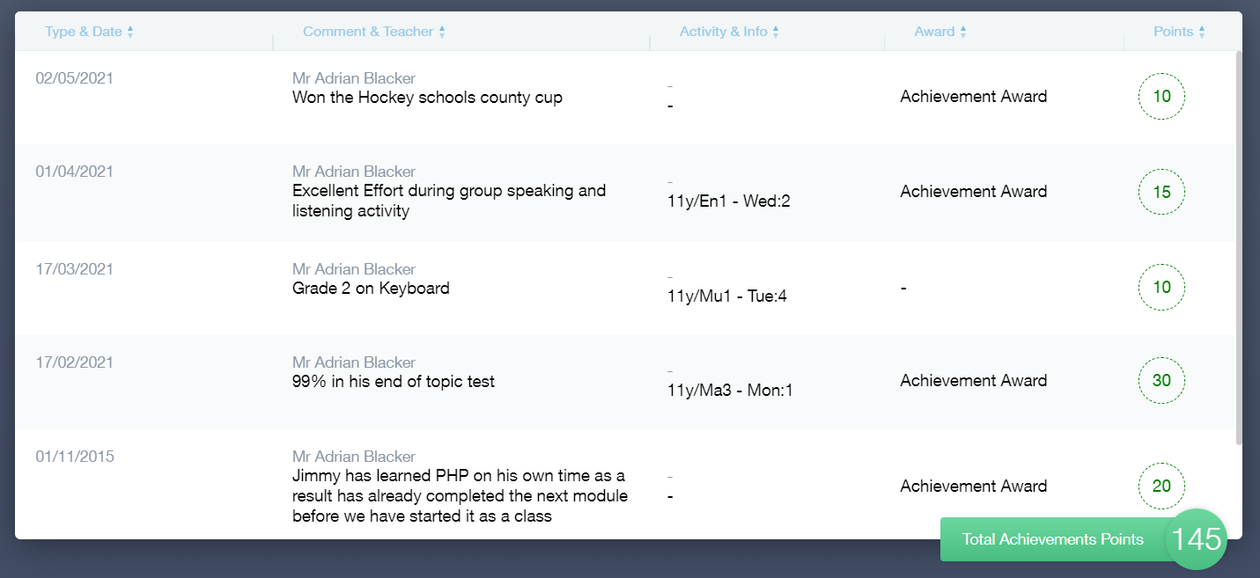
Achievement

Slide 19
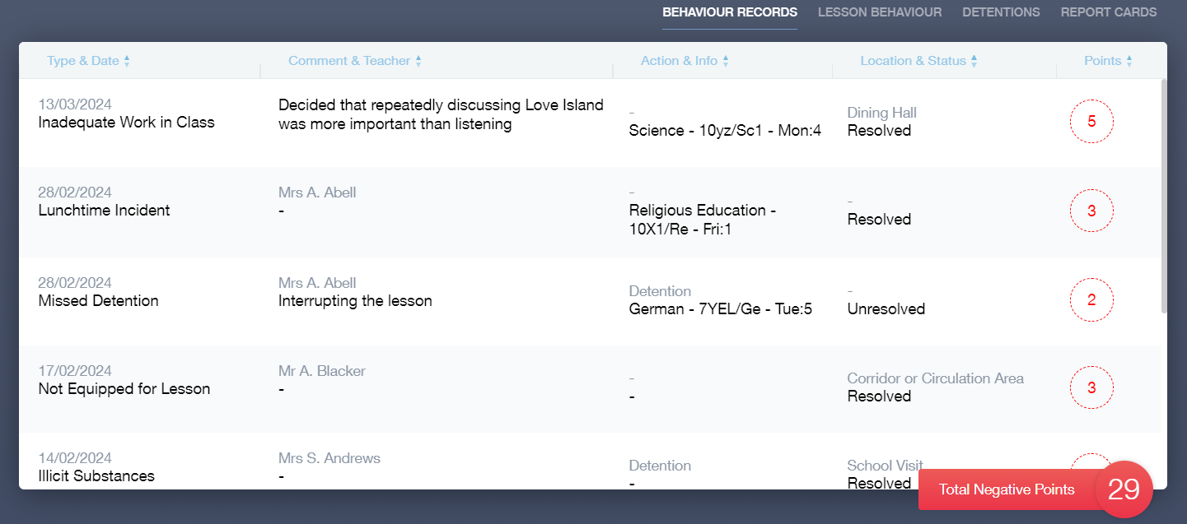
Behaviour

Slide 20
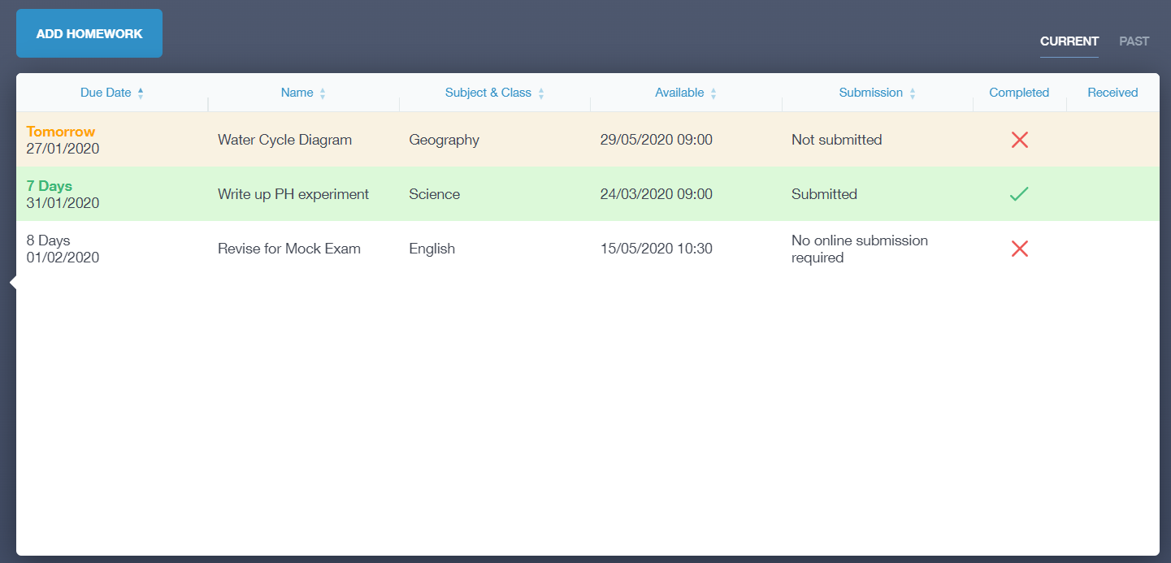
Homework

Slide 21
Personal Development: 'beyond the grades'
Importance of wider character
Our RESPECT course, life in modern Britain
Embracing opportunities:
Leadership
Wider experiences: work, volunteering, charity
Extend – our Kingshill extra-curricular offer

Slide 22
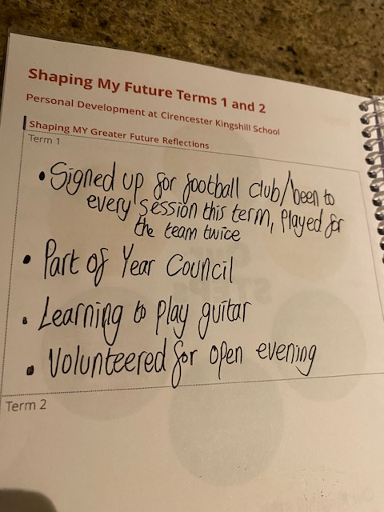
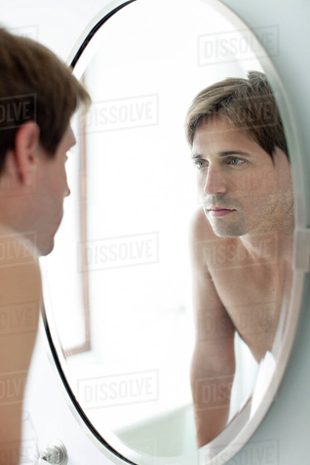
Reflecting on your Personal Development

Slide 23
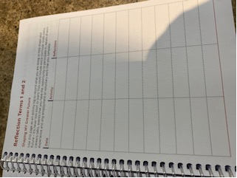
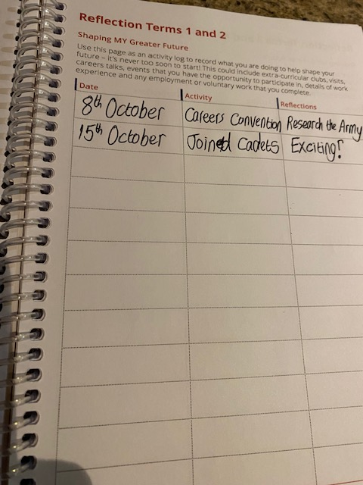
Creating Opportunity and Developing Ambition
Maximising Opportunities
Our EXTEND programme
Trips and visits
A full time Careers Advisor, Mrs Hicks
Employer talks
The Careers Convention, (8th October)
Support in PSHEE/Respect lessons
College visits
Work Experience, w/c 29 Sept 2025! (Y11)
Y11 Mock Interview Day

Slide 24
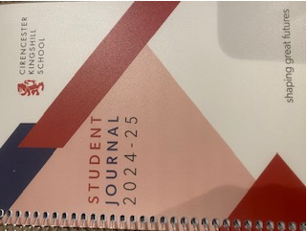
Organisation and Routine: the value and rationale of a journal….
Those who plan, prioritise and prepare well…perform well
Those who reflect well ….realise things

Slide 25
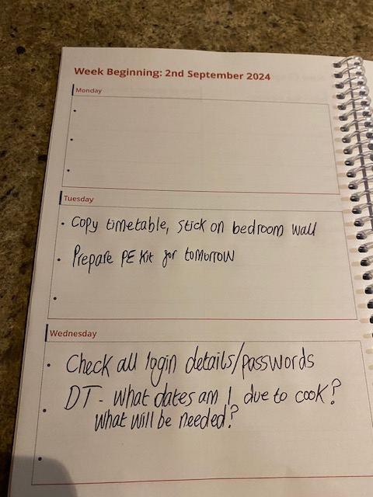
Daily Notes/Priorities

Slide 26
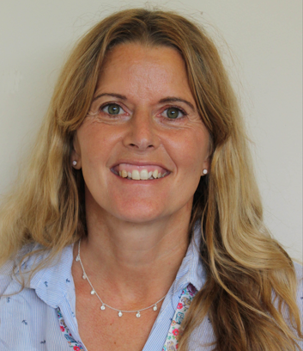
The Wider Team
Our Unlocking Potential Assistants
Mrs Nicci Norman

Slide 27
Our UP Strategy
Mr Darren Stillman
CIRENCSTER
KINGSHILL
SCHOOL
UP
Unlocking Potential

Slide 28
Our Performance Colours
Platinum
Blue
Green
Amber
Red

Slide 30
Responsibility
I have no more than 1 behaviour point each term
I have 2 behavior
points in a term
I have 3 behavior
points in a term
I have between 4 and
10 behaviour points
in a term
I have more than 10
behaviour points in a
Single term

Slide 31
Kindness
I fully embrace
myself into the
Extend Programme, take part in charity events, am a student leader and support the wider community
I embrace the Extend programme and take part in charity events or support as a student leader
I take part in the
Extend programme
I do not take part in the
wider life of the school

Slide 32
Platinum
Blue
Green
I work very well
and show high levels
of Resilience and
Respect as a result
I am outperforming
expectations
I am doing
all that is expected
of me as a student
and as a result I
am making expected
progress in lessons
I fully
embrace the culture
of our school which
allows me to perform
well above expectations
Year Group Recognition
Tutor Recognition
Always Considered
For Rewards

