Slide 1


Options Curriculum Governors Update
20th June 2023

Slide 2
Key messages
New Music Technology Qualification, which has proved to be a popular choice
Computing will miss a year off the curriculum in KS4 with BTEC IT being the course which we offer to students
Many subject numbers were slightly above a single class size and so we opted to run an additional class to maintain a high satisfaction rate
Overall satisfaction rate 97%

Slide 3
Key Stage 4 Curriculum
Core Subjects
English Language
English Literature
Science (Double Award)
Mathematics
Respect
Core PE
Option Subjects
Art
BTEC IT
BTEC Sport
BTEC Child Development
Computer Science
3D Design
Drama
Textiles Design
French
Food & Nutrition
Geography
German
History
Learning Support
Asdan
Music
Music Technology
Photography
PE
Religious Education
Science (Triple)
Spanish
Notes:
Students are encouraged to choose at least 1 EBACC subject (Highlighted Red(
German/French/Spanish (Open to those who have studied in year 8/9)
Learning Support students will have been targeted previously GCA.

Slide 4
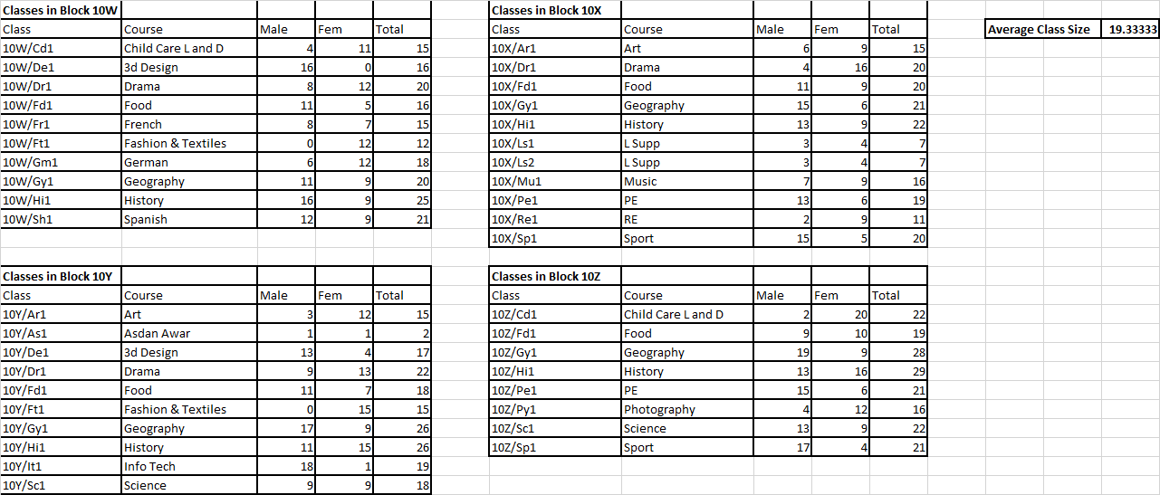
2022-2024

Slide 5
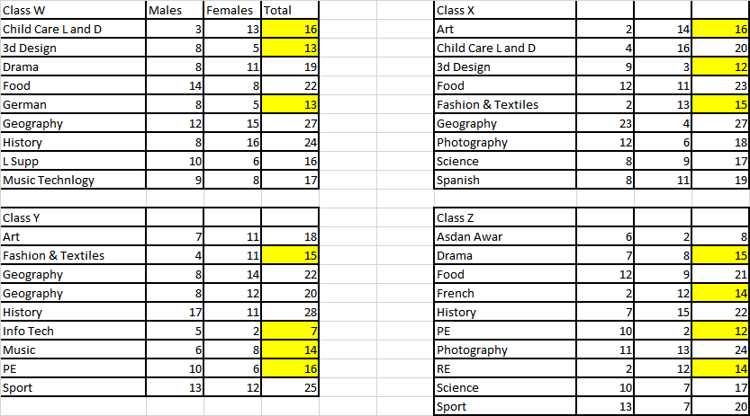
2023-2025

Slide 6
Next Steps
As with every year, ensure any changes are made efficiently
Ensure we maintain a strict cut off for student option changes (Oct 2023)
Options Taster Sessions to be timetabled (10/11 July)

