Slide 1
Your journey to top marks in the initial ideas section
Design Idea 1
Draw at least 1 idea in the style of a designer or design movement AND explain how the shape reflects the designers style.
Design Idea 2
2. Draw at least 1 idea taking inspiration from the images in your product analysis AND explain how you have been influenced by the shape, texture, pattern, colour in the photos
Design Idea 3
3. Draw at least 1 idea taking inspiration from your primary observation drawings AND explain how you have been influenced by the shape, texture, pattern, colour of the photos
(3) Or combine the best bits from 2 different concepts to make a different idea. Explain how you have combined the best bits and how the design has improved.
YES
YES
5. Label all the features of each design.
explain
The unique selling points
Material
Colour / finish
Possible construction method
Where it would go in the home / office / café etc
How it will work like where the coats hang, shoes go is it freestanding or wall mounted?
How it is easy to clean
How you have incorporated the theme curves into your design – bending, bowed, arched, curved, rounded
Design Idea 4
4a. Draw at least 1 idea that is sensible and one you think you would be happy to make in 10 hours. Explain how you think you could make it and write what tools, equipment and materials you could use.
4b. On your drawings 1-4, draw 1 with a stencil motif decoration, 1 with an engraving motif decoration, 1 with an embossed motif decoration, 1 with a debossed motif decoration.
YES
YES
YES
8. Number each design and CHECK that you have explained what inspired the shape.
6. Write a summary explaining how you have used the different visual sources (the photos) to give you ideas and how it is in a curved Style
Design Styles = symmetry, geometric, streamlines, aerodynamic, bold curves, strong vertical lines, zigzags, chevrons, bending, bowed, arched, curved, rounded
7. Cut out and stick next to your design idea a photo of a room. Draw a box on the photo to show the scale of your design in the room.
YES
YES

Slide 2
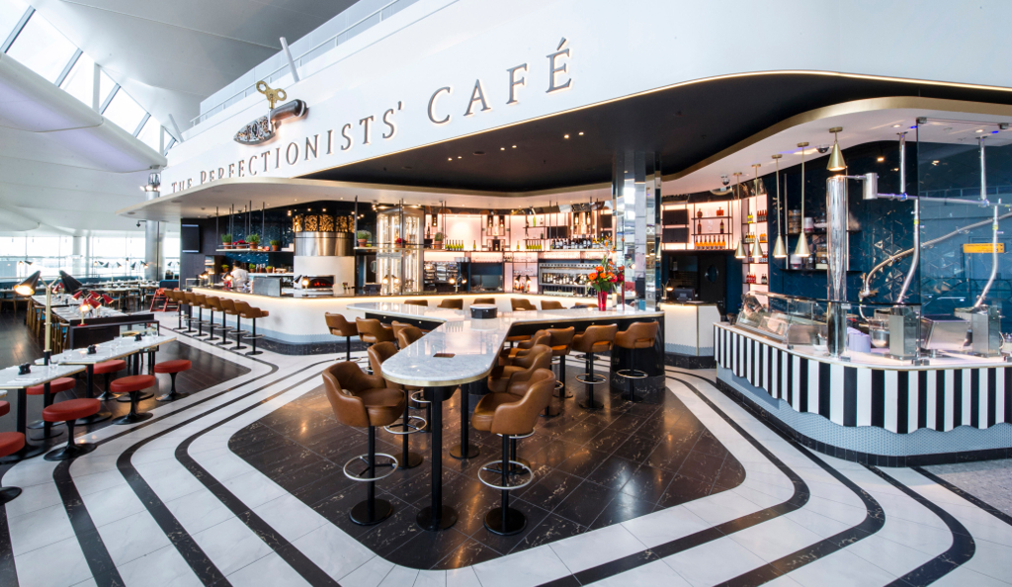
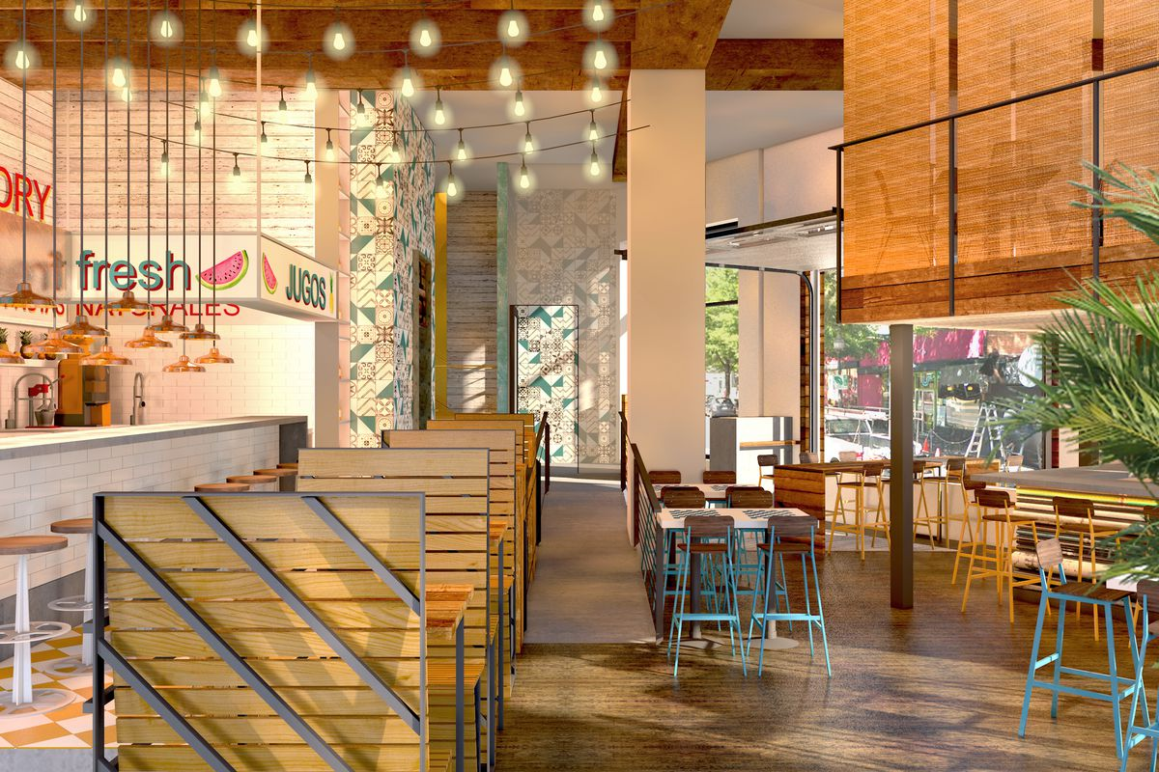
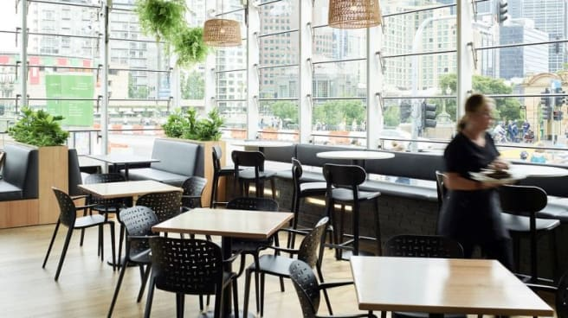
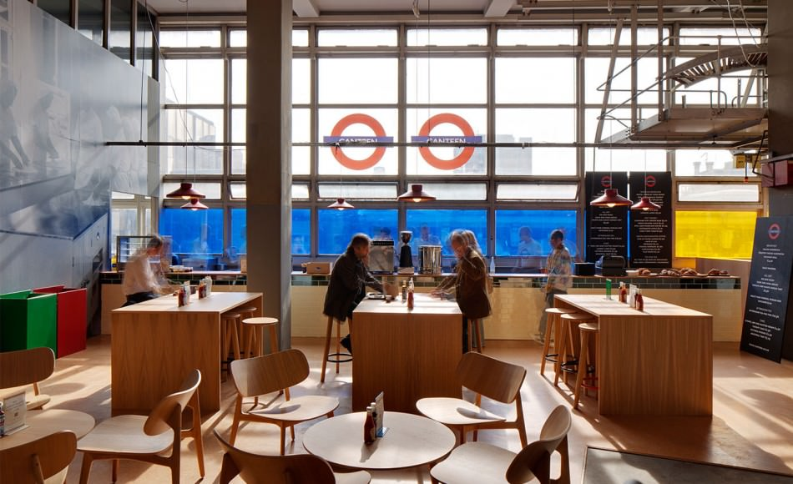
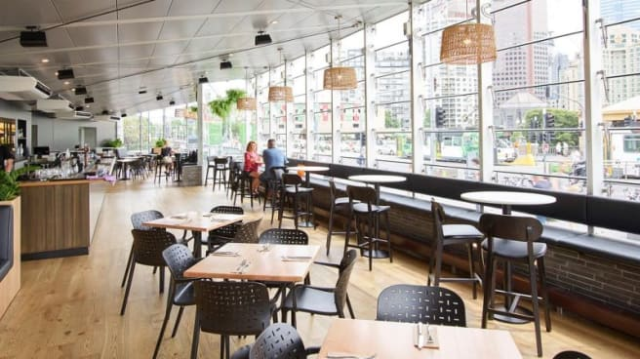
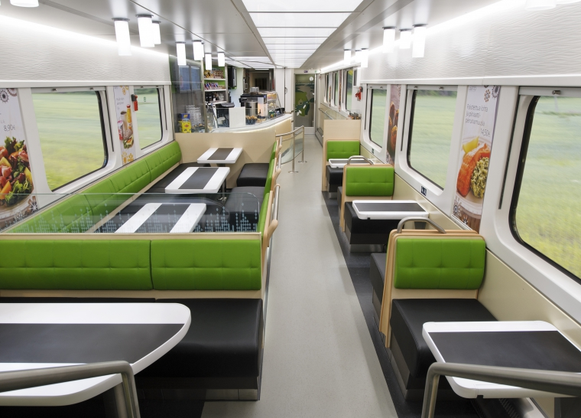
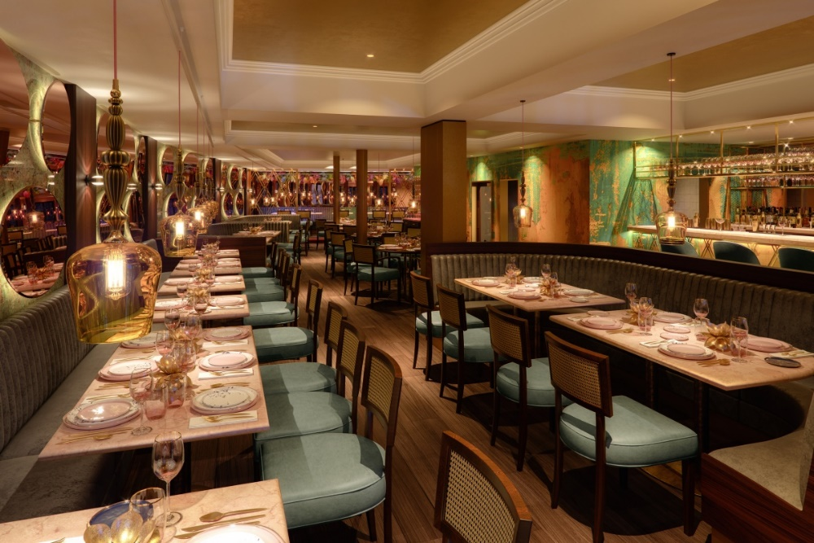
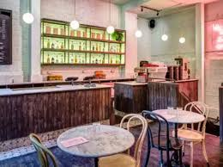
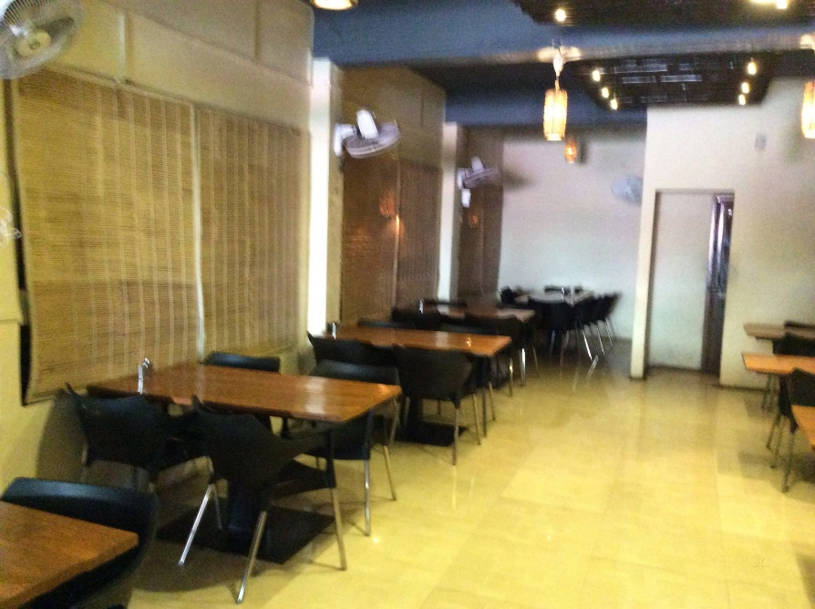

Slide 3
