Slide 1

DNA by Dennis Kelly
Lesson 4

Slide 2
Learning objectives
To use and apply still image or mime as performance technique to help convey a sequence of dialogue
To experiment with the use of placards within a scene

Slide 3
Read pages 19-23
Answer:
What have they done?
How do they feel about it?

Slide 6
Task 1-
KEY WORDS
FACIAL EXPRESSIONS
POWER AND DYNAMICS
PROXEMICS
BODY LANGUAGE
SPACE
CONTRAST
EYE CONTACT
PITCH
TONE
PACE
TENSION
Create a storyboard of 6 still images that show what happened to Adam.
Use PLACARDS (in the storyboard) showing lines from the play that contrast to what was happening e.g. ‘He was laughing’ and images shows him being beaten up.
Add some lines of narration to the images.
Things that happened:
Leaves
Socks
Nick vodka
Punch
Cigarette
Motorway
Climb fence
Stone

Slide 7
Read the rest of scene 3- 24-26
Phil dominates this section-
Answer:
Why has the playwright done this?
What do you think of Phil?

Slide 9
abducted, they'll be inquiries, police, mourning a service and if everyone keeps their mouths shut we should be fine. Any questions?
They stare at him open mouthed. He bends down. Picks up his Coke. He starts to drink his Coke.

Slide 10
Task 2
Can you storyboard Phils plan? A plan of attack ?
1. | 2. | 3.
4. | 5. | 6.
7. | 8. | 9

Slide 11
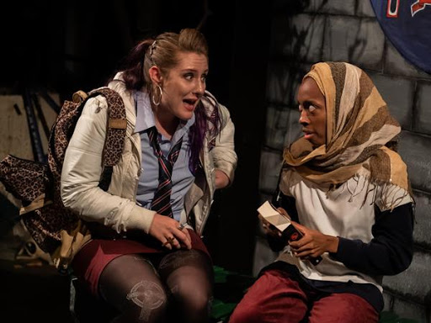
DNA by Dennis Kelly
Lesson 5

Slide 12
Task one- read Jan and Mark, Act 2 scene 1&2, pgs. 29 - 41
Answer:
Why has the playwright used these scenes between Jan and Mark at the start of each act?

Slide 13
Task two- consciences of the characters
Read act two scene 3. pgs. 41 - 43
On a piece of paper / word doc, write down a thought track for the following characters. This thought track should show their true feelings on the situation:
Phil
Brian
Leah

Slide 14
Task two continued
Imagine you are going to create a conscience corridor/ Argument alley (two lines facing each other)
Imagine when Phil walks down the corridor, you say your thought track for Phil out loud.
Answer - how is Phil feeling?
Repeat and answer for Brian and Leah.

Slide 15
Task 3
Create a script showing the following scene:
Either:
Adam’s parents on the news appealing for anyone to come forwards about Adam’s disappearance.
Or:
The group watching the news appeal and their different reactions/responses to this.

Slide 16
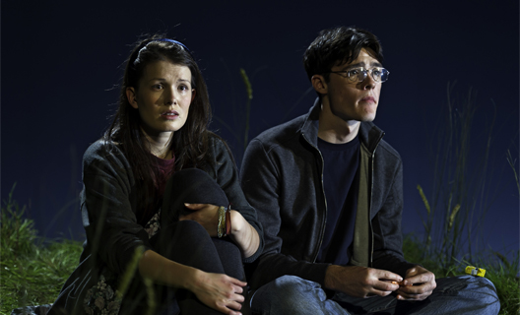
DNA by Dennis Kelly
Lesson 6

Slide 17
Starter- Leah’s speech- Act 2, scene 4, pgs.41-43
Leah has a speech and states the following:
‘ Do you think we are doomed to behave like people before us?’
Think about the question and form your own opinion:
Answer:
Can we change?
Are we born a certain way?
If we experience violence, do we become violent?

Slide 18
Task 1- Jan and Mark Act 3 scene 1
After reading Act three, scene one, pages 44-46, write a short improvisation of who they think Cathy found in the woods and what has happened.
Use cross cutting- on pages 44-46 add in your improvisation by annotating the script, to show how you would perform the scene using cross cutting.

Slide 19
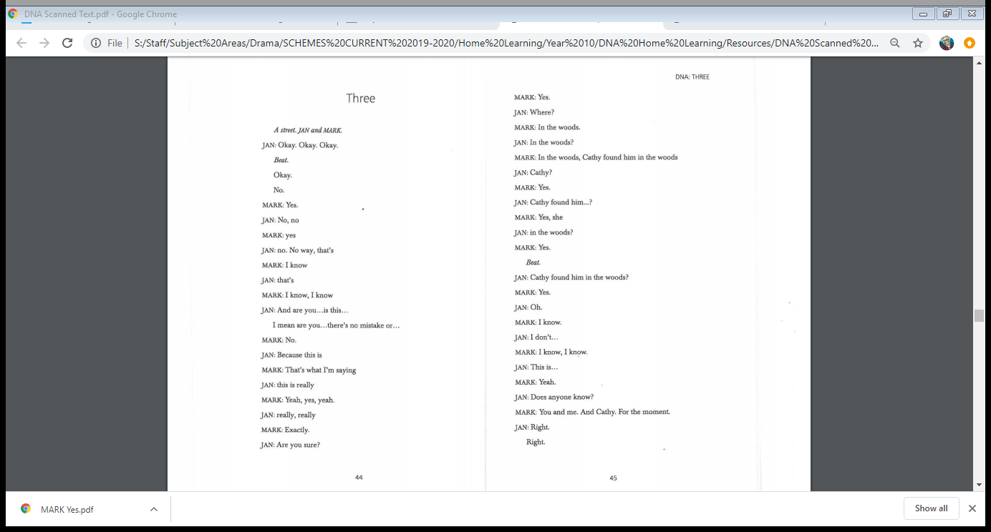
Script for cross-cutting

Slide 20
Task 2- Act 3 scene 3 Read 47-59
Jan Mark Lou Phil Brian Cathy Leah Adam
Hot seating the characters
Write down 5 questions you would like to ask one of the characters above and them answer them as the character.

Slide 21
Task 3- Leah page 60-61
Answer:
What is the change in Leah?
Why has she changed?

Slide 22
Reflection - Answer
How have the characters changed?
What should they have done?
When could this situation have been prevented?

Slide 23
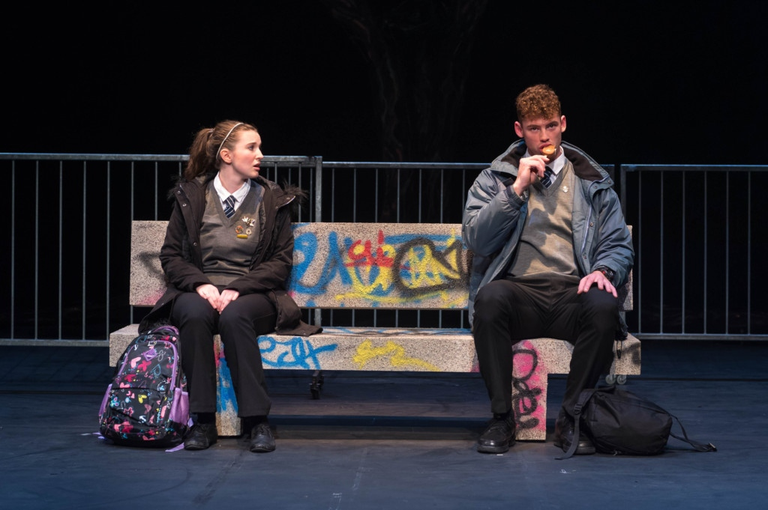
DNA by Dennis Kelly
Lesson 7
Assessment task

Slide 24
Task 1- Read pages 62-66 end of the play
Learning objectives
To decide what task to complete for your assessment.
To plan as if you were to perform for assessment.

Slide 25
Assessment options
Plan a performance of a scene from the script to include:
Costume
Lighting
Sound effects
Props
Music
Set
Pick a scene: e.g. Jan and Mark

Slide 26
Planning- Fill out the table
Scenes: | Lighting | Sound effects | Props
Set | Costume | Music

Slide 27
Assessment
1. Read through your chosen scene
2. Sketch the scene, include specific details and justify these elements:
Lighting
Sound effects
Props
Music if required
Set / stage furniture
3. Complete specific costume designs for at least 2 characters, again justify your choices.
Tip: for each element think what mood/atmosphere/message it will put across for the audience.
Tip: Do some research to make you think about the different elements.

