Slide 1
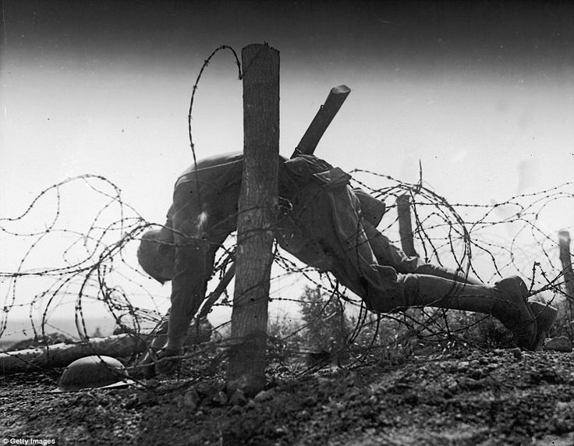
WAR!
WAR!
What is it good for?
Notes:
WUsing this picture as a starting point, pupils should write down a list ten words that they associate with “War”. All the words should be different. Once they have done this, go through the lists to see how many pupils have said the same words. Write the five most popular words on the board.

Slide 2
“A state of armed conflict between
different countries or different
groups within a country.”
Notes:
Is this the best definition of “War”? Can you improve it or add to it using the five words that were chosen as the most popular – pupils to write down new definitions on paper.

Slide 3
What are the following pictures
showing?
Notes:
Ask pupils to explain what is happening in the following picture – what are they about/where are they etc. Discuss all the images and the impact that they have on our lives and the lives of other people around the world. (Can be done as pair work with feedback later).

Slide 4
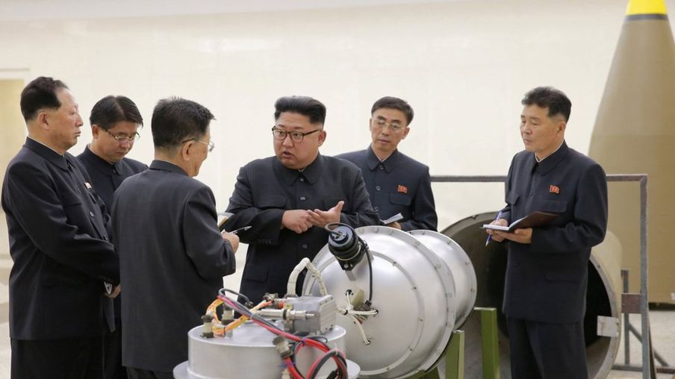
Notes:
North Korean nuclear missile tests.

Slide 5
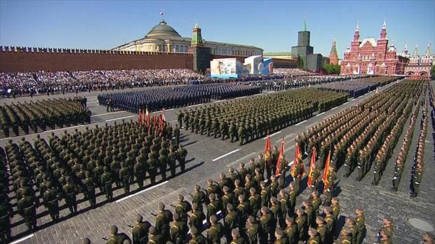
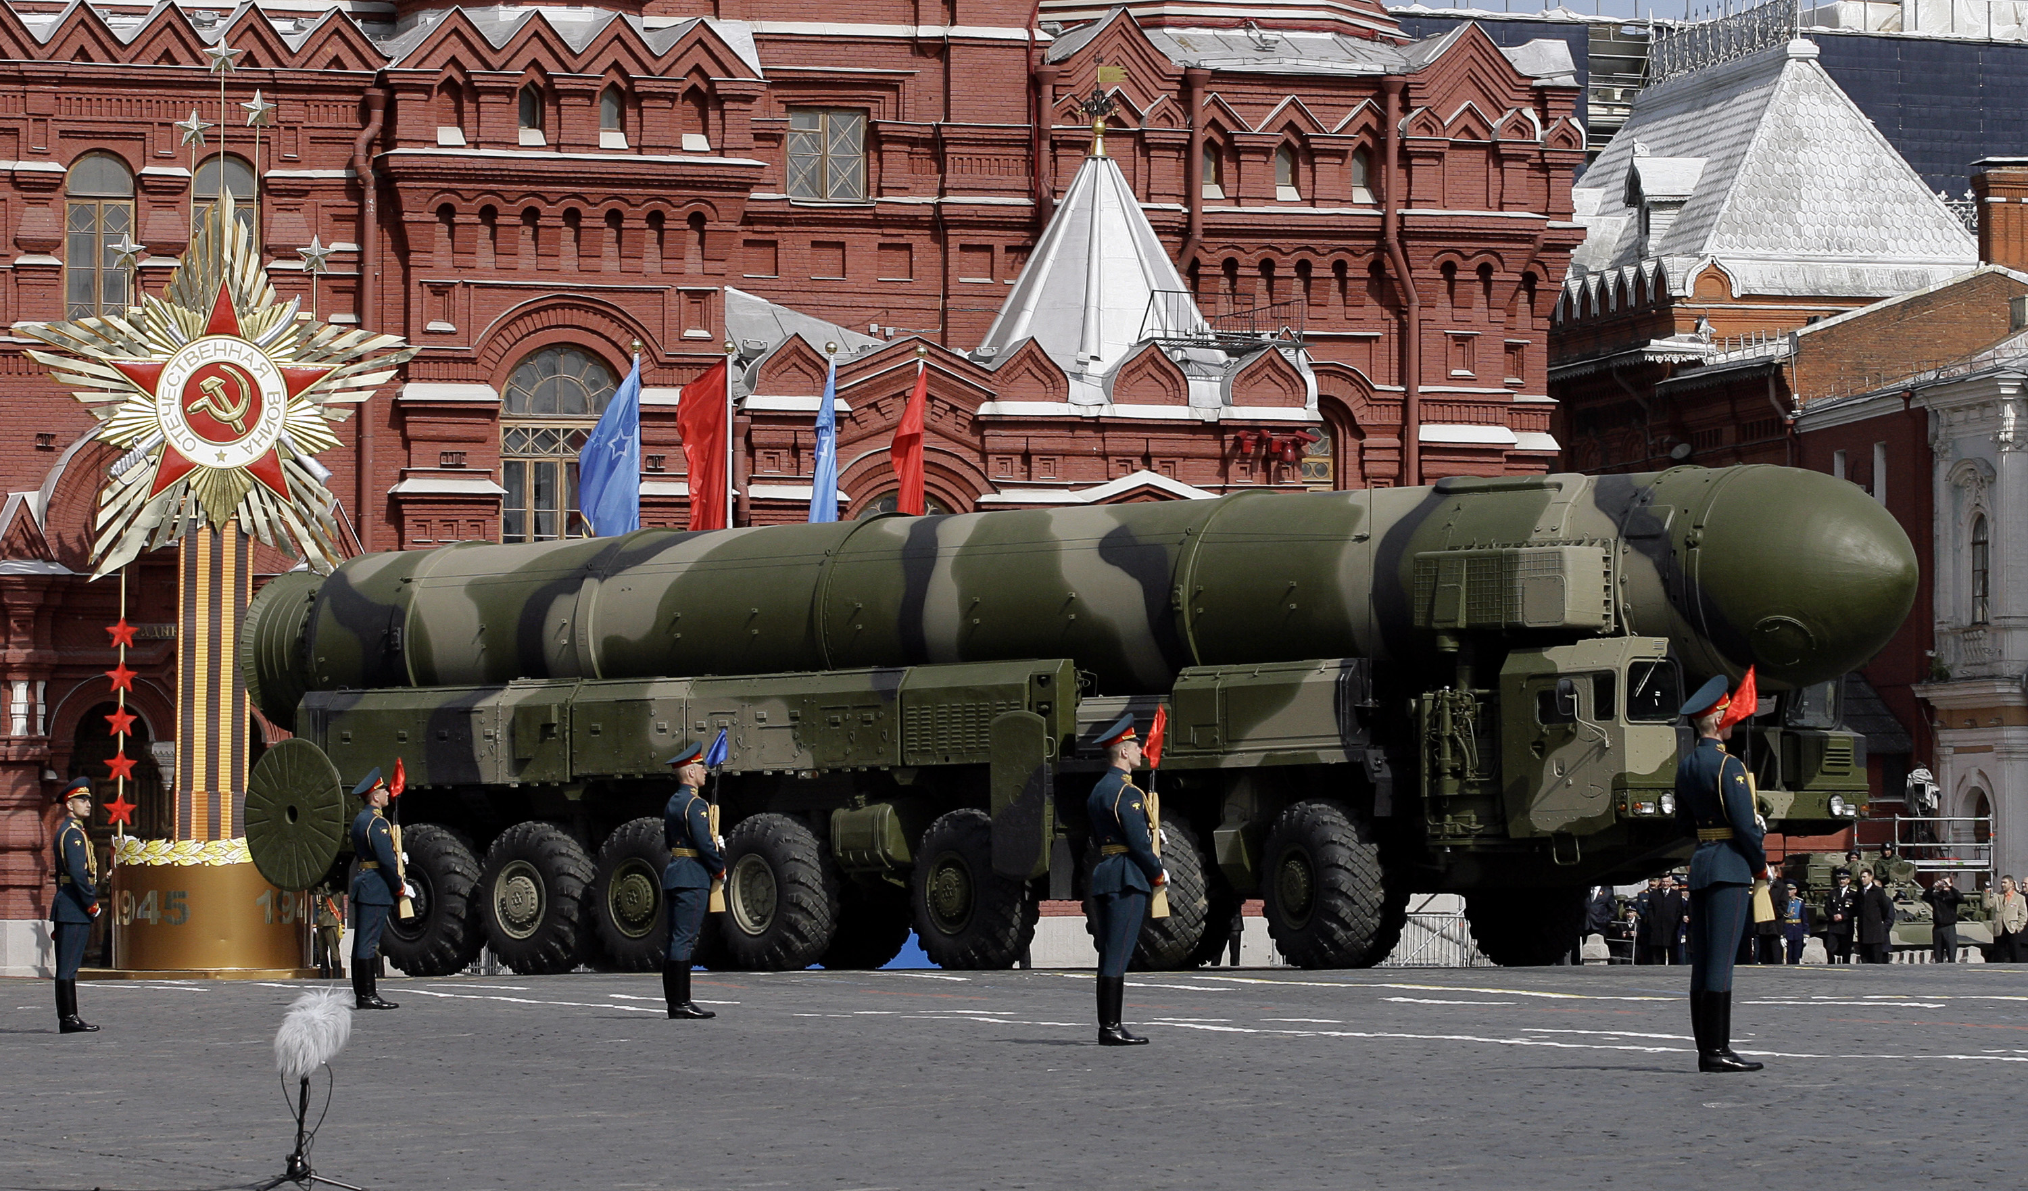
Notes:
Russian military display.

Slide 6
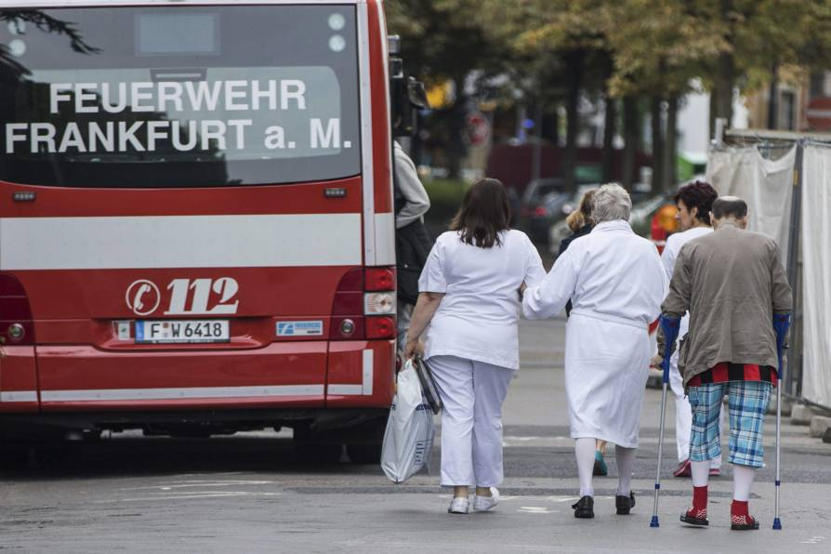
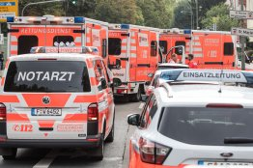
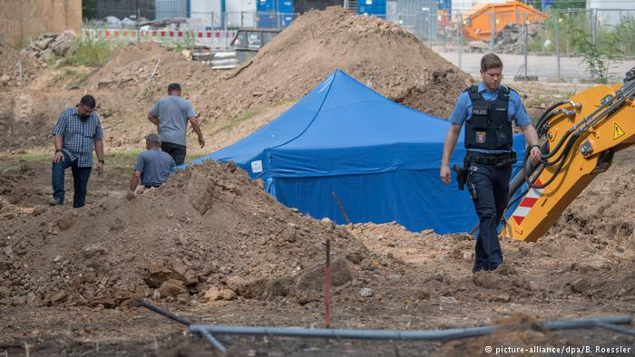
Notes:
British WW2 “Blockbuster” bomb found in Frankfurt

Slide 7
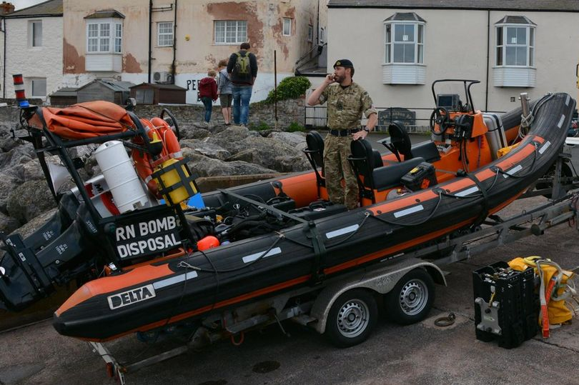
Notes:
German WW2 bomb found in Bristol

Slide 8
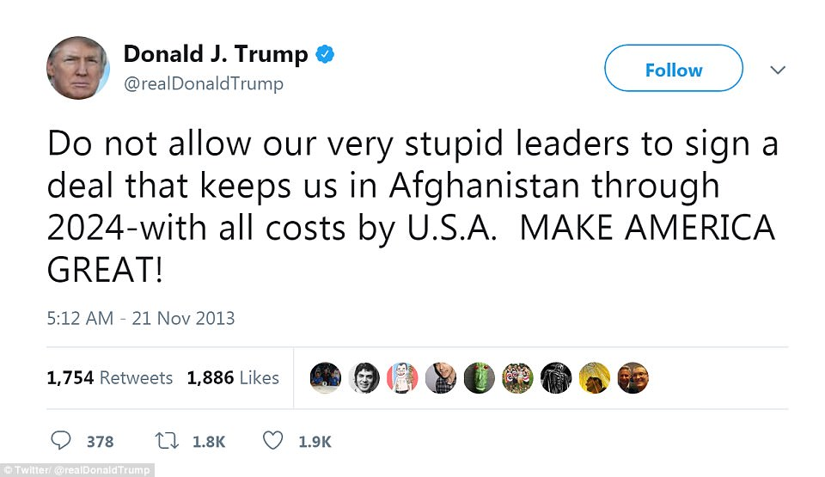
Notes:
Donald Trump 2013 tweet on war in Afghanistan

Slide 9
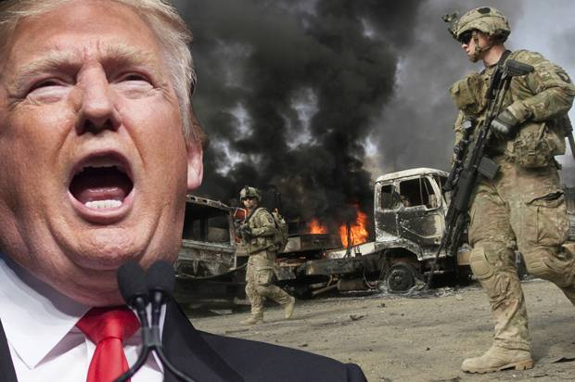
Notes:
August 2017 – President Trump announces greater American involvement in war in Afghanistan.

Slide 10
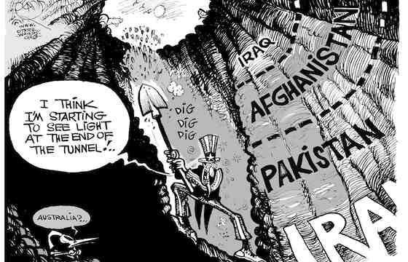
Notes:
What is this cartoon suggesting?

Slide 11
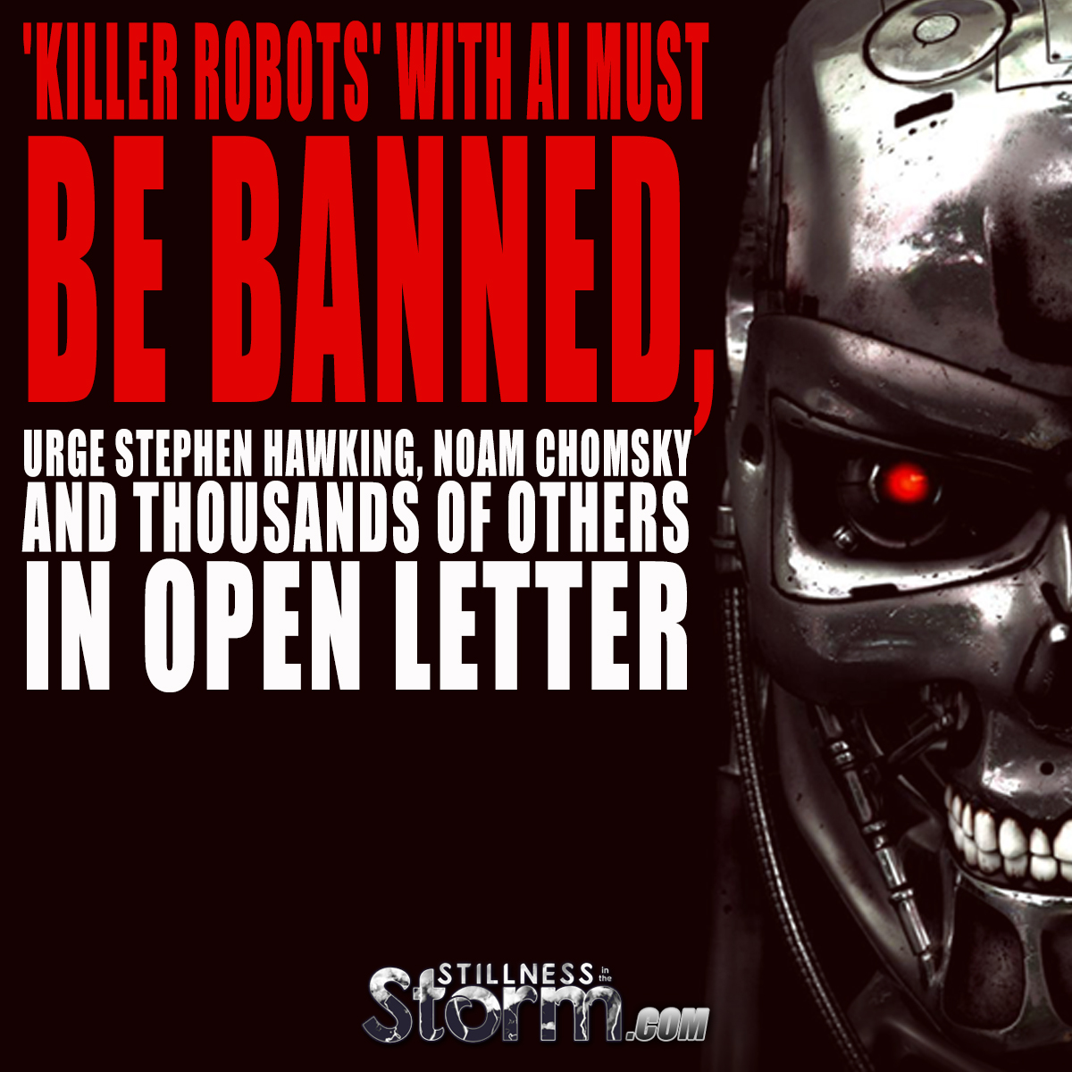
Notes:
What is this headline suggesting?

Slide 12
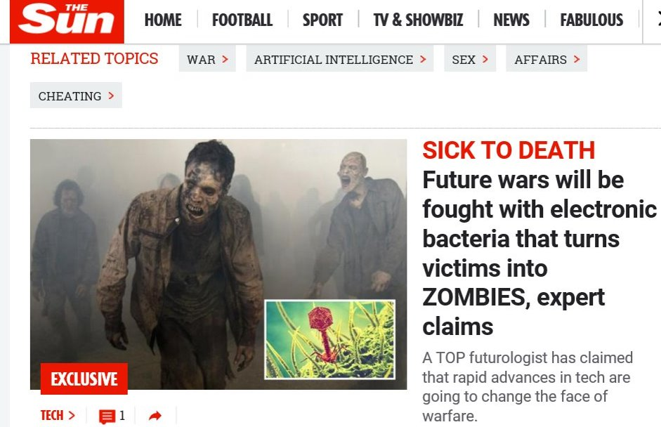
Notes:
A Sun headline on future of warfare.

Slide 13
On your map, mark each area
in the world where there is currently
war/conflict with a red dot.
Notes:
Hand out maps of the world. Pupils should draw in a red dot to show any areas of the world that are currently experiencing a war. (Use earlier definition to help identify wars). Can be done as individual/pair/group work.

Slide 14
http://www.irinnews.org/maps-and-graphics/2017/04/04/updated-mapped-world-war
Notes:
Use this link to see areas of the world currently involved in conflicts. Go through some of them. Look at how long they’ve lasted, number of deaths etc. Discuss. How do they compare to pupils’ maps?

Slide 15

WARNING
Contains scenes of horror and extreme violence that some readers might find upsetting.
From the outset.

Slide 16
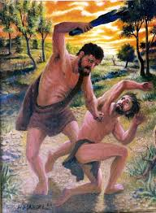
Cain & Abel
The children of Adam and Eve’s
Were terribly eager to please
They made offerings to God
Hoping He’d give them the nod
But He preferred roast lamb to green stuff with leaves.
So Cain beat his brother Abel to death.
And God was a bit miffed.

Slide 17
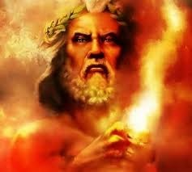
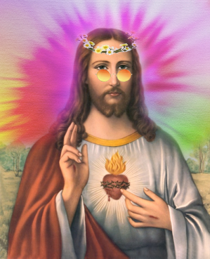
OR
Angry, violent, wrathful
Old Testament God
Peace Lovin’ Hippy
Jesus

Slide 18
Prepare for war! Rouse the warriors! Let all fighting men draw near and attack!
Blessed are the peacemakers.
If you forgive other people when they sin against you, your heavenly Father will forgive you.
Love your enemies and pray for those who persecute you.

Slide 19
I despise your religious festivals. Your assemblies are a stench to me.
Take the whole army with you and go up and attack the people of Ai.
I pursued my enemies…I crushed them so they could not rise; they fell beneath my feet.
Turn the other cheek.
Notes:
Discuss each quote in turn. Do pupils think it comes from the Old Testament or the New Testament? What does it mean? How might people interpret it today? Pupils should write the quotes into their booklets on the appropriate pages.

Slide 20
Defend the weak and the fatherless, uphold the cause of the poor and the oppressed.
Notes:
Discuss each quote in turn. Do pupils think it comes from the Old Testament or the New Testament? What does it mean? How might people interpret it today? Pupils should write the quotes into their booklets on the appropriate pages.

Slide 21
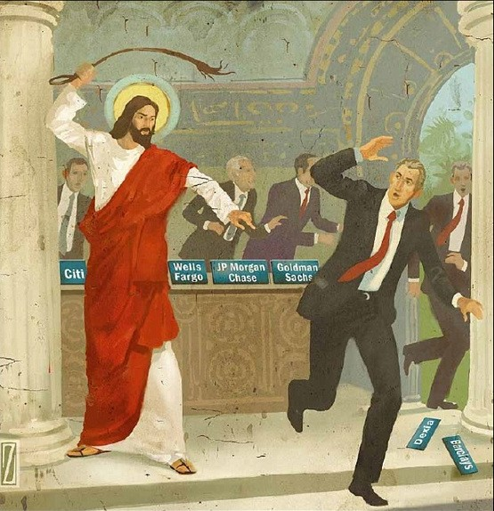
He did show violent, righteous anger
towards the traders in the Temple.
But his victims were mostly tables.
Does this mean that
Jesus was a pacifist?

Slide 22
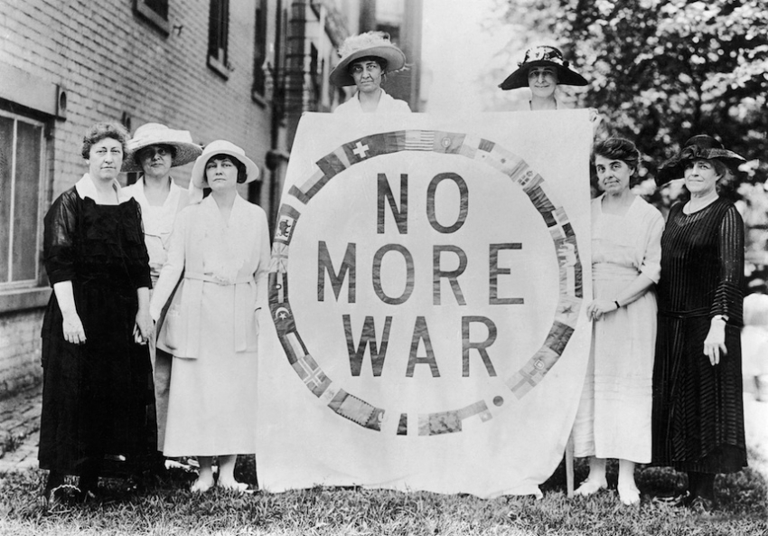
So how should Christians respond to
violent situations?
Should Christians serve
in the armed forces?
What sort of involvement should
Religion have in political decision-making?

Slide 23

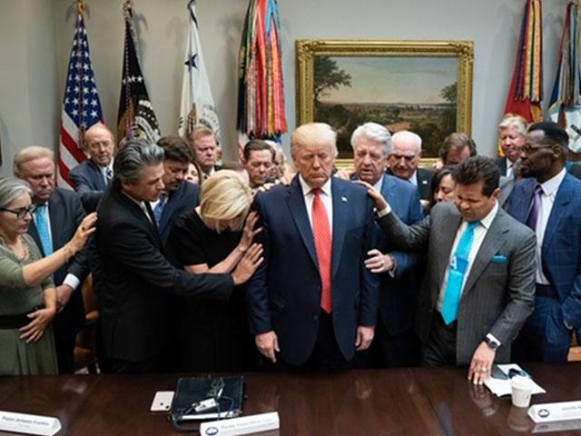
Donald Trump starts every morning with a prayer meeting.
And this is Donald Trump’s official spiritual advisor…
https://www.youtube.com/watch?v=Hvc7TDJhksA&safe=true

Slide 24
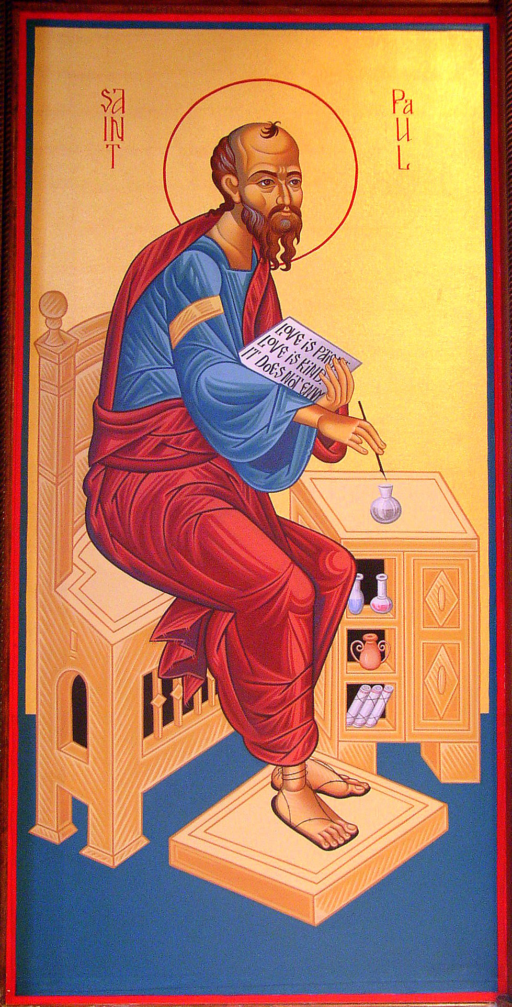

Dear Romans,
Obey your political leaders and don’t give them any grief because they are God’s servants and God must have wanted them to be the leaders so do what they say, ok?
Lots of love,
St Paul

Slide 25
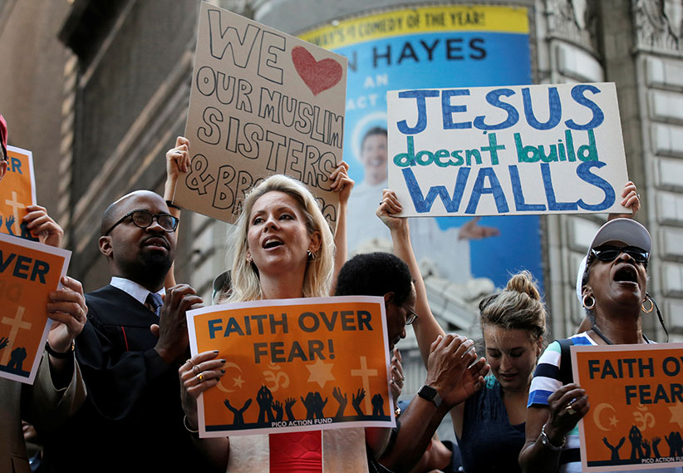
Yeah, lets kick some tables!
But many Christians believe it is their religious duty to become involved in political issues because of the example of Jesus.

Slide 26

UK
Parliament
Monarch
Lords
Commons
This is how the UK is governed.

Slide 27
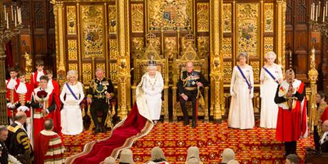

Slide 28
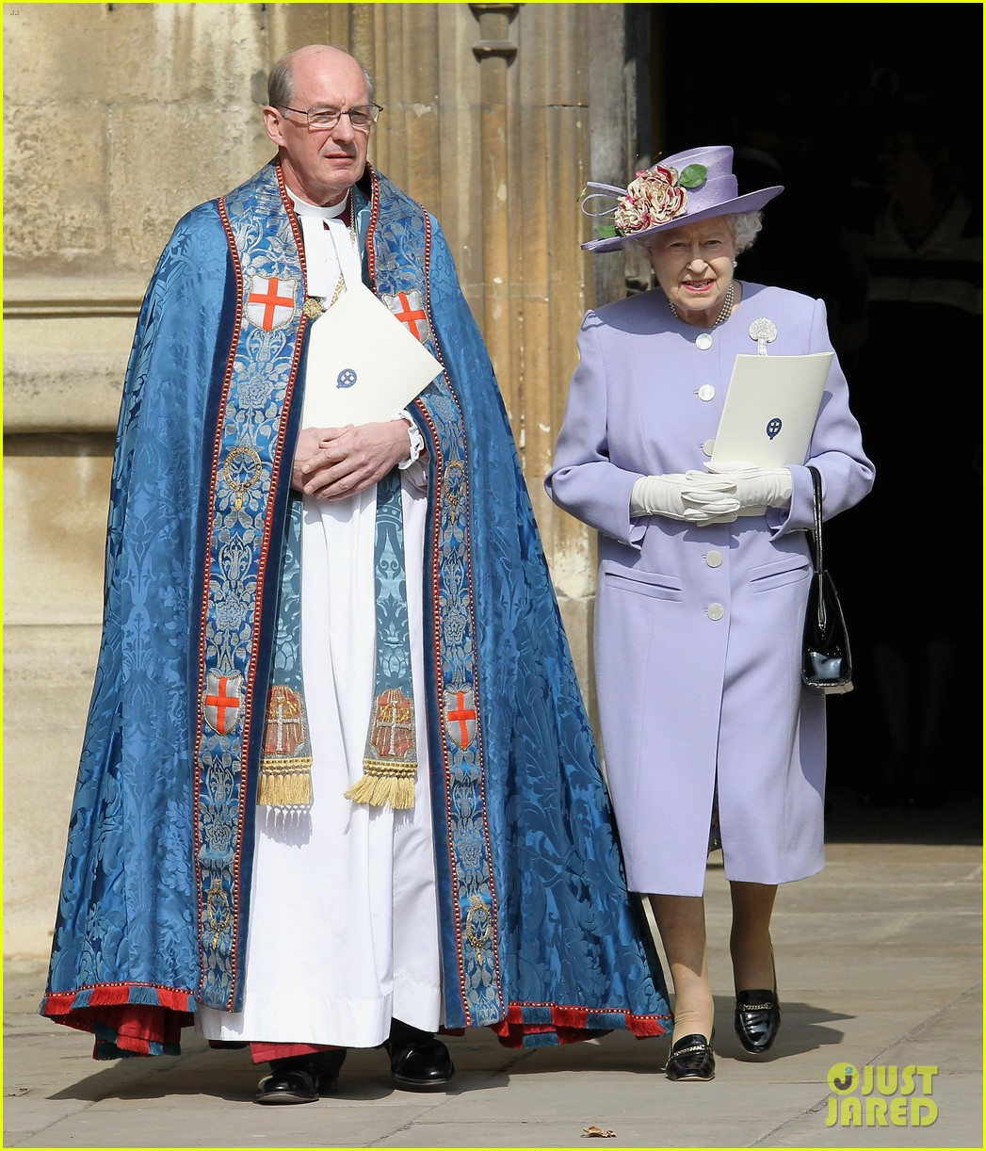
The monarch is also the head of the Church Of England.
How separate is
The Church from
politics in the UK?

Slide 29
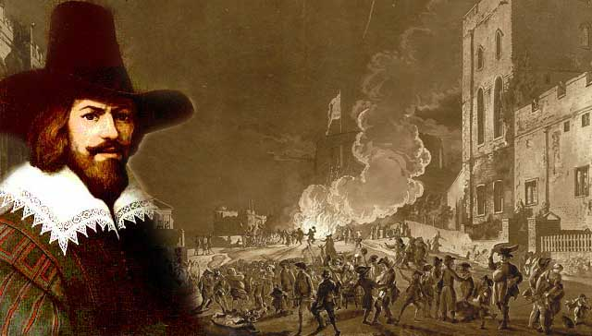
What is this picture showing?
What do you know about it?
Notes:
Discuss the role that Guy Fawkes has played in our nation’s history? Catholic/Protestant etc. Why do we remember November 5th?

Slide 30
A terrorist is…
A person who uses unlawful violence and intimidation, especially against civilians, for political aims.
Notes:
Let pupils attempt to create their own definitions first before showing the correct definition. What are the problems/issues with it? Who decides whether violence and intimidation is lawful or unlawful?

Slide 31
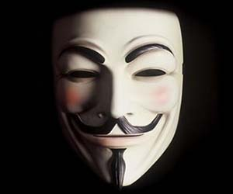
“One man’s terrorist is another man’s freedom fighter.”
What does this mean?
Do you agree with it?
What is important to you?
How far would you be prepared to take your protest?
What would you be prepared to make sacrifices for?
Would you ever be prepared to use violence?
What would you protest about?
What makes terrorists do what they do?

Slide 32
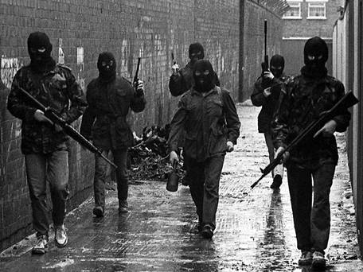

Slide 33
http://www.bbc.co.uk/history/troubles
Notes:
Discuss the activities of the IRA and terrorism in the UK. Watch the clip. After this watch the first fifteen minutes of the film “Bloody Sunday” (DVD). Afterwards discuss how people might have felt with military vehicles on the streets etc. Are there parallels with current events? If so what are they? What are the best ways to deal with terrorism?

Slide 34

A JUST WAR
Notes:
First ask if pupils can remember the definition of a “Just War”. What does it mean? What would an unjust war be?
Then ask them to write down the conditions/ingredients that they think a “jjust” war would have on the recipe page in their booklets.

Slide 35
https://www.youtube.com/watch?v=DWDT5pCxaB0&safe=true
https://www.youtube.com/watch?v=Lg68a-Bn7HM&safe=true
Notes:
Watch both clips.

Slide 36
JUS AS BELLUM (Latin for “The Right to go to war”)
This is the consideration of whether it is right to go to war. Thomas Aquinas thought there were three conditions that would make a war just.
The war must be started by a proper authority (eg the government).
The reason to go to war must be just (eg to protect people).
Everything must be done to ensure that good instead of evil results from the war.
Later on the Roman Catholic Church added two more criteria.
4) The war must be the last resort, every other way of solving the situation must have been tried and failed.
The force used must be no more than is necessary to win, and civilians or those not posing a threat should not be targeted.
Notes:
Copy out the points into pages in booklet.

Slide 37
JUS IN BELLO (is the law that governs the way in which warfare is conducted).
This concerns actions taken within a war, making sure the correct conduct is followed. A war that starts as a just war may stop being a just war if the way the war is fought becomes inappropriate.
Civilians should not be harmed.
Appropriate force only should be used.
Internationally agreed conventions regulating war must be obeyed.

Slide 38
JUS POST BELLUM
This refers to the actions taken after the war.
This part of justice should help countries move from war to peace in a positive way.
It includes
Punishing war criminals.
Helping retrain police and military in a defeated country where a bad government has been defeated.

Slide 39
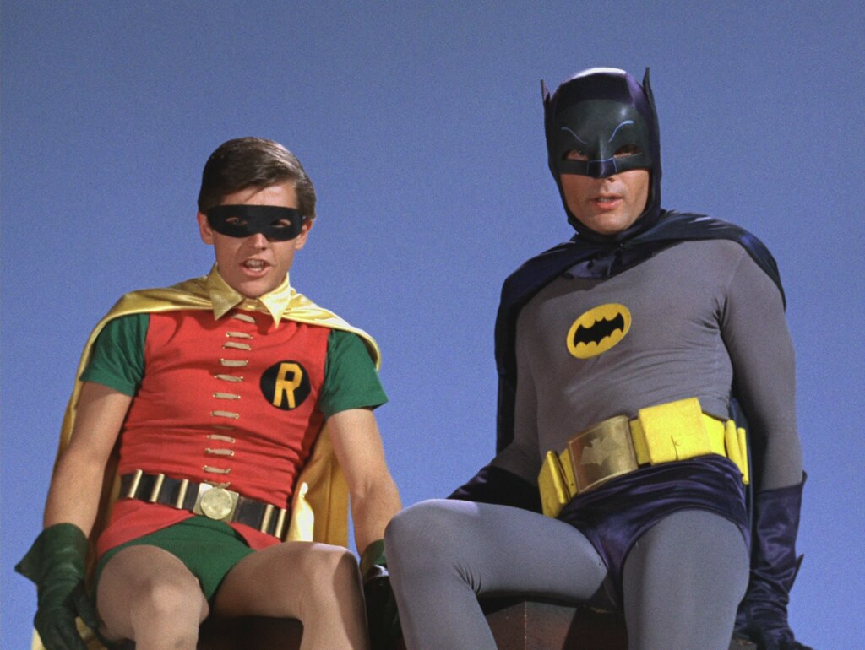
Holy war, Batman!

Slide 40
Some Christians believe that it is sometimes necessary to use violence to defend religion. This is called Holy War. Its causes can include claiming land for a religion, spreading the faith and defence of religious followers.
Holy Wars have three elements:
The achievement of a religious goal.
The authorisation of a religious leader (eg the Pope).
The promise of a heavenly reward for those who take part or fall in combat.
https://www.youtube.com/watch?v=Dv_Gussoya8&safe=true

Slide 41

Modern Day
Holy War?
US soldiers are NOT Christian Crusaders and they should not be depicted as such.

Slide 42
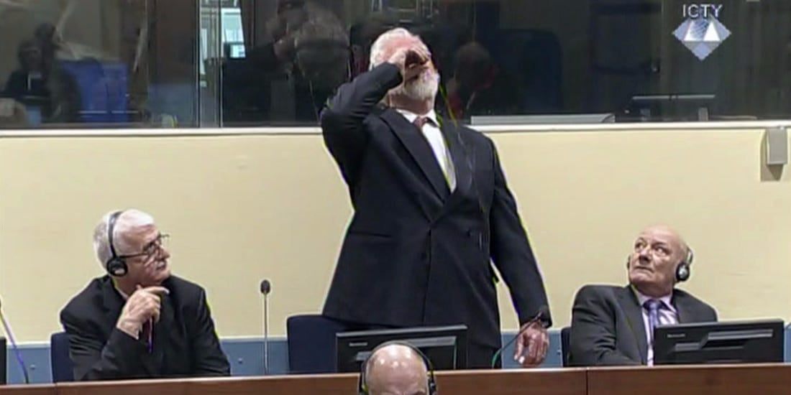
What are war crimes? Should soldiers be excused their behaviour in times of war? How should Christians behave during wartime?

Slide 43
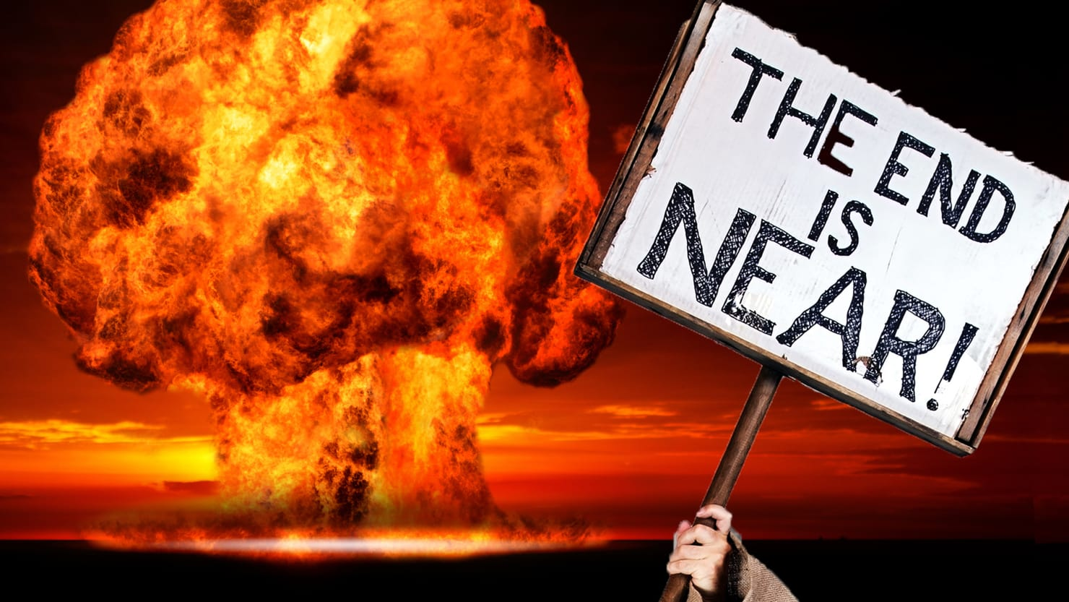
Christianity &
Apocalyptic Warfare

Slide 44
Watch the clip…
https://www.youtube.com/watch?v=-hJQ18S6aag&safe=true
Why do you think people have
always been so obsessed about
the end of the world?
Notes:
Watch the clip and discuss the different reasons why so many people have always been so obsessed with the idea of the end of the world. Why are there so many different prediction? Do the chances of the world ending really seem far greater today than they have been in the past? What has prevented another global conflict on the scale of the two world wars?

Slide 45
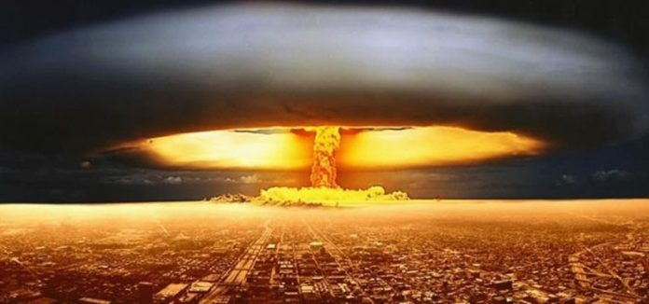
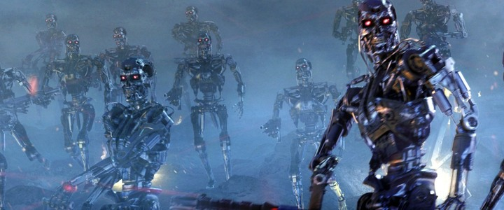
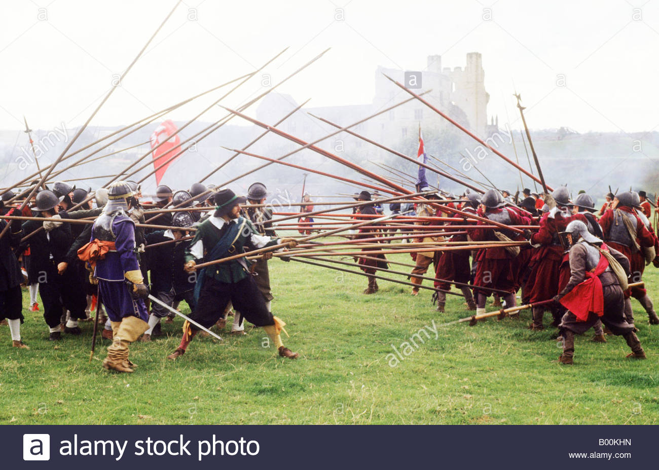
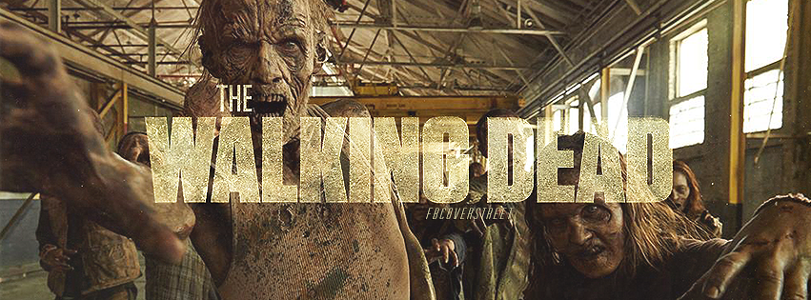

Slide 46
http://www.dailystar.co.uk/news/latest-news/605577/World-War-3-USA-Donald-Trump-North-Korea-Russia-China-May-13
http://www.dailystar.co.uk/news/latest-news/606843/world-war-3-trump-russia-nuclear-warning
http://fortune.com/2017/08/22/robots-hacking-bugging-devices-weapons/
http://www.dailymail.co.uk/sciencetech/article-3334786/Uh-oh-Robots-learning-DISOBEY-humans-Humanoid-machine-says-no-instructions-thinks-hurt.html
http://www.express.co.uk/news/world/763004/Europe-civil-war-European-Union-David-Engels-authoritarian-30-years-migrant-crisis
https://www.youtube.com/watch?v=oDXvlMA9O8s&safe=true
Notes:
Watch these clips that are based on the page in booklets titled “It’s the end of the world as we know it.” Discuss each one in turn.

Slide 47
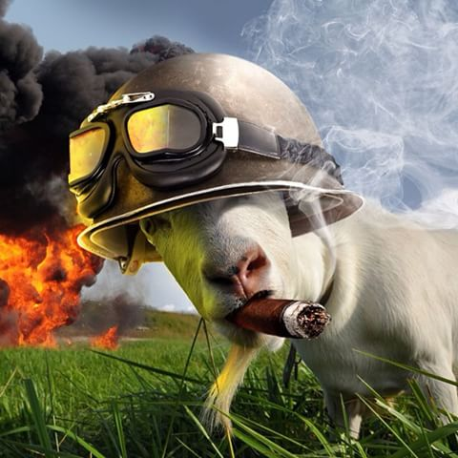
WELCOME TO THE FIRST ANNUAL
MEETING OF THE
GLOBAL OBLITERATION
AND ANNIHILATION THEORISTS
(G.O.A.Ts)
How worried do we need to be about the end of the world as we know it?
Notes:
Split the class into different groups. One group should focus on Nuclear Holocaust. One group on AI robots attacking humanity. One group on civil/class war in the UK. One group on wars fought with bacteria. Each group should make a) a list of reasons why we should be very worried about their issue b) a list or reasons why we shouldn’t be too worried about the other issues c) A survival guide in case the issue does actually happen. Groups can be split internally so that different people are concentrating on each aspect of their group work.

Slide 48
ISSUE | CHRISTIAN VIEW 1 | CHRISTIAN VIEW 2 | OTHER
Nuclear Weapons
Use of armed drones
Biological warfare

Slide 49
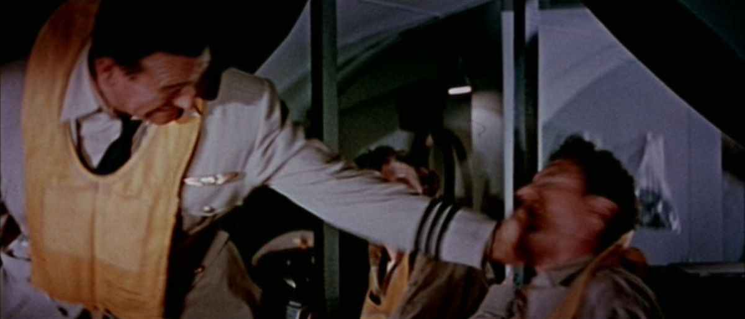
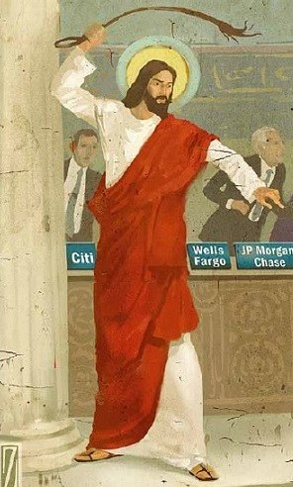
Christianity And Pacifism
What is pacifism?
Should we ALWAYS “turn the other cheek”?
Does Jesus
Turn the other cheek
Attack a table
Stick someone’s ear back on
All of the above?
ON BALANCE, HOW VIOLENT IS JESUS?
Notes:
Explain what the word “Pacifism” means. Discuss the clash within Christianity between Just War and Pacifism. Think back to the biblical teachings? Which ones support which concept? Which one is more important? Take a vote within the group – which is the better option?

Slide 50

What is peace?
Are pacifists
unrealistic?
Is world peace possible?

Slide 51
What price should we be
prepared to pay for peace?

Slide 52
ABSOLUTE PACIFISM | CONDITIONAL PACISFISM
The belief that violence or military action are NEVER acceptable no matter what the situation is or what the consequences might be. Eg Jesus giving himself up to the Roman soldiers in the Garden of Gethsemane when he knew that they would kill him.
The belief that violence or military action should not normally be used, but there are times when failing to use such actions result in a greater evil. So sometimes its ok to be violent. Eg self defence.
The Plymouth Brethren, The Amish and the Quakers.

Slide 53
Christianity And Pacifism
Case Studies
http://www.romerotrust.org.uk/who-was-archbishop-oscar-romero
https://www.youtube.com/watch?v=OmEZGbUvW2M&safe=true
https://www.youtube.com/watch?v=l7rKlzuC8OU&safe=true
Notes:
Watch each clip and discuss afterwards. After each one, pupils should decide in groups what the key points are and write them down into the boxes in their booklets. Feedback to ensure all groups have the best key points written in.

Slide 54

How easy do you find
it to forgive people?
Why?

Slide 55
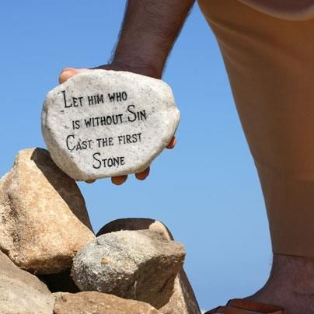
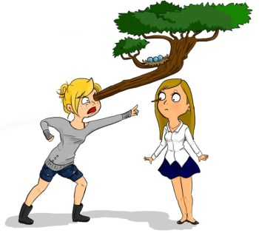
Jesus was very
keen on forgiveness
and reconciliation

Slide 56
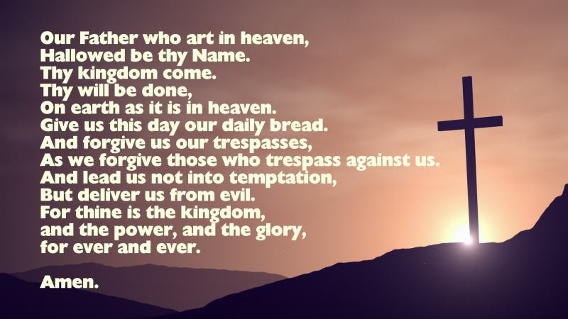
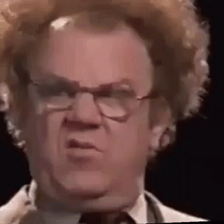

Slide 57
The Parable Of The Unmerciful
Servant.

Slide 58
Find out about…
The Ealing Vicarage Rape
Mary Johnson
The Dialogue Club

Slide 59

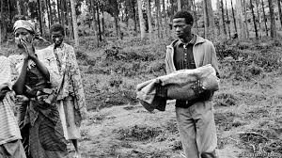
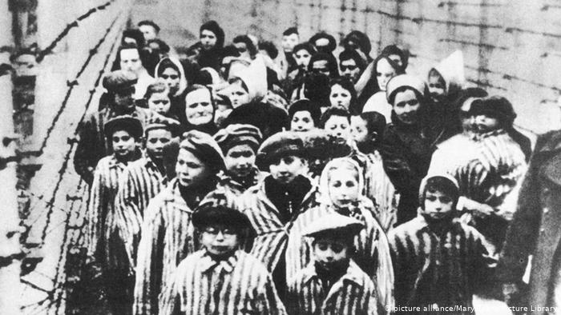
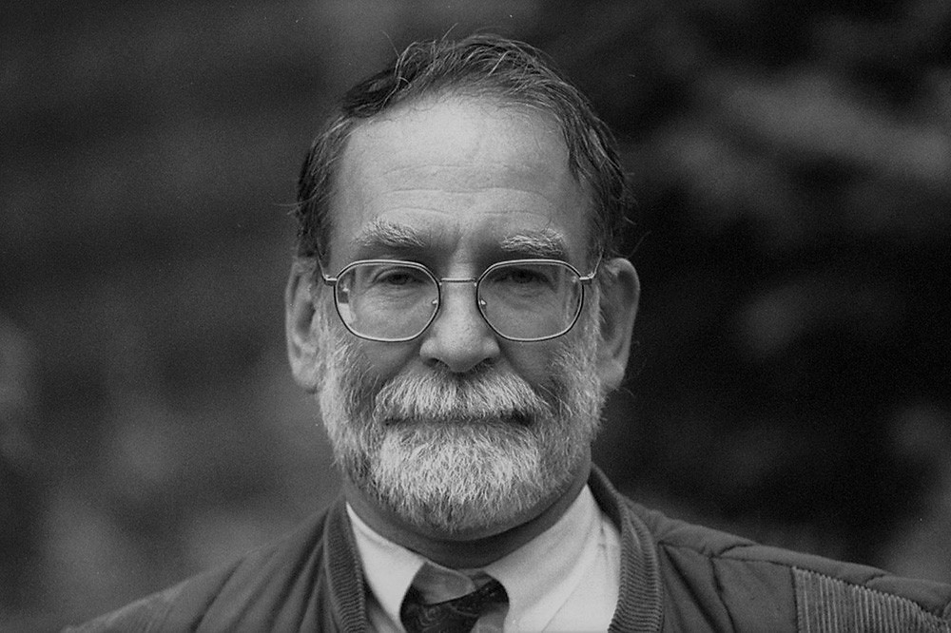
What cannot
be forgiven?

Slide 60
I despise your religious festivals. Your assemblies are a stench to me.
This is what God said to his people when they were a bit naughty. It seems to suggest that religious activity is meaningless unless people also behave ethically.

Slide 61
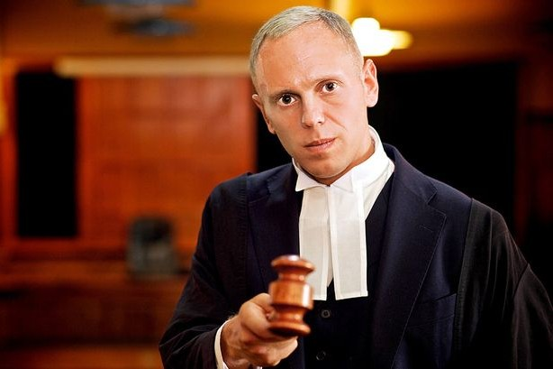
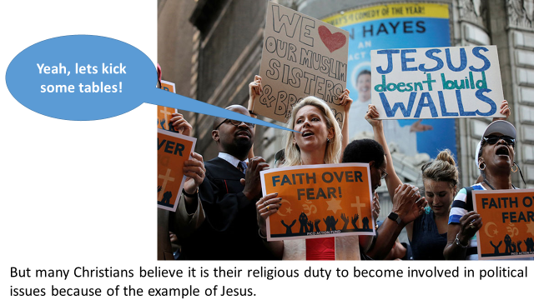
CHRISTIAN JUSTICE
In the Bible, God judges, condemns and punishes those who abuse others. He has compassion for those who suffer injustice.
He gets involved in world events and sorts stuff out.
God is a Judge
This is why many Christians feel that they SHOULD get involved and sort out injustice wherever they find it.
Its not ALL about being fluffy and forgiving!

Slide 62
SOCIETY
+
JUSTICE
=
PEACE
This is why Christians work for social justice
Fair Trade
The Salvation Army
Amnesty International

Slide 63
https://www.youtube.com/watch?v=Mk8M7EcmPGk&safe=true
Liberation Theology
Oscar Romero!

