Slide 1
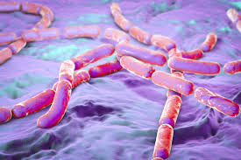
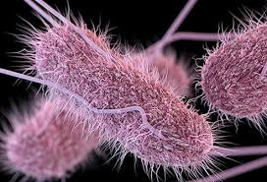
Food Preparation & Nutrition - Cereals
LO – The importance of storing crops correctly
The sources of food poisoning contamination in cereal crops
Food poisoning risks in cooked rice and fresh egg pasta
Task 1. Write todays date and under the title Sources of contamination explain where the contamination can come from and how to store cereals to prevent this.
Task 2. Write the title Bacillus Cereus – explain what this is and how it can be prevented. The do the same for Salmonella and explain why this could be a problem when making fresh egg pasta.
Bacillus Cereus
Salmonella

Slide 2
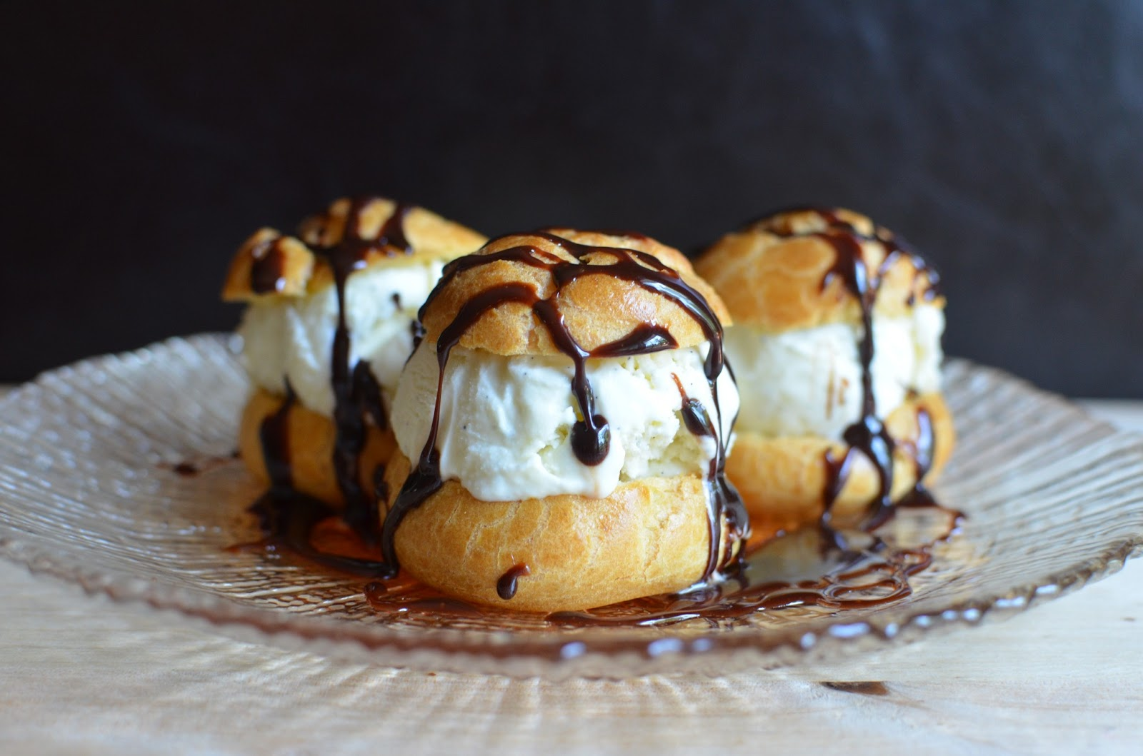
Food Preparation & Nutrition Cereals
On Tuesday you will be making profiteroles – I will be demonstrating and you will be making notes. I suggest you watch videos on Youtube so that you know what you are doing.
Homework – complete all 3 worksheets. To be handed in on Monday.

