Slide 1
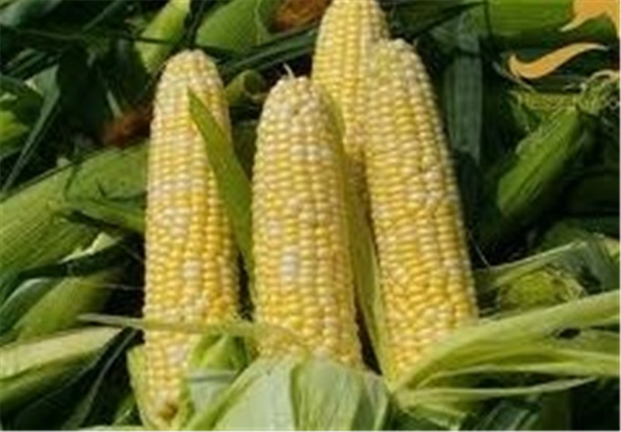
Food Preparation & Nutrition - Cereals
LO – To be able to describe what maize, corn, oats, barley and rye are.
To understand the process of primary and secondary processing is.
To be able to name product derived from the secondary processing.
Starter – Watch the video.
Task 1. Put todays date at the top of the page, then under the title Maize, write down 3 facts about maize including what is it also known as. (p.200)
Task 2. Under the title Secondary Processing describe 4 different products that it is made into.
Task 3. Describe and name the disease that is caused by the lack of niacin (vitamin B3).
Task 4. Write a brief description of the following cereals: oats, barley, and rye and what they can be used for.

Slide 2
Food Preparation & Nutrition Cereals
On Tuesday you will be making profiteroles – I will be demonstrating and you will be making notes. I suggest you watch videos on Youtube so that you know what you are doing.
Homework – complete all 3 worksheets. To be handed in on Monday.

