Slide 1
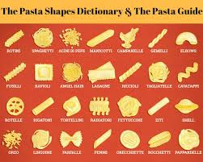
Food Preparation & Nutrition Lesson 5 - Pasta
LO’s – To know what pasta is.
To know the process of making pasta
The varieties of pasta
How to cook pasta
WILF – date written at the top of the page and underlined, all titles and subtitles underlined and neat note writing.
Starter – watch the video on how pasta is made in a factory.
Task 1. Put todays date at the top of the page, then under the title Pasta, explain what pasta, why it is so popular and what type of wheat it is made from.
Task 2. Read p.193 & 194. Write down these questions and answer them:
Name 6 shapes of pasta with a description of each – this could be a picture or a drawing.
What can be used to colour and flavour pasta?
What does the term ‘al dente’ mean?
What does the term ‘laminating’ mean?
What is ‘convenience food’?
What is the meaning of ‘extruded’?

