Slide 1
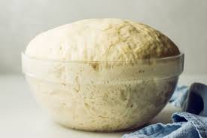
Food Preparation & Nutrition - Cereals – Lesson 4 - Bread.
LO – The varieties of bread products available
The key ingredients used in bread making and their functions
The importance of yeast
WILF – date written at the top pf the page and underlines, neat note taking, a poll carried out and the results written or displayed in your book.
Starter –
Task 1. Read p.185 - 187. Write down the functions of the 4 main ingredients in bread.
Task 2. Read p.188 – 189. Write down and answer the following questions:
Why should you sift the flour?
What temperature is optimum for the water.
What is the gas produced by fermentation?
Why do we knead the dough – think about the proteins?
What is meant by ‘proving the dough’?
Why after proving, do we then ‘knock it back’?
What 3 elements are released during cooking?
What is the name of the colour produced on the outside of the bread during cooking?

Slide 2
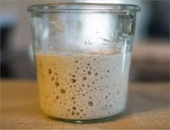
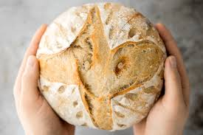
Food Preparation & Nutrition - Cereals – Lesson 4 - Bread.
Task 3. Write down the questions and then find and write out the answers:
Give 2 reasons why the bread rose and then collapsed in the oven.
Give 3 reasons why the bread has not risen properly and has a hard, open texture.
Give 4 reasons why the loaf is small and heavy.
Task 4. Describe the difference between leavened and unleavened bread and give examples of each.
Task 5. Explain the 3 different types of yeast available to a baker.
Task 6. Explain what sourdough and a sourdough starter is.

Slide 3
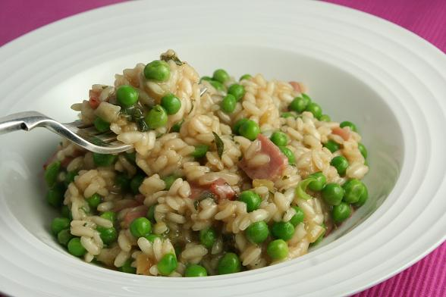
Next Week you will be making a pea and bacon risotto (or any other rice based dish but you will need to find your own recipe and ensure it will fit in with the timings of the lesson)
Risotto rice
To create an authentic creamy Italian risotto, the use of specialist rice is imperative. It comes in various forms and is usually very pale in colour, stubby and smooth in texture. Grains range in length from commune, to semifino, fino and superfino, which is the longest. The nature of the grain also varies from region to region. The most commonly used risotto rice in the UK is Arborio, although Italians may deem Carnaroli and Vialone Nano to have a higher quality. Other varieties include Roma, Ribe and Baldo. Other long grain rice should be avoided- semi-round risotto rice absorbs liquids and flavours and releases starch far better, giving risotto its characteristic texture

