Slide 1
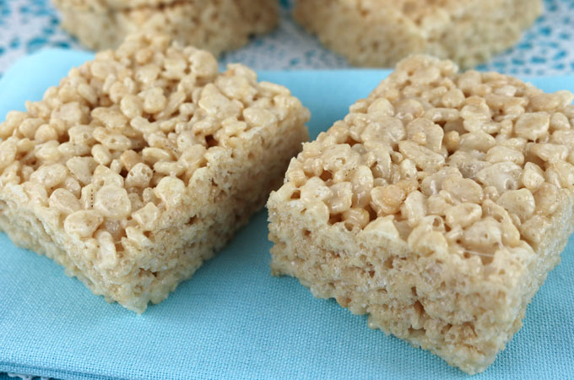
Food Preparation & Nutrition - Cereals – Lesson 3
LO – to understand how breakfast cereals are mass produced. (Secondary Processing)
To gain K & U of the functional properties of wheat flour
WILF – date written at the top of the page and underlined, all titles and subtitles underlined and neat note writing.
Starter – Watch the video of how Rice Krispies are made.
Task 1. Read p.182- 184. Write down the definition of secondary processing.
In your own words, describe how glutenin and gliadin form gluten.
Task 2. Under the title The effect of heat, discuss the effects of heat on wheat using the sub-titles Coagulation, Gelatinisation & Dextrinisation. Under the title, The effect of freezing, describe what happens to wheat when frozen.
Task 3. Research and list 2 dishes that could be made using the following types of flour: Stoneground Wholemeal Flour, Plain White Flour & Self-Raising Flour.

Slide 2
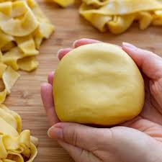
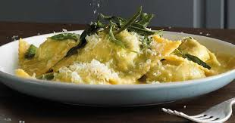
Food Preparation & Nutrition Eggs – Lesson 3
Next week you will be making fresh pasta which will be used to make ravioli.

