Slide 1
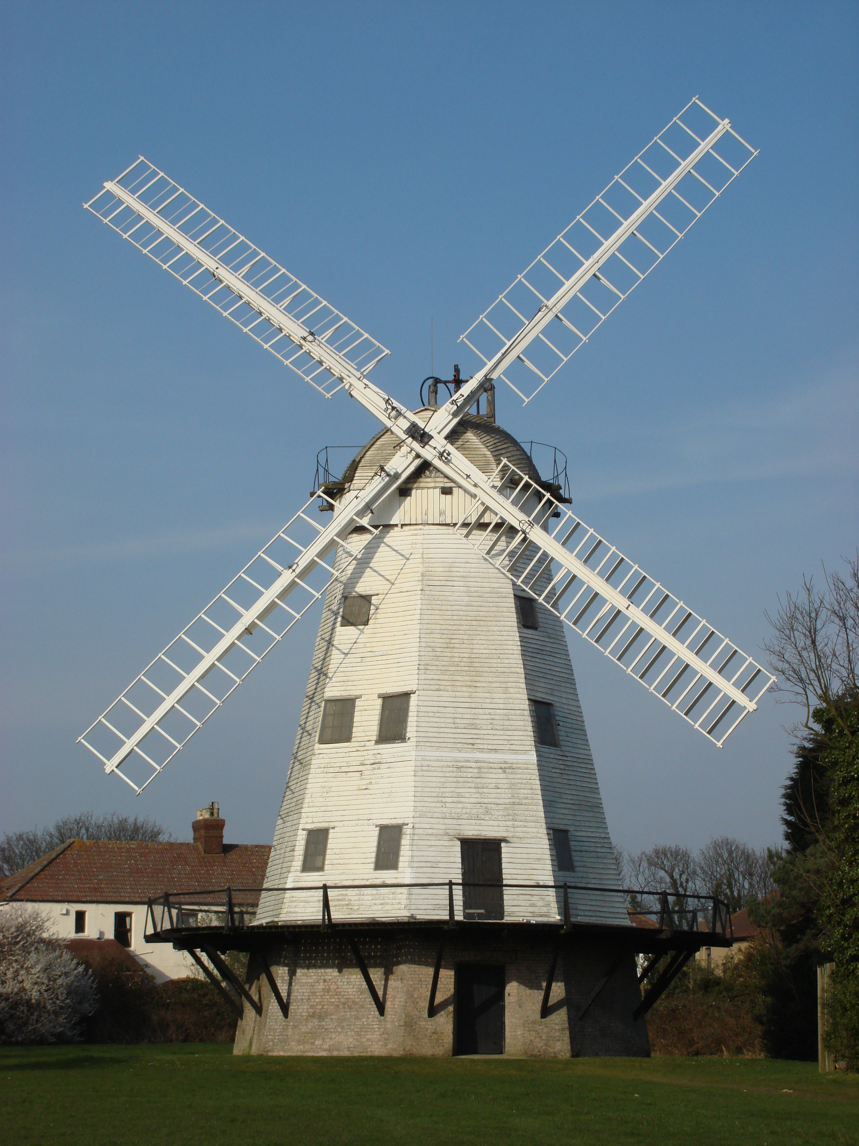
Food Preparation & Nutrition - Cereals – Lesson 2
WALT –What happens to flour after milling.
The different types of wheat flour.
The nutritional value of wheat.
WILF – Neat and legible writing in your books
The date to be underlined.
Starter – watch the video on milling
Task 1. Turn to p.180 in your textbook. In your books, or in a Word document, write down the different types of wheat flour available with a brief description of each. Don’t forget to put todays date at the top of the page and underline it.
Task 2. Read p. 181 including the key points, check it and the study tip. Discuss the nutritional value of wheat. In a sentence, describe why consuming foods containing phytates could be beneficial.
Task 3. Make a note of the different types of flour and their protein content N.B. the protein in flour is called gluten.
Task 4. Write down the definitions of the following terms:
Extraction rate, NSP and phytic acid. P.182

Slide 2
Food Preparation & Nutrition - Cereals – Lesson 2

