Slide 1
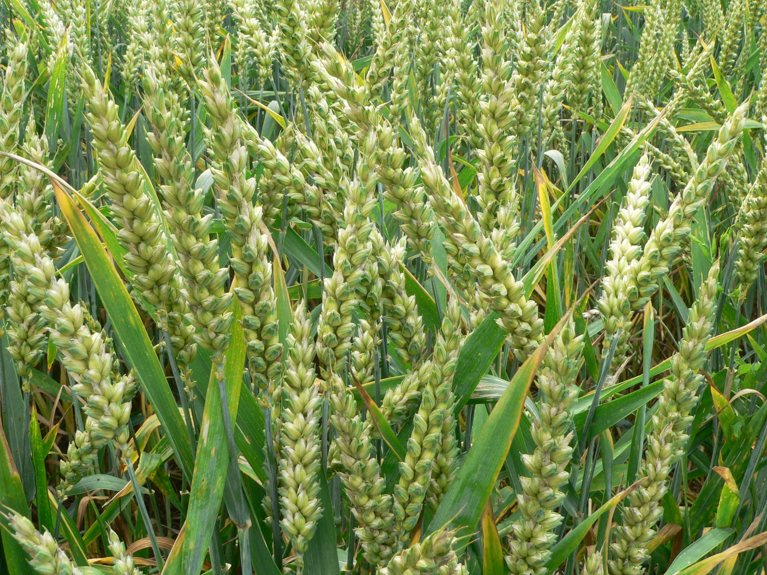
Food Preparation & Nutrition - Cereals – lesson 1
WALT – What cereals are.
The variety of cereals available.
The importance of staple foods in the diet.
WILF – clear and legible notes written in your books
Starter –Identify the cereal (click on the picture to go to the quiz)
Task 1. Write the title ‘Cereals’ and the date at the top of a new page. Underline both. Turn to the Cereals chapter in the textbook and describe what the term ‘cereal’ means. Copy down the meaning of ‘staple food’ which is in the box below.
Staple food – forms a large part of the diet, usually from starchy food that is indigenous to the country in which it is grown.
Now click on this presentation

Slide 2
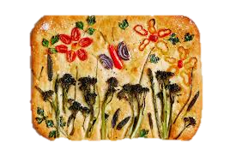
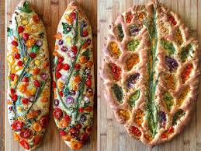
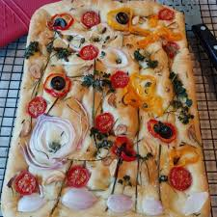
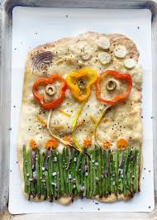
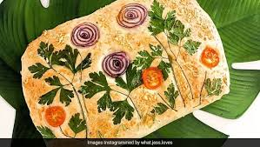
Task 2. Read pages 176 – 177 in the textbook. Draw and annotate a wheat grain. Explain what the 3 parts are.
Task 3. Read pages 178 – 179. Describe the ‘key processes of wheat milling’ as shown non p.179. Ensure you understand the term ‘primary processing’ by describing it in your own words. Read the chapter headed ‘Processing the flour after milling’.
Next practical – Bread Art!! This will take place during your double lesson W/C 1st March, at home, and will be a competition along the lines of the choux pastry one.

Slide 3
Food Preparation & Nutrition Cereals
Homework – due in next Week
Fill in worksheets C1, 3 & 4. Please ensure your name is at the top. When completed either staple or glue into your books.

