Slide 1
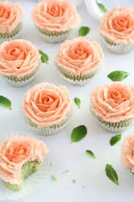
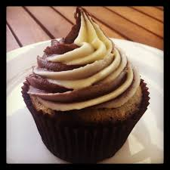
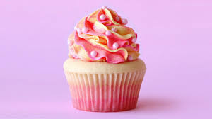
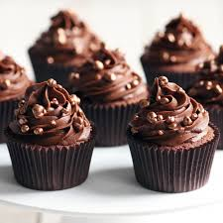
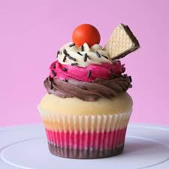
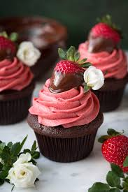
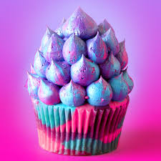
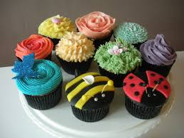
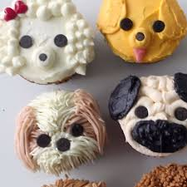
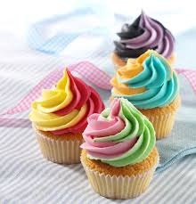
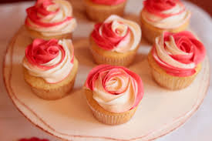
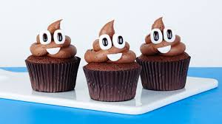
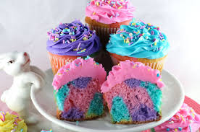
Food Preparation & Nutrition - Cereals
WALT – To make cupcakes and decorate them wit home-made buttercream icing using the piping technique.
WILF – evenly sized and baked cakes that are beautifully decorated
Starter – mis-en-place – e.g. get all equipment out everything out ready to use, weigh out all ingredients and preheat your ovens to 180/ gas mark 6.

Slide 2
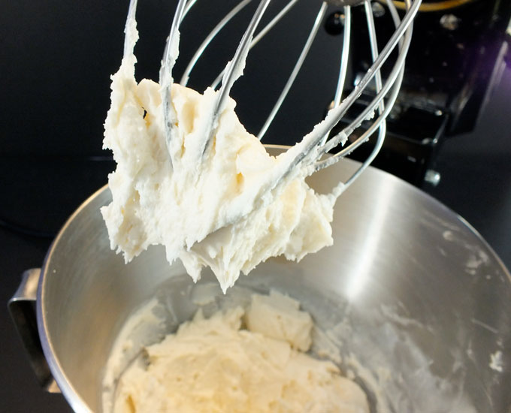
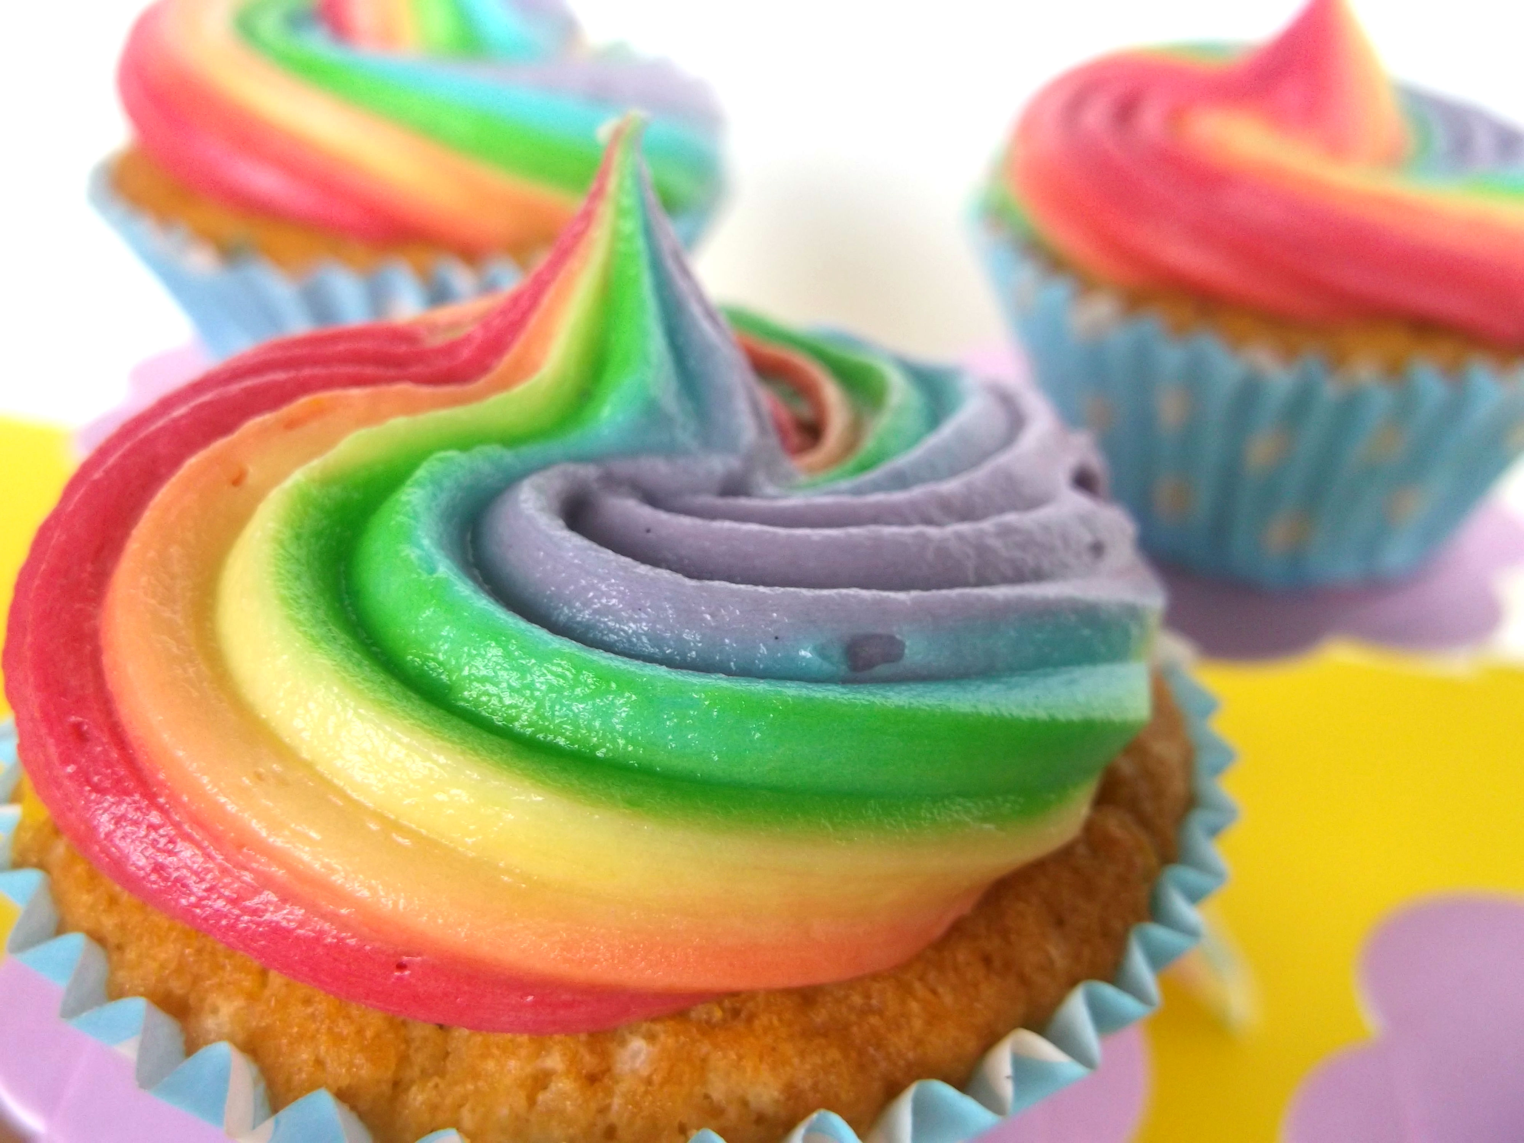
Food Preparation & Nutrition Eggs
Watch the following videos
Buttercreams icing recipe on YouTube
https://www.youtube.com/watch?v=NTR3oCgjOvw&safe=true
5 cupcake icing techniques
https://www.youtube.com/watch?v=jQsAeUG_ZJM&index=2&list=PLh1x9sEq7wajY75TmQ5AyLQB5koPvKGK1&safe=true

