Slide 1
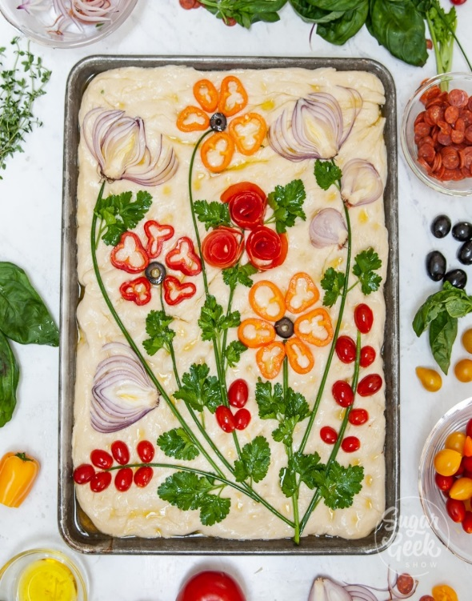
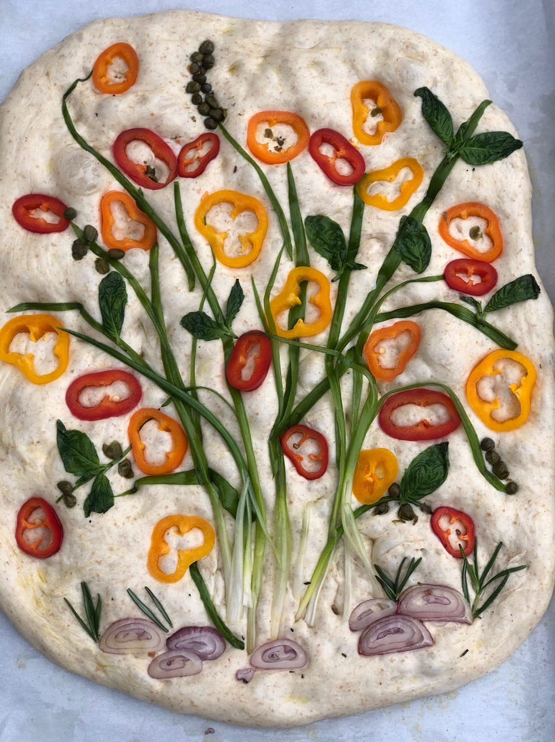
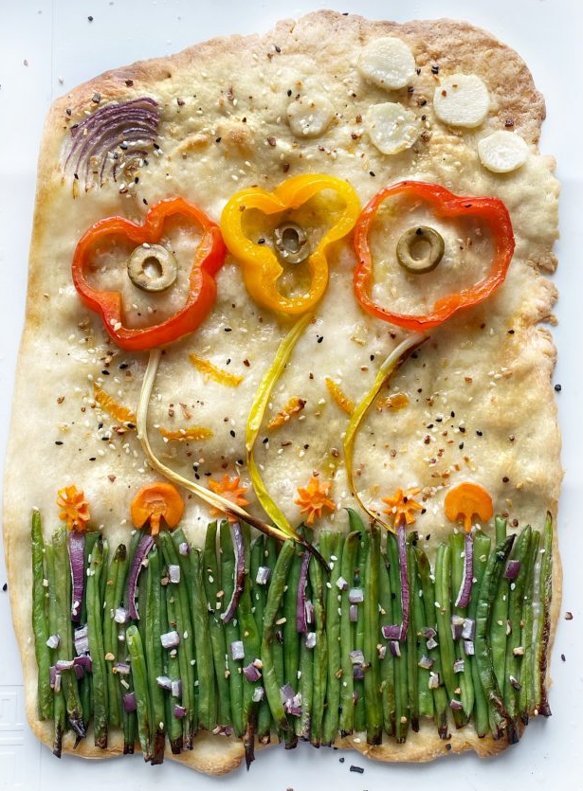
The Great Cirencester Kingshill Bake-Off
Bread Art Challenge
Your challenge is design and possibly go on to make a piece of bread art.
The making is optional and must be carried out under adult supervision.
Which ingredients do you think have been used to decorate these?
What type of bread do you think it is?

Slide 2
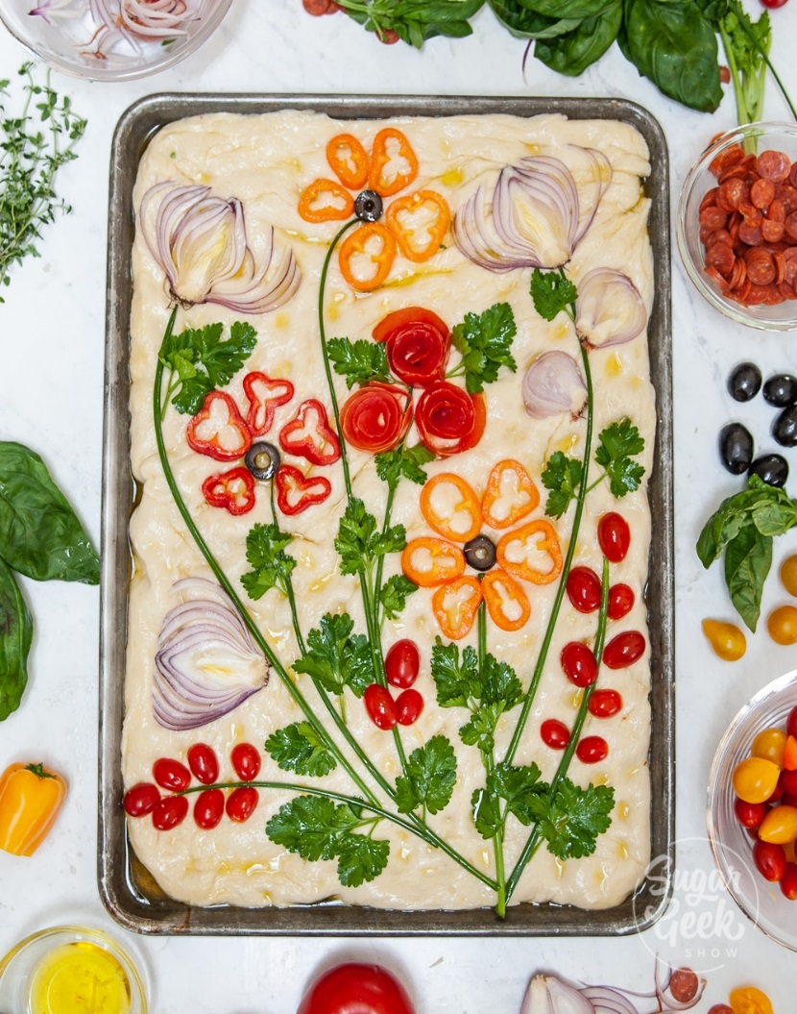
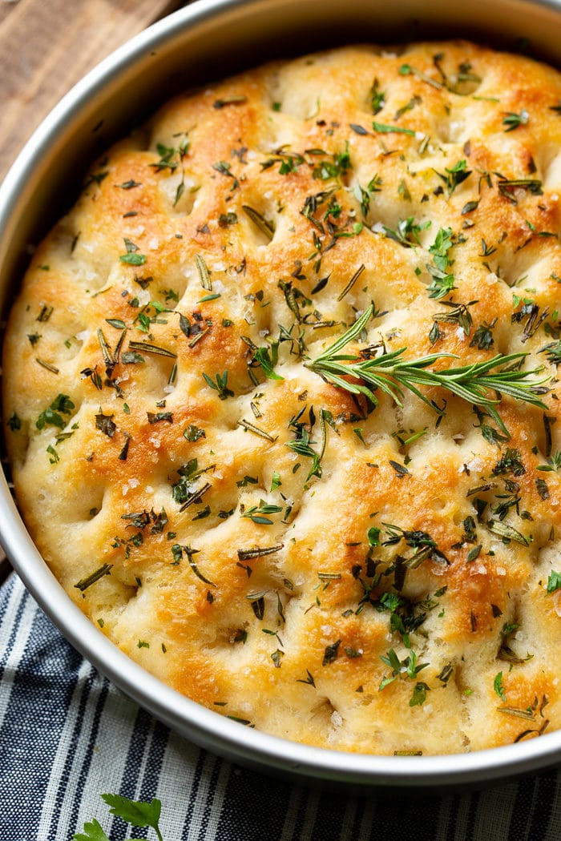
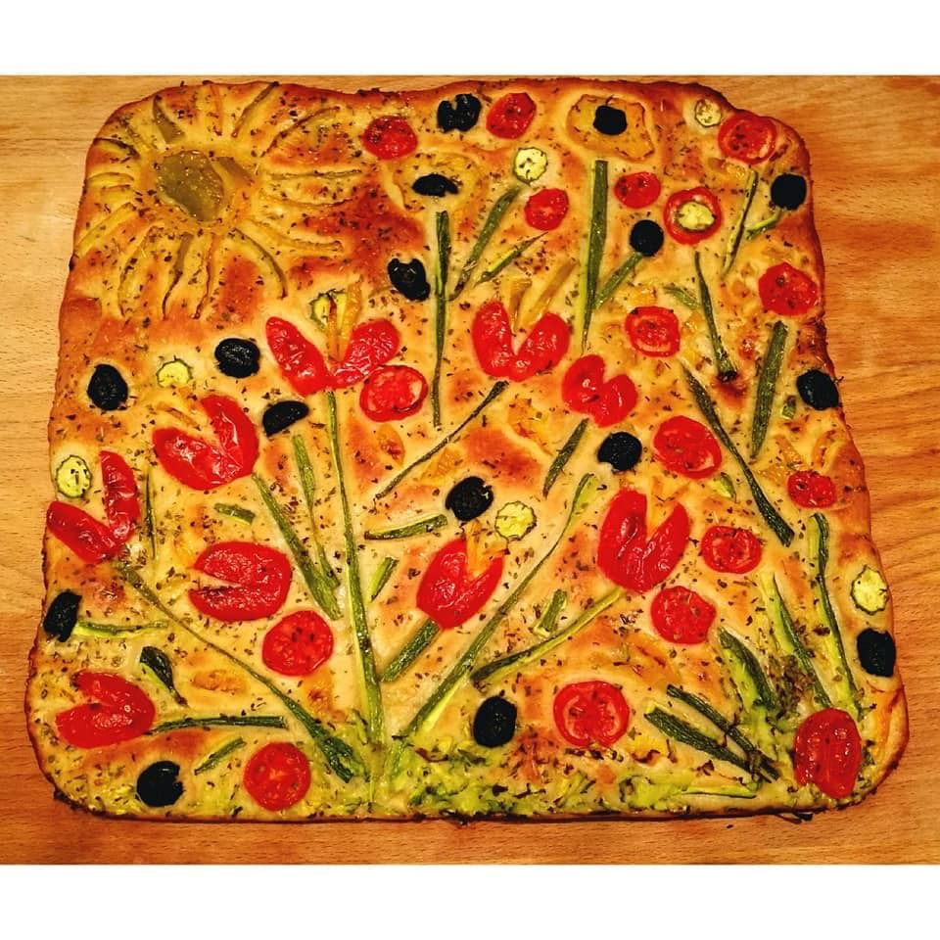
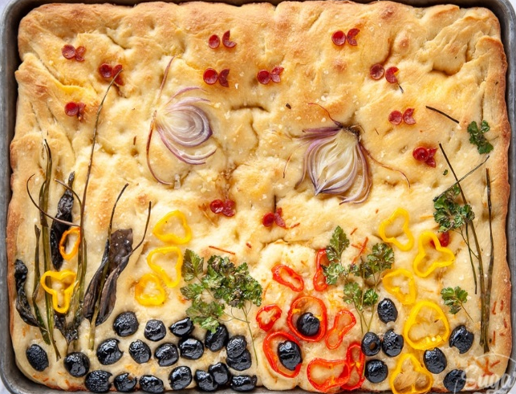
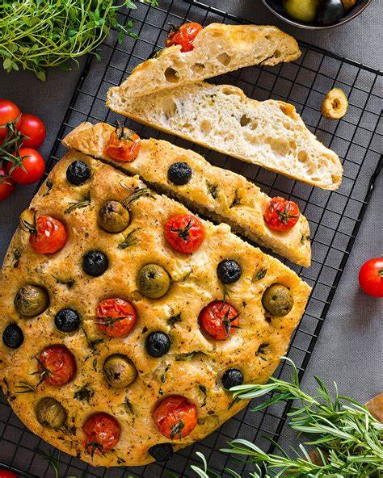
Focaccia Bread Art
This week you will be designing and possibly making Focaccia bread. This is an Italian bread baked in a flat sheet tin and flavoured with olive oil and topped with herbs, meats (optional) and vegetables.
You will need to select a range of ingredients to create a beautiful piece of artwork in your bread. You can be as creative and colourful as you like, think about the ingredients you will use to add flavour to your bread.

Slide 3
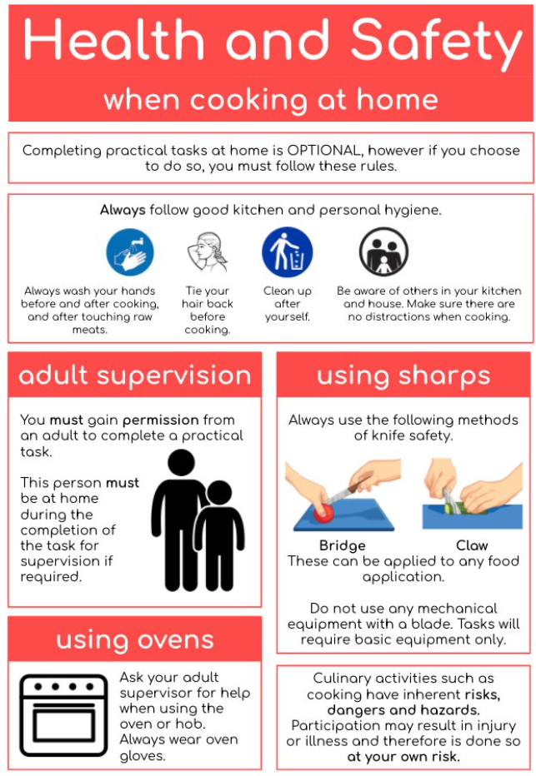
Do not forget these health and safety guidelines if you get the chance to cook at home : )

Slide 4
Ingredients:
You will need:
- 500g Strong white bread flour
- 7g (1 sachet) Dried fast action yeast
- 2tsp fine sea salt
- 5tbsp olive oil plus extra for the tin
- 375ml warm water
- Ingredients for your design

Slide 5
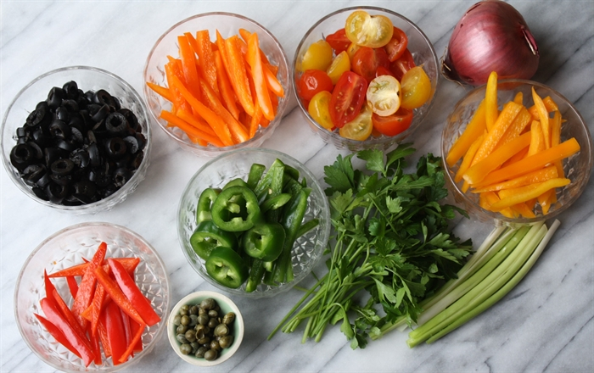
Suitable Ingredients
You can use a range of ingredients to decorate and flavour your focaccia such as:
Cherry tomatoes
Pitted olives
Chives
Spring onions
Red onions
Rosemary sprigs
Mini peppers
Mini courgettes
Rosemary
mushrooms
Basil
Flat leaf parsley,
Garlic,
Fresh chilli,
Capers,
Seeds

Slide 6
Method:
Sieve 500g strong bread flour into a large mixing bowl. Add yeast and salt and gently mix.
Make a well in the centre of the flour. In a jug mix together 2 tbsp oil and 375ml lukewarm water. Gradually add to the flour until you have a slightly sticky dough (you may not need all the water)
Sprinkle the worksurface with flour and knead dough for 5 – 10 minutes until it is soft and less sticky.
Put dough into a clean bowl, cover with a tea towel and leave to prove for 1 hour until doubled in size.
Oil a rectangle, shallow tin (25 x 35cm). Stretch your dough to fit in the tin. Cover with a tea towel and leave to prove for another 35-45 mins.
Whilst this is rising you can prepare your vegetables for decoration.
Mix together 2tbsp of olive oil and 1tbsp of water, brush this over the dough and arrange your vegetables and herbs, use the remaining oil to brush over the vegetables.
Bake for 20-25mins at 220˚C/200˚ fan, until golden, whilst bread is still hot drizzle 1-2tbsp of olive oil over the top.

Slide 7
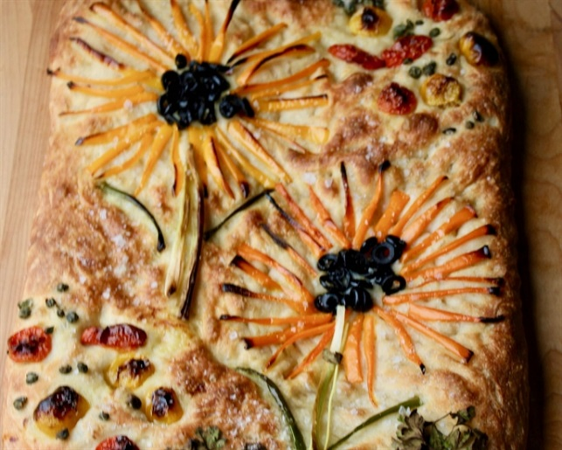

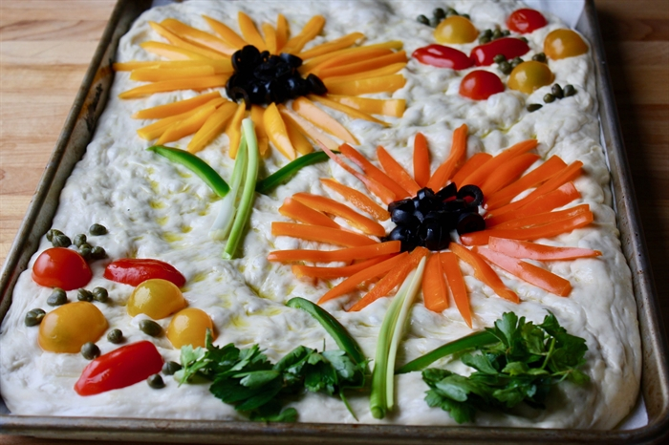
How to create your artwork
Peppers can be sliced into strips to look like flower petals, or sliced vertically so they stay round to look like small flowers.
Red onions – thinly sliced to look like flowers.
Olives – used for the centre of flowers or rocks.
Chives/spring onions can be great for flower stems.
Cherry Tomatoes – Sliced in half length-ways make great flower centres or seed pods.
Parsley/Basil – great for leaves or seaweed.

Slide 8
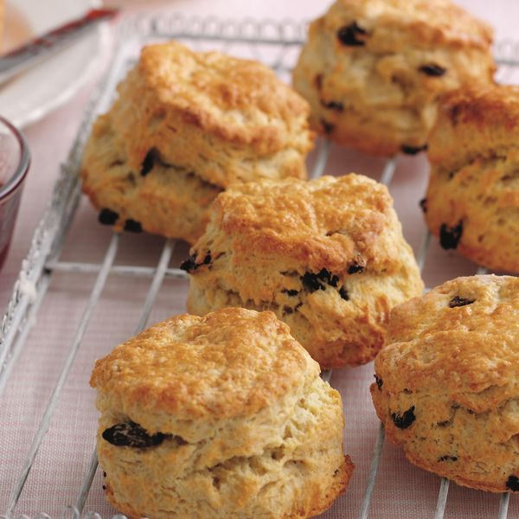
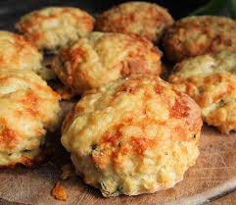
Use this scone recipe if you cannot get any bread ingredients
Scone dough
Ingredients
250g Self-raising flour
40g margarine
125ml milk
Cheese scone dough
75g grated cheese
2 tsp dried herbs
Method
Put oven on – 220C/Gas 7
Place the flour and salt in a mixing bowl
Rub in the margarine to the flour
Add the flavouring of your choice and stir in
Add the milk in a little at a time to make a dough. Cut in
with the knife
Knead lightly on a floured surface and press into the tin.
8. Add your extras and bake for around 10-15 until golden brown. Keep checking as it may not take long to bake.

Slide 9
During your lessons in Food Preparation & Nutrition this week, You need to:
Design four different Bread Art design ideas and then
Go on to complete a final idea.
Draw in pencil and apply colour after
Take your time when drawing – try not to rush your ideas.
Label your ideas to explain the following:
Ingredients which you will use
Explain what the flavours will be like
Explain the theme of your breads
The skills you will use to make it
Any other useful and interesting information about ingredients – nutritional info for example.
Focaccia Art Design Ideas: Initial ideas

Slide 10
Over your two lessons in Cooking and Nutrition this week, You need to:
Design four different Bread Art design ideas and then
Go on to complete a final idea.
Draw in pencil and apply colour after
Take your time when drawing – try not to rush your ideas.
Label your ideas to explain the following:
Ingredients which you will use
Explain what the flavours will be like
Explain the theme of your breads
The skills you will use to make it
Any other useful and interesting information about ingredients – nutritional info for example.
Focaccia Art Final Design Idea - Choose your best idea or merge some ideas together to create your final idea.

