Slide 1
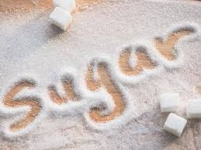
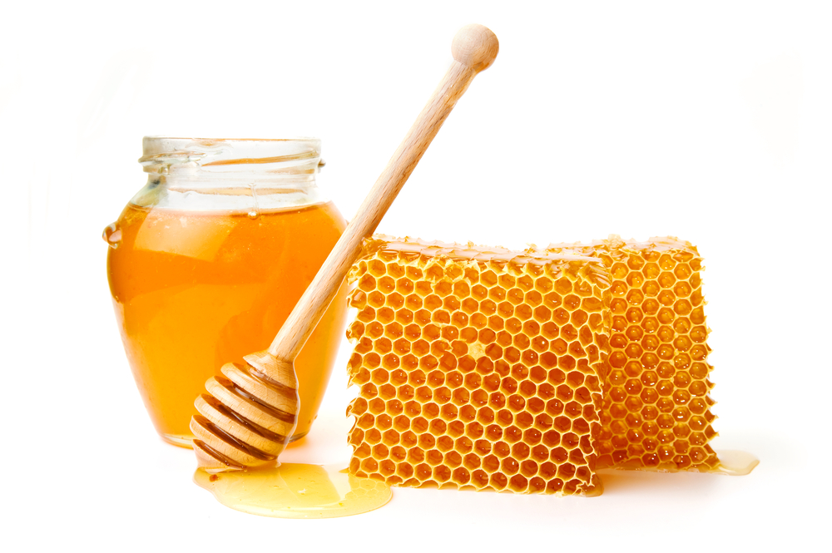
Food Preparation & Nutrition – Butter, Oil, Sugar & Syrup – lesson 5
LO’s
Types of sugar and sweeteners available to consumers.
Starter – watch the videos on sugar and honey
Task 1. Read p. 348 – 350. Write a brief description of the different types of sugar and syrups available (you can do this as a mind map, or just list them)
Notes:
Video – how sugar is made 2.37 Honey 2.25

Slide 2
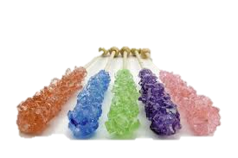
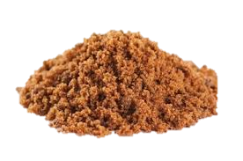
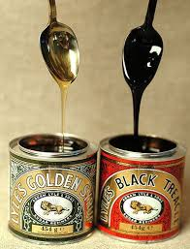
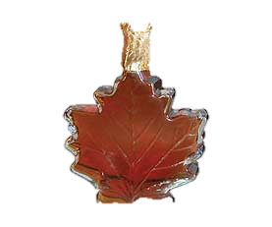
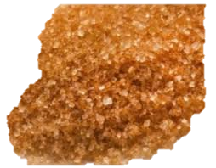
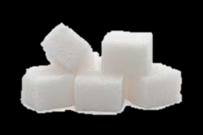
Molasses - thick, dark brown juice obtained
from raw sugar during the refining process
Sugars and syrups
Honey – bees produce honey from nectar that is collected from various flowers.
Other types of sugar
Brown Sugar
White Sugar
Coffee sugar crystals – large sugar crystals, sometimes sold in mixes of different colours. They
take longer
to dissolve
than other sugars.
Black treacle – made from molasses. Thick, heavy and dark coloured syrup with a strong flavour.
Muscovado – is a type of partially refined to unrefined brown sugar with a strong molasses flavour
Syrups
Soft brown (light or dark)
Granulated – large crystals
Caster – Made the same way as granulated but produces smaller crystals
Demerara – has larger crystals and is traditionally served with coffee and used for cake making
Golden syrup – refined, light syrup with a gold colour. Some of the sugar it contains is invert sugar. This makes is much sweeter.
Maple syrup – made from the sap of maple trees. 80% of worlds supply is from Canada
Lump sugar – made the same way as granulated, but the crystals are poured into special moulds, cooled until solid then cut into cubes or lumps.
Icing – made by pulverising granulated sugar into a fine powder.

Slide 3
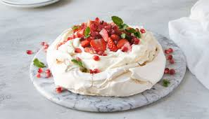
Food Preparation & Nutrition – Butter, Oil, Sugar & Syrup
Task 2. Write down the uses of honey.
Next practical - Pavlova

