Slide 1
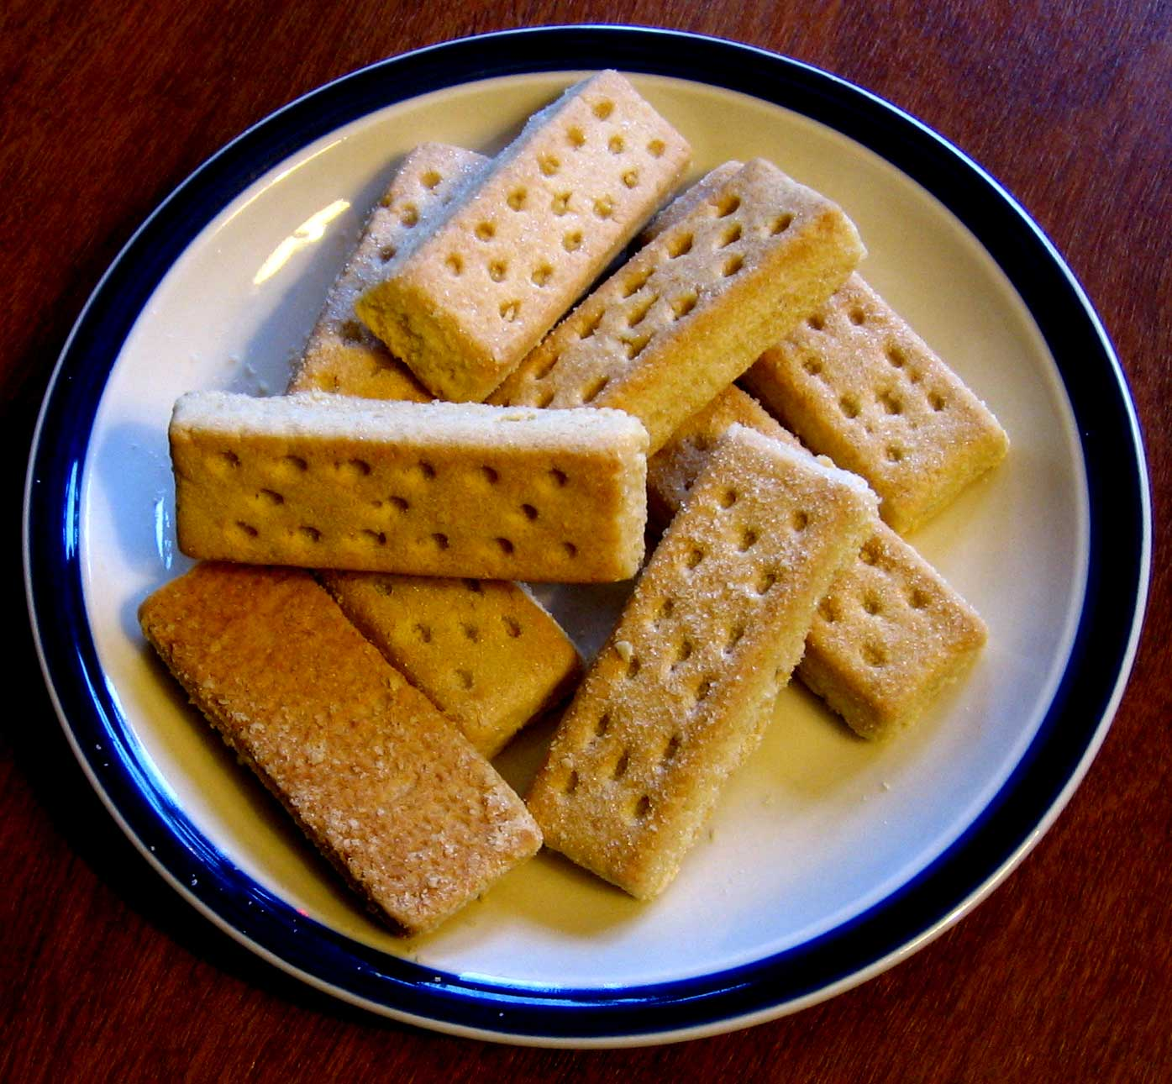
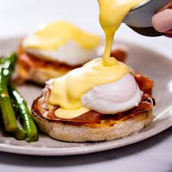
Food Preparation & Nutrition – Butter, Oil, Sugar & Syrup – lesson 4
LO’s
The functions of fats and oils.
What F & O are used for.
Properties of F & O.
The effect of heat on F & O
Starter – watch video on the functions of fat
Task 1. Create a mind map which shows the functions and uses of fats and oils.(See next slide for an example)
Notes:
Films – shortening p.345, emulsion – hollandaise, emulsification

Slide 2
Food Preparation & Nutrition – Butter, Oil, Sugar & Syrup
Functions
Aerates mixtures when creamed with sugar, it traps air.
Frying – used for shallow & deep fat frying
Uses
Extends the shelf life of baked products.
Gives shortening ability to a mixture and changes the texture. E.g. shortbread
Acts as a cooking medium for roasting or frying.
Spreading on toast etc.
Creaming – when creamed with sugar, fats have the ability to trap tiny air bubbles which help the mixture rise.
Fats & oils
Prevents lumps of flour forming in sauce.
Forms an emulsion with liquids such as vinegar e.g. mayonnaise
Shortening – when making pastry the fat coats the flour particles which gives a waterproof coating to prevent the absorption of water. Gives the pastry a crispy texture.
Making an emulsion – specifically in salad dressings and mayonnaise
Adds colour and shine to foods e.g. scones
Adds flavour & aromas
Improves the texture of flaky & puff pastry

Slide 3
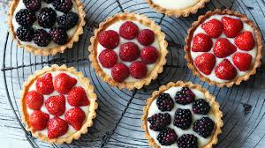
Food Preparation & Nutrition – Butter, Oil, Sugar & Syrup
Task 2. The effect of heat on fats and oils. Read p.346 & 347 and write down the definitions of smoke point and flash point.
Your next practical is Fresh fruits tarts with crème patisserie.

