Slide 1
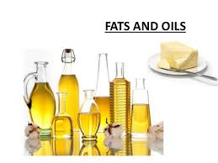
Food Preparation & Nutrition – Butter, Oil, Sugar & Syrup – lesson 2
LO’s
To investigate the nutritional value of fats and oils
Starter – click on the picture to watch the video
Task 1. Read p.342. Write down and then answer the following questions:
Name 2 functions of fats and oils in the body?
Which 2 essential fatty acids do fats and oils provide? (mainly from oily fish)
Name the fat soluble vitamins that are provided by fats.
Name the 3 elements that compose fat.
Butter, cream and whole milk are types of which type of fat?
Vegetable oils are types of which type of fat?
Describe cholesterol.
8. Why can too much cholesterol be bad for you?

Slide 2
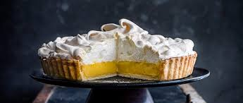
Food Preparation & Nutrition – Butter, Oil, Sugar & Syrup
H/W –Find the definitions for the following words and write them down.
Saturated fat unsaturated fat hydrogenation monounsaturated fat
Polyunsaturated fat omega-3 and omega-6 cholesterol sautéing
smoke point Nutritional supplement condiments aeration
shortening emulsion plasticity
You will find the answers in the FPN book (or you could ‘Google’ them. Log in details for the interactive book – www.illuminate.digital/eduqasfood Username SKINGS4 P/W STUDENT4.
Next Practical – Lemon Meringue Pie. You will need to make your pastry at home!
I will let you know about this as soon as I have finalised what is going on in school!

