Slide 1
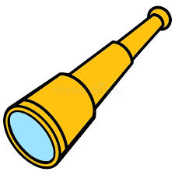

Slide 2
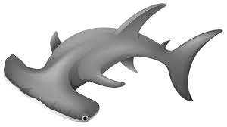
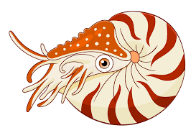

Slide 3
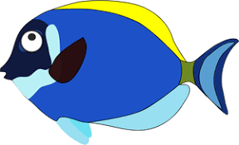

Slide 4
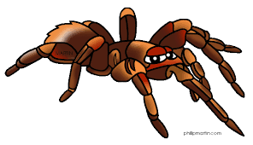

Slide 5
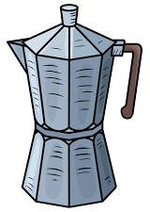
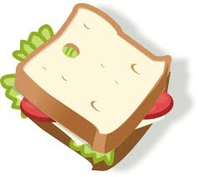

Slide 6
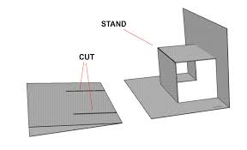
Single Layer Pop-Up Mechanism
Fold your A4 piece of paper in half.
Cut parallel lines.
Fold the cut section to create a crease.
Open up your piece of paper and invert the cut section.
You can repeat this process multiple times using different length & width cuts.

