Slide 1


A & V Fold Mechanism

Slide 2


Slide 3


Slide 4


Slide 5


Slide 6


Slide 7
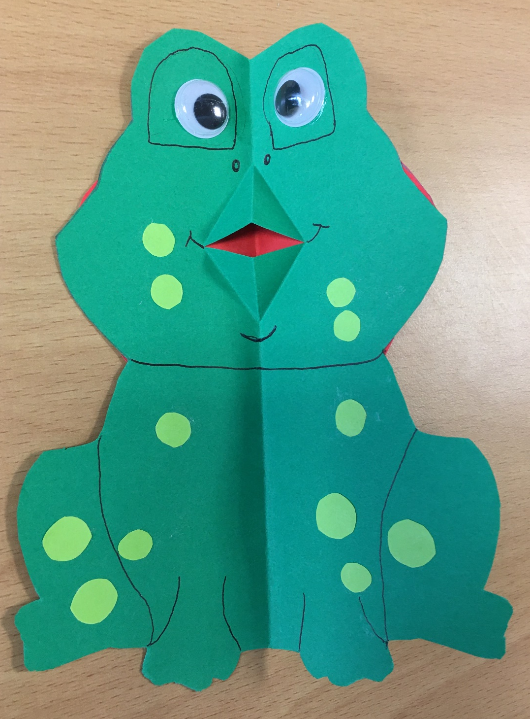
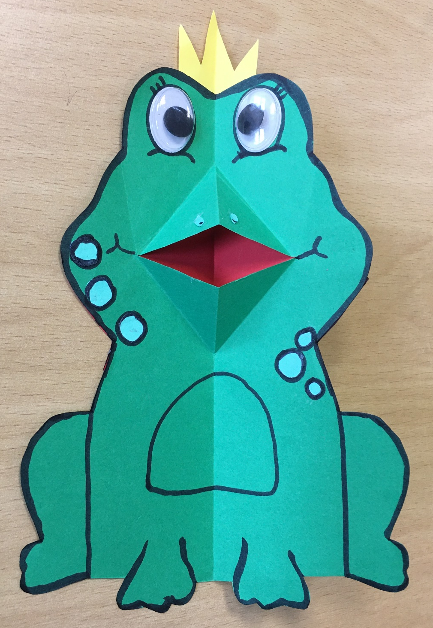

Slide 8






Frog
Research Design Ideas

Slide 9







Slide 10











