Slide 1
Processors 1
There are many different types/models/brands of processor.
Some are dedicated, which means that they can only do one thing. They have a small amount of memory (ROM) built in, which is programmed and fixed at manufacture. These sorts of processors are embedded (built in) into other machines and are used to control washing machines, heating systems, DVD recorders, etc.

Slide 2
Processors 2
In a PC, or tablet, or phone, the processor is multi-purpose. It can run a variety of applications programmes given to it.
All processors work like little machines. They follow strict working procedures. How they work depends on their internal structure, known as their architecture.

Slide 3
Processors 3
Every processor has a clock which controls the rate at which instructions are processed.
My PC has a clock speed of 2.93 GHz (Giga Hertz). This is 2,930,000,000 “ticks” per second. That’s how many operations that my processor can do each second!

Slide 4
RAM 1
RAM is like a filing cabinet that is used to store data. It is made up of millions of memory locations (drawers) which are where data are stored. Each location has a unique address so that the processor can access what data is stored inside it.
10011001 | 11110001
10011010 | 11110010
10011011 | 11110011
10011100 | 11110100
10011101 | 11110101
10011110 | 11110110
Memory locations showing contents
addresses

Slide 5
RAM 2
In the early days of PCs, each memory location could store only one byte of data, and address sizes were limited. Nowadays, memory locations are 64-bits big and addresses are virtually unlimited!
10011001 | 11110001
10011010 | 11110010
10011011 | 11110011
10011100 | 11110100
10011101 | 11110101
10011110 | 11110110
Memory locations showing contents
addresses

Slide 6
RAM 3
Connecting RAM to the processor are three sets of wires: they are called the address bus, the data bus and the control bus.
When a particular memory location is needed by the processor (either the processor is fetching data or needs to store data in a memory location), the address of the memory location is placed on the address bus. This is a signal that “unlocks” that memory location.
The data bus is used to carry the data to or from the active memory location.
It is the control bus that determines the direction that the data is travelling in.

Slide 7
RAM 4
It is crucial to remember that the data stored in a memory location could either be data to be acted on, or an instruction from part of a running programme. For example, a number stored in a spreadsheet, or the spreadsheet software itself.
Confusion between the two would be disastrous for the computer, resulting in a software crash.
It is the job of the Operating System to keep track of where programmes and ordinary data are stored in RAM.

Slide 8
Instructions
Instructions are stored as binary numbers. For example, 10010011. This is an 8-bit instruction, nowadays we use 64-bit.
Instructions are made up of two parts the opcode and the operand.
The opcode represents the type of instruction, e.g. increment, add immediate, invert.
The operand controls what the action is applied to. Often, it is a memory location.
opcode
operand
10010011

Slide 9
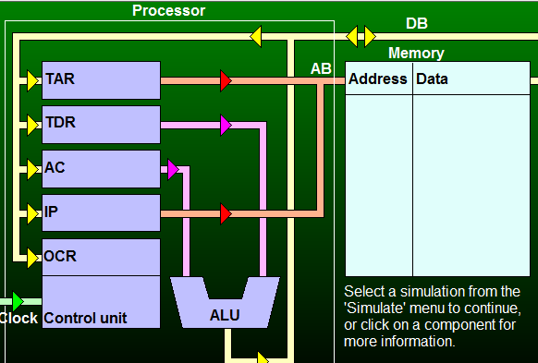
Processors 4
The picture below shows a very simplified processor architecture (left side), connected to RAM (right side). This standard architecture is called the Von Neumann architecture.
Registers are temporary holding places for data. A real processor may have hundreds.
The most important are the Accumulator, Memory Address Reg, Memory Data Reg and Program Counter.
M A R
M D R
Prog. Counter
The Control Unit figures out what kind of instruction is being processed and as a result places data onto various wires to go somewhere.
Inst Reg
The Arithmetic Logic Unit is where all calculations take place.

Slide 10
Processors 5
Registers are the fastest kind of memory there is.
You need to know the following registers and what they do:
Accumulator stores results of calculations in the ALU, also used to supply data for calculations.
Memory Address Register stores the address of the memory location that needs to be accessed.
Memory Data Register stores the data either being written to memory or being read from memory.
Program Counter (Instruction Pointer) stores the memory address of the next instruction.
Instruction Register stores the current instruction.

Slide 11
Processors 6
Processors work using what is known as the fetch–decode-execute cycle.
1st – the next programme instruction is fetched from memory and brought to the control unit.
2nd – the control unit decodes the instruction.
3rd – the instruction is carried out (executed).
This process is then repeated again and again for subsequent instructions.

