Slide 1
DID YOU KNOW 2026 - To be played as visitors enter

Slide 2




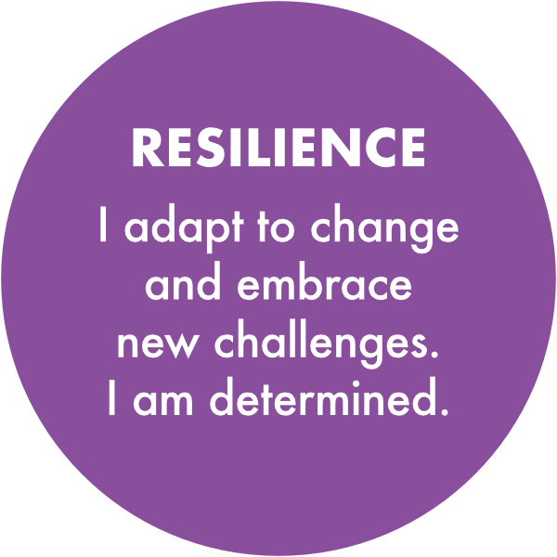
POST 16 Information Session
Thursday 17th September 2026

Slide 3
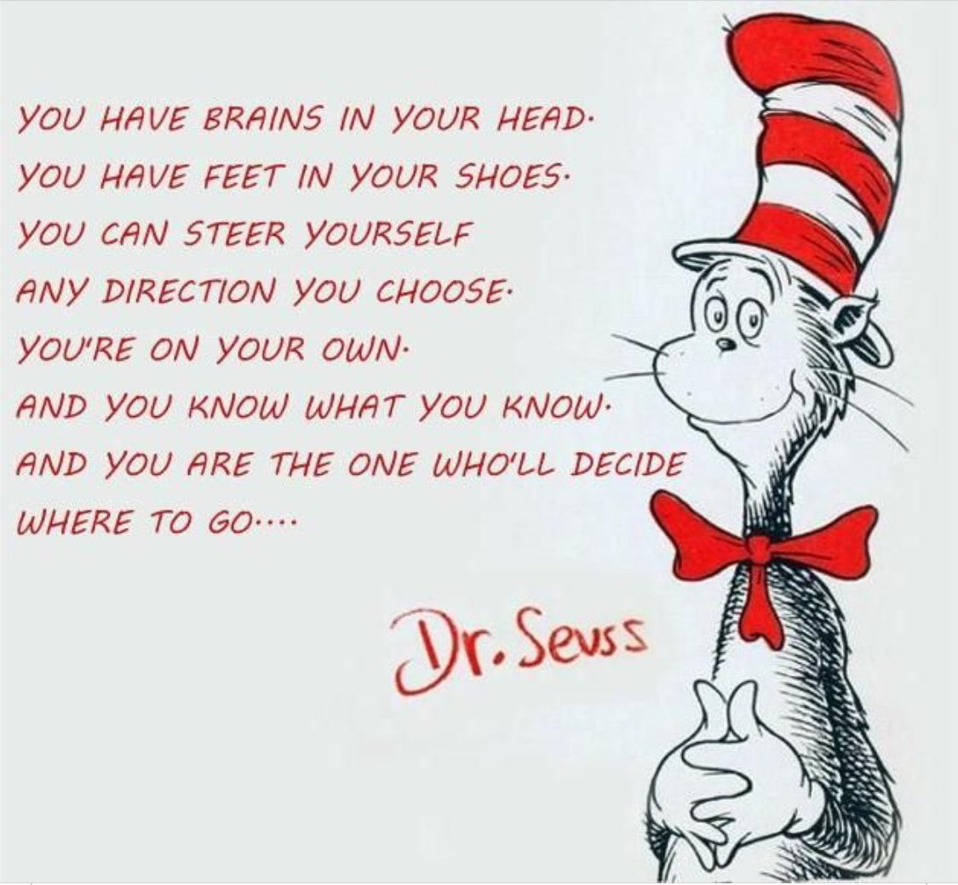

Slide 4

Options…Post-16
6th FORM
COLLEGE
A-levels
FOUNDATION COURSES
T-LEVELS
APPRENTICESHIP
Notes:
There is no "best" route, only the right route for each individual student.
Tonight we'll look at the main options available after Year 11.
Think about interests, strengths, learning styles and future goals.
Keep an open mind while exploring the different pathways.

Slide 5
26
school weeks until
May 2027
Notes:
It might feel like there is plenty of time, but the weeks will pass quickly.
Between now and May there are mock exams, coursework, applications and revision.
Every week counts.
The students who plan early tend to feel less pressure later on.

Slide 6
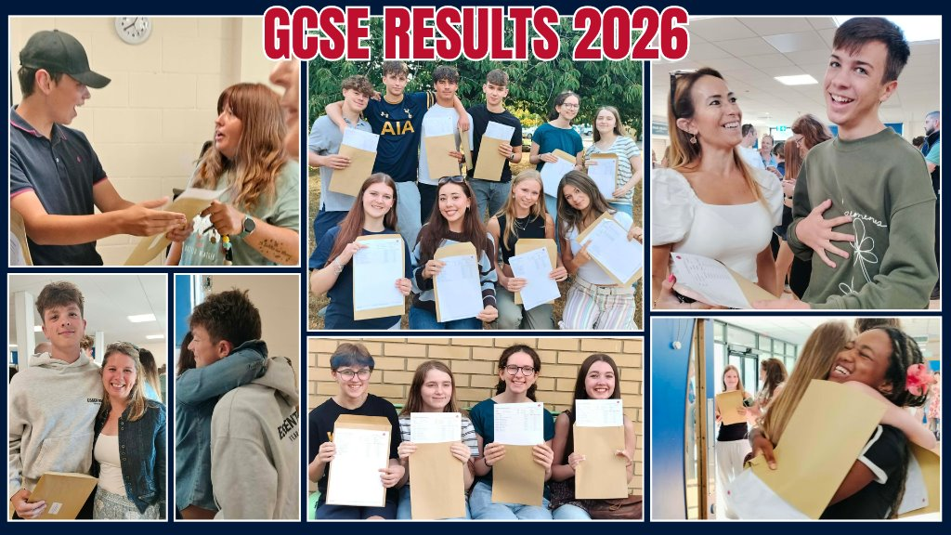
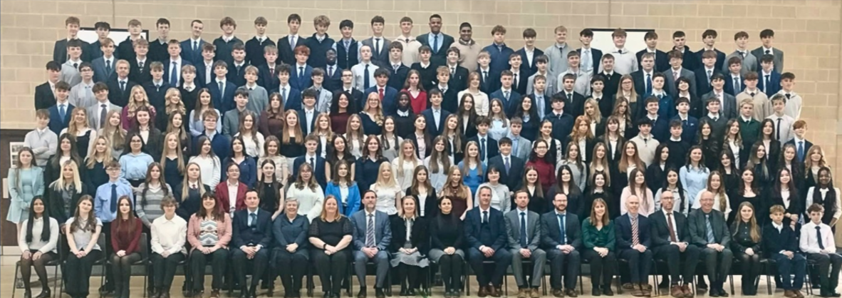

Slide 7
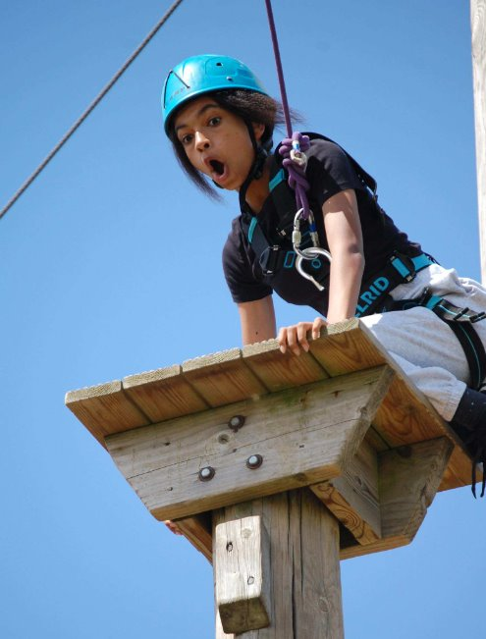
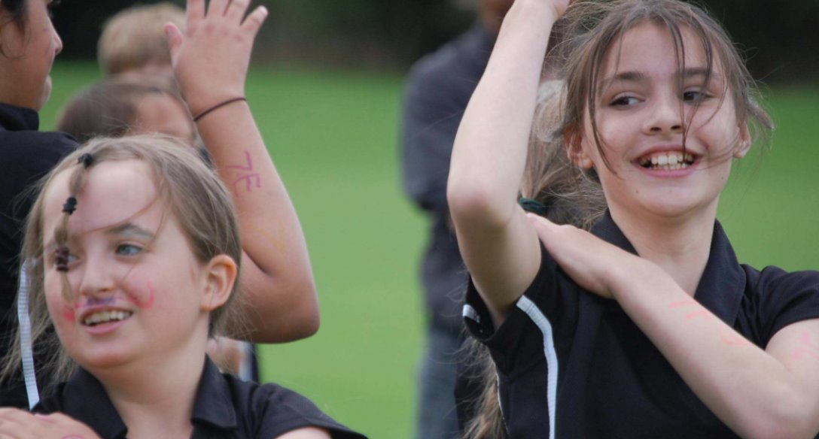
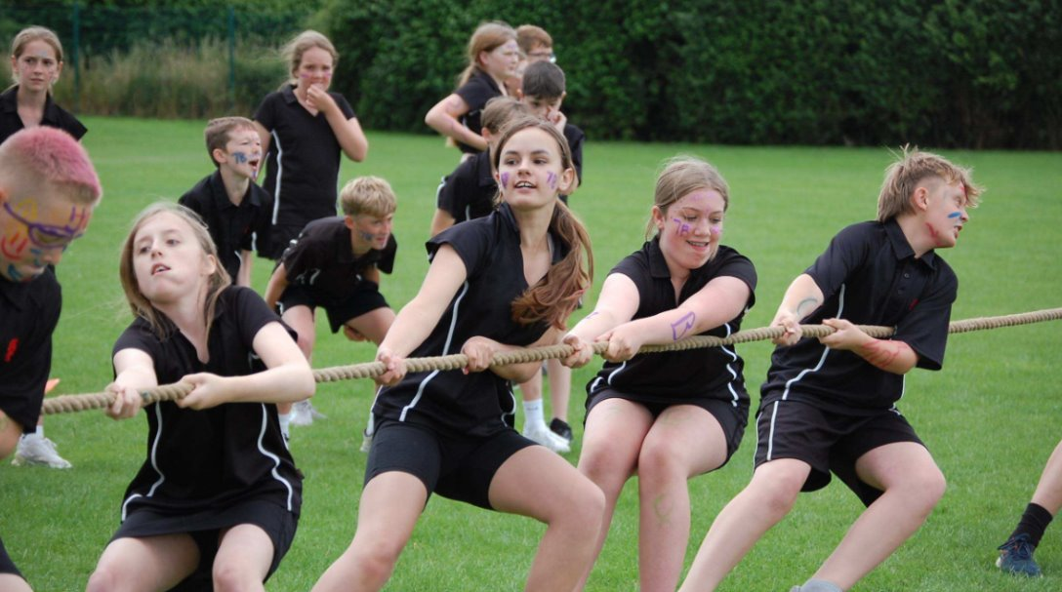
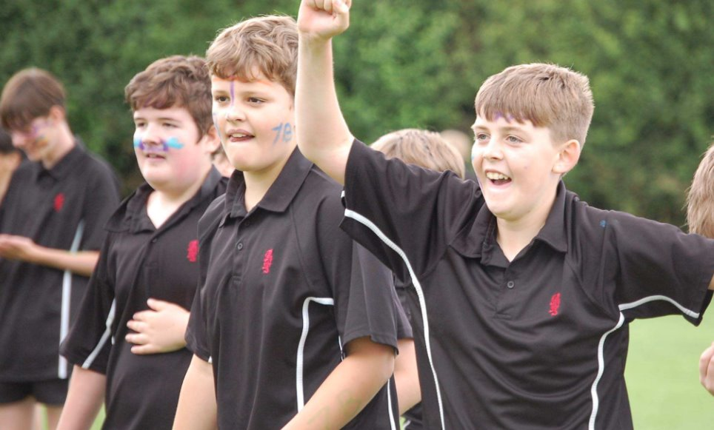
Thank you for how quickly you have settled back into school this week ahead of an important – and hopefully, exciting – year ahead!
A special thank you to our Student Leaders who have been so helpful in getting the year off to a good start – and to all of you who have acted as role-models to our younger students!
As you begin following your usual timetable today, please make sure you make a positive start and show your staff that you are ambitious to be the best version of you.
Start as you mean to go on... you've done it before and now it matters more than ever!
Mr Morland
Smiles
Teamwork: pulling in the same direction!
Facing our fears
Celebrating your success when it comes!
Notes:
JMO talking about not making comparisons

Slide 8
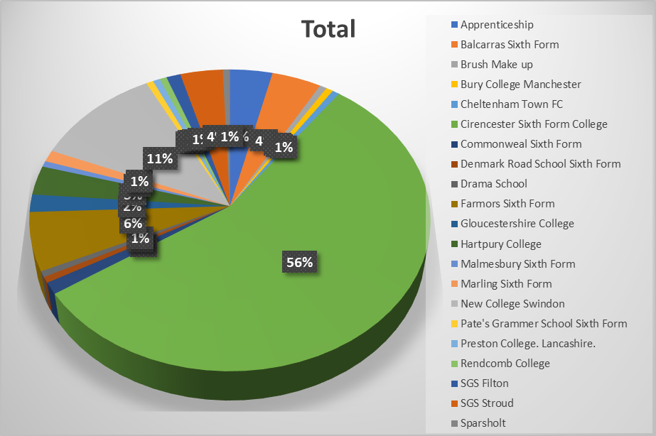
Destinations:
our students go far and wide...!
'pupils are well prepared for adult life...and life in modern Britain'
Notes:
Our students move on to a wide range of destinations every year.
There isn't one preferred pathway.
Some choose sixth form, some college, and some apprenticeships.
The important thing is finding the route that is right for you.

Slide 9
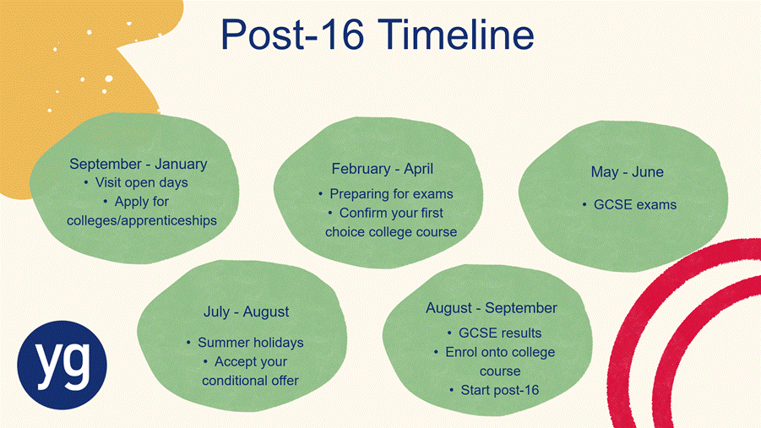

Slide 10


Making big decisions...
Notes:
We make big decisions all the time.
Example: I need a new car and I'd like to book a holiday.
How do I decide?
I don't buy the first car I see.
Research:
Cost
Reliability
Running costs
Reviews
Compare options.
Strengths and weaknesses.
Pros and cons.
Avoid nasty surprises later.
Holiday example
Compare destinations.
Compare prices.
What's included?
Is it good value for money?
Right choice for me?
Link to Post-16
Choosing a Post-16 course is no different.
You're committing the next two years of your life.
What will you study?
How is it assessed?
What grades do you need?
Where can it lead?
Key question
Don't just ask:
"Can I do this course?"
Ask:
"Is this the right course for me?"
Main message
Research.
Compare.
Ask questions.
Understand the positives and negatives.
Make an informed decision.

Slide 11
Considerations
Research
Comparison
Positives + negatives
Asking 'what is realistic'
Investment
Having more than 1 choice

Slide 12
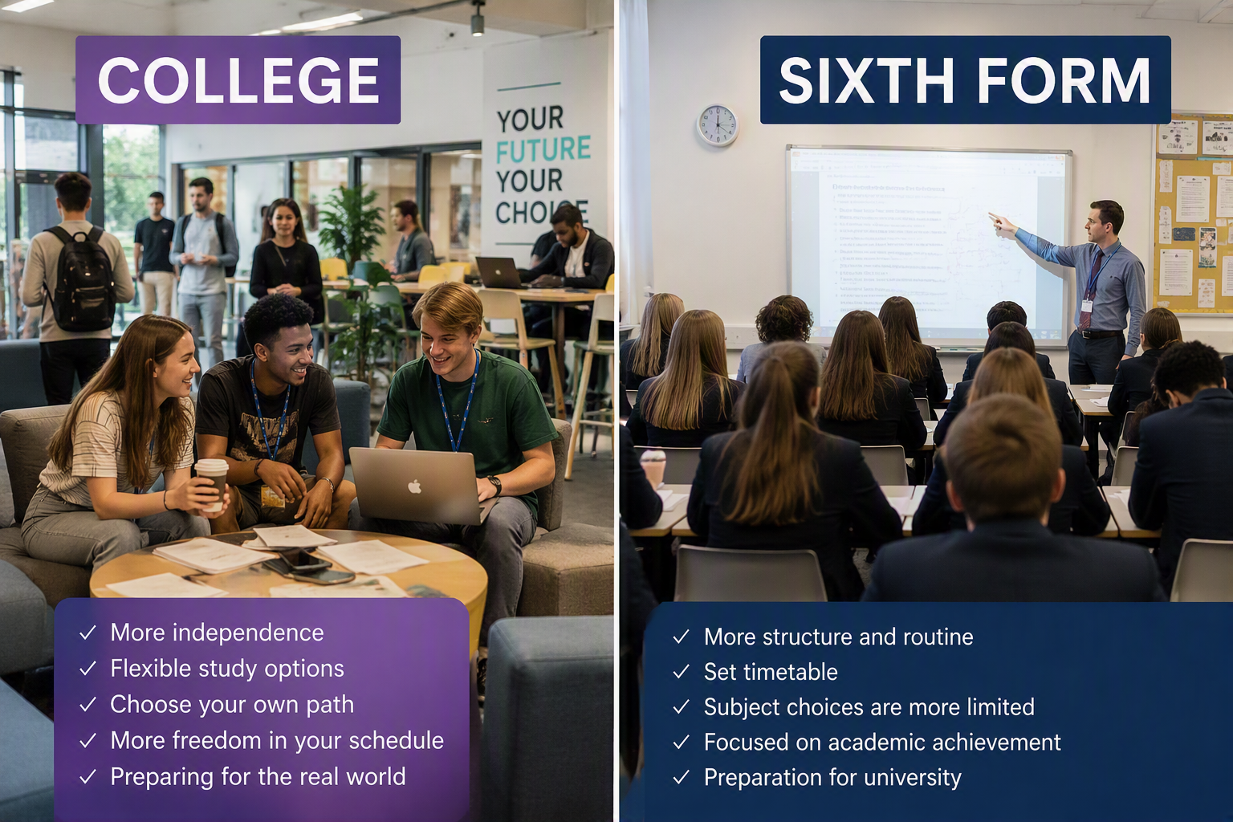
Notes:
Students often ask, "Which is better, college or sixth form?"
The honest answer is neither is better, they are just different.
Think about which environment suits you best.
Sixth Form
Often feels more like an extension of school.
Smaller environment.
More structured day.
Familiar routines and expectations.
College
Often larger and more independent.
More course choice.
Greater mix of students from different schools.
Students are expected to manage their own time more.
Can feel more like a stepping stone towards university or employment.
Things to Consider
How independent are you?
What style of learning do you prefer?
Do you want a familiar environment or a fresh start?
Which subjects or courses are available?
Key Message
Don't choose based on where your friends are going.
Choose the environment where you believe you will be happiest and most successful.

Slide 13
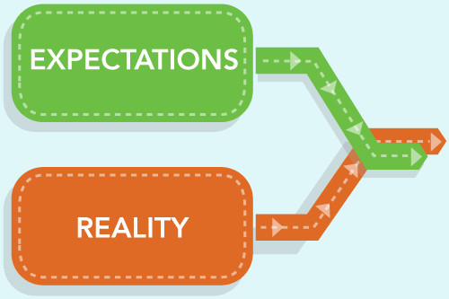
Year 12
What to expect
✓ Greater independence and responsibility
✓ More homework and independent study
✓ New teachers, classmates and learning environment
✓ Regular assessments and progress checks
✓ Opportunities such as enrichment activities, work experience and volunteering
✓ Increased focus on future plans, including careers, apprenticeships and university
✓ Support available to help you settle in and succeed
The step up can feel challenging at first, but most students quickly adapt and grow in confidence.
Notes:
The jump from Year 11 to Year 12 is significant
There is more independence and personal responsibility.
Students are expected to manage their time more effectively.
Most students adapt quickly and become much more confident within the first few months.

Slide 14

Entry requirements?
College and Sixth Form entry requirements vary, so it is important to check them carefully.
Check both the general entry requirements and any subject-specific requirements for the courses you are interested in.
Be ambitious with your choices, but make sure they are realistic and achievable.
Notes:
Entry requirements vary between providers.
Don't assume all colleges expect the same grades.
Check both general requirements and subject-specific requirements.
Be ambitious, but have realistic alternatives.

Slide 15

Most providers offering A Levels, T Levels and other Level 3 qualifications require students to achieve at least a Grade 4 in both English Language and Maths.
If these grades have not been achieved, students will usually be required to resit GCSEs or work towards an alternative qualification, including on some apprenticeship programmes.
This helps keep future education, training and career options open.
English & Maths
Requirements
Notes:
English and Maths are incredibly important after Year 11.
For many students, these grades can have a huge impact on the options available to them.
Most providers offering A Levels, T Levels and other Level 3 qualifications will expect at least a Grade 4 in both English Language and Maths.
It is important to check individual provider requirements, as some courses may ask for higher grades.
Certain subjects, especially Science, Maths, Engineering and some Business courses, often have specific GCSE grade requirements.
If a student does not achieve a Grade 4 in English or Maths, it doesn't mean education stops.
However, they will usually need to continue studying English and/or Maths alongside their main course.
This can mean resitting GCSEs or working towards an alternative qualification.
The reason providers insist on this is because English and Maths are key skills that employers, colleges and universities continue to look for.
Achieving those grades helps keep as many future opportunities open as possible
Key Message
A Grade 4 in English and Maths keeps the greatest number of doors open

Slide 16

Important Considerations
Competition for places may increase as colleges accommodate growing student numbers, including those resitting English and Maths.
Keep a copy of any college offer, as entry requirements or course availability may change depending on demand.
Providers may make different decisions if students do not meet their entry requirements, so it is important to discuss alternative options early.
Notes:
Colleges are facing increasing demand for places.
Applications should be made early rather than waiting.
Keep copies of offers and correspondence.
Always have alternative options available just in case.

Slide 17
Level by Level
Develop specialist knowledge and skills in a subject or career area.
Progression to:
University / Higher Education / Higher and Degree Apprenticeships / Skilled employment
Level 3 – Advanced
A Levels, T Levels, V Levels Diplomas, Advanced Apprenticeships
Level 2 – Intermediate
GCSEs Grades 4-9, Diplomas, Intermediate Apprenticeships
Build knowledge and skills in a chosen subject or vocational area.
Progression to:
Level 3 / qualifications / Apprenticeships / Employment
.
Level 1 – Foundation GCSEs Grades 1-3, Certificates, Diplomas
Develop confidence, knowledge and essential skills for further learning.
Progression to:
Level 2 / qualifications / Apprenticeships / Further training
Notes:
Qualification levels can sometimes seem confusing.
This slide gives a simple overview of Levels 1, 2 and 3.
The important thing to remember is that each level offers progression opportunities.
Starting at Level 1 or Level 2 is still a positive route towards future success.

Slide 18
A-levels:
A level 3 qualification
Academic • Subject-Based • Exam Focused
Typically, a 2-year course
Why study A-levels?
Study 3 subjects in depth over 2 years
Allows students to keep their options open or to specialise.
Wide range of subjects to choose from
Well recognised by universities and employers
Ideal for students who enjoy classroom learning and exams
Grades A* to E represent a pass at A-level
Notes:
A Levels are usually best suited to students who enjoy academic study.
Students normally study three subjects in depth over two years.
They are highly valued by universities and employers.
Assessment is mainly through examinations.

Slide 19
T-levels:
Level 3 Qualification
Career-Focused • Technical • Employer Designed
Why study T-levels?
Typically, a 2-year course
Equivalent to 3 A Levels
Minimum of 310 hours of work experience in an Industry placement.
T Level developed with employers
Combines classroom learning with practical experience
Attract UCAS points
Provides pathways into skilled employment, apprenticeships, higher education and university
Assessments include:
Exams, practical projects and industry placement work.
Notes:
T Levels combine classroom learning with substantial industry experience.
They suit students who already have some idea of their future career area.
They attract UCAS points and can lead to university, apprenticeships or employment.
Think of them as a blend of education and workplace learning.

Slide 20
V-levels:
Level 3 Qualification
Vocational • Flexible • Future-Focused
Why study V-levels?
Two-year course
Similar in size to one A Level
Can be studied alongside A Levels and other qualifications
Learning designed around real jobs and employer needs
Focus on applied learning and practical skills
Develop problem-solving and critical thinking skills
Attract UCAS points
Support progression to higher education, apprenticeships and employment
Assessed through: Practical assessments, applied learning and a significant proportion of non-exam assessment.
Rolling out as of Sept 2027 - TBC
Education & Early Years
Finance & Accounting
Digital
Notes:
Available to students as of Sept 2027
Education & Early Years
Finance & Accounting
Digital
Focuses on “Learning by doing” through practical assessments, projects, and workplace scenarios but without requiring a mandatory long term industry placement.
They last for 2 years.
They are similar in size to one A level.
Students will be able to take V Levels in multiple subjects and in combination with other qualifications such as A-levels or level 2 English or maths.
Learning is designed around real jobs and the skills employers need.
Students will receive a nationally recognised qualification.
They attract UCAS points
They are designed for students who want to keep their future options open while developing sector-specific knowledge and skills.

Slide 21
BTECs & Diplomas
Level 3 Qualifications
Practical • Career-Focused • Coursework Based
Why study T-levels?
Focus on one subject or career area
More coursework and project-based learning
Available in different sizes (equivalent to 1, 2 or 3 A Levels)
May include Work experience
At some colleges can often be combined with A Levels
Ideal for students who prefer practical learning and coursework
Assessment: Coursework, projects and practical assignments
Notes:
BTECs offer a more practical approach to learning.
They are often preferred by students who perform well through coursework and projects.
They are available in different sizes and can sometimes be combined with A Levels.
Universities and employers recognise these qualifications.

Slide 22
Level 2 qualifications
A stepping stone to Level 3 study
Why study level 2?
Wide range of subjects and career areas
Different assessment methods, including exams, coursework and practical work
Recognised by employers and colleges
Progression route to Level 3 qualifications
Opportunity to obtain that 4 in English and Maths where needed
Assessment varies by course:
• GCSEs: Mainly end-of-year exams
• Diplomas & Certificates: Coursework, practical assessments and sometimes exams
Notes:
Level 2 courses are often a progression route to Level 3.
They provide another opportunity to build qualifications and confidence.
Students may also continue improving English and Maths.
Many students successfully move from Level 2 to Level 3 study.

Slide 23
Level 1 qualifications
A foundation route to further study
Why study level 1?
Wide choice of subjects to keep your options open
Develop skills and confidence
Progress to Level 2 qualifications
Opportunity to improve English and Maths through GCSE resits or Functional Skills qualifications.
Prepare for further education or employment
Assessment: Coursework • Practical Assessments • Some Exams
Notes:
Level 1 qualifications provide a solid foundation.
They help students develop confidence, skills and experience.
They are designed as a stepping stone, not a final destination.
Progression opportunities remain available after successful completion.

Slide 24
Apprenticeships
Work • Learn • Earn
Why study an apprenticeship?
Earn a wage while you learn
Gain real workplace experience
Available in hundreds of career areas
Start after Year 11, Sixth Form or College
Progress from Level 2 right through to Degree Apprenticeships
Gain recognised qualifications and valuable skills
Get paid, gain experience and build your future career.
Notes:
Apprenticeships allow students to earn while they learn.
They provide valuable workplace experience from the start.
Apprenticeships are available across a huge range of industries.
They can lead all the way through to degree-level study.

Slide 25
How does an Apprenticeship work?
What does it look like day-to-day?
Work for an employer while training
Learn through a combination of work and study
Training may take place in the workplace, at college or online
Complete coursework and assessments as part of your programme
Gain skills, qualifications and work experience at the same time
Your employer and training provider will support your learning
Earn a wage while developing the skills needed for your chosen career.
Notes:
Apprentices spend most of their time working with an employer.
They also complete training and qualifications alongside their job.
Learning can take place in college, online, or in the workplace.
It is a combination of employment, training and education.

Slide 26

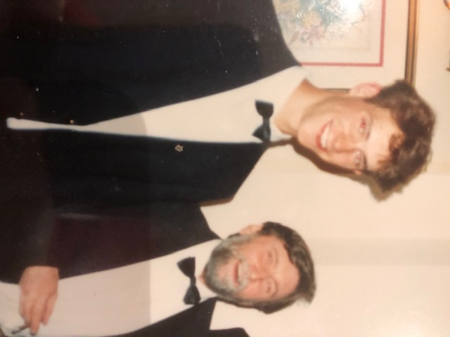
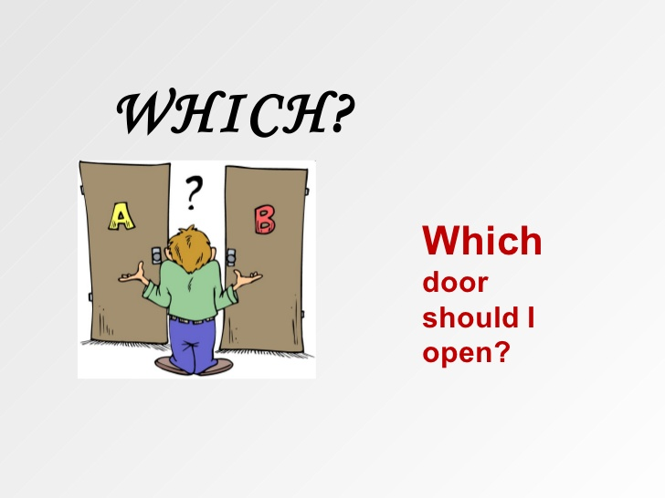

Mr Morland is 16...
.
Notes:
Mr Morland ….I want to put you on the spot a little!
Giggle at Mr Morland….
We spend a lot of time talking to students about making decisions, but I think it's really useful to hear from someone who has been through the process themselves.
So, Mr Moralnd, I want you to imagine you are 16 again..."
Can you remember what was going through your mind at this stage?
Did you know what you wanted to do after Year 11?
Were you confident in your decision, or were you still unsure?
Making the decision
What Post-16 route did you choose and why?
What influenced that decision?
Were your friends making similar choices, or did you follow your own path?
Research and planning
Did you look at progression routes before making your decision?
Were you already thinking about jobs, university or future careers?
How much thought did you give to where your qualifications might lead?
Reflection
Looking back now, was it the right decision for you?
Is there anything you wish someone had told you when you were 16?
Did anything surprise you once you started your course?
Today's world
If you were a Kingshill Year 11 student today, would you make the same choices?
With all the options available now, such as T Levels and apprenticeships, would you consider a different route?
Do you think young people today have more choices than you did?
Fun question
Be honest... did you choose any subjects simply because you enjoyed them rather than because they fitted into a career plan?
Were there any subjects you loved but never ended up using in your career?
If you could go back and pick one additional subject or qualification, what would it be?
Closing Question
"If you could leave our Year 11 students with just one piece of advice about making Post-16 decisions, what would it be?"

Slide 27
My Course Checklist…
The Course
Am I interested in this subject?
Does it play to my strengths?
How is it assessed (exams, coursework, practical work)?
How much independent study is required?
The College/Sixth Form
What are the class sizes?
What support is available?
What were the results for this course last year?
Can I see myself studying here?
My Future
What do students go on to do after this course?
Will it help me achieve my career goals?
Does it meet my personal criteria?
Notes:
The more information you gather, the more confident your decision will be.
Don't just ask whether a course is available. Ask whether it is right for you.

Slide 28
A competitive market
.
Right now:
  8.2 billion people on Earth
  5.4 billion adults
  3.1 billion people who want to work
  90% of these people want to work full-time
2.7 billion full-time formal jobs are wanted
With only 1.2 billion full-time jobs available
That’s a shortfall of 1.5 billion jobs
So, for every UK worker, there are 50 people on the planet who would like their job...
Notes:
This isn't designed to worry anyone.
It's designed to show why qualifications, skills and experience matter.
Employers and universities have choices.
The stronger your skills, qualifications and attitude, the more opportunities you create for yourself.

Slide 29
The Gloucestershire Labour Market
Who are Gloucestershire's biggest employers?
NHS
Gloucestershire County Council
GE Aerospace
Safran
Tesco
Barchester Healthcare
IBM
University of Gloucestershire
Sectors Growing in Gloucestershire
Cyber Security & Digital
AI & Data
Engineering & Advanced Manufacturing
Health & Social Care
Construction
Green Technologies & Sustainability
Agri-Tech (Agriculture & Technology)
Future Opportunities
Cyber Security Analyst
Data Analyst
AI Engineer
Software Developer
Renewable Energy Technician
Engineering Technician
Healthcare Professional
Digital Marketing Specialist

Slide 30








Future of Gloucestershire Jobs
Notes:
The world of work is changing quickly.
Many of the jobs our students will apply for in the future don't even exist yet.
That's why it's important not to focus solely on one job title.
Instead, focus on building skills, qualifications and experience.
Gloucestershire is becoming nationally recognised for cyber security, engineering and digital industries.
We are fortunate to live near major employers and growth sectors.
The opportunities are here, but employers are looking for skilled and adaptable young people.
The decisions you make over the next few years help prepare you for those opportunities.

Slide 31
What we need you to do:
.
Go to open evenings/events - explore, research
Talk
Listen
Keep positive - yet practical
Routine – and balance
Save the dates………..
MOCK INTERVIEW DAY - Friday 19th March 2027
RESULTS DAY - Thursday 19th August 2027, 8am
  (and a full petrol tank!)
Notes:
Tonight's message is quite simple.
Research thoroughly.
Ask questions.
Keep an open mind.
Stay focused on your studies.
Most importantly, make informed decisions rather than following the crowd.

Slide 32
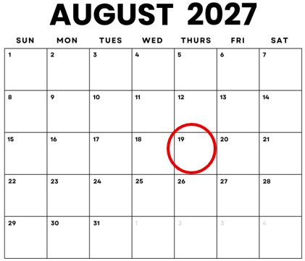

And finally...
Results Day, the reality and ...what is next?!
Thurs 19th August 2027 8am
ThePhoto by PhotoAuthor is licensed under CCYYSA.
Notes:
Results Day can feel exciting and stressful at the same time.
Preparation is key.
The more organised you are beforehand, the smoother the day will be.
Let's talk about what that preparation looks like.

Slide 33

What is success?
.
Success is…
Getting the best grades possible for you.
Being happy with your chosen pathway.
Knowing you couldn’t have done any more.
Believing in yourself and your decisions.
Notes:
Success looks different for everyone.
It isn't about comparing yourself with others.
It is about achieving the best outcomes you can.
Being happy with your choices and knowing you gave your best effort is success.

Slide 34
Before and On Results Day
19th August 2027
Before Results Day
• If invited to book an enrolment appointment, do so as soon as possible.
• Keep copies of all college, sixth form and apprenticeship offers.
• Ensure your results can be accessed quickly, especially if you are unable to collect them in person.
Results Day
8:00am - 9:30am: Collect GCSE results
• Check your results carefully against the entry requirements for your chosen course.
• Upload your results to your chosen provider or take them with you to your enrolment appointment.
• If your results are different from expected, speak to your chosen provider about alternative options.
Be Prepared !
Have that Plan B Ready just in case

Slide 35
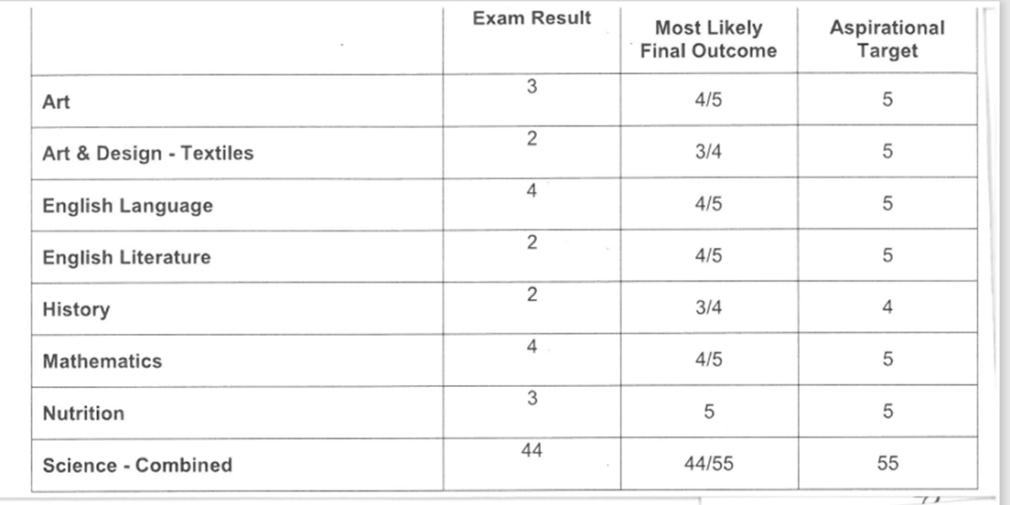

Back Up Plans/Lessons to Learn…
.
This person focused on the Maths, English and Science as that was the entry requirements for her course. However, she only got four grade 4s and she needed five.

Slide 36
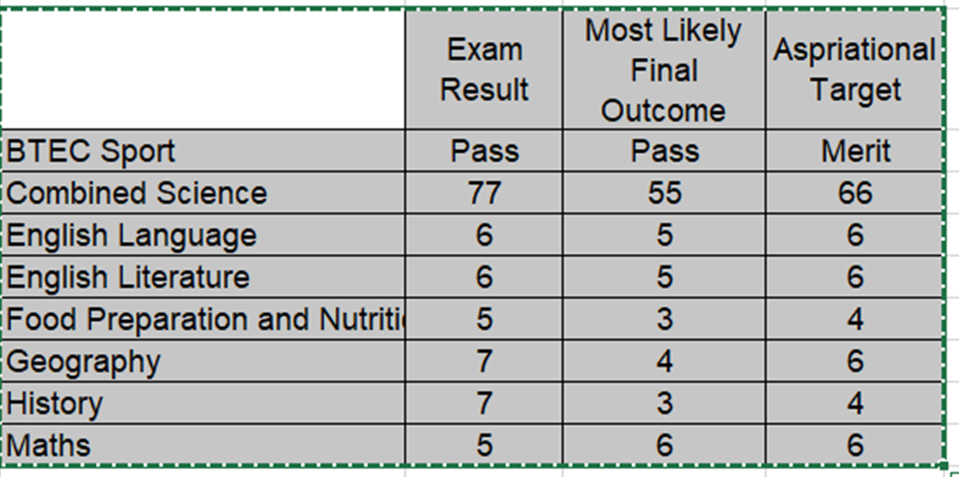
Back Up Plans/Lessons to Learn…
.
This person was quite lazy in KS4. He then worked really hard leading up to the exams and exceeded his targets. Unfortunately, he still couldn’t do his chosen A Levels as he only got a 5 in GCSE maths and this stopped him taking Science at A Level.

Slide 37
The lessons learned from previous Year 11 Cohorts…….
✅ “Take every assessment seriously”
✅ “Keep your long-term goal in mind”
✅ “Have a Plan A and a Plan B and maybe a plan C”
✅ “Research all of your options thoroughly”
✅ “Build positive relationships with staff”
✅ “Every grade counts...''
✅ “Give yourself the best possible chance of success on Results Day”
Notes:
These are the messages that previous Year 11 students most often wish they had heard earlier.
Take assessments seriously.
Research your options.
Build good relationships.
Have more than one plan.
Give yourself every possible opportunity to succeed.

Slide 38

Final Reflections
Step 4 – Decide and have a back up plan
Step 3- Investigate your Post-16 options
Step 2- Qualification levels – what is your starting point
Step 1 – Careers Research
Notes:
We've talked a lot tonight about making informed choices, and this slide brings everything together.
Think back to the "bag" activity. Sometimes things are not quite what we expect. Courses can be the same if we don't do enough research beforehand.
When you visit a college or sixth form, remember that they are promoting their courses. Before committing, make sure you understand exactly what you will be studying.
Choose subjects that genuinely interest you. Students who enjoy what they study are often more motivated and more successful.
Don't assume a subject will be the same as it was at GCSE. For example, if you enjoy some areas of Geography but not others, look carefully at the topics covered at post-16 level.
Research thoroughly using college websites, course guides and the information in your booklet.
Attend open evenings and open days whenever possible.
Speak to teachers, current students, employers and universities about where different courses can lead.
Listen to advice from others, but make sure the final decision is yours.
Finally, have a clear Plan A, but always keep a realistic Plan B in mind.
Key Message Research → Explore → Decide → Have a Back-Up Plan

